Slide 1
Same-Visit Contraception: Implementation Strategies for Clinic Staff
Last Reviewed April 2019
Notes:
Facilitator Notes
Today we will be discussing how we, as a clinic, can ensure clients get their method of choice without delay, when not otherwise medically contraindicated. We will be elaborating on how to provide clients their method of choice, including long-acting reversible contraception (LARC), during the same visit they first request one such method.
This may seem like a significant change in practice to what we’ve done before, but we’ll be talking today about not just why it’s important, but how we can make it a reality.
Activity
Conduct participant and facilitator introductions.
(Note: These slides are meant to be presented/facilitated by a Title X grantee, Title X clinic manager, other clinic staff motivated to provide same-visit contraception at the clinic. To this end, the facilitator notes use “we” throughout to generate enthusiasm among all staff for making the shift to same-visit provision of contraception.)

Slide 2
Meeting Objectives
Describe why it is important to offer methods during the same visit initially requested by the client (i.e., same-visit)
Including provider-dependent methods like the intrauterine device (IUD), implant, and injectable
Discuss our policy regarding when clients can obtain their method of choice same-visit, and when they may not
Identify strategies to increase client access to methods same-visit
Notes:
Facilitator Notes
Today we will:
Describe why it is important to offer all methods—including provider-dependent methods like an IUD, implant, and injectable—during the same visit initially requested by the client (that is, same-visit).
Discuss our policy that clients be able to access methods without delay, and receive methods during the same visit first requested. We’ll also discuss when clients may not receive methods same-visit (that is, the contraindications to this).
Discuss and identify strategies that we can adopt here at our site to increase same-visit access.

Slide 3
Contraceptive Access Change Package
Best Practice Recommendations
Stock all methods
Utilize client-centered counseling
Offer same-visit access
Reduce cost as a barrier
Link: https://www.fpntc.org/resources/contraceptive-access-change-package
Notes:
Facilitator Notes
Ensuring same-visit access to all methods is one of four best practice recommendations for increasing access to contraception from the Contraceptive Access Change Package, which was developed by the Family Planning National Training Center (FPNTC).
The Contraceptive Access Change Package is an overview of the best practice recommendations and strategies. It draws from the literature and current practice guidelines to increase access to the full range of contraceptive methods and increase performance on Contraceptive Care Performance measures (the percent of female clients using most or moderately effective methods, and the percent of female clients using LARC methods).
The other three Best Practices (BP) in the Contraceptive Access Change Package are:
BP 1: Stock a broad range of contraceptive methods, including provider-dependent methods.
BP 2: Discuss pregnancy intention and support clients through evidence-informed, client-centered counseling that enables them to choose from the full range of contraceptive methods if they do not desire pregnancy presently.
BP 4: Utilize diverse payment options to reduce cost as a barrier for the facility and the client.
In order to increase access, it is important to consider all four best practices.
Today, we’re focusing on the third best practice recommendation—offering same-visit access.

Slide 4
Defining Same-Visit Access
“Same-visit” access to all methods means that during a single visit, clients can request a method and leave their visit with that selected method*
Not requiring clients to come back for new appointment on a different day, or later the same day
Option should be available to clients
Regardless of reason for initial visit
Not expected that this will work for all clients
*When the provider can be reasonably certain that the client is not pregnant
Notes:
Facilitator Notes
Same-visit access to methods means that during a single visit, clients can request a method and leave their visit with that selected method.
Providing immediate access to contraceptive methods using Quick Start, and not requiring clients to return for a separate appointment on another day or even later the same day to initiate contraception, is referred to as making methods available “same-visit.”
This option should be made available to all clients—regardless of reason for the initial visit—although it is not expected that all clients will choose this option, nor that it will be right for everyone.
This is a challenge and it won’t be possible for all clients, all the time. But the goal is to work toward this being common practice.

Slide 5
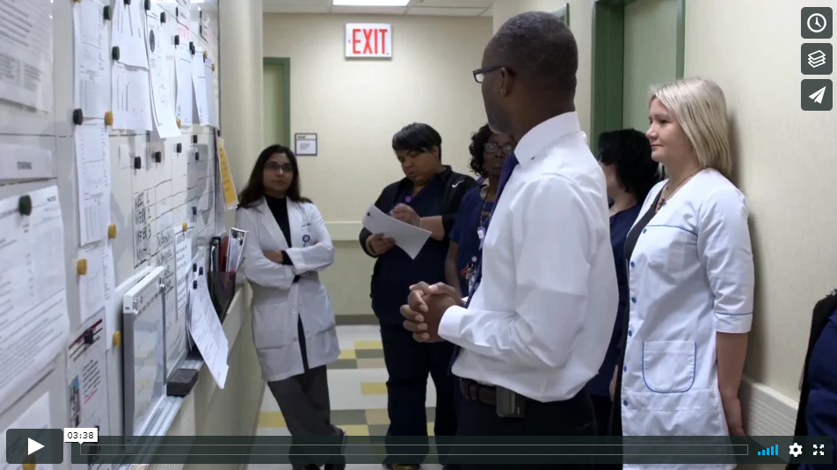
Initiating Long-Acting Contraceptive Methods Same-Visit: The Provider Perspective
Initiating Long-Acting Contraceptive Methods Same-Visit: The Provider Perspective
Link: https://www.fpntc.org/resources/initiating-long-acting-contraceptive-methods-same-visit-provider-perspective
Notes:
Activity
To get us started, let’s watch this brief video of the provider perspective on initiating long-acting methods same-visit. In this video, we’ll hear from a number of clinicians who are already offering methods same-visit, in a range of settings.

Slide 6
Rationale for Same-Visit Access
There is no medical reason to routinely require multiple visits to initiate any contraceptive method, if the provider can be reasonably certain that the client is not pregnant
CDC and ACOG agree that clinicians can provide the client’s method of choice in a single visit, unless additional testing is medically indicated
Use the Quick Start method to initiate contraceptive methods same-visit
Notes:
Facilitator Notes
Recent guidelines state that clients should be able to begin contraception at the time of visit rather than waiting for their next menses—or returning for another appointment—using the Quick Start method.
There is no medical reason to routinely require multiple visits to initiate any contraceptive method if the clinician can be reasonably sure that the client is not pregnant.
Although it has been common practice to require multiple appointments for methods such as the IUD or implant, CDC and ACOG recommend that clinicians initiate and provide the client’s method of choice in a single visit, unless additional testing is medically indicated.
Use the Quick Start method for initiating contraception, as described on the next slide.
Sources (for reference)
Gavin L, Moskosky S, Carter M. Providing Quality Family Planning Services: Recommendations of CDC and the U.S. Office of Population Affairs. MMWR Recomm Rep 2014;63 (No. RR-4):1–54
Curtis KM, Jatlaoui TC, Tepper NK, et al. U.S. Selected Practice Recommendations for Contraceptive Use, 2016. MMWR Recomm Rep 2016;65 (No. RR-4):1–66. DOI: http://dx.doi.org/10.15585/mmwr.rr6504a1
American College of Obstetricians and Gynecologists. “Long-Acting Reversible Contraception: Implants and Intrauterine Devices.” Practice Bulletin Number 186, November 2017.

Slide 7
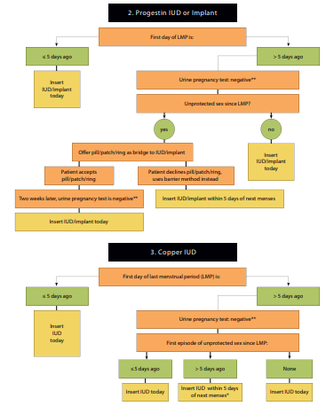
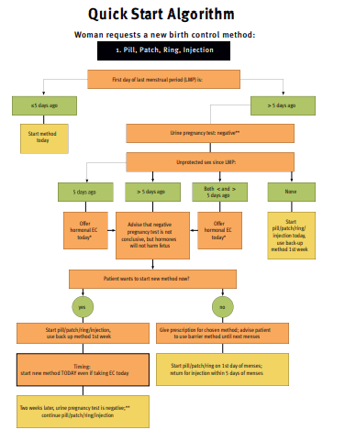
Link: https://www.fpntc.org/resources/quick-start-algorithm
Notes:
Facilitator Notes
Initiation of a contraceptive method on any day during the menstrual cycle, rather than restricting initiation to the subsequent Sunday or day 1 of the cycle is referred to as the Quick Start method.
Conventional initiation of hormonal contraception at the beginning of the next menstrual cycle may mean a delay of several weeks between the time a client receives her prescription and starts contraceptive use.
Compared to that approach, clients who begin contraception with the Quick Start method have reduced risk of unintended pregnancy and increased initiation and continuation rates.
To use Quick Start:
If the last menstrual period (LMP) was within the last 5 days, the method can be started immediately.
If LMP was more than 5 days ago and a pregnancy test is negative, assess the last episode of unprotected sex to determine if emergency contraception is required before the woman starts the method.
If the woman had unprotected sex within the last 2 weeks, start the contraceptive method and advise the client to return for a pregnancy test in 3 weeks.
Instruct women who are using the pill, patch, ring, injection, hormonal IUD, or implant whose LMP was more than 5 days ago to use back-up contraception for the first 7 days.
If intrauterine contraception is the choice, the provider should consider the possibility of an early undetected pregnancy. Intrauterine contraception poses a risk to the pregnancy (and thus is designated MEC category 4), whereas the other Quick Start contraceptive methods do not.
This Quick Start Algorithm on the screen was developed by the Reproductive Health Access Project and is available to download from the FPNTC website (link is on the slide).
Sources (for reference)
Reproductive Health Access Project. Quick Start Algorithm: https://www.reproductiveaccess.org/resource/quick-start-algorithm/
Curtis KM, Jatlaoui TC, Tepper NK, et al. U.S. Selected Practice Recommendations for Contraceptive Use, 2016. MMWR Recomm Rep 2016;65 (No. RR-4):1–66. DOI: http://dx.doi.org/10.15585/mmwr.rr6504a1
Phelps R, Murphy P, Godfrey E. Choosing a Birth Control Method. Association for Reproductive Health Professionals. Published September 2011, updated June 2014. http://www.arhp.org/Publications-and-Resources/Quick-Reference-Guide-for-Clinicians/choosing/Initiation-Hormonal-Contraceptives

Slide 8
How to Be Reasonably Certain a Client is Not Pregnant (CDC)
The client has no symptoms or signs of pregnancy and meets any one of the following criteria:
is ≤7 days after the start of normal menses
has not had sexual intercourse since the start of last normal menses
has been correctly and consistently using a reliable method of contraception
is ≤7 days after spontaneous or induced abortion
is within 4 weeks postpartum
is fully or nearly fully breastfeeding (exclusively breastfeeding or the vast majority [≥85%] of feeds are breastfeeds), amenorrheic, and <6 months postpartum
US Selected Practice Recommendations for Contraceptive Use, 2016
Link: https://www.fpntc.org/resources/how-be-reasonably-certain-patient-not-pregnant-and-when-start-contraceptive-methods-palm
Notes:
Facilitator Notes
As we discussed previously, if a clinician can be reasonably certain a client is not pregnant, she/he can initiate contraception immediately.
Clinicians may be hesitant to offer same-visit insertions out of concern that a client is pregnant. The CDC’s 2016 Selected Practice Recommendations include guidelines to help clinicians be reasonably certain a client is not pregnant. A clinician can be reasonably certain that a woman is not pregnant if she has no symptoms or signs of pregnancy and meets any one of the following criteria:
is ≤7 days after the start of normal menses
has not had sexual intercourse since the start of last normal menses
has been correctly and consistently using a reliable method of contraception
is ≤7 days after spontaneous or induced abortion
is within 4 weeks postpartum
is fully or nearly fully breastfeeding (exclusively breastfeeding or the vast majority [≥85%] of feeds are breastfeeds), amenorrheic, and <6 months postpartum
Download and print a palm card that has this checklist from the FPNTC website (link on the slide.)
Source (for reference)
Curtis KM, Jatlaoui TC, Tepper NK, et al. U.S. Selected Practice Recommendations for Contraceptive Use, 2016. MMWR Recomm Rep 2016;65 (No. RR-4):1–66.

Slide 9
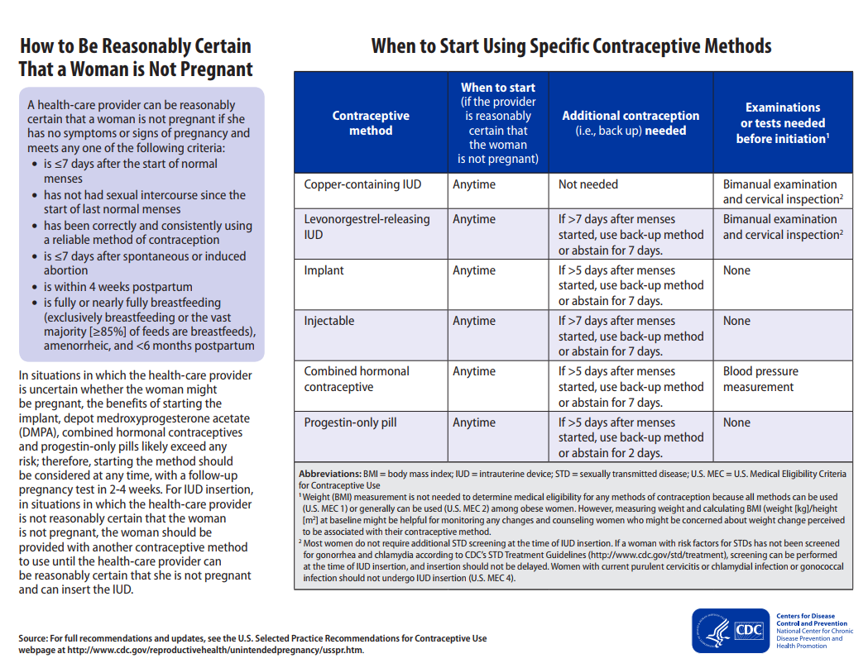
Notes:
Facilitator Notes
According to CDC, if providers can be reasonably certain a client is not pregnant, they can start any method “anytime.” CDC does not recommend that providers wait until the next menses to start a contraceptive method, if the provider can be reasonably certain the client is not pregnant.
In situations in which the provider is uncertain whether the woman might be pregnant:
The benefits of starting the implant, injectable, combined hormonal contraceptives, and progestin-only pills likely exceed any risk; therefore, starting the method should be considered at any time, with a follow-up pregnancy test in 2-4 weeks.
For IUD insertion, the woman should be provided with another contraceptive method to use until the provider can be reasonably certain that she is not pregnant and can insert the IUD.
Source (for reference)
Curtis KM, Jatlaoui TC, Tepper NK, et al. U.S. Selected Practice Recommendations for Contraceptive Use, 2016. MMWR Recomm Rep 2016;65 (No. RR-4):1–66.

Slide 10
Notes:
Facilitator Notes
Historically, a reason for delaying initiation of contraceptive methods was to conduct and obtain results for exams and tests.
According to CDC, for implants, injectables, and progestin-only pills, there are no necessary exams or tests needed before initiation. For the copper IUD and hormonal IUD, bimanual examination and cervical inspection are needed before initiation. Blood pressure measurement is needed prior to dispensing combined hormonal contraceptive pills.
CDC says that most women do not require additional STD screening at the time of IUD insertion. If a woman with risk factors for STDs has not been screened for gonorrhea and chlamydia according to CDC’s STD Treatment Guidelines (http://www.cdc.gov/std/treatment), screening can be performed at the time of IUD insertion, and insertion should not be delayed.
Note: Women with current purulent cervicitis or chlamydial infection or gonococcal infection should not undergo IUD insertion. (See footnote #2 on the slide.)
Sources (for reference)
Curtis KM, Jatlaoui TC, Tepper NK, et al. U.S. Selected Practice Recommendations for Contraceptive Use, 2016. MMWR Recomm Rep 2016;65 (No. RR-4):1–66.
Centers for Disease Control and Prevention. Sexually Transmitted Diseases Treatment Guidelines, 2015. MMWR Recomm Rep 2015;64 (No. RR-3): 1-137.

Slide 11
Additional Visits are a Barrier for Clients
Clinical Training Center for Family Planning online survey of APRNs (n=390)
35% of respondents had policies that permitted same-visit provision
Over half (56%) required ≥2 visits to provide method
Every one visit increase required for LARC provision resulted in fewer insertions
National Clinical Training Center for Family Planning, 2016.
Notes:
Facilitator Notes
Same-visit access is aligned with best practice guidelines from CDC. Now let’s talk about why it’s important for clients.
There is evidence that each additional visit that clients have to make to the clinic greatly reduces the likelihood that they will receive a LARC method after having selected it as their method of choice.
This study from the Clinical Training Center for Family Planning (CTCFP) of advanced practice registered nurses (APRN) found that each additional visit resulted in 24% fewer placements of copper IUDs, 27% fewer placements of hormonal IUDs, and 32% fewer placements of implants.
The low rate of follow-up for visits, along with subsequent lack of access to methods due to multiple visits, means that clients are choosing a method and then not getting the method they want. They continue to be at risk of unintended pregnancy, despite coming to the clinic and in order to prevent pregnancy.
This can also represent unrecognized revenue for the clinic. When you can provide the method same-visit, you are able to bill for those services. Requiring clients to come back when there is a high probability they won’t return is a lost opportunity to bill for services provided.
Source (for reference)
National Clinical Training Center: Findings from a National APRN LARC Survey. Presented at the National Family Planning and Reproductive Health Association Meeting, April 19, 2016.

Slide 12
Clients are Busy
Client barriers to accessing care
Child care
Transportation
Leave from work
“If the patient wants a LARC method and we provide it the same day, that prevents an issue with the patient having to come back to the clinic. It prevents the risk of an unplanned pregnancy because they're going to forget a pill or forget to come back for their next Depo or not be able to take another day off work to come back and get that LARC method.”
- Nurse Practitioner, Southern Nevada Health District
Notes:
Facilitator Notes
Why don’t clients always come back for their follow-up appointments?
They may have issues obtaining childcare, finding affordable transportation, being able to take time off of work, etc.
Part of Title X’s mission is serving and meeting the needs of vulnerable populations, and when we remind ourselves of the additional barriers that our clients face when accessing care, it becomes that much more important to put in the extra effort to be client-centered in the services we offer.
One clinician at a Southern Nevada Health District clinic who makes it a priority to provide methods same-visit when possible summed up these challenges nicely, saying, “If the patient wants a LARC method and we provide it the same day, that prevents an issue with the patient having to come back to the clinic. It prevents the risk of an unplanned pregnancy because they're going to forget a pill or forget to come back for their next Depo or not be able to take another day off work to come back and get that LARC method.”

Slide 13
Client Satisfaction
Offering methods same-visit increases client satisfaction
And when clients are satisfied, we’re satisfied!
“What I'm hearing from patients about how they feel about being able to get all of their needs met, including their contraceptive needs in one visit, is that they are sometimes surprised and always very excited to be able to do this.”
- Physician, NYC Health + Hospitals
Notes:
Facilitator Notes
When clients are able to get the services they want–all the services they want–in one visit, they leave their visit happy and satisfied.
One physician in New York City, who has found that clients are extremely satisfied and appreciative of being able to receive methods same-visit, said, “What I'm hearing from patients about how they feel about being able to get all of their needs met, including their contraceptive needs in one visit, is that they are sometimes surprised and always very excited to be able to do this.”
Clients recognize that this is an effort by their providers to meet their needs, and respect their time and resources.
When clients are satisfied, they are more likely to come back to the clinic, more likely to refer their friends and family to the clinic for services, and when our clients are satisfied, the staff are more satisfied too! We all know how good it feels to have clients leave their visits happy and healthy.

Slide 14
Our Policy
Based on nationally recognized standards of care (QFP, SPR, MEC), it is our policy to:
Provide clients access to the contraceptive method that they want without delay, unless medically contraindicated and as long as the provider can be reasonably certain the client is not pregnant.
Notes:
Facilitator Notes
It is our priority to offer services in a client-centered way.
Given that, it is now our policy that: in line with nationally recognized standards of care (such as Quality Family Planning, Selected Practice Recommendations, Medical Eligibility Criteria), we will provide clients access to the contraceptive method they want without delay, unless medically contraindicated and as long as we can be reasonably certain the client is not pregnant.
(Note to facilitators: Adapt this slide with your policy language.)
Sources (for reference)
Gavin L, Moskosky S, Carter M. Providing Quality Family Planning Services: Recommendations of CDC and the U.S. Office of Population Affairs. MMWR Recomm Rep 2014;63 (No. RR-4):1–54
Curtis KM, Jatlaoui TC, Tepper NK, et al. U.S. Selected Practice Recommendations for Contraceptive Use, 2016. MMWR Recomm Rep 2016;65(No. RR-4):1–66. DOI: http://dx.doi.org/10.15585/mmwr.rr6504a1
Curtis KM, Tepper NK, Jatlaoui TC, et al. U.S. Medical Eligibility Criteria for Contraceptive Use, 2016. MMWR Recomm Rep 2016;65 (No. RR-3):1–104.

Slide 15
Our Policy (cont.)
Methods should be available exclusively on a voluntary basis.
No client should be coerced to use a particular method or any method of birth control.
It is a client’s right to delay receiving the method, or have any method removed on request, at any time.
Notes:
Facilitator Notes
We want to make sure it is clear that this is the client’s choice. We never want clients to feel pressured to receive a method same-visit. Our policy also says that:
Methods should be available exclusively on a voluntary basis. No client should ever be coerced to use a particular method or any method of birth control.
It is a client’s right to delay receiving the method, or have any method removed on request, at any time.
(Note to facilitators: Adapt this slide with your policy language.)

Slide 16
What Methods are Available Same-Visit?
What methods are we currently able to provide during the same visit initially requested by the client?
Hormonal IUD
Copper IUD
Contraceptive implant
Depo
Pill, patch, ring
Fertility awareness-based methods
Notes:
Discuss
Let’s take a minute to think about where we are starting from as it relates to our ability to offer methods same-visit.
What methods are we currently able to provide during the same visit initially requested by the client?
For methods that have historically been a challenge to provide same-visit (i.e., IUDs and implants), how often are we able to offer these methods same-visit currently?
Are there any other methods not available immediately (e.g., injectable, pill, patch, ring, or fertility awareness-based methods)?

Slide 17
Why is It Challenging to Offer Some Methods Same-Visit?
What makes it challenging to offer these methods during the same visit initially requested by the client?
Hormonal IUD
Copper IUD
Contraceptive implant
Depo
Pill, patch, ring
Fertility awareness-based methods
Notes:
Discuss
Offering methods same-visit can be challenging. Why is that? What are the challenges we face in being able to offer these methods consistently during the same visit initially requested by the client? For example:
Are there requirements that routinely require clients to return for a follow-up visit (e.g., requiring STD results prior to insertion)?
Are all methods stocked and readily available for clients who choose them?

Slide 18
Domains of Same-Visit Contraception Implementation
1. STOCK
Stock devices and make supplies readily available.
2. SYSTEMS
Adjust systems for efficient and sustainable service delivery.
3. STAFF
Engage, train, and support all staff.
Link: https://www.fpntc.org/resources/same-visit-contraception-implementation-guide-family-planning-providers
Notes:
Facilitator Notes
Now that we’ve identified some barriers, let’s discuss implementation strategies.
There are three strategies for implementing same-visit access to the full range of methods. These strategies include:
Strategy 1: Stock devices and make supplies readily available.
Strategy 2: Adjust systems for efficient and sustainable service delivery.
Strategy 3: Involve all staff through training and support.
These strategies, and related action steps, are outlined in the guide, Same-Visit Contraception: An Implementation Guide for Family Planning Providers, developed by the Family Planning National Training Center (link is on the slide.)
On the following slides, we’ll go through these strategies in more detail and discuss which we should prioritize for implementation.

Slide 19
Stock Devices and Make Supplies Readily Available
Stock the full range of methods, including at least one of each provider-dependent method.
i.e., hormonal IUD, copper IUD, implant, and injectable
Keep supplies for IUD and implant insertions and removals in exam rooms (e.g., in kits or a caddy).
Develop a system to maintain sufficient stock of contraceptive methods.
Notes:
Facilitator Notes
The first strategy is to stock devices and make supplies readily available.
Recommendations under this strategy include:
Stock the full range of methods, including at least one of each provider-dependent method (i.e., hormonal IUD, copper IUD, implant, and injectable).
Keep supplies for IUD and implant insertions and removals in exam rooms (e.g., in kits or a portable caddy).
Develop a system to maintain sufficient stock of contraceptive methods to avoid having too much or too little stock.
Discuss
Which of these strategies do we already do? (Note to facilitators: Consider making this an interactive activity. Type “X” in boxes that you are already doing. This will help you easily identify the strategies that you are not already doing in order to prioritize them for implementation.)
Which strategies are we not already doing, but could, with a small amount of difficulty, implement?
For new strategies, how can we go about implementation? Who will be responsible for which tasks? What is our first step?
(Note to facilitators: Implementation guidance and supportive tools for each of these recommendations are outlined in Same-Visit Contraception: An Implementation Guide for Family Planning Providers: https://www.fpntc.org/resources/same-visit-contraception-implementation-guide-family-planning-providers)

Slide 20
Adjust Systems for Efficient and Sustainable Service Delivery
Adopt a policy that supports same-visit provision.
Make adjustments to the schedule, if necessary, to enable flexibility in service provision.
e.g., eliminate designated appointment slots for IUD and implant insertions, use one appointment length
Make changes, if necessary, to clinic workflow to ensure same-visit integration does not increase client cycle time.
e.g., reduce number of client stops, eliminate duplication of effort
Notes:
Facilitator Notes
Second, adjust clinic systems for efficient and sustainable service delivery.
Recommendations under this strategy include:
Adopt a policy that supports same-visit provision of all methods.
Make adjustments to the schedule if necessary (e.g., block appointments, eliminate double booking, use one appointment length) to enable flexibility for same-visit provision. This may include eliminating designated appointment slots for IUD and implant insertions, and streamlining the appointment schedule (eliminating double booking, using one standard appointment length).
Make changes as necessary to the clinic workflow (e.g., reduce number of client stops, eliminate duplication of effort, increase efficiency of client flow) to ensure same-visit integration does not increase client cycle time.
Discuss
Which of these strategies do we already do? (Note to facilitators: Consider making this an interactive activity. Type “X” in boxes that you are already doing. This will help you easily identify the strategies that you are not already doing in order to prioritize them for implementation.)
Which strategies are we not already doing, but could, with a small amount of difficulty, implement?
For new strategies, how can we go about implementation? Who is responsible for which tasks? What is our first step?
(Note to facilitators: Implementation guidance and supportive tools for each of these recommendations are outlined in Same-Visit Contraception: An Implementation Guide for Family Planning Providers: https://www.fpntc.org/resources/same-visit-contraception-implementation-guide-family-planning-providers)

Slide 21
Engage, Train, and Support All Staff
Clinicians
Current standards of care
Insertion and removal of LARC methods
Quick Start (including posting of reference guides)
Administrative and support
How to respond to clients’ questions about obtaining methods
Billing and coding
Use of coding modifiers
Tracking claims data and quality assurance of coding and billing to ensure adequate reimbursement
Notes:
Facilitator Notes
Finally, this is going to be a team effort! We will all work together on this, and support each other during implementation.
For clinicians, we know that we may need to support you with training and resources around:
Current standards of care for provision of contraceptive services.
How to insert and remove the full range of LARC methods.
And, we can post Quick Start job aids in exam rooms for quick reference guides.
Administrative and support staff may need additional support to respond to clients’ frequently asked questions about obtaining methods, including receiving methods same-visit
Staff responsible for billing and coding may need support around accurate coding for same-visit services. This includes tracking claims data and quality assurance of coding and billing to ensure appropriate reimbursement.
The important thing is that we all have a role to play in providing methods same-visit, and this is not just going to fall on one person or role.
Discuss
Which of these strategies do we already do? (Note to facilitators: Consider making this an interactive activity. Type “X” in boxes that you are already doing. This will help you easily identify the strategies that you are not already doing in order to prioritize them for implementation.)
Which strategies are we not already doing, but could, with a small amount of difficulty, implement?
For new strategies, how can we go about implementation? Who is responsible for which tasks? What is our first step?
(Note to facilitators: Implementation guidance and supportive tools for each of these recommendations are outlined in Same-Visit Contraception: An Implementation Guide for Family Planning Providers: https://www.fpntc.org/resources/same-visit-contraception-implementation-guide-family-planning-providers)

Slide 22
Brainstorm Improvement Ideas
What are we trying to accomplish?
Where are we starting from? What is our goal?
How will we know that a change is an improvement?
How will we measure it?
What changes will lead to improvement?
What are our improvement ideas?
What will have the most impact?
What is the “low-hanging fruit”?
Notes:
Facilitator Notes
We’re ready to start thinking about our steps for implementation. Building on our discussions from the previous slide, let’s brainstorm as a group what are our next steps for implementing same-visit contraception.
Discuss
As we’re thinking about next steps, let’s keep our eyes on the prize: What are we trying to accomplish? What is our goal?
The goal should take into account where we are starting from. For example, maybe a first goal is to start offering the copper IUD same-visit as emergency contraception, and then we’ll build from there.
As we’re thinking about improvement ideas, how will we know (i.e., measure) that a change is an improvement?
What data sources do we have available? What measures do we want to track?
What changes will lead to improvement?
What are our improvement ideas? (Note to facilitators: When brainstorming, there are no “wrong” answers. Just make a list of ideas and encourage everyone to participate. Consider writing down ideas on a flip chart to help keep the conversation going.)
What will have the most impact?
What is the “low-hanging fruit”?

Slide 23
Implementation Plan
What (Strategy) | Who | By When | Communication Plan | Sustainability Plan
Example: Stock exam rooms with supplies | Rosa | End of the month | Rosa will let Dr. May know when rooms are ready | Rosa will check rooms once a week to monitor supplies
Notes:
Facilitator Notes
Now we’ll start to narrow down ideas and fill out an implementation plan. This will be a living document that we will update as we begin implementation. The goal is just to get started on it today.
Activity
Select 3–4 implementation strategies from the prior brainstorm. Focus on strategies that are relatively low-burden to implement, and strategies that have generated a lot of excitement among the group.
As a group, begin to fill out this implementation plan. Brainstorm who will do what, by when, and how they will communicate the changes that have occurred. Also note how the change will be sustained.

Slide 24
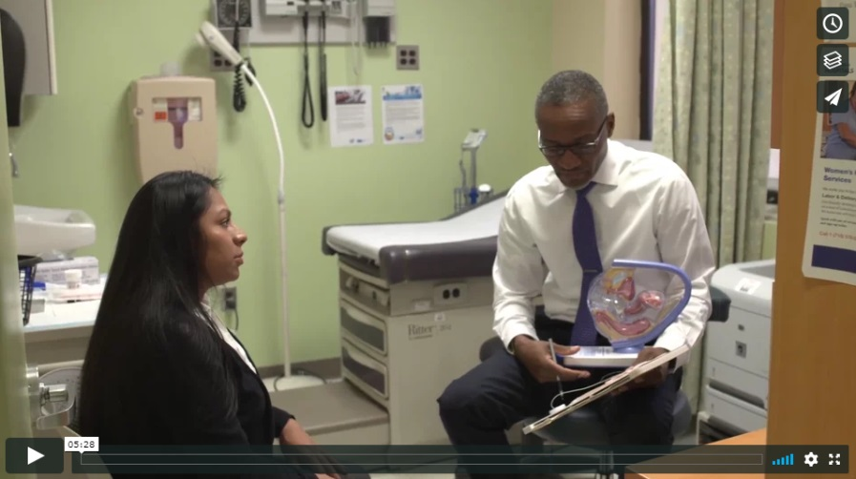
Case Study Videos
A Case Study: Same-Visit Provision of Contraception at the Southern Nevada Health District, East Las Vegas Health Clinic
A Case Study: Same-Visit Provision of Contraception at the Louisiana Office of Public Health, Rapides Parish Health Unit
A Case Study: Same-Visit Provision of Contraception at New York City Health + Hospitals, Gotham Health, Morrisania and Lincoln
Links:
https://www.fpntc.org/resources/case-study-same-visit-provision-contraception-southern-nevada-health-district-east-las
https://www.fpntc.org/resources/case-study-same-visit-provision-contraception-louisiana-office-public-health-rapides
https://www.fpntc.org/resources/case-study-same-visit-provision-contraception-nyc-healthhospitals-morrisania-and-lincoln
Notes:
Activity
Watch one or more of these three study videos of family planning clinics that are offering methods same-visit. The staff talk about some of the challenges they encountered, how they overcame those challenges, and how things are running smoothly now.
(Note to facilitators: Each video is about 5 minutes long.)
Discuss
How are we feeling about the idea of offering methods same-visit?
What are our fears and reservations?
How has hearing from other sites in the case study videos impacted those fears?

Slide 25
We’re not alone!
Same-Visit Contraception: A Toolkit for Family Planning Providers
Implementation tips
Supportive tools
Link: https://www.fpntc.org/resources/same-visit-contraception-implementation-guide-family-planning-providers
Notes:
Facilitator Notes
Finally, we’re not alone in making these changes. Drawing from the experience of other providers who are already providing methods same-visit, the Family Planning National Training Center has assembled a guide called Same-Visit Contraception: An Implementation Guide for Family Planning Providers. The guide has, for each of the strategies we just discussed, related implementation tips and supportive tools.
It’s available to print or to peruse online. The link is on the slide.

Slide 26
Thank you!
Contact:
fpntc@jsi.com
Notes:
Facilitator Notes
Thank you for participating in today’s discussion. Ultimately we, the staff, have to make same-visit contraception a reality, and we will all need to work together.
If applicable, you can contact me at:_________
You can also always contact the Family Planning National Training Center (fpntc@jsi.com) with questions/comments.

