Slide 1
HHS Office of Population Affairs Prescribing PrEP in Family Planning Settings
May 20, 2019
12:00 pm ET
Notes:
Hello everyone, and welcome to today's webinar, Prescribing PrEP in Family Planning Settings. This is Katie Quimby, from the Title X Family Planning National Training Center, and I am very pleased that you're here joining us today. A few things before we begin. Everyone on the webinar today is muted, given the large number of participants. Please use the chat at the bottom left of your screen to ask questions at any time. We will be taking questions and addressing them at the end of the presentation. Following today's webinar, we will be posting a recording of the webinar, along with a slide deck and the transcript.

Slide 2
Welcome!
Objectives
Outline how to identify PrEP candidates, offer PrEP, and prescribe PrEP
Describe approaches to counseling about PrEP in family planning settings
Review resources for patients, providers and advocates
Introduction of the speaker
Dominika Seidman, MD, MAS, University of California San Francisco (UCSF)
Note: This call will be recorded
Notes:
The objectives of today’s webinar are to:
Outline how to identify PrEP candidates, offer PrEP, and prescribe PrEP
Describe approaches to counseling about PrEP in family planning settings; and
Review resources for patients, providers, and advocates.
Dr. Dominika Seidman is an OBGYN and assistant professor of obstetrics, gynecology and reproductive sciences at the University of California San Francisco. She completed fellowship training in family planning and reproductive infectious disease. She currently practices clinically at Zuckerberg San Francisco General Hospital, and her research focused on expanding PrEP and HIV prevention access for women.
With that, I'm going to now turn it over to Dr. Seidman to get us started. Nika?

Slide 3
Prescribing PrEP in family planning settings
Dominika Seidman, MD MAS
Notes:
Thank you so much, and everyone on the call, thank you very much for joining. Good morning to people on the West Coast, and good afternoon to those on the East Coast. Today we're going to build on the prior webinar, and focus on how to prescribe PrEP in family planning settings, and if you haven't seen those prior webinars, I'd really recommend the prior ones.
During the last session, the speakers described why HIV prevention is a critical part of family planning care, and to summarize that, we know that family planning clients want family planning providers to talk to them about HIV prevention, and specifically PrEP, and we know that many family planning clients are at risk of HIV. Today, we're going to focus specifically on how to provide PrEP services in the family planning setting. Before we get started, I wanted to clarify two aspects of this webinar. First, when I say PrEP, I'm referring specifically to oral PrEP, with Tenofovir and Emtricitabine, or otherwise known as TRUVADA. There are many other kinds of PrEP in development and in clinical trials, including combination products with contraceptives, which are incredibly exciting. However, we're not going to focus our discussion on these today.
In addition, for the majority of this talk, I'm going to focus on prescribing PrEP to cisgender women. That is not to say that family planning providers do not care, take care of cisgender men or transgender individuals, but as described in the prior webinar, given that family planning providers have a unique opportunity to offer PrEP to cisgender women, and given that PrEP knowledge and uptake in cisgender women, particularly black women, who are disproportionately affected by HIV, and in addition, given that we know that PrEP use among these populations is comparably low, offering PrEP to cisgender women in the family planning setting is going to be the focus of this talk.

Slide 4
Disclosures
I have nothing to disclose.

Slide 5
Agenda
Identifying PrEP candidates
PrEP
Counseling
Labs
Prescribing
Follow-up
Discontinuation
Specific Populations
PEP
Resources
Notes:
So, today we're going to begin by talking about how to identify individuals who are at risk of HIV, and who may be interested in PrEP. We'll then review some key counseling messages, required labs, how to prescribe PrEP, what you need to do in terms of follow-up care, and PrEP discontinuation. We'll highlight care of several specific populations, but again, that's not going to be the focus of these talks, of this talk, and specifically we'll talk a little bit about care of adolescents, transgender individuals, and people who want to get pregnant, are pregnant, or are currently breastfeeding. Then we'll transition to talk briefly about post-exposure prophylaxis, or PEP, counseling and prescribing, and then finish up with a review of key resources.
While I'm providing a lot of information today, I really wanted to emphasize that there is no one right way to offer PrEP in the family planning setting, and that counseling can be more or less in depth, depending on your clinical setting and time constraints. The most important piece that I would argue is that if you aren't talking to your patients about PrEP, then I'd really encourage you to take the next step and try bringing it up. If you are already talking to patients about PrEP, then try taking the next step, and consider prescribing it.
PrEP provision does not need to be complicated, and with a little bit of practice, can become part of routine care. The main misstep I would argue that we make as a family planning community is to not talk to our clients about PrEP, because we know that our patients want to learn about it from us, and we know that it's unlikely that they're going to learn about it or utilize this HIV prevention method elsewhere.
So in summary, if we are serious about providing person-centered family planning care, and specifically about promoting health equity, then PrEP must become a routine part of family planning services. So, let's get started.

Slide 6
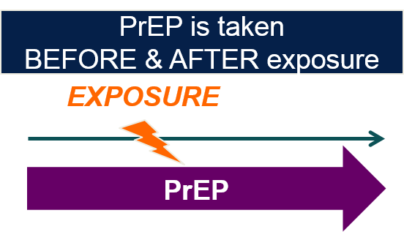
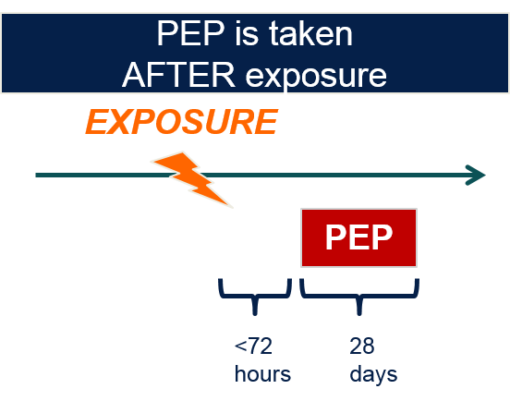
A PrEP primer
Pre-exposure prophylaxis for HIV prevention
HIV-negative individuals take antiretroviral medications before and after exposure for an indefinite amount of time
BOTH PrEP and PEP are highly effective and safe.
Notes:
Before we begin, it's really important to quickly review the differences between PrEP and PEP. PrEP, as you know, stands for pre-exposure prophylaxis for HIV prevention, and involves an HIV negative person taking antiretroviral medications to prevent HIV before and after an exposure, for an indefinite period of time. That exposure could be sex, or an injection, for example. That's in contrast to PEP, that you can see on the other side of your screen, which stands for post-exposure prophylaxis, and involves individuals taking medicine after an exposure, within 72 hours, to prevent HIV. Both PrEP and PEP are extremely effective and safe.

Slide 7
Identifying PrEP candidates
Notes:
So, now we're going to transition into talking about how we might, in our clinical settings, identify people who might be interested in talking PrEP.

Slide 8
CDC: Indications for PrEP in MSM
Notes:
The CDC has published guidelines for people who may benefit most from PrEP, and I wanted to run through very briefly the indications, as the CDC describes, for PrEP in men who have sex with men and other populations. For men who have sex with men, the big takeaway is that PrEP should be offered to any man who reports sex with a man, who has had condomless anal sex in the prior six months, or a bacterial STI in the prior six months.

Slide 9
CDC: Indications for people who inject drugs
Notes:
The CDC describes indications for people who inject drugs, and those indications are similarly simple. For these populations, the CDC recommends offering PrEP to anyone who reports injecting drugs, and has shared injection needles or drug preparation equipment in the prior six months.
One additional piece that I would highlight is that these individuals, even if they are injecting drugs and using safer injection practices, they may also be at risk for sexual exposure, so it's also important to think about what other ways they might be vulnerable to HIV.

Slide 10
CDC: Indications for PrEP in women
Notes:
And finally, for the focus of this talk, we're going to focus on care of specifically cisgender women, and the majority of cisgender women in the U.S. who acquire HIV do so through sexual exposure. Specifically, the CDC guidelines highlight offering PrEP to any cisgender woman who has had condomless sex in the prior six months, with a person with a penis, or otherwise known as a cisgender man, or a transgender individual with a penis, who is living with HIV, who has sex with other men, or who injects drugs.
I'm going to go back one slide. In addition, the reason that the yellow part of this slide is highlighted is because in 2017, the CDC added to these guidelines that a recent bacterial STI, and for cisgender women specifically, they're referring to syphilis or gonorrhea, in the prior six months, is another reason to certainly consider offering PrEP to cisgender women.

Slide 11
STIs are a biomarker for HIV vulnerability
Notes:
I wanted to focus for a moment on why the CDC added syphilis and gonorrhea to the suggested indications for offering PrEP to cisgender women. Specifically, these data are based on a study in Florida, looking at HIV diagnoses after an STI. In this large study, they found that a diagnosis of gonorrhea or syphilis in the prior six months dramatically increased an individual’s likelihood of acquiring HIV, and that likelihood was even more pronounced for black women with syphilis, as you can see in the graph. This study demonstrates how intersecting factors, including social and structural determinants of health, contribute to HIV vulnerability.
Source:
Peterman, Int J of STI & AIDS 2014

Slide 12
Challenges of identifying at-risk women
CDC criteria are primary based on partner-based risk factors
HIV risk is deeply rooted in social and structural determinants of health
Notes:
While the CDC guidelines are very clear on paper, implementing them can be challenging for multiple reasons, contributing to why PrEP uptake in cisgender women has been so low. First, CDC criteria for PrEP in cisgender women are based primarily on partner-based risk factors. However, as you all know, many cisgender women do not know if their partner has sex with other men, injects drugs, or has HIV. In addition, based on HIV epidemiology, it is strikingly apparent how HIV vulnerability is rooted in social and structural determinants of health, and specifically race and racism, as well as poverty, your zip code, among many other factors. For so many women who are diagnosed with HIV and vulnerable to HIV, it is not one specific behavior that puts them at risk, but a series of intersecting factors at the community and structural levels.
These factors can be quite difficult to identify or name, both for providers and for patients, making many women unaware of their HIV vulnerability. One thing that we as providers can do is to begin to explore these vulnerabilities with patients, including the HIV incidence and prevalence in our ZIP Codes surround our clinics, which can easily be looked up at a website called AIDSVu.org, and coupling this information with individualized conversations about individual behaviors and experiences that may increase or decrease an individual's likelihood of acquiring HIV.
I don't mean to make this conversation overly complicated, but I also want to emphasize that there is not an HIV risk calculator for cisgender women in the U.S., and if one is ever developed, it will likely be for specific areas of the country, where HIV prevalence is quite high. For the rest of the country, in order to identify PrEP candidates, and people, in particular, people who are both at increased vulnerability to HIV, and motivated to take PrEP, we have to talk to cisgender women not only about their sexual and injection practices, and also those of their partners, but also about structural determinants of HIV that we know to be related to HIV vulnerability.

Slide 13
Screening may be problematic
Stigma around sexual practices
Distrust of the medical system
Experiences of racism in medicine
Personal history of (other) trauma(s)
Low levels of PrEP awareness among cisgender women
Dehlendorf, Krajewski, Borrero. Clin Obstet Gynecol. 2014;57(4):659-73.
Thorburn, Bogart. Women & Health. 2005;42(1):23-39.
Cipres et al. J Adolescent Health e-pub 2017.
Smith et al. AIDS Education and Prevention, 2012; 24(15):408-421.
Seidman et al. R4P oral abstract 2016.
Notes:
In addition, screening in itself for HIV risk can be problematic for a variety of reasons. First, there continues to be tremendous stigma around sexual practices, posing barriers to disclosing risk at the time of screening. In addition, many people, particularly those most vulnerable to HIV, may have significant distrust of the health care system, due to personal experiences of racism, among other experiences in medicine, as well as awareness of the U.S.'s long history of racist practices in medicine. These were coupled with high rates of trauma, both at the individual and structural levels, and all of these put people at increased vulnerability to HIV.
Putting all of these pieces together, screening in itself, and specifically screening questions, can be particularly triggering. When you couple these barriers to disclosure about HIV risk with cisgender women's remarkably low awareness about PrEP, it's no wonder that people don't screen in for PrEP eligibility, and so rarely self-identify as wanting PrEP, walking into our clinics saying, "Hey, please, can I have PrEP today?" After all, it's really impossible to ask about PrEP if you don't know it exists, and it's unlikely that you'll disclose your sexual practices or other HIV vulnerabilities if you think that the only thing you're going to receive in return is a lecture about condoms.
Sources:
Dehlendorf, Krajewski, Borrero. Clin Obstet Gynecol. 2014;57(4):659-73.
Thorburn, Bogart. Women & Health. 2005;42(1):23-39.
Cipres et al. J Adolescent Health e-pub 2017.
Smith et al. AIDS Education and Prevention, 2012; 24(15):408-421.
Seidman et al. R4P oral abstract 2016.

Slide 14
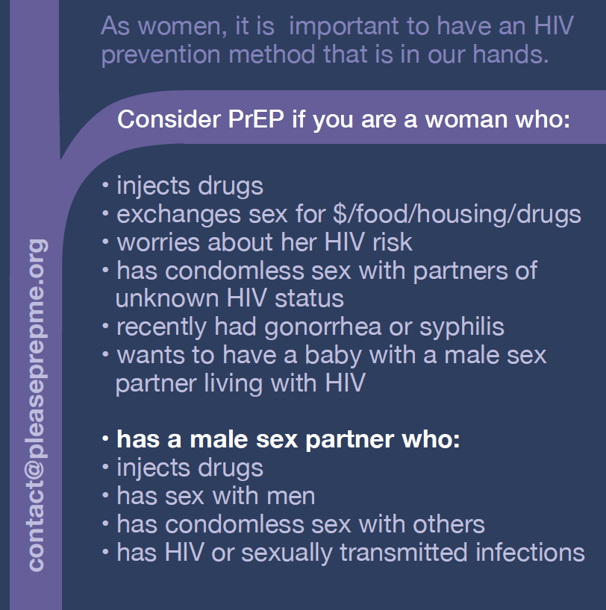
Offer universal education, then screen (or just offer!)
Lessons learned
When to offer?
Any HIV test
Any STI screen
Any sexual history
Who is PrEP for?
Use inclusive language
Cast a broad net
Trust women
What is PrEP?
Compare to what women already know (birth control pills)
Why use PrEP?
For independence
For confidence
For love
HIVE, Black Women’s Health Imperative, PrEP4love
Notes:
One approach to PrEP provision, acknowledging these barriers posed by screening, is to offer education to everyone about PrEP. This makes sense, especially because PrEP is relatively new, and still in 2019, few cisgender women know about PrEP. Discussions about PrEP can easily be integrated into conversations at the time of an HIV test, STI testing, or pregnancy testing, or even finding out someone is pregnant. In these brief conversations, I like to highlight a wide range of people who may benefit from PrEP, some examples of whom are listed on this palm card that is handed out in one of the clinics where I work. I describe what PrEP is, and often compare it to a birth control pill. It's highly effective if you take every day, and isn't effective if you don't. Lastly, I emphasize that taking PrEP is about having a healthy sex life, and avoid using scare tactics that have been demonstrated to be less effective in clinical trials and other studies.
Really importantly for the business family planning clinic settings, PrEP education can be provided in a variety of different ways, and by a variety of people, ranging from health educators to clinicians. One last key point that I always try to emphasize is that even if PrEP isn't right for an individual at this moment in time, I ask that they share this information with their friends, their sisters, their mothers, the other people in their lives who might be interested and want to know about PrEP, or that it might be useful for them in future.
Source:
HIVE, Black Women’s Health Imperative, PrEP4love

Slide 15
PrEP counseling: overview
Offer PrEP as part of an integrated strategy to prevent HIV
PrEP is for seasons of vulnerability
PrEP is not a recommendation
PrEP is not for everyone
Continually assess for
Changes in risk
Opportunities for new prevention strategies
Notes:
With that, we're now going to move into talking about PrEP counseling. When we talk about PrEP, it's critical to talk about it as part of an integrated prevention strategy. Because of that, I never think of PrEP as a recommendation. An oral PrEP, which requires a daily pill, taken every single day, is really not for everyone, as we know better than anyone in the family planning field. In addition, just like behaviors about pregnancy intentions change, HIV vulnerabilities change over time, and therefore conversations about PrEP and HIV prevention can't be a one-time discussion. Instead, as situations and behaviors change, individuals experience different HIV vulnerabilities, as well as different abilities and interests in taking a daily pill, and consequently conversations about HIV prevention must be ongoing.

Slide 16
PrEP is one of many HIV prevention options
Notes:
I mentioned, PrEP is not for everyone, and it's important that we talk about PrEP in the context of other HIV prevention options. Those include condoms, partner testing, among others. Later on in this webinar, we'll focus specifically on PEP, or post-exposure prophylaxis, but I specifically wanted to highlight for a moment treatment as prevention.

Slide 17
Undetectable = Untransmittable Source: Prevention Access Campaign PreventionAccess.org
Notes:
Treatment as prevention has grown into the U=U campaign, which many of you may have heard of, which states, based on excellent clinical data, that a person living with HIV, who has an undetectable viral load, does not transmit the virus to their sexual partners. This is incredibly powerful for both people living with HIV, and people who have sex partners who are living with HIV, and can be a really important motivator, as well, for partner testing. While many people are fearful of learning their HIV status, empathizing that if you know you or a sex partner has HIV, you can start medicines and have an undetectable virus in your blood. When that happens, you have zero risk of transmitting HIV to others.
Source:
Prevention Access Campaign https://www.preventionaccess.org/

Slide 18
Key counseling messages about PrEP
PrEP is highly effective at preventing HIV: >90% effective for vaginal exposures
Adherence = effectiveness, especially for vaginal exposures
PrEP is safe & has few side effects
Regular HIV testing is mandatory
PrEP does not prevent against other STIs

Slide 19
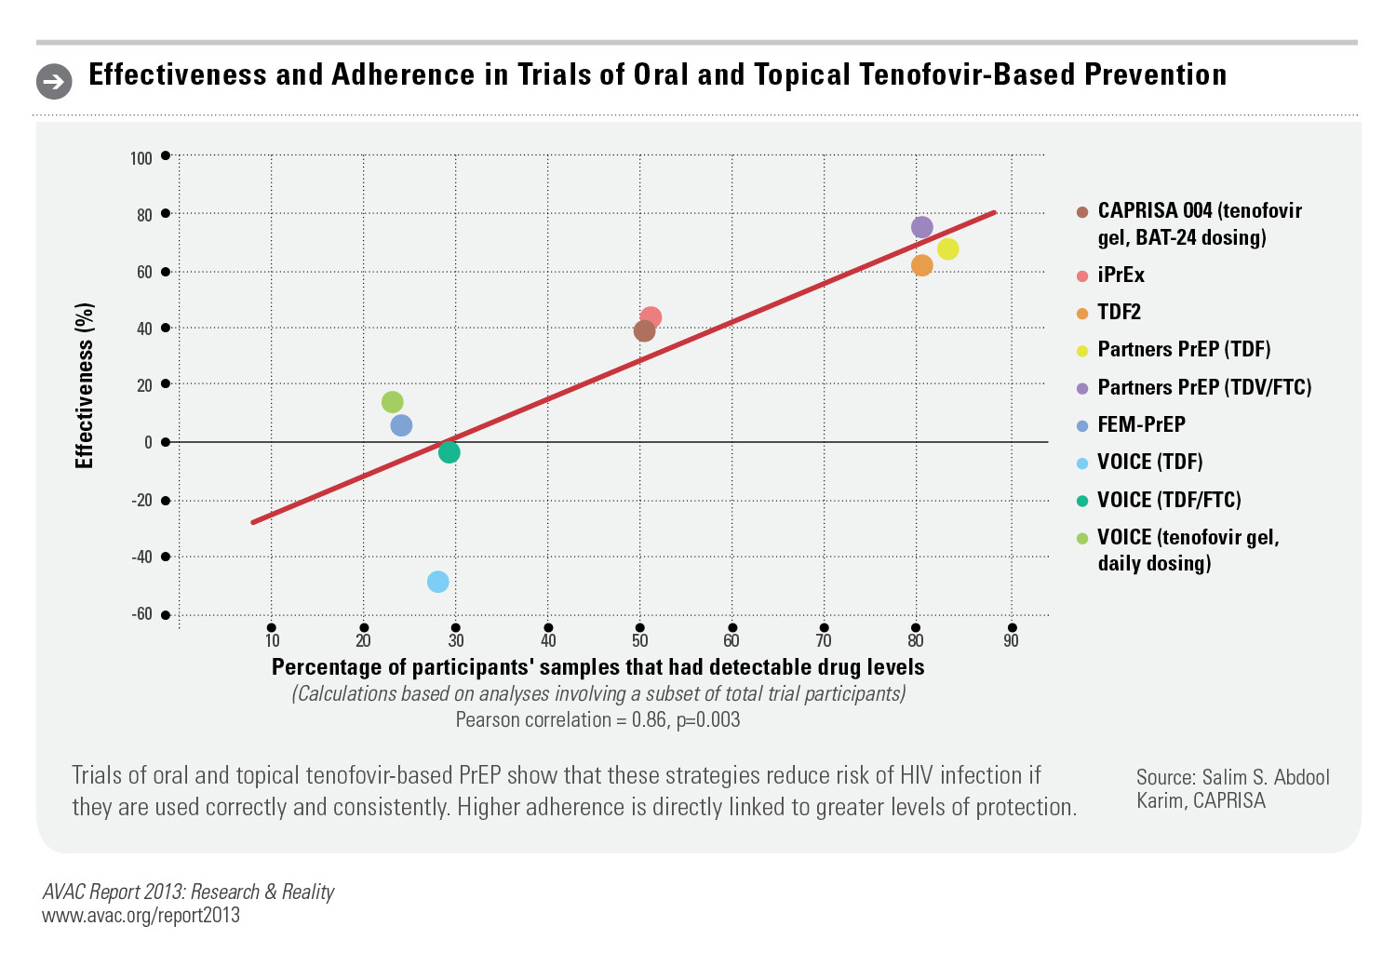
PrEP is highly effective when taken
Notes:
So, let's now go through each of these counseling messages in turn. First, we know that oral PrEP is highly effective when taken. This is shown graphically here. However, where you'll see on the X-axis, the percentage of people that had detectable drug levels in studies, this is a marker of adherence. On the Y-axis, you'll see effectiveness. Clearly, as adherence, or taking your pill every day increases, so does the effectiveness of PrEP. This is particularly true, as I mentioned, for vaginal exposures.

Slide 20
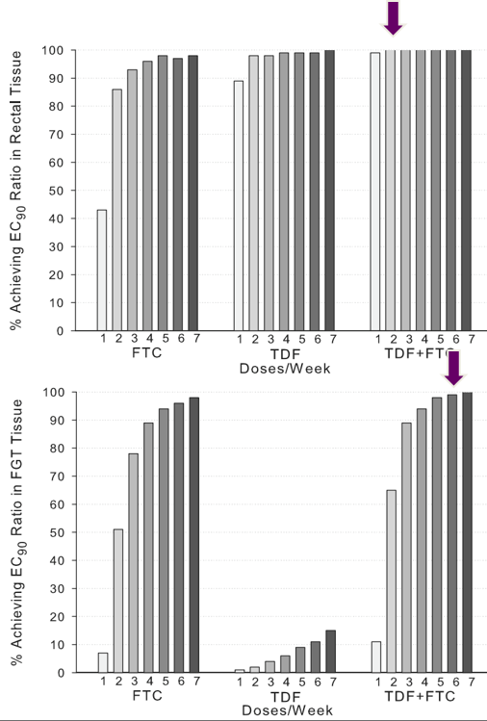
Protective levels in cervical/vaginal tissue require higher adherence. Cottrell et all. JID 2016
Notes:
The difference between vaginal and rectal exposure:
It's likely even more true that people have to adhere closely to PrEP to protect themselves against HIV for vaginal exposures than for rectal exposures.
In this graph, the Y-axis is tissue achieving an EC90 ratio, which is really just a marker for protective levels in the tissue.
On the X-axis are doses of the medicine, or PrEP taken per week.
In the top graph, you can see rectal tissue, and in the bottom graph, you can see vaginal tissue.
What you can see on the far right is that protection is achieved in the rectum very quickly after starting PrEP, but it takes significantly longer to achieve those same protective levels in the vagina.
What this means for people with vaginal exposures is that it takes longer to achieve protection, and adherence has to be higher in order to maintain that protection.

Slide 21
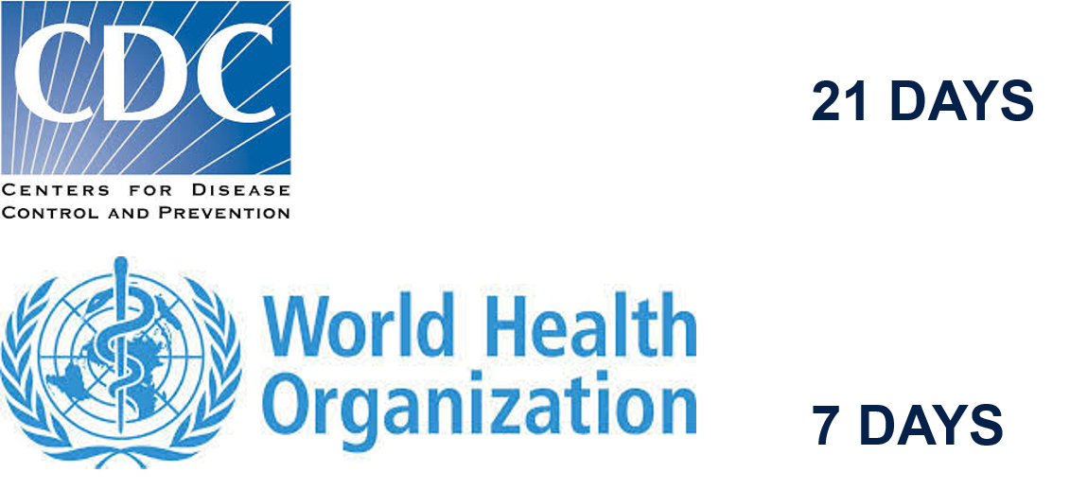
Time to protection in the cervix/vagina is longer than in the rectum No pericoital PrEP dosing for vaginal exposures!
Notes:
There's a lot of emerging pharmacokinetic and pharmacodynamic data about PrEP, and the CDC and WHO interpret these data slightly differently. Both overall agree that the time to protection is longer in the vagina than in the rectum, but the CDC suggests that it takes up to three weeks to achieve maximal protection, while the WHO suggests it takes closer to a week. I generally say that with PrEP, you achieve protection from vaginal exposures at a week, but it may take up to three weeks to achieve maximum protection. Importantly, I emphasize that while pericoital dosing, or dosing just around the time of an exposure or sex, has been proposed for rectal exposures, we don't think that based on the data we just discussed, that this will be effective for vaginal exposures, given the biological differences in the vagina and the rectum.

Slide 22
PrEP is safe and well tolerated
Serious adverse events are rare
1/200 risk renal dysfunction
1-2% change in bone mineral density; no ⬆ risk of fracture over 1-2 years; reversible after discontinuation
PrEP is well tolerated
Nausea in < 10% subjects; primarily during 1st month (PrEP “start-up” symptoms)
Risk of developing drug resistance is highest when PrEP is prescribed to individuals already infected with HIV
Overall risk of resistance 0.1%
CDC. Preexposure Prophylaxis for the Prevention of HIV Infection in the US: A Clinical Practice Guideline 2014. Fonner et al. Oral pre-exposure prophylaxis (PrEP) for all populations: a systematic review and meta-analysis.
Notes:
Moving on to additional counseling message, we know that PrEP is incredibly safe and well tolerated. Serious adverse events are quite rare. Specifically, there's a one in 200 risk of renal dysfunction, and a very low risk, around 1% to 2% change, in bone mineral density. However, there's been no known increased risk of fractures over years, and we think very similar to Depo-Provera, after someone stops their PrEP, that bone mineral density changes discontinues and reverts back to normal. In addition, in terms of side effects, which we're learning more and more that people really want information about up front, PrEP is very well tolerated. In approximately one in 10 people who take PrEP, they experience nausea or headache. These symptoms usually occur in the first month, and are known as a PrEP startup syndrome. However, these symptoms, in the vast majority of the time, go away on their own, and so what I'll often do is let people know about them, and if they develop those symptoms, prescribe antiemetic or Tylenol for a headache, and then really encourage them over time, letting people know that those symptoms are most likely to go away within the month.
What providers are often the most concerned about is the risk of developing drug resistance. This is the highest if PrEP is prescribed to individuals who are already infected with HIV, or diagnosed with HIV, excuse me, and so what is really important is that we as providers do our best to make sure that someone is HIV negative when we prescribe PrEP. In many, many large studies, the overall risk of HIV drug resistance development was far less than 1%.
Source:
CDC. Preexposure Prophylaxis for the Prevention of HIV Infection in the US: A Clinical Practice Guideline 2014. Fonner et al. Oral pre-exposure prophylaxis (PrEP) for all populations: a systematic review and meta-analysis.

Slide 23
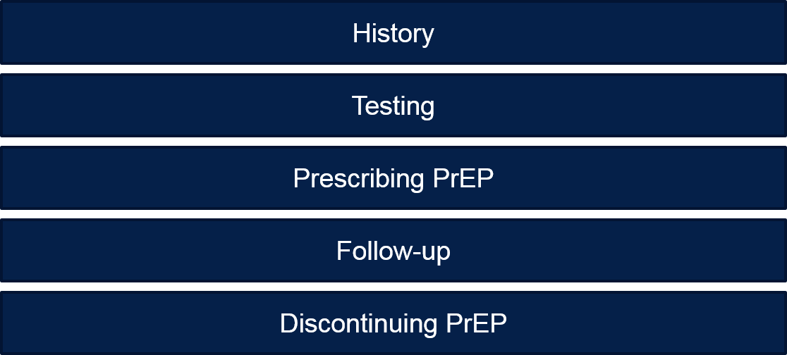
You think PrEP might be right for a patient. Now what?
Notes:
So now, assuming you have identified someone who might be interested in PrEP, and counseled them about their options, as well as specific, important counseling messages about PrEP, what do you do next?

Slide 24
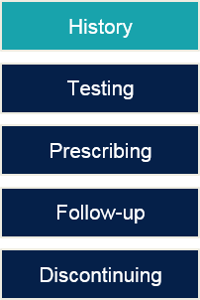
Take a history
Determine timing of last exposure
- If <72 hours, offer PEP
Assess for signs/symptoms of acute HIV in prior month
Determine pregnancy/breastfeeding status and fertility desires
Notes:
Take a history. One important piece is to determine when the person last had an exposure, and again, that might be sex or injection.
If that happened in the prior 72 hours, you can offer them post-exposure prophylaxis, which we'll talk more about in a few minutes.
In addition, assess for signs and symptoms of acute HIV in the last month, and determine pregnancy and breastfeeding status, and fertility desires, as those might require some additional counseling messages.

Slide 25
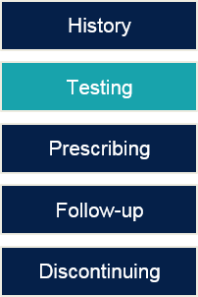
Laboratory testing
HIV testing | Document negative HIV test before starting PrEP (within the week) Do NOT use oral rapid test If recent exposure & symptoms: test for acute HIV infection with 4th generation test or viral load (RNA PCR)
Additional testing | Cr clearance (ineligible if <60 mL/min) Hep B S Ag & Hep B S Ab (immunize if titer<10; discuss with hepatologist if HBV positive) Consider HCV Ab Screen for and treat STIs
Notes:
The most important way of preventing development of HIV resistance is to make sure that someone is HIV negative when we prescribe PrEP.
The CDC is very clear that when we do our HIV testing, we do not use an oral rapid test in order to initiate PrEP, because of the lack of sensitivity of these tests.
If you don't already know the type of HIV test that your lab is using, it’s important to find out what that is. Knowing if it's a third generation test, or a fourth generation test will improve your ability to know what the window period of your test is, and how sure you are that the person sitting in front of you is HIV negative.
There is a resource list at the end that can help you think through if it's safe to prescribe someone PrEP at that moment in time.
There is additional testing that is recommended by the CDC in order to prescribe PrEP, and specifically looking at someone's renal function, as well as testing for hepatitis.
Lastly, we know that people who are vulnerable to HIV are also at risk of acquiring STIs, and so screening for and treating STIs is an important part of PrEP care.

Slide 26
Establishing HIV status before PrEP initiation
When was last exposure?
<72 hours, offer PEP
https://www.cdc.gov/hiv/pdf/risk/prep/cdc-hiv-prep-guidelines-2017.pdf
Notes:
This slide is helpful in terms of walking people through knowing someone's HIV status before starting PrEP.
The most important piece, not reflected on this slide, is in the CDC manual, and that is incorporating that first piece of information that we mentioned in the history taking: asking when was the person's last exposure.
If the person's last exposure was in the last 72 hours, you do not need to think about what type of HIV test you're doing, and you can just offer post-exposure prophylaxis.
Bigger picture, if it was greater than 72 hours ago, and you're thinking about if the person sitting in front of you has HIV or not, again, this goes back to the piece of knowing what type of HIV test you're using.
If you're using a third generation HIV test in your clinic, the window period is approximately 28 days; so if you've had a patient with an exposure in the past month, their test results may result as a false negative.
Consequently, the CDC recommends assessing for signs or symptoms of acute HIV in the past month, and if someone does have acute signs or symptoms, then you send a fourth generation test, or a viral load.
With people who have a negative rapid test, or a negative third generation test, and no exposures in the past month, or no signs or symptoms of acute HIV, starting PrEP the same day is reasonable and even preferable, given that you know their HIV status that day.
Source:
https://www.cdc.gov/hiv/pdf/risk/prep/cdc-hiv-prep-guidelines-2017.pdf

Slide 27
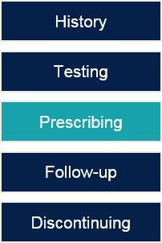
Prescribing PrEP
Tenofovir/Emtricitabine (300/200 mg): 1 tablet by mouth daily
Rx < 90-day supply
Refill only after confirming patient remains HIV-negative
ICD-10 codes
Z20.6: Contact with or exposure to HIV/AIDS
Z20.2: Exposure to an STI
Notes:
Prescribing PrEP is incredibly simple. You simply need to write TRUVADA, or Tenofovir/Emtricitabine, one tab by mouth daily.
The CDC is very clear that they recommend prescribing less than a 90-day supply, without refills. We only prescribe a refill after confirming someone remains HIV negative. This is an effort to prevent that risk of generating HIV drug resistance.

Slide 28
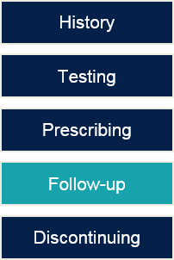
Follow-up care for patients on PrEP
Notes:
Provide a grace period.
If someone has not come in for their HIV test due to things going on in their lives, it's been three months, they're due for a test, talk to them on the phone, continue their PrEP, and really encourage them to come in for testing.
We generally would not recommend stopping PrEP just because we don't have an HIV test, especially if someone is reachable and plans to come in soon.
Follow-up care for patients on PrEP is also relatively simple, and can be incorporated into brief visits.
First, at each visit it's important to assess someone's behaviors, and provide counseling and condoms. It's really important to evaluate someone's adherence and motivation to continue taking a pill every day, and asking people about their pregnancy intentions, and doing additional counseling as needed.
HIV testing is recommended every three months. After those negative tests, you can refill someone's PrEP.
Depending on the population, the CDC has different recommendations for when to test for STIs.
Lastly, because of the rare but important side effect from PrEP, in terms of renal toxicity, it is important to check someone's kidney function approximately every six months.
Source:
CDC 2015 STD guidelines
https://www.cdc.gov/std/tg2015/screening-recommendations.htm

Slide 29
STI testing
MSM: syphilis, GC, CT every 6 months (3-site testing)
every 3 months if prior STI or multiple partners
anytime if symptomatic
Other adults: syphilis, GC every 6 months; CT per STD guidelines
cisgender women who have sex w men: <25: annually; 25+ PRN
cisgender men who have sex w women: PRN
Notes:
The CDC recommends different STI testing for different populations.
Review the STI guidelines for cisgender women and men; specifically, for people who are men who have sex with men, the CDC recommends syphilis, gonorrhea, and chlamydia testing every six months, including three-site testing, as well as every three months if someone has a prior STI or multiple partners, or anytime someone is symptomatic. That's also true for other individuals, in terms of testing at the time of symptoms.

Slide 30
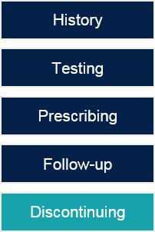
Discontinuing PrEP
Perform HIV test(s) to confirm HIV status
Review declining PrEP effectiveness after 7-10 d
Establish linkage to risk-reduction support services
If active HBV infection
Discuss with hepatologist
If HIV is diagnosed
Discontinue PrEP, link to HIV care provider
Notes:
How do you discontinue PrEP? That also is quite simple.
Generally, we recommend performing an HIV test to confirm someone's HIV status, and making sure that someone understands the window period, and so repeat testing may be necessary.
The effectiveness of PrEP we think declines over the course of about seven to ten days, and so that someone may be at risk of HIV soon after they discontinue PrEP.
It's important to establish linkage to other risk reduction support services. For example, knowing someone's partner status, offering testing to other partners, perhaps treatment as prevention is their plan. There are lots of different ways, but one important piece of PrEP discontinuation is seeing if someone is discontinuing because they are no longer at risk of HIV, or if because they're interested in a different HIV prevention method, which we want to be equally supportive of.
Of note, if someone has active hepatitis B infection, it is important to talk with a hepatologist before discontinuing PrEP, because those medicines can also suppress hepatitis B, and [discontinuing PrEP] may cause a hepatitis B flare.
Finally, if you are in the very rare situation that HIV is diagnosed, it's recommended to discontinue PrEP, and link ideally that day to an HIV care provider. This is another situation in which I would strongly recommend using the resources that I'll present at the end of this webinar, calling the HIV line at the Clinicians Consultation Center, and talking through how to manage care of that individual, specifically so that you can help them link to care quickly.

Slide 31
Prescribing PrEP to specific populations
Adolescents
Transgender individuals
People who desire pregnancy or are pregnant/breastfeeding
Notes:
Next, we're going to transition into talking very briefly about how to prescribe PrEP to specific populations, and if there are any contraindications in those populations.

Slide 32
PrEP is safe for adolescents.
Notes:
In May of 2018, the FDA approved PrEP for adolescents, and specifically anyone who weighs more than 77 pounds.
One piece that makes life much easier for prescribers is that the dosing is exactly the same in adolescents as in adults.
Care of adolescents and providing PrEP to adolescents is an entire talk in itself, but at least from the medical standpoint, the prescribing is very simple.
It's also important to note that in different states in the country, parental consent may or may not be required, and accessing PrEP may be more of a challenge in particular if someone is on their parents' insurance.

Slide 33
PrEP is safe for transgender individuals.
No known significant interactions with hormones
Data is emerging
Notes:
In addition, we know that PrEP is safe for transgender individuals.
While there is very limited data, more data is emerging.
One piece that transgender individuals frequently want to know is if there is significant interaction with gender affirming hormones. We do not know of any significant interactions with hormones to date; however, data really is limited, and it is very important that we emphasize to people that information is changing quickly.
If you are taking care of transgender individuals, it’s important to listen to people's concerns very carefully, and validate them, because as data emerges and changes, we want to be sure that people know that we will update them, and be very transparent about specifically what we know, and what we don't know.

Slide 34
Offering PrEP peri-conception, in pregnancy & lactation is supported by data & guidelines.
CDC, WHO suggest offering PrEP in pregnancy and lactation
ACOG: TDF/FTC has “reassuring” safety profile and providers should be ”vigilant” for seroconversion during lactation
Notes:
For all of these populations, offering PrEP is supported by data, and by the guidelines. The CDC, the WHO, all support offering PrEP to people who are pregnant and who are breastfeeding, and the American College of Obstetrics and Gynecology notes how PrEP has a reassuring safety profile; however, they do note that providers should be vigilant for seroconversion during lactation. We'll talk about why that is in a moment.

Slide 35
Why are pregnancy intentions critical to HIV prevention decisions?
Pregnancy is associated with ~2X increased risk of HIV acquisition
HIV transmission risk per sex act is higher in late pregnancy (aRR 2.8, p=0.01) and postpartum (aRR 4.0, p=0.01) compared to outside of pregnancy/peripartum
Acute HIV during pregnancy associated with ~8X increased risk of perinatal transmission
Acute HIV during breastfeeding associated with ~4X increased risk of lactational transmission
Heffron CROI 2018; Mugo, AIDS 2011; Drake, PLoS Med 2014; Humphrey, BMJ 2010; Singh, CROI 2013.
Notes:
Pregnancy intentions are important to HIV prevention.
Pregnancy is associated with an approximately two-fold increase risk of HIV acquisition in some observational studies. This could be due to a variety of factors, either because:
People's behaviors in pregnancy change, and they may be less likely to use condoms;
People's sexual practices also change in pregnancy, in terms of the type of sex that they have; and finally,
Biology changes in pregnancy, and so it may be that due to biological differences, specifically in the vagina, under the influence of different hormones, may increase someone's vulnerability to HIV.
These observational data are supported as well by more specific data, suggesting that HIV transmission per sex act is higher in late pregnancy, and even postpartum, compared to outside of pregnancy and the peripartum period. Again, research and data are emerging in this area.
So, why else does all of this matter? Well, we know that acute HIV, meaning HIV that is acquired during pregnancy, is associated with an eight-fold increased risk of perinatal transmission.
In addition, acute HIV, or HIV that is acquired during breastfeeding, is associated with a four-fold increased risk of lactational transmission.
All of these pieces of information really point to suggesting why thinking about HIV prevention specifically in pregnancy, both for the health of the individual person who is pregnant or breastfeeding, as well as their children, is incredibly important.
Source:
Heffron CROI 2018; Mugo, AIDS 2011; Drake, PLoS Med 2014; Humphrey, BMJ 2010; Singh, CROI 2013.

Slide 36
PrEP is safe in pregnancy.
Majority of data from people living with HIV
No evidence of birth defects, even with 1st trimester exposures
Systematic review of tenofovir in pregnancy: no differences in
pregnancy loss
preterm birth
low birth weight infants
infant or maternal mortality
Limited data on PrEP in pregnancy: no differences in preterm birth, pregnancy loss or birth defects
The Antiretroviral Pregnancy Registry Interim Report. Jan 1 1989 – Jan 31 2015. Mofenson, Baggaley, Mameletzis. Tenofovir disoproxil fumarate safety for women and their infants during pregnancy and breastfeeding: systematic review. AIDS. 2017;31(2):213–32. Heffron, CROI, 2017 Poster 934.
Notes:
We go a little bit more deeply into the data, we know that PrEP specifically is safe in pregnancy. This is based on a large body of data, most of which comes from people who are living with HIV.
Specifically, a systematic review of 26 studies of people living with HIV and with hepatitis B found no differences in pregnancy loss, pre-term birth, low birth weight infants, or infant or maternal mortality in people exposed to Tenofovir.
In addition, based on the U.S. antiretroviral pregnancy registry, we know that there is no evidence to date of birth defects with exposure to these medicines, including exposures in the first trimester.
While there are limited data on specifically PrEP in pregnancy, those prior data were primarily focused on people living with HIV. Based on the available data on PrEP and pregnancy, no differences in pre-term birth, pregnancy loss, or birth defects have been seen.
Source:
The Antiretroviral Pregnancy Registry Interim Report. Jan 1 1989 – Jan 31 2015. Mofenson, Baggaley, Mameletzis. Tenofovir disoproxil fumarate safety for women and their infants during pregnancy and breastfeeding: systematic review. AIDS. 2017;31(2):213–32. Heffron, CROI, 2017 Poster 934.

Slide 37
PrEP is safe during lactation.
TDF/FTC is secreted in breast milk, but infant levels are extremely low
50 mother/infant pairs, exclusively breastfeeding, DOT with TDF/FTC PrEP x 10 days
TDF not quantifiable in 94% of infant serum samples
FTC quantifiable in 96% of infant serum samples
Drug levels <1% those of therapeutic infant dosing
Mugwanya et al. Pre-exposure Prophylaxis Use by Breastfeeding HIV-Uninfected Women: A Prospective Short-Term Study of Antiretroviral Excretion in Breast Milk and Infant Absorption.
PLoS Med 2016 Sep 27;13(9):e1002132.
Benaboud et al. Concentrations of tenofovir and emtricitabine in breast milk of HIV-1-infected women in Abidjan, Cote d'Ivoire. Antimicrobial agents and Chemotherapy 2011.
Notes:
We also believe that PrEP is safe during lactation.
This is based on a very well designed study in sub-Saharan Africa in which PrEP was given with directly observed therapy to 50 people who were breastfeeding and their babies. This was performed for 10 days, and measurements of the medicines were taken in the breast milk, in the infants, and in the infant serum.
As you can see from these slides, Tenofovir was not quantifiable, and Emtricitabine was not quantifiable in the vast majority of infant specimens, suggesting that there is very, very, very low if any exposure of these medicines to the infant.
In addition, when comparing the drug levels in infants of breast-fed people who were taking PrEP, those levels were less than 1% of the therapeutic drug dosing when we give these medicines to infants who are diagnosed with HIV. So again, big takeaway, we think that PrEP is very safe during breastfeeding.
Source:
Mugwanya et al. Pre-exposure Prophylaxis Use by Breastfeeding HIV-Uninfected Women: A Prospective Short-Term Study of Antiretroviral Excretion in Breast Milk and Infant Absorption.
PLoS Med 2016 Sep 27;13(9):e1002132.
Benaboud et al. Concentrations of tenofovir and emtricitabine in breast milk of HIV-1-infected women in Abidjan, Cote d'Ivoire. Antimicrobial agents and Chemotherapy 2011.

Slide 38
PrEP is one of many safer conception options.
Treatment as prevention
Timed condomless intercourse +/- PrEP or PEP
Intrauterine insemination +/- PrEP or PEP
IVF +/- PrEP or PEP
Sperm donor
Adoption
Notes:
For people who express interest in getting pregnant, PrEP is one of many what we call safer conception options, or options to get pregnant and have a baby without acquiring HIV.
Treatment as prevention can also be used as a very safe and effective safer conception option; however, PrEP can also be added on to many other types of HIV prevention options.
Some individuals may be interested in adding on PrEP at the time of trying to get pregnant, even if they know that their partner is living with HIV, and has an undetectable viral load.
Other individuals may be interested in using a method like timed, condomless intercourse, with or without PrEP or PEP.
Some individuals are interested in using intrauterine insemination, or IVF, but we have no data to support the fact that IVF or intrauterine insemination are any more safe than some of these other approaches to safer conception options.
It is really important, if you're talking to someone about safer conception options, to talk about all of the options, and those additional options might include a sperm donor or adoption.

Slide 39
PEP (post-exposure prophylaxis)
An HIV result is NOT required to start
Time is critical – start at most 72 hours after exposure
Reduces HIV transmission by ~80%
Efficacy is dependent on adherence
Side effects / safety profile similar to PrEP
Safe in pregnancy & lactation
Notes:
When we're talking with cisgender women in clinics, it’s important to emphasize that PrEP is one of multiple HIV prevention options that may work for them. For post-exposure prophylaxis, that means when someone has an exposure, and antiretroviral medications are taken after that exposure, within 72 hours, and those medicines are prescribed for only 28 days.
Many health care providers have heard of PEPs, specifically in the health care setting after a needle stick. This can also be used after sex, or after other injection practices.
Very importantly for post-exposure prophylaxis, an HIV result is not required to start the medicine. That's because timing is so critical here. We believe that those medicines are more effective the sooner after the exposure as possible, so we wouldn't want to wait for the results of that HIV test before starting the medicine.
The data on how effective is post-exposure prophylaxis is relatively poor, but we believe that PEP reduces HIV transmission by at least 80%, if not more. Very similarly to PrEP in terms of counseling, it's important to emphasize how the effectiveness is dependent on adherence, and you have to take your medicine every day for it to be highly effective.
The side effects and the safety profile are similar to PrEP, although I'll highlight in a moment one difference in pregnancy. However, in general we believe that post-exposure prophylaxis is safe in pregnancy and lactation, and again, may be particularly important in terms of our overall goal of preventing HIV acquisition both for an individual's long-term health, but also to prevent the possibility of perinatal HIV transmission.

Slide 40
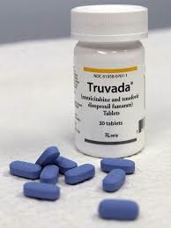
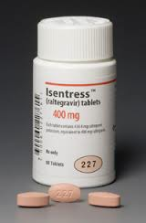
Prescribing PEP
Emtricitibine/tenofovir (Truvada) 1 pill PO QD x 28 days
AND
Raltegravir (Isentress) 400 mg PO BID x 28 days OR
Dolutegravir (Tivicay) 50 mg PO QD x 28 days
Notes:
How do you PEP? PEP is similarly very easy to prescribe. Again, it's the same medicine as for PrEP, or TRUVADA. One pill daily, however just for 28 days, in addition to either Raltegravir, 400 milligrams twice a day for 28 days, or Dolutegravir, which is 50 milligrams, once a day for 28 days. So, big picture, for someone who's taking PEP, they will be taking at least two or possibly three medicines a day.

Slide 41
PEP in pregnancy
Emtricitibine/tenofovir (Truvada) 1 pill PO QD x 28 days
AND
Raltegravir (Isentress) 400 mg PO BID x 28 days OR
Dolutegravir (Tivicay) 50 mg PO QD x 28 days***
***Avoid in 1st 8 wks of pregnancy; signal towards neural tube defects
https://www.cdc.gov/hiv/pdf/basics/cdc-hiv-dolutegravir-alert.pdf
Notes:
A National Institutes of Health (NIH)-funded observational surveillance study of birth outcomes among pregnant women on antiretroviral therapy (ART) in Botswana identified neural tube defects (NTDs) in four infants born to 426 women who initiated a dolutegravir (DTG)-based regimen prior to pregnancy, and who were still receiving it at the time of conception.¹
This study is ongoing, and more data from approximately 600 additional births among pregnant women who have been using a DTG-based regimen from conception are expected in the next 9 months.
Importantly, the same study presented data on women who initiated ART during the first trimester of pregnancy, and no NTDs were identified in the infants of the 116 women who initiated a DTG-based regimen in the first trimester or in 396 women who initiated an efavirenz (EFV)-based regimen.²
In the upcoming months, data from this study and other investigations will provide more information about the safety of DTG for infants exposed in utero.³
¹ National Institutes for Health. Recommendations Regarding the Use of Dolutegravir in Adults and Adolescents with HIV Who Are Pregnant or of Child-Bearing Potential. May 2018.
https://aidsinfo.nih.gov/news/2109/recommendations-regarding-the-use-of-dolutegravir-in-adults-and-adolescents-with-hiv-who-are-pregnant-or-of-child-bearing-potential
² Ibid
³ Ibid
https://www.cdc.gov/hiv/pdf/basics/cdc-hiv-dolutegravir-alert.pdf

Slide 42
Resources

Slide 43
Guidelines
CDC
https://www.cdc.gov/hiv/pdf/risk/prep/cdc-hiv-prep-guidelines-2017.pdf
https://www.cdc.gov/hiv/pdf/risk/prep/cdc-hiv-prep-provider-supplement-2017.pdf
DHHS
https://aidsinfo.nih.gov/guidelines/html/3/perinatal-guidelines/0
ACOG Committee Opinion
https://www.acog.org/Resources-And-Publications/Committee-Opinions/Committee-on-Gynecologic-Practice/Preexposure-Prophylaxis-for-the-Prevention-of-Human-Immunodeficiency-Virus
Notes:
These are the links to the CDC guidelines, the DHHS guidelines for PrEP in pregnancy, and the ACOG Committee opinion on pre-exposure prophylaxis.
Sources:
CDC
https://www.cdc.gov/hiv/pdf/risk/prep/cdc-hiv-prep-guidelines-2017.pdf
https://www.cdc.gov/hiv/pdf/risk/prep/cdc-hiv-prep-provider-supplement-2017.pdf
DHHS
https://aidsinfo.nih.gov/guidelines/html/3/perinatal-guidelines/0
ACOG Committee Opinion
https://www.acog.org/Resources-And-Publications/Committee-Opinions/Committee-on-Gynecologic-Practice/Preexposure-Prophylaxis-for-the-Prevention-of-Human-Immunodeficiency-Virus

Slide 44
Provides clinicians of all experience levels with cost-free, confidential, timely, expert responses to questions on:
HIV/AIDS management
Occupational and non-occupational exposure management
Management of HIV in pregnant women and their infants
Providing PrEP as part of HIV prevention
HIV Management: 800.933.3413 9 am – 8 pm EST, M-F PEPline: 888.448.4911 9 am – 2 am EST, every day Perinatal HIV Hotline: 888.448.8765 9 am – 2 am EST, every day PrEPline: 855.448.7737 11 a.m. – 6 p.m. EST, M-F Online Consultation: nccc.ucsf.edu
Notes:
The Clinicians Consultation Center is a free resource for any health care provider to call with questions about a patient. It's specifically for health care providers, clinicians, health educators to call with questions about how to take care of a patient. They answer questions about people who are living with HIV, about post-exposure prophylaxis, about HIV, as well as HIV prevention in pregnancy and breastfeeding, and most importantly and relevant to this webinar, there is a line that is specifically focused on PrEP.
For example, if you call with a question about HIV testing, and knowing whether you should start PrEP or not, they will walk you through that. No question is too simple, and no question is too complex. If they don't know the answer, they will call you back or email you back. It is a free and confidential consultation.
Clinician Consultation Center Online Consultation:
nccc.ucsf.edu

Slide 45
Questions? Feel free to contact me: dominika.seidman@ucsf.edu

Slide 46
OPA PrEP Training Webinar Series
Notes:
Webinar Topic Date
#1: Prescribing PrEP in Family Planning Sites May 20, 2019
12:00 pm EST
#2: Financing PrEP Services in Family Planning Sites June 6, 2019
3:00 pm EST
#3: Innovative Models for PrEP Programs in Family Planning Sites July 2019
TBD
#4: Leveraging Partnerships for PrEP in Family Planning Sites August 2019

