Slide 1
HHS Office of Population Affairs Financing PrEP Services in Family Planning Settings
June 6, 2019
3:00 pm ET
Notes:
Slide 1
Welcome to today’s webinar, Financing PrEP Services in Family Planning Settings, hosted by the HHS Office of Population Affairs.

Slide 2
Welcome!
Objectives
Describe the components of PrEP services and the associated costs
Provide an overview of the various financing and delivery mechanisms for PrEP, including co-pay assistance programs, state PrEP assistance programs, and 340B models
Discuss late-breaking policy developments with implications for PrEP financing
Share resources for PrEP financing
Introduction of the speakers
Cynda Hall, HHS Office of Population Affairs (OPA)
Amy Killelea, National Alliance of State and Territorial AIDS Directors (NASTAD)
Note: This call will be recorded
Notes:
Slide 2
The objectives of today’s webinar are to describe the components of PrEP services and the associated costs, provide an overview of the various financing and delivery mechanisms for PrEP, discuss late-breaking policy developments with implications for PrEP financing, and share resources for PrEP financing.
Today’s speakers are Cynda Hall, Public Health Advisor at the HHS Office of Population Affairs (OPA) and Amy Killelea, Senior Director of Health Systems Integration at the National Alliance of State and Territorial AIDS Directors (NASTAD).
Cynda Hall, from the Office of Population Affairs, will lead off with some expectations from OPA around offering PrEP services, and then we'll hear from Amy Killelea, the director of health systems integration team at the National Association of State and Territorial AIDS Directors. Amy leads the alliance's health reform, public and private insurance, and health care financing efforts, including providing resources and technical assistance for state HIV programs, and developing recommendations to inform state and federal policy. Previously, Amy worked as a senior fellow in Harvard Law School Center for Health Law and Policy Innovation, conducting legal and regulatory analysis of federal health care reform, Medicaid, and private insurance.

Slide 3
Pre-Exposure Prophylaxis (PrEP)
PrEP, a once-a-day pill (brand name Truvada), has been demonstrated to reduce the risk of HIV infection up to 92% when taken as directed.
In 2014, the US Public Health Service released the first comprehensive clinical practice guidelines for PrEP, which were developed by a federal inter-agency working group led by Centers for Disease Control and Prevention (CDC).
Guidelines recommend PrEP as one prevention option for:
Sexually-active adult MSM, adult heterosexually active men, adult injection drug users and heterosexually-active women at substantial risk of HIV acquisition.
Source: Centers for Disease Control and Prevention (CDC). Preexposure Prophylaxis for the Prevention of HIV Infection in the United States - 2014: A Clinical Practice Guideline.
Notes:
Slide 3
Cynda Hall
For quick background as we get started, Pre-exposure prophylaxis, or PrEP, is a once-a-day pill (brand name Truvada) that has been demonstrated to reduce the risk of HIV infection up to 92% when taken as directed. In 2014, the US Public Health Service released the first comprehensive clinical practice guidelines for PrEP, which recommend PrEP as one prevention option for sexually-active adult MSM, adult heterosexually active men, adult injection drug users and heterosexually-active women at substantial risk of HIV acquisition.

Slide 4
Family Planning Services and PrEP
Title X family planning sites are a primary source of care for many women, serving approximately 3.5 million women annually
Family planning providers are exceptionally qualified to provide HIV prevention services to women while incorporating clients’ health goals into individual health care decisions
Women also consider family planning clinics a preferred source for information about PrEP and access to PrEP services
Sources: Auerbach, J. D., et al. (2015). Knowledge, attitudes, and likelihood of pre-exposure prophylaxis (PrEP) use among US women at risk of acquiring HIV. AIDS patient care and STDs, 29(2), 102-110.; Sales, J. M., et al. (2019). Patient recommendations for PrEP information dissemination at family planning clinics in Atlanta, Georgia. Contraception.; Seidman, D., & Weber, S. (2016). Integrating preexposure prophylaxis for human immunodeficiency virus prevention into women's health care in the United States. Obstetrics & Gynecology, 128(1), 37-43.
Notes:
Slide 4
In our context, we are specifically discussing integrating PrEP services in the family planning setting as a way to reduce the barriers to PrEP awareness, access, and uptake that we know cisgender women face specifically.
Title X family planning sites are a primary source of care for many women and serve approximately 3.5 million women annually, and research shows that women want to learn about PrEP and access PrEP through their family planning providers. Title X sites have a key opportunity to address gaps in PrEP awareness and access among women by integrating PrEP services into existing HIV prevention services, which often include HIV and STD prevention education, testing and referral, risk reduction counseling, and behavioral interventions, such as condom use promotion and post-exposure prophylaxis (PEP).

Slide 5
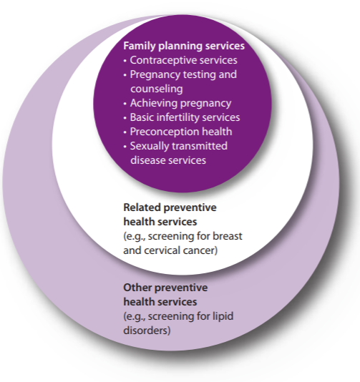
Title X and HIV Prevention
Title X is the only federal program dedicated solely to the provision of family planning and related preventive services.
All Title X funded agencies are required to provide, at a minimum, HIV/AIDS prevention education, including education on risks and infection prevention, and testing, either on-site or by referral.
Providing PrEP as a part of Title X services is allowable and can be covered as a Title X service if a grantee includes it in their description of their Title X project.
Notes:
Slide 5
Today’s webinar will cover PrEP financing and Amy will discuss the various financing and delivery mechanisms for PrEP more broadly, but I do want to start by speaking to the Title X context specifically.
In 2014, OPA and CDC released the MMWR, Providing Quality Family Planning Services (QFP). In the QFP, STD and HIV services are considered family planning services because they improve the health of both men and women and can influence a person’s ability to conceive or to have a healthy birth outcome, and all Title X funded agencies are required to provide, at a minimum, HIV/AIDS prevention education, including education on risks and infection prevention, and testing, either on-site or by referral. Family planning clients who are at risk for an STD should be screened for HIV and other STDs, in accordance with CDC’s STD treatment guidelines.
PrEP also offers an option for those clients who are at risk for HIV infection, and the family planning visit provides a key opportunity to educate the client about HIV prevention and about PrEP, and many family planning service sites are already offering PrEP counseling, referrals, or on-site services. Providing PrEP as a part of Title X services is allowable and can be covered as a Title X service if a grantee includes it in their description of their Title X project.

Slide 6
OPA PrEP Training Webinar Series
Webinar Topic | Date
National Kick-Off Webinar: PrEP for HIV Prevention in Family Planning Settings* | April 4, 2019 3 pm EST
#1: Prescribing PrEP in Family Planning Sites* | May 20, 2019 12 pm EST
#2: Financing PrEP Services in Family Planning Sites | June 6, 2019 3 pm EST
#3: Innovative Models for PrEP Programs in Family Planning Sites | July 2019 (TBD)
#4: Community Partnerships for PrEP in Family Planning Sites | August 2019 (TBD)
*Recordings and slides for past webinars are available on www.fpntc.org
Notes:
Slide 6
Lastly, I’d like to note that this webinar is a part of a PrEP training webinar series our office began in April. Our future webinars this summer will cover innovative models for PrEP programs in family planning sites, and leveraging community partnerships for PrEP in family planning sites.
If you did not have an opportunity to participate in the past webinars, the recordings and slides are available on the Family Planning National Training Center’s website, FPNTC.org.

Slide 7
PrEP Financing & Sustainability Amy Killelea NASTAD
Notes:
Slide 7

Slide 8
Presentation Road Map
PrEP Overview
PrEP Pipeline Overview
Coverage and Cost Landscape
Coverage Policies Impacting PrEP Access and Affordability
Considerations for Sustainable PrEP Payment and Delivery Models
Notes:
Slide 8
Amy Killelea
To give you just a sort of road map of what I want to cover in fairly short order, is to do a quick rundown of the importance of PrEP, what it offers as a prevention intervention for HIV, and some of the unique financing challenges that we're confronting with PrEP. I do want to spend some time talking about the PrEP pipeline.
We've got a lot happening in terms of the PrEP medication landscape, and particularly a lot is going to change over the next months and couple of years that will impact how we finance and deliver PrEP.
And then I really want to focus the rest of the presentation on our current coverage and cost landscape, the coverage policies that will impact PrEP access and affordability, and then considerations for how we can really leverage family planning clinics and other delivery settings to support sustainable PrEP payment and delivery models. And I will leave some time at the very end for questions and comment, and definitely want to hear from all of you.

Slide 9
PrEP Overview
Notes:
Slide 9

Slide 10
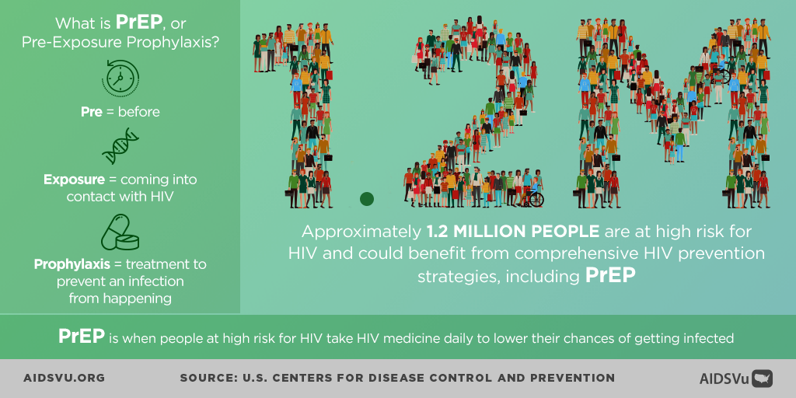
What is PrEP
Notes:
Slide 10
To get started at the beginning, in terms of PrEP as a real opportunity, it really is sort of one stop shop for both the populations who are at highest risk for HIV and are indicated for PrEP, and so what I want to underscore here is that we've got an intervention that is both highly effective, and so I really just want to reiterate the efficacy that was just presented of nearly 99% effective when used regularly at preventing HIV acquisition.
I do want to note in terms of PrEP, just something that I think is important, that yes it's an antiretroviral medication, but unlike ARVs which are used for treatment, individuals typically aren't on PrEP for a lifetime.
They may use PrEP for a period of time where they might be at higher risk of HIV, and then stop if those circumstances change, and that makes sense.
In the most recent studies presented at CROI earlier this year indicated that that average timeframe that someone's on PrEP is about 14 months. It’s an important distinction and an important data piece when we think about financial forecasting, when we think about sustainability models for PrEP access.
And then just to end with a number in bold print in front of you there, and that's taken the CDC recommendations and the populations that were just described, in terms of who is indicated for PrEP, that ends up being 1.2 million people who are actually indicated for PrEP in the U.S.
So it’s a significant potential as an HIV prevention tool, and we'll discuss throughout why we have not quite managed to scale up access in a way that really meets the potential of PrEP.

Slide 11
Payment and Delivery Barriers to PrEP
Notes:
Slide 11
One of the things to think about at the outset, and many of you may be more familiar or somewhat familiar with the HIV treatment and care landscape, where we've got a fairly sophisticated system mostly built on the foundation of the Ryan White HIV/AIDS Program that is incredibly comprehensive--there are still gaps, to be sure, but a comprehensive safety net for people living with HIV.
At the outset of this question of PrEP payment, and delivery and access, is a question of why is PrEP different? Why does PrEP pose these financing and cost barriers that are unique in the HIV space? And I think there are actually a couple of reasons.
First and foremost, we have this financing conundrum when it comes to federal grants. We have two main programs at the federal level when it comes to HIV.
One is the Ryan White HIV/Aids Program, which I just mentioned, out of the HRSA HIV/AIDS Bureau, which funds care and treatment for people living with HIV, and it's a statutory requirement. You have to be living with HIV to get services under that program. That program houses the AIDS Drug Assistance Program, which is the program for medication access and delivery for uninsured individuals. It is a 340B entity. That is the infrastructure for medication access, but we cannot use that funding for people who are not living with HIV.
We can use the infrastructure, and we'll learn about how jurisdictions are doing that, but that really is one funding stream that is cut off because of the statutory prohibition.
Then the other side, you have the CDC, which is a major funder for HIV prevention services; however, they have a fairly long standing, and up till now immovable policy to not allow CDC grants to be used to actually pay for the medication itself. Unlike the Ryan White HIV/AIDS Program situation, that is a policy decision by CDC that is not a statutory bar, so more likely to change than the Ryan White situation, that creates a sort of no man's land of the two major federal programs dedicated to HIV who are not able to actually fund payment for the medication.
What that has really caused is this sort of outsized reliance and leveraging of public and private insurance, so Medicaid, Medicare, and then commercial insurance, individual plans and employer sponsored plans, to really ensure there's a payer source for PrEP.
There are a couple of problems with that. On the Medicaid side, in the states that have not yet expanded Medicaid, there's a big gap there, because if you think about the populations who are indicated for PrEP, they are not the populations who are meeting the really strict eligibility standards in those states who have not yet expanded Medicaid, so that cuts off a chief payer source for low income folks in those states. That's one big barrier.
If you visually overlay this Medicaid expansion map in front of you, with thinking about PrEP utilization disparities, there's a real big overlay there, or connection there, that the states who have not yet expanded Medicaid also tend to be the jurisdictions where PrEP uptake is pretty low.
Then on the private insurance side, we've actually done a pretty good job of really advertising private insurance as a way to pay for PrEP, of creating pathways to get people enrolled in insurance when they're eligible. But it's also a little bit problematic that private insurance is not always the best public health intervention mechanism, especially when the intervention, like Truvada, is expensive. So we've seen problems in terms of high tiering for Truvada, and subsequently high cost sharing, and other issuer behavior that makes it hard to actually be able to afford the medication, even when you do have insurance.
CDC came out with a paper about two years ago (Source: Smith DK et al. JAIDS 76.5 (2017)), that really looked at the financial barriers in particular to PrEP, and they found some interesting things. One of the things they found was that the majority of folks had some form of insurance. They had some form of access to public or private insurance, but where the barriers were was on cost, and that was a really big barrier for folks for whom their Truvada was on a specialty, really high-cost tier, and so the prescription copays were very, very high, so that was a noted barrier.
The other thing that’s important to the story of PrEP financing in this country is that paper doesn't lead with this. You kind of have to read the whole thing and then say it back, and say, "What is this saying?" But what the paper really did find was that we have an outsized reliance, a really significant reliance on the Gilead Patient Assistance Program, and the copay assistance program, when it comes to filling those gaps. And in some ways it sort of masks the health systems gaps, because people are still in that patchwork able, in some cases, to get access to the drug, or access to copay assistance programs through the manufacturer programs, but it's not really a substitute for an integrated and well-functioning health care and public health system, and I think that's an important point, and was an important finding of that paper.

Slide 12
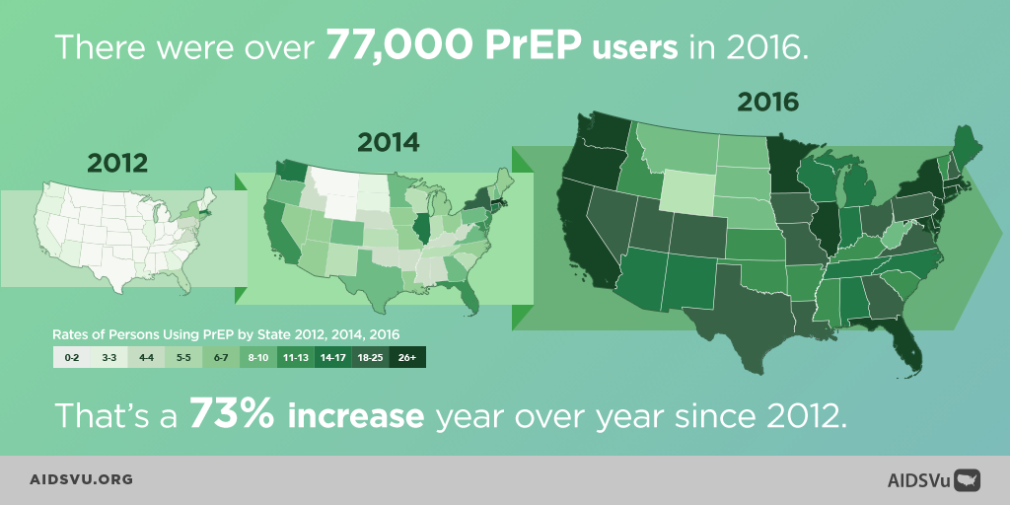
PrEP Prescribing Patterns
But it’s not nearly enough…
Notes:
Slide 12
Thank you to the folks at Emory University who put together aidsvu.org, which you’ll see referenced in a couple of these slides. It is a great resource for PrEP. Their PrEP data is fairly new, but you can really look at it by state, to look at what does utilization for PrEP look like in your jurisdiction, to see kind of where you stack up, and sort of what utilization looks like compared to rates of HIV infection, for instance, so it's a great resource.
One piece of the story is that since 2012, when the FDA first approved Truvada for PrEP, PrEP use has certainly gone up. That is a story told by the data. There's been a 73% increase, year over year, since 2012, but I want to caution that while national PrEP uptake is going up, it is not going up for everyone, and in fact I think we've got increasing disparities when it comes to PrEP uptake.

Slide 13
PrEP Disparities
PrEP prescriptions varied significantly based on gender, geography, and race/ethnicity:
Only ~7% of the 1.2 million people eligible for PrEP are actually using it as a prevention tool
Among Black and Latino gay and other men who have sex with men, only 1% and 3% are using PrEP respectively
Women had far lower rates of PrEP prescriptions (93% of all PrEP users in 2016 were men)
The U.S. South, which accounted for half of all new HIV diagnoses in 2016, had lower rates of PrEP prescriptions
Notes:
Slide 13
In drilling down in the disparities, and this is based of AIDSVu data and CDC data, you see disparities based on gender, based on geography, and race and ethnicity. Also, of those 1.2 million people that we talked about who are actually indicated for PrEP in this country, we only have uptake of about 7% of that number—so, 7% of the 1.2 million people who are eligible for PrEP are actually using it. That is very, very low.
Those 7% are not the folks who actually have the highest rates of new HIV infections, so among black and Latino gay men, and other men who have sex with men, for instance, only 1% and 3% are using PrEP, respectively. Women, which I know is a focus area for family planning clinics, have far lower rates of PrEP prescriptions. 93% of all PrEP users in 2016, according to the AIDSVu data, were men.
We also see geographic disparities. The U.S. South, again, home of a lot of non-Medicaid expansion states and some other sort of health systems inequities, the U.S. South accounts for half of all new HIV diagnoses in 2016, but also had lower rates of PrEP prescriptions than the national average.
There are many, many reasons for these disparities. I think we can probably spend the remaining time just kind of naming them:
Stigma
Provider willingness to prescribe PrEP
Consumer knowledge about PrEP; and
Consumer willingness to access and use PrEP.
I don't want to minimize any of those other driving forces behind these disparities, because I think that you could do a presentation on each one of them. I'm going to drill down into one challenge in particular today, and that's the financing coverage and cost challenges with accessing PrEP, because I think that they are unique and need some individualized attention to get at what's going on and how can we best address them.

Slide 14
PrEP Pipeline Overview
Notes:
Slide 14

Slide 15
PrEP Pipeline: At-a-Glance
Product | Route of Administration | Status
TDF/FTC | Oral | Single generic competitor in Sept 2020; multiple competitors beginning March 2012
TAF/FTC | Oral | Phase III (Phase I-II in African women)
RAL/3TC | Oral | Phase IV
Cabotegravir | Long-acting | Phase III
Dapivirine | Ring | Phase III/FDA review (ring); 3-month ring and rectal gel in development
Tenofovir | Ring | Phase I
Dapivirine or tenofovir + levonorgestrel | Ring | Phase I
Tenofovir, TAF/EVG, IQP-0528, Griffithsin, PC-1005, DS-003 | Vaginal or rectal inserts, enemas, and tablets | Pre-clinical – Phase I
Notes:
Slide 15
I debated whether to put this PrEP pipeline update at the end and going through an entire presentation of PrEP financing and sustainability, and then ending with, "But wait a minute, this is all going to change." I decided not to do that. I wanted to start with the existing financing models right now that are based on the current landscape, which is a one drug landscape. It is Truvada, a brand name product, the only FDA approved drug for PrEP right now, but that landscape is changing, and is going to change fairly rapidly, and so I think it's important just to start with that, and a quick overview of the dynamic PrEP medication landscape.
Very soon, we're going to see competition in this PrEP space for the first time, and there are both benefits to that competition, mostly competition drives down prices. That is a huge benefit. But there are also challenges, as the space becomes more complicated. So this slide focuses only on the medications in the slide that are moving the quickest. For the other ones, particularly the ring updates, I wanted you all to have them, but for time's sake, I am not going to focus on those. Those approval timelines are far longer down the road.
The first major change to the PrEP landscape is likely actually going to be very quick, before the end of the year and as early as October, when Descovy, which is another Gilead brand name product, gets an FDA indication for PrEP. Descovy is a slightly different formulation than Truvada. Truvada is TDF/FTC, and Descovy swaps out TDF for TAF. Gilead has shown some indication that there is slightly lower toxicity for a TAF-based regimen. There is some clinical evidence that questions exactly what that benefit is, and how to quantify it, so I'll just leave that there, as there's some back and forth on that.
Gilead has secured a fast track review process for FDA approval of the PrEP indication, so this is happening rapidly. Before the end of the year, we're going to have more than one product for PrEP.
We also have a generic form of Truvada, so again, that's the TDF/FTC, so generic form of Truvada on the horizon. There will be a single generic competitor, offered by Teva Pharmaceuticals, which will happen in September of 2020, with multi-generic competition beginning of March, 2021, after the six-month exclusivity period has ended.
In terms of impact to the system, probably the multi-generic competition has the most potential for impact to the system.
I'm going to be referencing some of these changes throughout, and how they could potentially impact our financing approaches to PrEP.

Slide 16
PrEP Coverage and Cost Landscape
Notes:
Slide 16

Slide 17
PrEP Components and Costs
PrEP Components | Cash Price*
Medication (Truvada is only FDA-approved medication for PrEP currently) | ~$1,700/month (Wholesale Acquisition Cost, no discount); ~$440/month (340B Price)
Lab costs** (at PrEP initiation and every three months) Baseline HIV test HBV tests (at initiation only) Metabolic panel/creatine test Gonorrhea and Chlamydia screening Syphilis screening | ~$291 to $3,955
Physician visit (at initiation and every three months) | ~$60 to $177 per visit
* Above costs are estimates, the cash price of services varies significantly depending on geography and provider. Many providers provide lab and clinical services to uninsured patients at a reduced rate. ** Providers should refer to the CDC PrEP Clinical Guidelines for specific lab recommendations based on patient risk and other factors. Source: Whitman, et al, Costs of Providing PrEP for HIV Prevention: Estimates from a Community Health Center, (Abstract PS3-44, 39th SMDH, 2017).
Notes:
Slide 17
Now I'm going to move into a deeper discussion of the PrEP coverage and cost landscape, and what's going on there, what's changing, what's working, what's not working, and where the gaps are
I want to start very briefly, because throughout I reference the high cost of PrEP, and I don't want you to take my word for it. I want to have some numbers and data to back that up. This includes the cash price for three components of PrEP. These are probably not all of the components that we could say should be included in our definition of PrEP. We all know it is not just the medication, and some things that are probably missing from here are counseling and linkage services. For simplicity purposes I wanted to focus on the big three that are the focus of the CDC clinical recommendations, as well, and that breaks down into medication, the lab cost, and then physician visit costs.
The medication, Truvada, is the drug right now that's approved for PrEP. The cost is a little bit closer to $1,800 a month now, wholesale acquisition cost, or list price, without a discount. And for completion purposes, Descovy has the exact same list price as Truvada, so if folks were thinking of that, hat piece of competition will likely not drive down price immediately.
Then you've got lab costs. Having the range there is really important. This is all over the board. We use a national claims database to get our averages. But we also do validation testing with focus groups of providers, and what we get are answers that are all over the place in terms of the actual cost of the labs. This really does vary, and varies also by discounts that providers are able to negotiate with labs. This is a variable element, but this is the range, and it can be a fairly significant cost. You've got lab costs that need to happen at initiation, and then every three months in accordance with the CDC PrEP clinical guidelines.
And then you have physician visits. This varies as well, but also varies by type of provider. So for a primary care provider, if you're able to bill a provider, that's going to be different than if you're a specialty provider within an infectious disease clinic. This gives you a sense of the general cost breakdown, an important starting point.

Slide 18
Getting the Cost and Access Incentives Right
Family planning clinics
PrEP DAPs
(state HD)
Private providers
Local health departments (STD clinics)
Community health centers
Uninsured populations (non-340B discount)
Underinsured populations
Uninsured populations (340B discount)
Underinsured populations
Insured populations
Insured populations
Manufacturer Co-pay and Patient Assistance Programs
& Donation Program
Notes:
Slide 18
Before getting into some of the components of how we are financing PrEP right now, let’s take a step back and think about how the financing mechanisms really do put a thumb on the scale for a certain delivery mechanism. In thinking about PrEP in particular, and you could probably apply this to a great many interventions and services in the public health space, if we decided to design a system where the primary goal was to A, get PrEP into as many hands as possible, and B, get PrEP into hands that were disproportionately impacted by HIV and not getting access to PrEP currently, I might design a system that is very different than the system that we have right now. I might really put my thumb on the scale of innovative, and varied, and community-based providers that were really able to meet people where they were.
Think about who are the populations, and how to pick and cultivate providers that are able to best reach them. Because this is not the system that we have. We have a system that's the opposite, very much driven by the high cost of Truvada in this case.
We start with the financing, and we use that to really guide what exactly our delivery systems look like. It's a little backwards. If you really wanted to think in a public health lens, and access lens, how would you do it? We're a little bit hamstrung by the high cost of PrEP, in the 340B context.
In the 340B context, that means there is a thumb on the scale of 340B entities being primary providers of PrEP because of the unique sustainability models that are available in those settings; family planning clinics, local health department STD clinics, community health centers.
That does leave out some of the other non-340B entities, mainly PrEP drug assistance programs, from that equation. They are not 340B entities. They're only 340B entities for people living with HIV, so you are leaving out a swath of public health providers.
The other thing is that we kind of rest our system heavily on the manufacturer copay and patient assistance programs. As we talk about those programs, note the ways in which that ends up with a fairly fragmented system for PrEP access.
Some of you may have models where you are sending people to the patient assistance program for their medication access, or the copay assistance program. You know that anytime you add different access points, where you say you get your medication here, but you get your lab services here, and this is how we'll pay for this thing, and this is how we'll pay for that thing, you add complexity to a system, and you run the risk of creating a complex system for a consumer who's not going to want to deal with that.
Note that this patchwork does have an impact on access. The biggest thing that turns this patchwork and these incentives on their head is the multi-generic competition. That's the even playing ground that allows us to provide access across a larger swath of providers.

Slide 19
Financing Models for PrEP: A Patchwork of Funding and Delivery Mechanisms…
 | Drug Access | PrEP Clinical Visits & Lab Costs | Counseling and Linkage
Uninsured | Manufacturer Patient Assistance Program PrEP Drug Assistance Programs or “PrEP DAPs” (state funded) Community Health Centers; Family Planning Clinics; STD Clinics using 340B savings | PrEP DAPs (state funded) CDC prevention funds to pay for HIV/STD testing Community Health Centers; Family Planning Clinics; STD Clinics using 340B savings | PrEP DAPs (state funded) CDC prevention grants and 340B savings Community Health Centers; Family Planning Clinics; STD Clinics using 340B savings
Insured | Covered by payers; co-pay assistance through manufacturer assistance program | Largely covered, but with patient co-pays PrEP DAPs pay for lab/clinical visit co-pays (state funded) | Not well covered by public or private insurance
Notes:
Slide 19
I'm going to spend the next several slides really picking apart this patchwork that I talked about, and really getting at how each of these patchwork systems and programs work, and how they interact with one another. We can also use this as a way to figure out where some of the gaps emerge. This slide tries to provide a visual of both the components of PrEP programs, dividing it up into three buckets that make up a PrEP access program.
You've got drug access, that is probably one of the most important buckets, but not the only bucket. You then have the PrEP clinical visits and lab cost, and then you have counseling and linkage services.
There is another dividing line, in terms of uninsured folks and insured folks, and the way in which individuals access each of these buckets of services varies quite a bit, both depending on the service, and depending on whether they have insurance.
To start out with the uninsured population, for drug access, we have several different mechanisms. These are probably the most common. First and foremost, the manufacturer patient assistance program is a huge source of access to the medication itself for uninsured folks.
You have PrEP drug assistance programs, or PrEP DAPs, these are often using the AIDS drug assistance program infrastructure at the state level, but are state or local funded. You cannot use federal funds for that, and are not 340B eligible, so PrEP drug assistance programs that are purchasing drugs, are purchasing at the full drug price. There is no discount there.
And then you have community health centers, family planning clinics, STD clinics. The sustainability story is the ability of those clinics to generate 340B program income and savings via their models with insured clients, to then be able to provide the medication to folks who are uninsured. From left to right, that is the same way that PrEP clinical visits and lab costs are paid for uninsured folks for those 340B entities, and that counseling and linkage services are paid for by those 340B entities.
The clinical visits and lab costs provide more of a conundrum, in terms of making sure that those services are covered for uninsured folks. Again, it's a patchwork. Some PrEP drug assistance programs are able to step in and fund those services. CDC prevention funds are able to pay for some, but not all, of those services. And then we talked about the 340B entity savings reinvestment, and then the same thing holds true for how counseling and linkage services are paid for for uninsured folks.
For insured folks, the drug access piece is a little bit more straightforward. It is covered by payers. NASTAD does analysis of commercial plan coverage, and we've got access to a national database of plan coverage, and really the vast majority of plans have Truvada on formulary, and we don't see a lot of examples of prior authorization that denies Truvada when it's used for PrEP.
We've got pretty saturated coverage on public and private formularies, and then we do see access challenges and affordability challenges with high copays, or even coinsurance, where folks are paying a percentage of the list price of the drug, and we talked about what the list price of the drug was, so that can get very, very expensive, when you're paying 30, 40% of that list price at every fill.
Also for insured folks, those out-of-pocket costs for copays and coinsurance associated with your medication can go through the manufacturer, the copay assistance programs, through the manufacturer. Many, many people have used that. In terms of insured folks, PrEP clinical visits and lab costs are largely covered.
Patient copays do exist. They're obviously not going to be as high as for a medication, but there still can be a barrier, and there are some ways that both clinics have been able to help with that, and that state PrEP drug assistance programs have been able to help with those copays, as well.
The counseling and linkage services is one thing that is not well covered by public or private insurance. Counseling is covered a little bit more, but linkage is not a very well defined, sort of CPT code and service for public and private insurance.

Slide 20
Patient and Co-pay Assistance Programs
Patient Assistance Programs
Program | Clinical Visits & Labs | Health Insurance | Income Eligibility
Gilead Patient Assistance Program | Not covered | Uninsured | 500% FPL
Notes:
Slide 20
Because I've mentioned several times now the role that the patient assistance programs play, I want to spend a second walking through what these look like.
Even when a clinic, or a public health program has a sophisticated PrEP program, often the sort of first referral out is to the Gilead Patient Assistance Program. Not always, but that's a part of how a lot of these programs run. That might be a part of how your program runs, and so I just want to spend a second walking through this.
So, the first program for uninsured folks who are looking to access PrEP is the Gilead Patient Assistance Program. There is an income eligibility limit on this. To underscore the point, this is just for the medication; this is not for clinical visits and labs. So it does leave patients who are accessing the drug through this program on their own, or with the help of assisters, to really figure out how to get those other costs and services covered.
Note that when Descovy is approved, the patient assistance program is likely to be very similar if not identical to the one for Truvada. I think that will become important when we have new drugs to make sure that we don't have confusing systems with different rules, and it looks like that's going to be fairly similar.

Slide 21
Co-pay Assistance Programs
Co-pay Assistance Programs
Program | Medication Copay Max | Clinical Visits & Labs | Health Insurance | Income Eligibility
Gilead Advancing Access Copay | $7,200/yr | Not covered | Private health plans | Any income
Patient Advocate Foundation | $7,500/yr | Not covered | Plans covering Truvada | 400% FPL
Patient Access Network Foundation | $8,000/yr | Covered (limited) | Medicare | 500% FPL
Notes:
Slide 21
For underinsured individuals, folks who have insurance but have really high copays or coinsurance, we've got a number of different copay assistance programs.
The Gilead Advancing Access copay program is the most widely used. It is fairly generous. There is no income limit for that, and in fact, the medication copay maximum last year was raised up to $7,200 a year, and that was a fairly significant increase from what it was before. Again, clinical visits and lab copays are not covered, and this covers copays associated with private health plans, so not Medicare and not Medicaid.
And then you've got charitable programs, as well, so these are not operated by manufacturers. These are charities, and so they have to have income eligibility thresholds, and so the two programs listed there do.
The first one, the Patient Advocate Foundation, it tends to ebb and flow in terms of when they're open and when they have to close, because they do not have funding, and so it's been typically used as a backstop to the Gilead Advancing Access copay program. That's usually the first stop, and then the Patient Access Network Foundation is even less used. It is only for Medicare, and we have not seen much uptake there. But that's kind of the landscape for copay assistance.

Slide 22
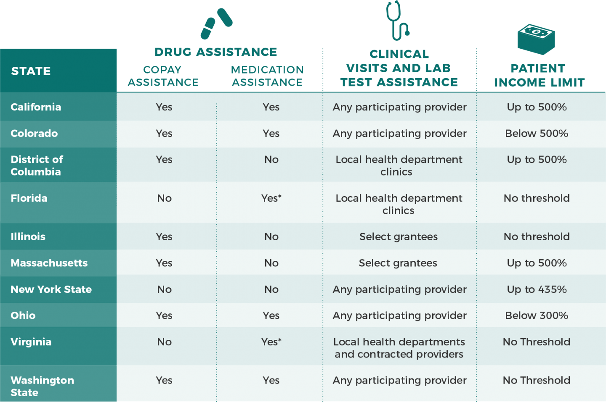
State PrEP Assistance Programs
Notes:
Slide 22
I've mentioned a couple of times now the state prep assistance programs, or PrEP DAPs, and this list has grown and perhaps is continuing to grow. There may be jurisdictions on there that we need to add. This is updated as of about four months ago, and this is constantly evolving.
These are programs that have used some combination of state and local funds to create, and these are all at the state level or District of Columbia level, a PrEP program that covers some degree of medication assistance, copay assistance, clinical visit, and lab. It differs by jurisdiction, but these are state run programs that are really attempting to mirror the Ryan White HIV/AIDS Program models, and provide financing and distribution models.
If you're in one of the states, they all have websites, and those website links are actually up on NASTAD's website. I'll show you the link at the end of the presentation, but it's good to check out what your state is doing, and what's available to folks.

Slide 23
340B Models for PrEP
Community Health Centers
Reach into some (but not all) communities at high risk for HIV
340B savings to fund services for uninsured
STD Clinics
Deep reach into communities at high risk for HIV
340B savings to fund services for uninsured
Family Planning Clinics
Deep reach into communities at high risk for HIV, particularly women
340B savings to fund services for uninsured
Start-up funding needed (cannot use CDC grant to purchase drug)
Notes:
Slide 23
In terms of 340B, this was another area where I want to have a few caveats at the outset. This is a very coverage- and policy-heavy presentation. I am not going to get into the 340B compliance and regulatory weeds. That is a topic for another day, and probably many, many hours, and folks with more 340B legal compliance background certainly than I do.
I approach this from a coverage and systems financing piece. What I want to really underscore here is that the 340B models for PrEP have really been a sustainable and innovative financing mechanism for PrEP. But it looks a little bit different depending on what type of 340B entity you are, and there are pluses and minuses and unique challenges for each one.
The sustainability part of this is that you have a drug, Truvada, that has a fairly high, if not very high list price, and you also have a drug, Truvada, which has had price increases year on year for the past several years. That combination of facts means that the drop down to the 340B discount from that list price is significant. That means that the drop down from the commercial usual and customary rate down to the 340B discount is significant.
If you've got a population of commercially insured folks, you are really able to use that spread, which is significant, to cover a whole bunch of services for uninsured people. And I say reinvest the savings. These are program income, not sort of a profit, but it has allowed programs to be able to cover medication and other services for their uninsured population.
That is probably old hat to most of you, but I think that's important just to kind of name the exact reason why the 340B models work. We see them pop up in community health centers and STD clinics, and then in family planning clinics.
Community health centers are probably the biggest model, with the most funding, in terms of the different settings we're talking about. They have reach into some but not all communities at high risk for HIV. By their mission, they have to serve folks who are in need, and have special population focuses, and so that is one area.
STD clinics are another really good entry point into communities at high risk for HIV. In some ways, they are reaching different populations than those who are going to community health centers, including gay and other men who have sex with men, and women, and so a little bit of a more diverse community reach. Again, the 340B savings can be generated.
The trick with the STD clinics has been that startup funding, state or local funding, has been needed. Going back to the financing conundrum that I talked about at the beginning, CDC grant funds cannot be used to purchase the drug for STD clinics. So, we've seen more STD clinics go down the route of using their 340B status to stand up PrEP programs. We've actually seen an expansion of the 318 designation for STD clinics to get 340B status, and perhaps we will see some loosening of the grant restrictions on PrEP medication payment, as well.
Family planning clinics, in many ways, are similar to the SDT clinics, and probably the two have and can learn a lot from one another in terms of how these models are set up. The real draw in family planning clinics is in a deep reach into communities at high risk for HIV, particularly women, who perhaps are not as well served in the other settings that are scaling up access to PrEP, so there's a real opportunity there.

Slide 24
Ending the Epidemic Initiative
Notes:
Slide 24
It’s important to reference the administration's Ending the Epidemic Initiative because it is in many ways focusing us, and putting a spotlight on PrEP access, both in some of the gaps for PrEP access, and I think in identifying areas for new funding.
In terms of PrEP, the front and center pillar of the administration's plan to end HIV is going to be a piece of new funding for PrEP, and more attention to innovative models for PrEP, and expanding PrEP access particularly to populations who are not really using PrEP in ways that would be indicated by our HIV incidence rate.

Slide 25
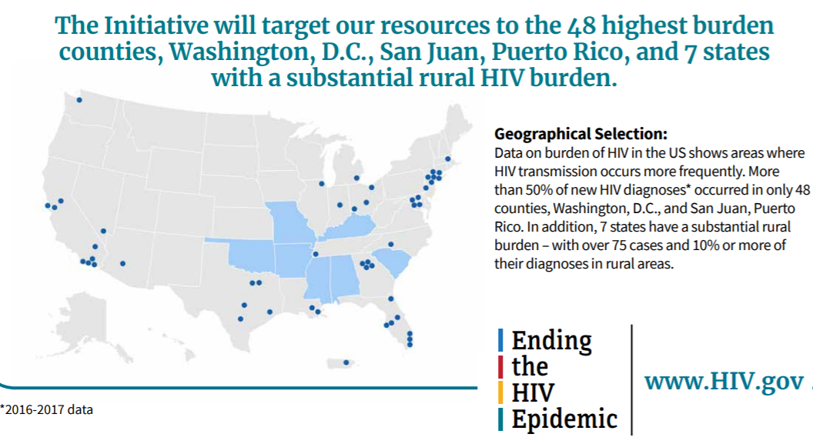
Ending the Epidemic Initiative
Notes:
Slide 25
In terms of where the Ending the Epidemic Initiative is focusing, it is a geographic focus, at least in the first iteration, focused on the 48 counties and seven jurisdictions with the highest rates of HIV infections.
That is the map that you see in front of you. If you are in one of those jurisdictions that are in blue, or, and it's a little bit harder to see, you may have to go to the website to kind of figure out that list of counties.
This might be a real opportunity in terms of new funding, new community planning, and just new attention to how that jurisdiction is going to meet the PrEP indicators in this Ending the Epidemic Initiative. I actually think that we could see some real movement, in terms of support of new models, and certainly some new funding.

Slide 26
Gilead PrEP Donation
On May 9, 2019, Gilead Sciences announced they will donate PrEP medication (Truvada and then Descovy) for up to 200,000 individuals per year for up to 11 years to assist in the ETE 2030 initiative
Details are forthcoming, but Gilead intends to make PrEP available to uninsured individuals, largely through community health centers
Notes:
Slide 26
Speaking of new funding, one thing that has been connected with the Ending the Epidemic Initiative has been the Gilead PrEP Donation program. On May 9th, so not so long ago, Gilead announced that they will donate PrEP medication, so Truvada, and then once Descovy is approved, Descovy, for up to 200,000 individuals per year, for up to 11 years, to assist, and this is part of meeting the Ending the Epidemic Initiative. Details are forthcoming, that is... I'd just bold and underline that. The dust has not settled, and I do not think there's a concrete plan as of yet to operationalize this. It has been committed, so I think that Gilead has sort of stepped up and committed to doing this, but I think the details of how that happens, to be determined.
One way this could happen is to sort of put the thumb on the scale of community health centers, and that's certainly been talked about as a key piece. NASTAD and others have really pointed out that in order to really expand access to PrEP to populations who are not accessing it, you really need to think innovatively about settings, including public health settings that would include health departments and family planning clinics.
More to come on that, but that's something to watch. That has not yet been rolled out, and details are forthcoming.

Slide 27
PrEP Coverage Policies
Notes:
Slide 27

Slide 28
USPSTF Draft Grade A Recommendation
Population | Recommendation | Grade
Persons at high risk of HIV acquisition | The USPSTF recommends that clinicians offer pre-exposure prophylaxis (PrEP) with effective antiretroviral therapy to persons who are at high risk of HIV acquisition | A
ACA mandates that private insurance plans and Medicaid expansion programs cover preventive services with a USPSTF A or B rating at no cost
Plans must adopt in the plan year that begins at least one year following the final USPSTF recommendation
Notes:
Slide 28
The last thing that I want to cover before opening it up for questions is the U.S. Preventive Services Task Force. The USPSTF is an independent body, and it reviews clinical evidence, and issues recommendations for preventative services.
This was sort of a wonky, lesser-known body before the ACA. With the ACA, there's a really exciting provision in the ACA that requires the majority of private insurance plans to cover any preventive services with an A or B rating without cost sharing. That's huge, and that really makes these grades that USPSTF issues very, very important.
For PrEP, in November of 2018, the USPSTF issued a draft recommendation after a multiyear review process. I will underscore, this was a laborious process. There were many comment periods, and they really are heavily clinically based.
After this process, PrEP was given a grade A. That is the highest grade, which indicates there is a high certainty of substantial net benefit, and that's very, very exciting for PrEP access.
The recommendation has not yet been finalized. We're anticipating that the final draft could come out as early as this month. I think we're anticipating at least some time before the end of the year
In terms of the mandate to cover PrEP without cost sharing, of when that would go into effect, that would be January 2021. There's about at least a year lag between the final recommendation and when plans actually have to start covering.

Slide 29
Implementation Considerations
Access to PrEP services beyond medication
Includes HIV, hepatitis, and STI testing at initiation and every three months as well as follow-up provider appointment every three months, all of which should be covered without cost sharing
Access to the medication
Potential for UM to be used in discriminatory (e.g. prior authorization)
Need to anticipate a different PrEP medication landscape in the next 1-2 years (e.g. generic PreP, long-acting injection)
Notes:
Slide 29
I want to talk through four major considerations when it comes to the USPSTF recommendation. There are going to be some implementation questions and challenges that we need to be aware of.
Number one is access to the medication. You've got this interesting circumstance where the final recommendation is going to be released in a point in time where there's only one FDA approved product for PrEP. But then let's jump to January of 2021, when the recommendation will be implemented by plans, and that will be a time where we could potentially have, and likely will have three products for PrEP: two brand name and one exclusive generic.
That's very different, and so part of the question that was not well defined in the draft recommendation is what will plans be required to cover? Will they be required to cover everything? Will they be able to say, "We're only going to cover one thing?" Will they be able to say, "We're going to start you on a generic, and if you fail on the generic, then we'll move you to Truvada or Descovy?"
You could generate endless questions on what they will be able to do, so that is a real question that will impact how expansive the USPSTF recommendation is, both for coverage, and then coverage without cost sharing for folks in the insurance market, and the Medicaid expansion programs. The USPSTF recommendations also cover Medicaid expansion programs.
The second consideration is access to PrEP services beyond the medication, so we talked about PrEP is not just the medication. I think the recommendation actually did a fairly good job of walking through and citing heavily to CDC guidelines about all of the ancillary services that make up PrEP, but not a lot of specific guidance for payers of, "You have to cover this entire suite of services, and you have to cover them without cost sharing." So we will look to see either clarification in the final recommendation and or subregulatory guidance clarifying that.

Slide 30
Implementation Considerations Cont’d
Accounting for different delivery systems for PrEP
PrEP is accessed at a range of provider types, including health department STD clinics, pharmacy distribution models, and tele-medicine programs
Identifying Individuals at high risk
Includes heterosexual people, men who have sex with men, and transgender people with a partner living with HIV or other additional risk factors, and individuals who inject drugs
Notes:
Slide 30
Identifying individuals who are at high risk. Our main concern here is that identifying folks for whom PrEP is appropriate really should be at the provider level, and should not be in the hands of an insurance company.
Using prior authorization, for instance, to identify who is eligible for PrEP, really has potential stigmatizing and discriminatory implications. So we would certainly argue that that is not an appropriate use of prior authorization, and that that sort of decision is a clinical one, and it should be with the provider.
Finally, there are different delivery systems for PrEP than I think the USPSTF body typically writes for. Their primary audience is primary care clinicians, and we know that PrEP is provided in many, many settings, including public health, family planning settings. Really ensuring that the recommendations are disseminated and applied across varied settings is critical, because they're applicable across varied settings.

Slide 31
Next Steps for USPSTF Implementation
Anticipated CMS/CCIIO and CMS/CMCS guidance to private insurance plans and state Medicaid agencies about appropriate implementation
Anticipated state insurance regulator bulletins and guidance to plans (e.g., NY Department of Insurance Bulletin on non-discriminatory practices for PrEP coverage)
Provider and consumer education is critical to ensure that USPSTF and CDC guidelines are being followed and to ensure consumers know about new cost-sharing protections
Notes:
Slide 31
In terms of next steps, we can anticipate federal subregulatory guidance. We are certainly working to inform what that federal and state subregulatory guidance looks like to make sure that the recommendation is interpreted as widely and broadly as possible.
For provider and consumer education, I actually think the USPSTF recommendation in addition to the Ending the Epidemic Initiative are a one-two punch together, and a great way to build provider education and awareness around PrEP. It will be a good rallying cry just to build awareness of PrEP.

Slide 32
Considerations for Sustainable PrEP Payment and Delivery Models
Notes:
Slide 32

Slide 33
PrEP Medication Pricing Changes
Truvada ($56)
Descovy ($56)
Single TDF/FTC Generic ($50)*
Multi TDF/FTC Generics ($6)*
Commercial Plans
Commercial Plans
Commercial Plans
Stat. required Medicaid/340B (~$43.50)
Stat. required Medicaid/340B (~$37.00)
Commercial Plans
Stat. required Medicaid/340B (~$15.00)
Voluntary 340B (~$15.00)
*Forecasted
*Forecasted
Notes:
Slide 33
To bring it together in terms of what's on the horizon, we’ll look at changes to the medication landscape, and how that impacts sustainability. I will give all the credit in the world to my brilliant colleague Tim Horn who put together this slide, which presents a great color-coded way of walking through what are some, particularly 340B, implications for how our landscape is changing.
Truvada and Descovy are priced identically. The rebate for Truvada is a little bit more, because they've had more year on year increases, but the manufacturer's offering supplemental rebates for Descovy, so that really makes those two products identical, and you could see why the manufacturer would want to do that. We're probably going to see more pushes from them to get people onto Descovy, particularly as the TDF/FTC-based regimen goes off patent.
The thing I really want to draw your attention to is on the right hand side of the screen. In September 2020, we have the first, single TDF/FTC generic, with no competition there. Without competition, that price is not going to come down that much.
Because it's a generic, though, you really don't get the spread that you get on a high list price brand name drug. The long story short there is that the large impact in terms of sustainability is a couple years out to 2021, where we have multiple TDF/FTC generics
This is all a little bit in flux, and I think we'll have to observe systems and payer behavior, and particularly when it comes to Descovy, when it comes to the single generic.

Slide 34
Considerations Moving Forward
Do we need to rethink our current PrEP models in light of changes to the PrEP medication landscape?
How do we make sure that PrEP is getting to the right places and people, while also designing a cost-effective delivery model? Are those two priorities in tension?
How should we prepare to engage community health centers given their central role in PrEP expansion as part of the ETE 2030 initiative?
How should the community respond to formulary designs that preference certain forms of PrEP over others based on cost?
Notes:
Slide 34
The last question that I think this is really important for the entire HIV community to really grapple with is how do we respond to formulary designs in particular (but you could say it's program designs) that preference certain forms of PrEP over others based on cost?
This is a real ethical question we need to grapple with on who gets what. We're sort of there, and I think we'll see that when Descovy is approved, of who gets a TAF-based regimen, and for whom is that indicated, and we'll see that when payers start making decisions about preferencing generic or lower cost options over brand name and higher cost options. We as a community will have to be prepared to deal with that, and to message that to consumers as well.

Slide 35
Resources
Amy Killelea, NASTAD, email: akillelea@nastad.org
NASTAD PrEP Resources
AIDVu PrEP Mapping
CDC PrEP Guidelines
Notes:
Slide 35
Resources:
Amy Killelea, NASTAD email
akillelea@nastad.org
NASTAD PrEP Resources
https://www.nastad.org/prepcost-resources/additional-resources
AIDVu PrEP Mapping
https://aidsvu.org/prep/
CDC PrEP Guidelines
https://www.cdc.gov/hiv/risk/prep/index.html

