Slide 1
Utilize Diverse Payment Options to Reduce Cost as a Barrier for the Facility and the Patient
Contraceptive Access Change Package
Best Practice 4
Last Reviewed November 2017
Notes:
Facilitator Notes
Today we will be discussing utilizing diverse payment options to reduce cost as a barrier for the facility and the patient. Ultimately, the goal of this best practice recommendation is to ensure patients have access to a broad range of contraceptive methods and services regardless of ability to pay.
Activity
Conduct participant and facilitator introductions.

Slide 2
Introduction to the Contraceptive Access Change Package
Best Practice Recommendations
Stock all methods
Utilize patient-centered counseling
Offer same-visit access
Reduce cost as a barrier
Link: https://www.fpntc.org/resources/contraceptive-access-change-package
Notes:
Facilitator Notes
Reducing cost as a barrier is Best Practice 4 of the four best practices for increasing access to contraception outlined in the Contraceptive Access Change Package.
The Contraceptive Access Change Package, which is an overview of the best practice recommendations and strategies, draws from the literature and most current practice guidelines to increase access to the full range of contraceptive methods.
The other three Best Practices in the Contraceptive Access Change Package are:
BP 1: Stock a broad range of contraceptive methods, including provider-dependent FDA-approved methods
BP 2: Discuss pregnancy intention and support patients through evidence-informed, patient-centered counseling that enables them to choose from the full range of contraceptive methods if they do not desire pregnancy presently.
BP 3: Develop systems for same-visit provision of all contraceptive methods, at all visit types.
In order to increase access, it’s important to consider all four best practices. We strongly encourage you to refer to the Contraceptive Access Change Package for more ideas about strategies and successes. It can be found on the FPNTC website (the link is provided on the slide).

Slide 3
Contraceptive Access Change Package: Best Practice 4
Utilize diverse payment options to reduce cost as a barrier for the facility and the patient. Inform patients about self-pay, sliding fee schedules, and insurance enrollment options. Ensure access to services regardless of ability to pay.
Notes:
Facilitator Notes
The change package recommendation is: “Utilize diverse payment options to reduce cost as a barrier for the facility and the patient. Inform patients about self-pay, sliding fee schedules, and insurance enrollment options.”
The goal is to ensure patients can access services regardless of ability to pay.

Slide 4
Meeting Objectives
By the end of today, you should be able to:
Describe the rationale for reducing cost as a barrier to contraceptive services
Identify at least one strategy to reduce cost as a barrier for access to contraception
Identify at least one resource to support you in utilizing diverse payment options for contraceptive services
Notes:
Facilitator Notes
There are 3 objectives for today’s discussion. By the end of today, we hope you will be able to:
Describe the rationale for reducing cost as a barrier to contraceptive services
Identify at least one strategy to reduce cost as a barrier for access to contraception
Identify at least one resource to support you in utilizing diverse payment options for contraceptive services
As the objectives imply, we want to take time today to talk about not just what should happen, but also potential strategies for putting these recommendations into practice—ultimately, to increase patients’ access to their contraceptive methods of choice.

Slide 5
Rationale for Utilizing Diverse Payment Options
Cost has historically been a barrier to contraceptive use
Cost remains a barrier for uninsured and underinsured clients
Title X program provides access to services regardless of ability to pay
Removing cost barriers empowers individuals to choose the best methods for themselves, and allows them to meet reproductive goals
Notes:
Facilitator Notes
Cost has historically been a significant barrier to contraceptive use, especially for IUDs/implants that have high up-front costs for patients (to pay) and providers (to stock on site).
The Affordable Care Act has increased access to contraception for those with health insurance, as it requires most health insurance companies to cover FDA-approved contraceptive methods without cost-sharing.
Enrolling eligible patients in insurance and ensuring they remain enrolled are priorities for increasing access to contraception. For providers, increasing insurance coverage means that quality services can be appropriately reimbursed, which makes offering contraception more financially sustainable.
However, gaps in coverage remain, and cost may still pose a substantial barrier for the uninsured or underinsured.
The Title X Family Planning Program is the only federal program dedicated solely to the provision of family planning and related preventive health services. The program is designed to provide contraceptive supplies and information to all who want and need them, with priority given to persons from low-income families.
Research shows that removing cost barriers increases the adoption of contraception, empowers individuals to choose the most appropriate and desired method for them, and results in increased continuation rates and satisfaction over time.
Sources (for reference)
Health Insurance Marketplace Home: Marketplace.CMS.gov.
Gandal-Powers, M. The Affordable Care Act and Birth Control Coverage: What Every Healthcare Provider Should Know. National Women’s Law Center. Presentation. March 27, 2014
Andrea Flynn, “The Title X Factor: Why the Health of America’s Women Depends on More Funding for Family Planning,” Roosevelt Institute, October 28, 2013, accessed March 11, 2014, http://rooseveltinstitute.org/sites/all/files/2013_10_28_Flynn_Title_X. pdf.
Enroll America. The State of Enrollment: Lessons Learned From Connecting America to Coverage. June 2014.

Slide 6
Contraceptive Access Assessment
Notes:
Facilitator Notes
If you haven’t already, please take a minute to complete the Contraceptive Access Assessment questions related to stocking. Consider how often all methods are immediately available (i.e., stocked on site) to patients. We encourage you to be critical—how often are these practices happening really (not what you hope is happening)? This tool is designed to help us identify areas to improve.
Activity
Participants will fill out or refer to the Contraceptive Access Assessment tool. Ask participants to fill out ahead of time, or provide 10-15 additional minutes to fill it out during the session.

Slide 7
Discussion of Challenges
To what extent is cost a barrier for patients? For your facility?
What is challenging about ensuring patients have access to services, regardless of ability to pay?
What method-specific challenges do you face?
Notes:
Discuss
Reflecting on the results of your Contraceptive Access Assessment, what extent is cost a barrier for your patients? For your facility?
What is challenging about ensuring patients have access to services, regardless of ability to pay?
For which methods is cost a barrier? What method-specific challenges do you face?

Slide 8
Overview of Strategies
Ensure organizational policy is in line with Title X program requirements
Obtain third-party reimbursement, when possible
Optimize revenue cycle management and patient fee collection protocols
Identify and access all available sources of revenue
Notes:
Facilitator Notes
As outlined in the Contraceptive Access Change Package, there are four primary strategies that drive this best practice. These include:
Ensuring organizational policy is in line with Title X Program Requirements
Obtaining third-party reimbursement, when possible
Optimizing revenue cycle management and patient fee collection protocols (utilize cost reduction strategies)
Identifying and accessing all available sources of revenue, including private and grant funding
Now let’s go through each strategy one at a time.

Slide 9
Title X Program Requirements
Ensure organizational policy is in line with
Title X program requirements¹
Patients must not be denied services because of inability to pay
Projects should not have a policy of no fee or flat fees for the provision of services to minors
Eligibility for discounts is based on the income of the minor
Patients whose documented income is at or below 100% of FPL must not be charged & a schedule of discounts is required for individuals between 101% and 250% FPL
All reasonable efforts must be made to obtain third-party payment
9
¹ Program Requirements for Title X Funded Family Planning Projects. 2014
Notes:
Facilitator Notes
The first strategy is to ensure organizational policy is in line with Title X Program Requirements, including:
Patients must not be denied services or be subjected to any variation in quality of services because of inability to pay
Projects should not have a general policy of no fee or flat fees for the provision of services to minors, or a schedule of fees for minors that is different from other populations receiving family planning services
Patients whose documented income is at or below 100% of the federal poverty level (FPL) must not be charged, although projects must bill all third parties authorized or legally obligated to pay for services
A schedule of discounts is required for individuals between 101% and 250% FPL
For families over 250% FPL, charges must be made in accordance with a fee schedule to recover the reasonable cost of providing services
Eligibility for discounts for un-emancipated minors must be based on the income of the minor
Where there is legal obligation or authorization for third-party reimbursement, including public or private sources, all reasonable efforts must be made to obtain third-party payment without the application of any discounts
Reasonable efforts to collect charges without jeopardizing client confidentiality must be made
Source (for reference)
Office of Population Affairs (OPA). Program Requirements for Title X Funded Family Planning Projects. Version 1.0 April 2014

Slide 10
Obtain Third-Party Reimbursement
2. Obtain third-party reimbursement
Provide insurance screening and application
Optimize billing & coding, especially for LARC
3. Optimize revenue cycle management and patient fee collection protocols
Reduce cost as a barrier
Notes:
Facilitator Notes
The next two strategies relate to obtaining third-party reimbursement.
First, obtain third-party reimbursement for patients with third-party coverage such as private insurance, Medicaid, or family planning or state plan amendment (SPA) benefit programs.
Regularly review, and if necessary, renegotiate contracts with insurance companies, including Medicaid managed care organizations, to ensure updated reimbursement rates
Work with state Medicaid to establish new payment strategies and ensure all related services are covered
However, you can’t bill for services if patients don’t have coverage. Provide insurance eligibility screening and application assistance (either on site or by referral), including:
Provide access to enrollment assistance on site or develop a formal linkage with federally qualified health centers or other organizations that can provide assistance
Train financial staff to refer patients without insurance or in difficult financial situations to enrollment assistance services
Educate all staff including front desk/receptionist staff to be able to answer basic questions about eligibility/enrollment and where patients can go to apply or renew
Post “apply and renew” signage in public waiting spaces with information on how to connect with an enrollment assistance worker. Include information about financial assistance available in brochures, signage, and other promotional materials
Optimize billing and coding for contraceptive care, especially LARC.
Optimize revenue cycle management and patient fee collection protocols, including:
Collect copays at the time of visit.
With regard to insured patients, family income should be assessed before determining whether copays are charged. Patients whose family income is at or below 250% FPL should not pay more (in copays or additional fees) than what they would otherwise pay when the schedule of discounts is applied.
Consider asking for donations. According to Title X requirements, “Voluntary donations from clients are permissible; however, clients must not be pressured to make donations, and donations must not be a prerequisite to the provision of services or supplies.”
Let’s walk through a case to see how this works.

Slide 11
Meet Amy!
18 years old
Looking for contraception, initially not sure what method she wants
Decides on a hormonal IUD during the visit
On her parents’ insurance plan
Notes:
Facilitator Notes
We know that if LARC is seen as a financial drain, it is challenging to make these options readily available. We also know that we support the mission of Title X to fill a gap when insurance isn’t available, or when patients don’t feel comfortable billing insurance.
Let’s take a case study approach to look at what can be done to balance demands of confidentiality, comprehensive access, and sustainability.
Amy is an 18-year-old patient at the California Valley Clinic. She is wrapping up high school in a few months, and isn’t sure what she’ll be doing after school ends. She is in a new relationship and doesn’t want to get pregnant; she comes into the clinic looking for contraception. She knows several of her friends use the pill, but she’s not sure which method she wants. During the visit she learns about longer-acting methods and decides she wants a hormonal IUD. She has insurance through her parents’ insurance plan and will have it until she is 26. Your clinic has recently developed a policy that patients can receive their method of choice same-visit (during the same visit initially requested by the patient), and Amy elects to use this option.
Let’s talk about some challenges that may arise around Amy’s visit, as they pertain to cost for both Amy and your clinic.

Slide 12
Billing & Reimbursement: Challenges
Don’t leave money on the table!
Amy may be totally comfortable using her parents insurance
Most Medicaid programs do not send an explanation of benefits (EOB)
Let’s assume Amy is okay with billing her parents’ insurance
Notes:
Facilitator Notes
We know that Amy is on her parents’ insurance. Sometimes it’s assumed that she would want to receive “confidential services,” but it’s possible that she’s okay using her parents’ insurance coverage. Don’t assume she doesn’t want to bill her parents’ insurance, as you’ll just be leaving money on the table.
The concern for many patients is the “EOB” (explanation of benefits), which is sent to describe the charges for the services provided. Most Medicaid programs do not send an EOB, so it would not be a confidentiality risk to bill if Amy is on Medicaid. (Know your state’s Medicaid policy. There is variability between states, so confirm your state’s Medicaid policy to avoid breaching patient confidentiality.)
Let’s say Amy is okay with billing her parents’ insurance. Since we’re assuming that we can bill her parents’ insurance because we’ve asked Amy and she is okay with it, let’s talk about billing and reimbursement.
Discuss
What challenges do you have with billing third-party payers for LARC?
How do you know if you are billing correctly?
How do you know you have a problem with billing?
How do you know if the services are getting coded correctly? How do you work with providers/staff to help them code accurately? (Incorporate training, cheat sheets, drop-down menus, etc.)
Are you getting reimbursed for all methods (including LARC) for all insured patients successfully? For what methods are you having issues, and in what patient situations?
How do you know that you are getting reimbursed the right amount? What quality assurance are you doing?
What strategies do you use to optimize reimbursement?
Are denials common? Are you doing quality assurance and “working your denials”?

Slide 13
Billing & Reimbursement: Strategies for QA
Billing
Monitor known performance measures/QA systems (e.g., denial rate, collection rate)
Build provider capacity: training, superbill, drop-down menu, cheat sheets
Reimbursement
Track reimbursement per device
Track reimbursement by plan to reduce need for benefits verification
Work your denials, feedback loop
Notes:
Facilitator Notes
Here are some strategies to help support accurate billing and optimizing reimbursement from third-party payers.
To ensure you are billing correctly, strategies include:
Monitor known performance measures/QA systems (e.g., denial rate, collection rate)
Conduct quality assurance procedures to ensure coding for contraception is accurate to ensure reimbursement
Conduct training, as needed, for providers, administrative, and billing staff to ensure full reimbursement for services rendered
Support staff to implement correct codes, using training, electronic health record drop-down menus, cheat sheets, job aids, etc.
To optimize reimbursement from third party payers:
Track reimbursement—by device (for LARC methods) and by insurance plan. This can help you know for what methods or plans you are consistently running into reimbursement issues with, and to identify potential problems.
Work your denials. Again, tracking devices and plans can help you identify when denials are happening, to identify trends.
Ensure you have a continuous feedback loop so that lessons learned about denials is passed on to providers and billers. Communication is key.

Slide 14
Billing & Reimbursement for Same-Visit LARC
Use the correct modifier
Track which insurance companies cover methods to reduce staff burden and avoid delay due to need for insurance verification
Notes:
Facilitator Notes
Are there any issues particular to the fact that Amy says she would like to get an IUD before she leaves today, so she doesn’t have to make the trip back to the clinic?
Third-party reimbursement for LARC devices provided same-visit is possible, but may require a modifier. Modifiers are additions to CPT codes that give information on how, where, and why a procedure was performed. It’s important to use the correct modifier. We’ll discuss modifiers in more detail in a moment.
Additionally, it is important to track which insurance companies cover methods to reduce staff burden and avoid delay due to need for insurance verification.
Discuss
Are there any issues particular to the fact that Amy says she would like to get an IUD before she leaves today, so she doesn’t have to make the trip back to the clinic? If you are currently providing same-visit LARC, are you successfully obtaining reimbursement? How are you doing it? (If not, what are the reasons provided?)
What strategies have people used to code and bill for same-day provision of services?
Use the correct modifier. We’ll share more detail about modifiers now.

Slide 15
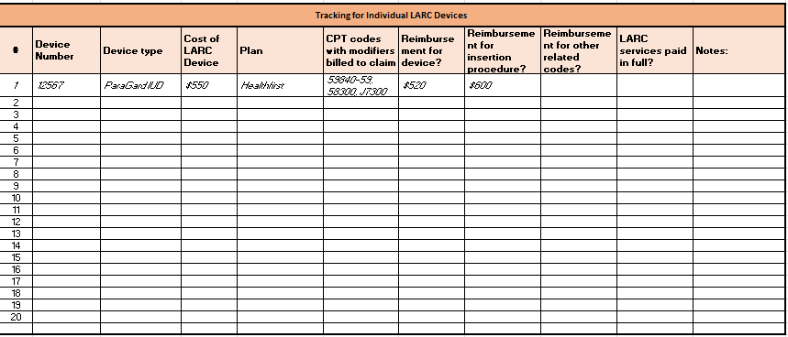
Sample Device Tracking
Ann Finn Consulting, LLC (www.annfinnconsulting.com)
Notes:
Facilitator Notes
Keeping track of trends in reimbursement, using a tracking sheet like this one, can help you identify common reimbursement issues.
This device tracking grid was created by Ann Finn of Ann Finn Consulting, LLC.
The tracking grid captures information about the device, device cost, insurance plan, what codes were billed, and was reimbursed, as well as any other notes.
This is a good way to identify requests of particular plans. Additionally, tracking this information can help you identify strategies and lessons learned for successful reimbursement. For example, if you see that one plan is not reimbursing what you expected, you can drill into what may be happening to cause that observation.

Slide 16
Common Modifiers for LARC
Modifier | Description
22 | Increased Procedural Services (not used on E/M)
24 | Unrelated E/M Service by the Same Physician / QHCP During a Postoperative Period
25 | Significant, Separately Identifiable E/M by Same Physician or QHCP on Same Day as Other Procedure or Service
51 | Multiple Procedures – same session and clinician
52 | Reduced Service
53 | Discontinued Service
59 | Separate Procedures or Distinct Procedural Services
76 | Repeat procedure same physician / QHCP
77 | Repeat procedure different physician / QHCP
79 | Unrelated procedure by the same physician or QHCP during the post-operative period (starting the day after the procedure)
Ann Finn Consulting, LLC (www.annfinnconsulting.com)
Notes:
Facilitator Notes:
Incorrect or missing modifiers can impact claim payment creating either an underpayment or an overpayment of services.
Here are common modifiers for LARC. You may need to check with individual plans and your state Medicaid program for additional guidance particular to those plans and to your state.

Slide 17
Same-Visit Modifiers
Modifier 51 Multiple Procedures
Modifier 59 Distinct procedural service
Indicates: Multiple procedures performed on same day, during same session
Indicates: Procedure or service was distinct or separate from other services performed on the same day
When choosing between modifiers 51 and 59, payer policy may be the determining factor
Typically payment is 50% for second procedure
Documentation should support the reasons for removal and reinsertion on the same day (e.g., IUD expired, wanted to continue with same method)
Ann Finn Consulting, LLC (www.annfinnconsulting.com)
Notes:
Facilitator Notes
Modifiers 51 and 59 indicate same-visit services.
When choosing between modifiers 51 and 59, the payer policy may be the determining factor. Some payers, including Medicare contractors, do not acknowledge modifier 51.
Though we should not code solely based on reimbursement, you should be aware that modifier 51 may result in a multiple payment reduction.
A multiple payment reduction happens when a provider performs multiple related procedures during the same visit, and the insurance company does not pay 100% of the fee schedule amount for both procedures. They may, for example, pay 100% of the fee schedule amount for the first procedure, and 50% of the fee schedule amount for the second procedure.
On the other hand, modifier 59 may trigger a front-end edit, and the payer may require documentation, which will inevitably delay claim reimbursement.
Modifier 59 is used to identify procedures/services, other than E/M services, that are not normally reported together, but are appropriate under the circumstances. Documentation must support a different session, different procedure or surgery, different site or organ system, separate incision/excision, separate lesion, or separate injury (or area of injury in extensive injuries) not ordinarily encountered or performed on the same day by the same individual. However, when another already established modifier is appropriate, modifier 51, not modifier 59, should be used. Only if no more descriptive modifier is available and the use of modifier 59 best explains the circumstances, should modifier 59 be used.
The intent of modifier 59 is to distinguish procedures and services that are "not normally reported together.” Unfortunately, payers often mandate use of modifier 59 in many other situations, resulting in payment denials and resubmissions.

Slide 18
Coding eLearning Course
Unit 1: The Fundamentals of Coding
Unit 2: The Coding Process
Unit 3: Advanced Case Studies in Coding
Link: https://fpntc.org/training-and-resources/coding-in-the-reproductive-healthcare-environment-1
Notes:
Facilitator Notes
There are several additional resources from the Family Planning National Training Center that can help Title X providers build skills in billing and coding.
One important resource is this interactive, three-part eLearning course on billing and coding specific to family planning.
Unit 1: The Fundamentals of Coding covers the purpose of coding. It also provides a broad overview of billing codes and describes how codes are used to document the services provided during a medical visit. Unit 1 is intended for beginner coding clinic staff who have never done medical coding before, or for anyone who would like a refresher course in basic medical coding.
Unit 2: The Coding Process examines the process for selecting preventive medicine and problem-focused evaluation and management (E/M) codes. The unit provides a framework for capturing all elements of a visit with the appropriate codes. The unit does NOT cover the types of codes in detail; rather, it shows how a list of questions can guide the process for determining codes. Unit 2 is intended for intermediate coding clinic staff who want to learn more about the nuances of selecting the appropriate code and capturing all the elements of a medical visit.
Unit 3: Advanced Case Studies in Coding provides a range of complex, reproductive health-focused case studies for coding staff. Unit 3 is intended for experienced coding clinic staff who would like to test their coding skills by going through reproductive health examples of complex cases.

Slide 19
Coding Podcast Series
Link: https://www.fpntc.org/training-packages/coding
Notes:
Facilitator Notes
There are also several quick refresher resources and support tools.
On the Clinical Training Center for Family Planning website, there are six 15-minute podcasts in the “Coding with Ann Finn” series. These brief podcasts support providers to code accurately. The topics of these coding podcasts include:
Outpatient evaluation and management (E/M) coding using time in a family planning context
Billing and coding for the contraceptive implant
Billing and coding for the placement and removal of IUDs
Common miscoding of LARC services that she sees throughout different agencies
ICD-10 changes impacting reproductive health services that went into effect October 1, 2016
Common codes for contraceptive services that providers should be aware of

Slide 20
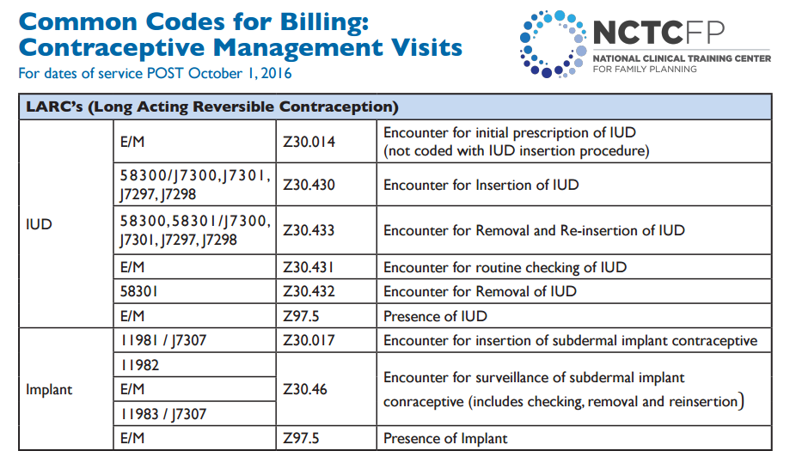
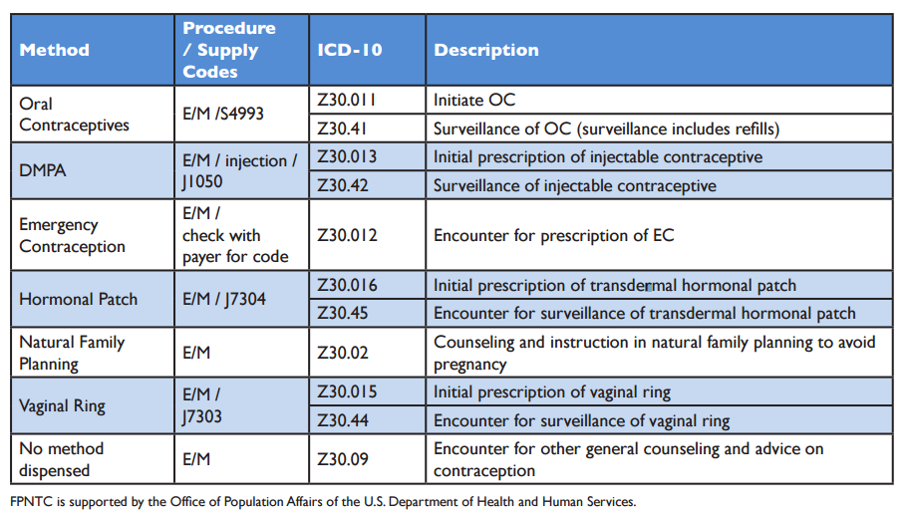
Coding Palm Card Job Aid
Link: http://www.ctcfp.org/billing-and-coding-pocket-card/
Notes:
Facilitator Notes
There is also a palm card, developed by the National Clinical Training Center. This helpful reference card contains common billing codes used in the provision of contraceptive services and is small enough to fit in your pocket or keep next to the computer.
Providers can use this to quickly reference procedure, supply, and ICD-10-CM codes for each contraceptive method.

Slide 21
Billing & Coding Toolkits
Link: http://larcprogram.ucsf.edu/
Link: http://www.upstream.org/partner-resources/administrative-tools/
Notes:
Facilitator Notes
Finally, there are a number of toolkits available to help providers and billing staff with billing and coding for family planning services.
One of this is called IUD & Implants: A Guide to Reimbursement, and was developed by the Universe of California San Francisco. This interactive guide aims to explain the landscape of public and commercial insurance coverage for LARC and serve as a resource for providers navigating stocking, reimbursement, and other scenarios that create barriers to the provision of these methods. The guide is intended to help alleviate financial challenges so that providers are better able to offer the full range of contraceptive methods and minimize out-of-pocket costs or delays in care for their patients.
Another toolkit is called Coding Guidelines for Contraceptives, developed by Upstream. It is a great quick reference tool that contains the latest guidelines on coding for contraception.

Slide 22
Self-Pay
Amy says she isn’t sure about using her parents’ insurance…
Notes:
Facilitator Notes
Let’s return to our case study.
Now let’s say Amy says she isn’t sure about using her parents’ insurance. She does not want an EOB sent to her parents’ home.
Discuss
What challenges do you have related to confidential billing?
How do you ensure confidentiality for patients (e.g., adolescents) who require it ?
How do you do this and still obtain reimbursement for methods (especially for adolescents)?
What strategies have you used to ensure no EOB is sent?

Slide 23
Confidential Billing Staff Workflow
Link: https://www.confidentialandcovered.com/file/ConfidentialandCovered_Staff-Workflow.pdf
Notes:
Facilitator Notes
It’s important to consider how you offer patients confidential services. Patients may not understand the implications of using or not using their health insurance. This diagram is an example workflow and includes a sample script that can help staff provide confidential billing to patients when requested.
This highlights the difference between confidential services and confidential billing.
Confidential billing does not automatically mean not billing. For example, in states where Medicaid does not send EOBs, patients can obtain services, and insurance can be billed. Private insurance companies may withhold an EOB on request.
All patients receive confidential services, meaning staff will keep their information private; but only a small number of people need confidential billing.
Provide insurance enrollment assistance for any available programs that offer patients confidential billing. For instance, some states have state family planning program options, so make sure you are aware of these options and fully utilizing them.

Slide 24
Strategies for Obtaining Low-Cost Supplies
Patient payment options
Self-pay / sliding fee scale
Payment plans
Low cost supplies
Group or bulk purchasing
340B pricing for some IUDs = only $50.00
Notes:
Facilitator Notes
Let’s say that Amy has actually told you that she doesn’t want to use her parents’ insurance. If Amy is not using her parents’ insurance, she’ll be “self-pay” for the visit. In this example, Amy is put on the sliding fee scale using her own income to determine how much she owes. Given this information, the cost of providing the method slides to zero.
What strategies do you use to reduce the cost of the methods, supplies, and services, so you can serve patients like this?
There are several strategies for obtaining low-cost supplies, that can help keep the cost of supplies down.
First is obviously the self-pay/sliding scale that goes along with the Title X requirements and with the requirements for a schedule of discounts, as described previously.
Payment plans may also be used for patients over 250% of FPL. Patients who want an implant or copper IUD are able to arrange staggered payment plans through Curascript or Teva Women’s Health, respectively. For an implant, a patient may choose to make three or six monthly payments. For a copper IUD, a patient may choose to make four or 12 monthly payments.
Another strategy is bulk purchasing or group purchasing agreements.
Finally, Title X can register to participate in the 340b Drug Pricing Program. There is more on the 340b Drug Pricing Program on the following slide. For example, one hormonal IUD is $50 with 340B pricing.
Discuss
Which of these strategies do you use to keep the cost of supplies down?
Which strategies are the most effective?
Are there other strategies that you use?
What are other challenges when it comes to obtaining low-cost supplies?

Slide 25
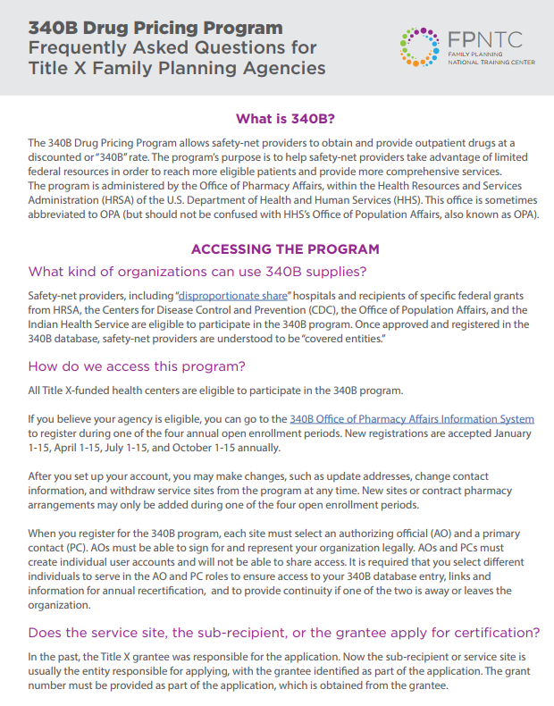
340B Resources
340B Drug Pricing Program: Frequently Asked Questions
340B Drug Pricing Program: Compliance Tips for Title X Agencies
340B and Medicaid: An Explanation for Family Planning Providers (NFPRHA)
Link: https://www.fpntc.org/resources/340b-drug-pricing-program-frequently-asked-questions
Notes:
Facilitator Notes
The 340B Program enables covered entities to stretch scarce Federal resources as far as possible, reaching more eligible patients and providing more comprehensive services. Manufacturers participating in Medicaid, agree to provide outpatient drugs to covered entities at significantly reduced prices.
To participate in the 340B Program, eligible organizations/covered entities must register and be enrolled with the 340B program and comply with all 340B Program requirements. Once enrolled, covered entities are assigned a 340B identification number that vendors verify before allowing an organization to purchase 340B discounted drugs.
There are a lot of questions about the 340B program. To help address these questions, check out these resources from FPNTC.org on 340B, including:
340B Drug Pricing Program: Frequently Asked Questions
340B Drug Pricing Program: Compliance Tips for Title X Agencies
340B and Medicaid: An Explanation for Family Planning Providers (a NFPRHA resource)

Slide 26
Use All Available Revenue Sources
4. Identify and access all available sources of revenue
Notes:
Facilitator Notes
The final strategy for utilizing diverse payment options is to identify and access all available sources of funding. State and local grants, from public or private sources, may be available to support family planning services. Donations from local partners are another possible source of income. (According to Program Requirements for Title X Funded Family Planning Projects, “voluntary donations from clients are permissible; however, clients must not be pressured to make donations, and donations must not be a prerequisite to the provision of services or supplies.”)
This also includes informing patients about device manufacturer payment plans and patient assistance programs (such as the ARCH program). The Access and Resources in Contraceptive Health (ARCH) Patient Assistance Program provides Bayer IUDs (Kyleena, Mirena, and Skyla) at no cost to women in the United States who do not have either private health insurance or Medicaid coverage for Bayer IUDs.

Slide 27
Success Story: Engaging Staff (Family Health Council of Central PA)
Quality assurance around billing and coding for LARC inserted same-visit
Developed protocol
Identified incorrect coding for some services
Formal training for staff—including clinicians, supervisors, clinician assistants, front desk and billing staff—stressed importance of accurate coding that led to increased reimbursement rates
Key point: All staff have a role to play in ensuring financial health of the organization
Notes:
Facilitator Notes
Now let’s look at a success story from the field. We know it can be valuable to see how are other Title X sites are implementing these best practice recommendations.
This is a story from a real site that participated in the Family Planning National Training Center (FPNTC) Performance Measurement Learning Collaborative. Their story was written up as a short case study, and included in the Contraceptive Access Change Package.
Family Health Council of Central Pennsylvania wanted to focus on ensuring reimbursement from third-party payers. They began by investigating what codes should be used and creating a protocol for how to bill LARCs inserted during the same visit to third-party payers. After reviewing the data, they discovered some quality issues in coding practices at its Lebanon Family Health Services site. Staff identified problems with incorrect coding for some services, and realized they were not always getting paid for services they had provided. This motivated them to institute a formal training for all staff—including clinicians, supervisors, clinician assistants, front desk and billing staff—on coding and billing procedures. During this training, the importance of accurate coding for the organization’s health and ensuring third-party reimbursement for services provided to patients with private and public health insurance were stressed. Through putting systems in place and providing additional training, they intended to keep monitoring and improving the accuracy of their coding.
Key point: All staff had a role in ensuring the success of the initiative; all staff play a role in ensuring the financial health of the organization.
Discuss (if time allows)
What opportunities exist for you to increase staff engagement and reduce cost as a barrier?

Slide 28
Success Story: Comprehensive Approach to Reduce Cost as a Barrier (Montana DPH)
Multifaceted approach to reducing cost as a barrier
Pre-verified patient insurance benefits prior to visit
Increased assistance for health insurance enrollment
Purchased and stocked low-cost IUD (Liletta)
Measured impact: Between Oct. 2015 and May 2016
Pre-verification of benefits increased from 70% to 100%
Utilization of most and moderately effective methods increased from 80% to 86%
Key point: A multifaceted approach to change enhances impact
Notes:
Facilitator Notes
This is a second success story from the field from a site that also participated in the FPNTC’s Performance Measurement Learning Collaborative, and is included in the Contraceptive Access Change Package.
Montana Department of Public Health and Human Services Women’s and Men’s Health Section took a multifaceted approach to reducing cost as a barrier, beginning with their sub-recipient, Bridgercare. This included pre-verifying patient insurance benefits prior to their visits, utilizing a sliding fee scale, increasing their on site assistance for enrolling patients in Montana’s Medicaid health insurance program, and purchasing and stocking the low-cost IUD (Liletta). Between October 2015 and May 2016, the percent of women 15-44 with pre-verified insurance information increased from 70% to 100%. Also over that same time period, the percentage of women using most- or moderately- effective methods increased from 80% to 86% and the percentage of women choosing LARC increased from 11% to 16%.
The key point: taking a comprehensive approach is needed to see real impact.
Discuss (if time allows)
What is one strategy that we’ve talked about today that you may want to adapt or implement to reduce cost as a barrier?

Slide 29
What other questions do you have? What other issues would you like to discuss?
Notes:
Discuss (if time allows)
What other questions do you have for each other before we end? Are there other issues or challenges that we haven’t had a chance to discuss yet? (Note to facilitators: If challenges came up in earlier discussions, this could be a good time to discuss them.)
Before we leave, what is one thing you will take away from today’s discussion? (Note to facilitators: Consider round robin sharing or ask a couple of participants to share.)

Slide 30
Thank you!
Contact:
fpntc@jsi.com
Notes:
Facilitator Notes
Thank you for participating in today’s discussion.
If applicable, you can contact me at:_________
You can also always contact the Family Planning National Training Center (fpntc@jsi.com) with questions/comments.

