Slide 1
The What and Why of Systems Mapping for TPP Programs
Sheri Marlin
Waters Center for Systems Thinking
Tucson, AZ
Notes:
Yvonne Hamby: Hello, everyone. This is Yvonne with the Reproductive Health National Training Center, and I'm so excited to welcome you all to today's webinar, The What and Why of Systems Mapping for TPP Programs. I have a few announcements before we dig in to our exciting presentation today. Everyone on the webinar is muted, given just the large number of participants that we have joining. So we plan to have time for questions towards the end of the webinar, where everyone can verbally share thoughts, share questions, but you can always ask your question using the chat at any time during the webinar. And we'll be monitoring that to be able to highlight any questions that are really coming up that we would want to highlight. We'll also be asking for your participation at a few points during the webinar, and we'll hope that you'll join in and share your responses via chat. And a recording of today's webinar, the slide deck, and a transcript will be available on rhntc.org within the next few days. So if you have any colleagues that weren't able to join us live, please know that these will be available for you to share with other colleagues. We'll be chatting out the evaluation link if it hasn't already gone out so that you have it to reference. It's always nice to have that. It'll also pop up at the end of the webinar. And please do share your thoughts. Your feedback is extremely important and has enabled us to make quality improvements in our work based on your feedback at the end of webinars. Please take a moment to open the link, and so you have it, and you can complete that evaluation in real time. And then just know that this presentation was supported by the Office of Population Affairs and its contents are solely the responsibility of the authors and do not necessarily represent the official views of OPA, OWH, or HHS.

Slide 2
Learning objectives
By the end of the session, you will be able to:
Understand how systems mapping can help you describe your TPP project's system
Describe how to use a systems map
Create a systems map for your project
Why do you want to learn about systems mapping?
Notes:
Yvonne Hamby: So we'll go to the next slide and kind of hone in on what we're hoping to accomplish today together. Like I said, we're excited to continue this journey. This is the third and final webinar in our series around systems thinking. And again, it's looking at systems mapping. And I want to share that this webinar content was developed for a TPP program audience, but we recognize that we might have folks from other areas who registered for this session and you may not be affiliated with the TPP program, and that's okay. We're happy that others would love to join us and learn about systems thinking and systems mapping in particular. Just keep in mind that the presentation is tailored for our TPP audience and with examples and discussion points, but I think it can be helpful and applicable to all who have joined us. And with that in mind, at the end of this webinar, we hope that you'll be able to understand how systems mapping can help you describe your TPP program's system or TPP project's system, describe how to use a systems map, and then create a systems map for your own project. So before we get started, let's do a quick chat to help us understand how you would like to use mapping to better understand your program. And of course, there's no wrong answers, 'cause we're all coming at this with our own learning and history. So, why do you want to learn about systems mapping and joining us today? And please, put your answers in the chat. And we'd love to get a sense of why you're joining us.So while you're putting in your responses, we'll go to the next slide.

Slide 3
Presenters
Sheri Marlin, She/Her
Waters Center for Systems Thinking
Vicki Draeger
Life-Skills, Empowerment, and Development Services, Inc. (LEADS)
Notes:
Yvonne Hamby: And I'm excited to introduce you to our guides during this webinar today. I know for those of you that might have been joining us, have joined us for the other two webinars around systems thinking, you've met Sheri from the Waters Center for Systems Thinking. And she's been such a wonderful guide on this journey with us in helping us learn about systems mapping. And we feel very fortunate to have Sheri. She's the Chief Learning Officer for the Waters Center for Systems Thinking, and she writes, speaks, and collaborates with others to apply systems thinking in a real-world context. She's taught preschool through graduate school and has worked as a building principal and district curriculum specialist. So we're so excited to have her with us. And we're equally excited to have Vicki Draeger who is a fellow TPP program. And Vicki holds a doctorate in Curriculum and Instruction and is the author of "Kids, Quarks and Quanta" with a foreword by Nobel Prize-winning physicist, Dr. Leon Lederman. She was the finalist for the Albert Einstein Distinguished Educator Fellowship for the US Department of Energy. And Dr. Draeger was the founder and former CEO of LEADS, the TPP program in St. Petersburg, Florida, providing teen pregnancy prevention programs to youth ages 11 and 18. We're so excited to have her join us and provide a real-world example of how systems mapping can help us in understanding our programs. So I'm going to check in with Megan and see if there's anything you would like to highlight with folks joining us and what they would like to learn about systems mapping.
Megan Hiltner: Absolutely. And we've got a lot of continuous excited, curious learners in this group, folks wanting to learn new tools for complex concepts, ways to apply critical systems thinking frames, just folks excited to learn. Love it.
Yvonne Hamby: Awesome, awesome. And before I hand it over to Sheri, we have a super exciting announcement for those that are really looking to dig in with systems mapping and systems thinking. We'll be launching a systems thinking peer learning group in October. So following this webinar when we send out all of the materials from this webinar, we'll also send out information about that peer learning group and registration information. So we really hope to see you there. And it's really going to provide you an opportunity to continue learning from your peers and really apply that systems thinking lens to your sustainability planning, as we're going into the final year of funding. So we're really excited to share that information with you and launch that in October. And Sheri will continue to be our guide through those peer learning group opportunities. So with that, I'll hand it over to Sheri.

Slide 4
Part 1:
Systems Mapping Explained
Notes:
Sheri Marlin: Thank you. Thank you, Yvonne. It's, again, a pleasure to be with you. We have had two previous webinars, and so I'm going to kind of just do a brief highlight of those. The first one, if you were with us, was about mental models. And I would make the assertion that mental models actually are a type of a systems map because they're the most fundamental level. We have to surface those, we have to see those in a visual way. But because we're really good at yapping about what's in our head and what's in our brain, we need some tools to be able to translate those onto paper. So as I watched the chat, and that question was super helpful, some of you really do just want to think about systems and almost the iceberg as a model, which is a type of systems modeling, and how you put the tools and the habits together to look at your system in a specific way. Last time we talked about feedback loops and causal connections. Causal loops and feedback loops are interchangeable terms. We'll try to use causal loops as much as we can, but it's a feedback loop. And that also is in that chat, that what's driving our system, what's causing a limit on our system, and we call that reinforcing and balancing feedback, respectively. So what we're going to do today is we're going to do a systems map that's called sort of a multiple loop or causal connection circle map. The other type of systems maps that you might be familiar with are stock-flow maps, which are super helpful. I was in a coaching situation with an early childhood professional just before jumping on and she's like, "What tool would I use to really look at workforce development?" And we dove right into the stock-flow map. So I'll just put another plug for that PLD.

Slide 5
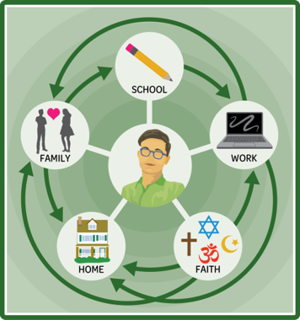
Maps that make connections
Notes:
Sheri Marlin: We can do some of those really specific tools, but the connection circle that we're going to look at today, this is one of the habits of a system thinker from the Waters Center. And this habit says that a systems thinker makes meaningful connections within and between systems. So this illustration helps underscore that idea of what this important systems thinking principle is. What is not is truly a connection circle. And I will say that, as we work and I give some instruction and as you work with your facilitators and groups to actually build a map around a TPP challenge today, that probably the most difficult thing is identifying the variables and wording those variables in a way that they don't have qualifiers, that they have dynamics to them. So we worked on that last time. And hopefully, some of you were in that webinar, you have some recollection of those, and you'll bring that knowledge and that information when you go to build your map in a few minutes. But if we were to take this illustration that you see in the slide right here and make it into a connection circle, it would be things like my level of enjoyment for school, my satisfaction at work, number of days attending school. So there would be something that was changing. So for example, the connection to my family, family support. So as family support goes up, engagement in school goes up. And those are the kinds of connections that you're going to be making.

Slide 6
Connection circle: example 1
Connection Circle Diagram containing 9 boxes that connect to one another.
Box 1: Teacher training on best practices. Connects to box 5.
Box 2: Local demand for early childhood care & education. Connects to box 4.
Box 3: Resource allocation.
Box 4: Access to high-quality environments. Connects to box 8.
Box 5: Classroom quality. Connects to box 6.
Box 6: Family engagement. Connects to box 5.
Box 7: Informed policy making.
Box 8: Preschool deserts.
Box 9: Quality outcomes (findings).
Notes:
Sheri Marlin: I'm going to show you an example, not from a TPP setting, but just to really specifically show what you are going to be doing, and more importantly, what you're going to be listening for as Vicki shares some of her story in just a few minutes. So if this was, again, early childhood and they were looking at really that issue down there of preschool deserts, how do we eliminate, how do we make sure that every child has access to high-quality early childhood care and education? So they brainstorm some variables. And you remember I just mentioned identifying these variables is pivotal. Teacher training on best practice, resource allocation. We always think that one's going to be key. You notice in this initial draft, that one didn't even get mentioned yet. And what you see here are also two colored arrows. We're going to use those today because that's going to help us move from just a causal connection circle to an actual causal loop and be able to close some loops. So this story that I could tell from this says that as local demand for early childhood care and education goes up, access to high-quality childcare environments goes up. As family engagement goes up, classroom quality goes up, and the equal part of that is that as classroom quality goes up, family engagement goes up. The yellow arrow suggests connections that are going in an opposite or more of a balancing direction. So as access to high-quality environments goes up, preschool deserts goes down. Those are going in an opposite direction. Physically using your thumbs is a perfectly acceptable way, particularly in this learning stage, to see if those are going in the same direction or the opposite direction.

Slide 7
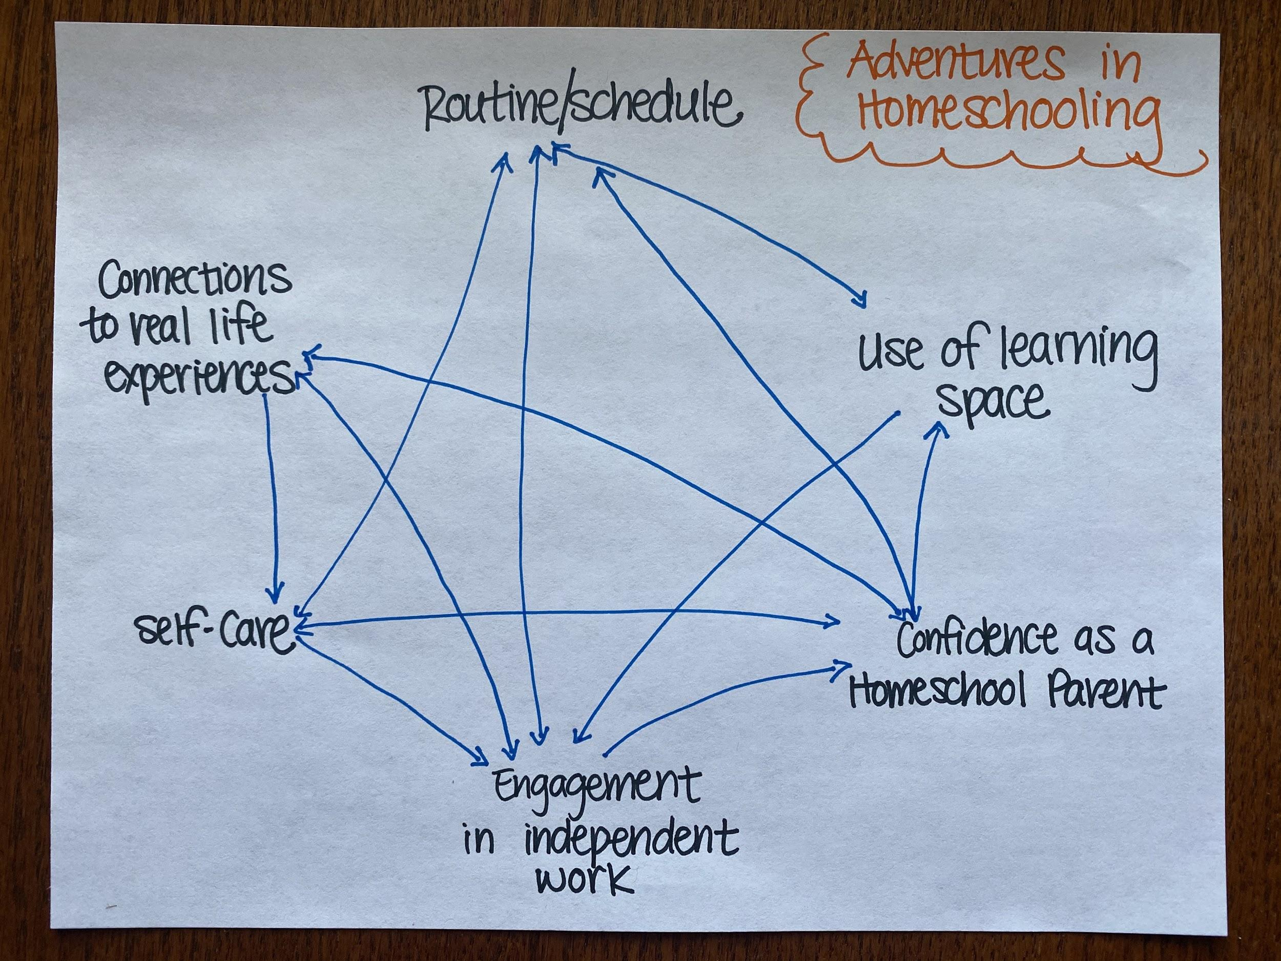
Connection circle: example 2
Notes:
Sheri Marlin: Now, I want to show you one more example before I turn this over. This is an example of a parent who found herself at the beginning of the pandemic in the throes of homeschooling. And this was a systems thinking parent who said, "This is driving me crazy, so I want to look at my system." Just exactly what you said in your early chats. And so she found some things, she didn't use the two colors here, but some things that reinforced. So that the more her routine and schedule was put in place, the better she was able to use the learning space that she had available in her home. And conversely, the more she used that space well, the more her routine and schedule fell into place. She found a connection between when she was able to make connections in that learning for her students, it increased her confidence as a homeschool parent. And as she had more confidence in homeschool parent, she was more maybe to deviate from those lesson plans that were coming home from the school in order to help her children make those real-life connections. So she found a lot of reinforcing feedback. And when she had taken a minute to look at her system, she was excited and she sent us that example. So those are two unrelated examples, just to give you very quickly an idea of what this connection circle mapping is all about. Now, usually, and Yvonne and Megan know, I cringe at my introduction, but today it was meaningful, because when it said that I write and collaborate with people in order to help them do their best thinking, today I'm so excited we're going to get to hear one of those stories. So I was privileged to travel and to meet with Vicki's LEADS group in Florida, met with them virtually, met with them in person. And she's going to share that story of how some of the systems mapping that you're going to do today played out and how it impacted their work. So Vicki, take it away.

Slide 8
Part 2:
Using Systems Mapping in a TPP Project
Notes:
Vicki Draeger: Okay. Well, very happy to be here. This is all exciting. Looking forward to sharing this information with you. We can go to the first slide. I'm not changing slides.

Slide 9
Who is LEADS and what do we do
Relatively new agency, founded in 2017
Provides LOVE NOTES SRA effective program to primarily Black American youth ages 11–19 in six Florida counties
Services are conducted in community settings
Notes:
Vicki Draeger: Okay. So LEADS is Life-Skills, Empowerment, and Development Services, which is way too long in a name, so we just go by LEADS. What we do is basically we're a relatively new agency, we were only founded in 2017, and we got our first grant, which was a TPP grant, in 2019. And we really hit the ground running. We use Love Notes SRA EBP. And we work primarily with Black American youth ages 11 to 19. We do middle school and high school, and we're in six Florida counties right now. And services are conducted in community settings. So we're in Black churches, we're in African American schools that are connected with Black churches. We're not really in the public school system. We work at community rec centers. We just make as many community connections as we can. So we're a community-based organization.

Slide 10
How we got started with systems thinking
Contacted the RHNTC for further information and support
  They had excellent tools, and also put us in touch with the Waters Center for Systems Thinking
Contacted the Waters Center, where we met Sheri and began our deep dive into systems thinking
Notes:
Vicki Draeger: We got started with systems thinking because it was in the TPP FOA. And I did not know, I knew something about it, because in 1994, when I first arrived in Hawaii, where I worked with an indigenous population for 15 years, I was introduced to Peter Senge's book, "The Fifth Dimension". And it's very much involved with systems thinking. But I hadn't really used it a lot. And so I researched it a lot to be able to write our grant proposal, but I didn't want to just to have it out there as a grant proposal thing, I wanted to really dig into it, know about it. So I didn't know where to start. And then somebody suggested RHNTC, and I contacted them for further support. And they had some excellent tools. And they also put us in touch with the Waters Center for Systems Thinking. And we contacted Waters Center, and that's where we met Sheri and we began our deep dive into systems thinking.

Slide 11
All staff systems thinking training
Notes:
Vicki Draeger: And the rate we did this was we started off with virtual because we are in six counties. And Sheri did two hours, two-hour sessions for four weeks, one a week. So we had eight hours of virtual training. But I'm a people person and I pretty much had it with everything being virtual. So we brought everybody together from the six counties to Orlando, which was a central location for us. And this is a picture of some of our staff. We brought all of our facilitators, all of our community project coordinators, our administrators. We brought everybody together for this training. I thought, oh, ain't I wonderful? I brought everybody together for this training. And then I realized, guess who I didn't bring into the systems thinking training, which was a big mistake, was our board of directors. And I am going to make sure that our board of directors get systems thinking training, because systems thinking also informs your policies and your procedures, which have to be approved by your board. And so everybody in your organization, from the president of your board down to whoever, I mean, nobody is lowly in our organization, they're all wonderful, but everybody, facilitators, CPCs, administrators, and board of directors, all need to have this training. Well, we had everybody here but the board. So let's go next.

Slide 12
Team alignment on youth R&R challenges
Notes:
Vicki Draeger: And one thing that's super important in any organization and is a bedrock part, I think, of systems thinking is team alignment. And here we worked with people that were working in six different counties. So we had to try to bring them together, and we did. And they felt so, I think, empowered to be brought together and working on the same thing. And let's see.

Slide 13
Opportunities to improve youth R&R
Ensure facilitators are relatable to project participants
Include personalized and targeted messages in the communication strategy
Develop and leverage the right partnerships to facilitate outreach
Implement new youth engagement strategies to encourage active participation during class
Invest in peer-to-peer outreach to improve recruitment and retention
Notes:
Vicki Draeger: We're going to have more trainings after this training. I did a little review for people down the line, because this systems thinking thing has to become a part of you. It can't just be, I'm going to haul out my systems thinking notes or my habit cards now, you have to kind of know those things, and that takes a while, that's a process. So, but we worked on opportunities. We came up with our question, and we wanted opportunities to improve our recruitment and retention. And after doing all this, what we came up with was that we wanted to ensure that our facilitators were relatable to the project participants. To do that, we recruit our facilitators from the communities that we serve. So since we're serving young African Americans, we wanted young African American facilitators, not teenagers, but young that could relate to these kids, and we hired them from the communities that we serve. We include personalized and targeted messages. These are all things that came out of our maps to include personalized and targeted messages in the communication strategy, and then to develop and leverage the right partnerships to facilitate outreach. Okay, so when you work with TPP, you get the idea that they want you to have a lot of partnerships. And so we have like 32 MOUs. But then we looked at that, and it's not about the quantity of MOUs, it's about the quality of your MOUs. We went back and we looked at our partnerships strategically, and we're strategically addressing what partners we're seeking. And then to implement new youth engagement strategies to encourage active participation during class. All these times, we think we're doing these things, but you have to think about it more intentionally. And the kids will have name tags, or they'll make little things with their name on 'them, but we want our facilitators to make a concerted effort to learn those names and to use their names when they're calling on them during discussion and to give them positive feedback, not general feedback, oh, that was good or that was interesting, but I like the way you said such and such. So you're being very specific and that's very encouraging to kids. And also invest in peer-to-peer outreach to improve recruitment and retention. So we're working on developing our youth advisory board and in training some youth to be co-facilitators. Next.

Slide 14
Action steps to improve youth R&R
Create a clear and concise “pitch” or mission statement
Update the website to be more inviting
Create an Instagram account
Link all counties on one social media platform
Create great communication materials: flyers (including for community partners), letter for recruitment
Create a marketing kit brochure
Write a letter to parents to build buy-in and invite their questions/concerns; tailor message to fit county target populations
Ensure all communication outlets state the same tailored message for the county
Reach out to community partners
Reach out to former participants
Reach out to other organizations that offer youth programs to give information about LEADS
Reach out to community leaders to form partnerships
Reach out to retailers to form partnerships
Reach out to stores to provide snacks for youth
Reach out to local church for parent communication/buy-in
Network with other organizations and community leaders
Notes:
Vicki Draeger: So, huh, after all this, we came up with action steps to improve it, and look at all the action steps we've come up with, and this isn't even all of them. But the good thing is that we've actually been able to go down this and to do any number of these things. So go to the next one.

Slide 15
Part 3:
Practicing System Mapping
Notes:
Vicki Draeger: Okay, this is the next part, but just let me conclude by saying that we want to look at the big picture. That's so important to anything with systems thinking. And LEADS has actually changed our mission statement as a result of this training and this kind of thinking. Not our mission, just our mission statement, because our mission statement before was to educate children, empower families, enable equitable communities, and embrace diversity. And then, by looking at the big picture, we could see that actually our mission is to strengthen families in the communities we serve. And that's the big picture. It incorporates all those things that were in our mission before, but it's so much simpler. To strengthen families in the communities we serve, that was one of the outcomes of our training in using systems mapping. I'm done.
Sheri Marlin: Thank you, Vicki. That, again, was a great process. And you summarized two, it was almost two full days that we spent going through those maps, making those causal connections, and identifying the variables. And so we're going to give you that opportunity in 20 minutes to do what Vicki's team took two days to do. But hopefully that will give you a taste of what it means.

Slide 16
Choosing variables
Considerations
Elements of the story change over time
State in terms that can go up or down
  # of
  % of
  Level of
  Quality of
Avoid qualifiers
Examples
% of students who complete the curriculum
# of projects available statewide
Level of sponsor buy-in for project offerings
Level of access to PD offerings
Quality of PD opportunities
Notes:
Sheri Marlin: I've sort of talked about causal connections, and we reviewed that last time, we're going to use the thumbs. So I really want you to begin to think if in your own mind, and maybe even make some notes to prepare you for the breakout room, as you think about wrestling with this question. And again, this is very specific, a TPP question, but hopefully those of you in other areas, you'll connect to how this might look in your work. But that challenge, how do you meet enrollment requirements and retain, recruit? What are some of those variables? So as you write the variables, it's important to consider that it's something that changes over time. It has to have a dynamic component to it. You want to state it in terms that can go up or down. Sometimes we refer to variables as accumulations, and again, in our English frame of that word, we think of accumulations as increasing, but it actually suggests something that can go up or down. So the beginnings that sound like number of, percent of, level of, quality of. Think about those grant reports you write, all right? You're using those kinds of measures all the time. That's also going to help you avoid, I was afraid of that, that's going to help you identify your very best variables, and in so doing, I am going to encourage you to avoid qualifiers, because qualifiers, again, it's just going to be hard to go up and down. So here are some ideas. You're going to have maps that actually have, connection circle maps that have some variables that in consultation with Vicki and Yvonne and others in your world make sense for this idea of TPP recruitment, but you'll also have the opportunity to modify them or to add some, but if you add some, I'm really going to encourage you to take some away. Here's a key component of systems mapping. You have to set some boundaries on the system. Recruitment and retention of students is big. Vicki was really good about being specific about her population, African American students in specific counties within Florida. So when you actually go to your systems to do this mapping, setting up those boundaries is going to be a really important part and important task. So in your small groups, you may even choose to set some constraints. Maybe somebody really has a question they want to wrestle with, and so they're going to say, can we focus on? And that's perfectly acceptable. Likewise, you could easily generate 25 variables in the time that you have in this group, and it's not going to be helpful, 'cause it's going to be too much to really look at. This is probably one of the key adages in model building, so I'm going to put it out on the table right here. George Box said, "All models are wrong, some models are useful." So when you think about systems mapping and systems model building, let's keep those egos in check. Everything new today is going to be wrong, it's based on limited information. We don't always have the data. We certainly can't know what's going on in people's minds all the time. But when we take our mental models and we put them on paper, then we can get some useful conclusions, some action steps, just like what Vicki just shared, and that's the power of modeling.

Slide 17
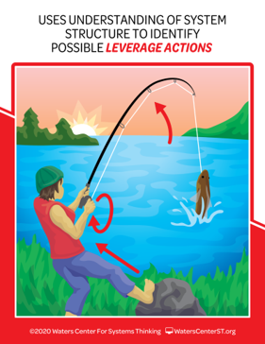
Finding leverage
A circle labeled “4” contains 4 arrow pointing out of it. Text reads “Count the arrow tails for each post-it”.
Notes:
Sheri Marlin: So another reason that we model is that it can help us identify leverage. Here's another big systems habit. A systems thinker uses and understands possible leverage actions. They use the structure of the system to identify leverage actions. So as you draw these causal connections, circle maps, in just a few minutes, notice where the tails are, okay? Notice where the tails are. And this is not absolute, it certainly isn't true every time. But oftentimes, we did this with Vicki's group, where you find a lot of tails, that tells you that that's the potential for leverage, because it's influencing a lot of things. So if I looked back at some of those number of students enrolled, if that affects number of students who complete, number of word of mouth referrals, number of satisfaction surveys completed, then all of a sudden, number of students enrolled becomes a powerful, important variable. So looking at those number of tails can be helpful. Now, if you have one variable that has all the heads at it, typically that's what you're focused on. So it might be, I think, and I wouldn't be talking out of school to say in Vicki's case like completers, a lot of arrow heads went to completers, because that was an important component. And so we're looking for things that increased that role. All right.

Slide 18
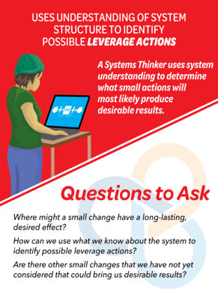
Questions for finding leverage
Identify the connection circle variable
with the most arrow tails.
Is this variable within your circle of influence?
If so, how can one small change in
this variable impact the whole system?
Are there other variables that are influencing this one?
Notes:
Sheri Marlin: And some questions to find. Leverage your facilitators. Have these, they can go through them with you. Again, that's the purpose.

Slide 19
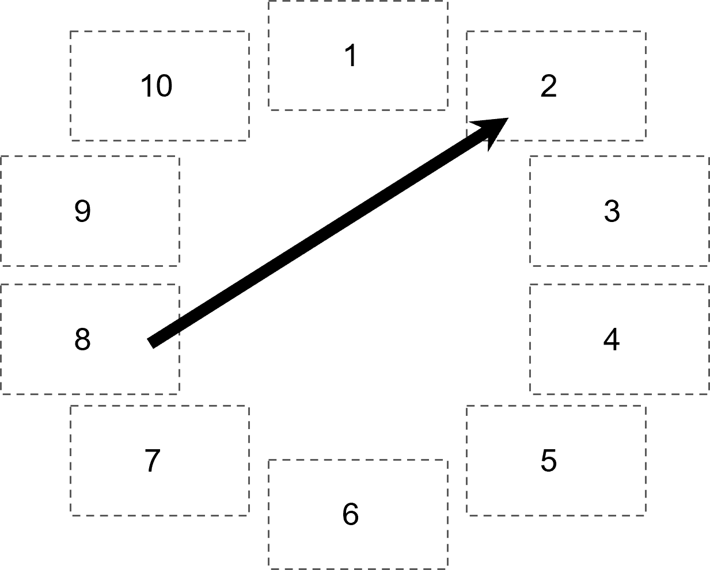
Creating connection circles
Use arrows to make connections between variables, showing how a change in one element causes a change in another element
Make as many connections as you can
Tell the story of each connection
This arrow shows that a change
in #8 causes a change in #2
Notes:
Sheri Marlin: Here's one last slide of directions. This is what you're going to do. John's going to put you in a breakout room in just a moment. You are going to work with a facilitator. You've got some variables there to get you started. You can change them. It's in a mural board, so I'm going to be able to watch all of these unfold. We'll be back here at 10 minutes of the hour where we'll take some questions and talk a little bit more about the ways that we're going to wrap up and you can get access to these materials going forward. So we'll see you back in 20.

Slide 20
Q&A
What questions do
you have?
Notes:
Sheri Marlin: Are we all back? It looks like we are. So that was, I'm very much fascinated by your connection circles. You all did great work. I see many variables there and some commonalities. If I have the benefit of seeing all of them, like, again, lots of arrow heads on all three into quality of instruction and a lot being relative to the number of arrows on each map. But again, you're looking at recruitment. So it wouldn't always occur that a focus of recruitment and retention is quality instruction. Now it might, because you're seasoned in that area, but that's a really interesting connection. I also have to say, Ilana, group three, you guys had the most closed loops, the quickest. So you guys really were into finding the loops and the feedback. And where is it reinforcing? Because sometimes, and that's, I think, one of the real benefits of this, is we drive on enrollment, enrollment, enrollment, and we need to say, what else will feedback into a system that will eventually increase enrollment? We do that with achievement in education. We haven't, and there are even authors who've written about the laser-like focus on student achievement, and it's not always done so well for us in all groups and in all populations. So I thought that was very interesting. Number of students completing. Again, in map three, you guys, that was the one that had your most arrows there, but that was the subject of the map. Calling out group two for getting that reinforcing and balancing feedback, asking those hard questions. So things don't reinforce forever. What's going to cause us to balance? And that connection makes perfect sense. That the more programs you have statewide as programs go up, instructors are going to go down, because there's only so much time and so much availability. And then I did see that the quality of professional and development was super important. And then, again, cheers to group one for adding a variable. So, what about the marketing plan? How does that factor into it? And that's a reality. That if we want students enrolled and we want them completing, we want that marketing plan. And great. So, any questions at this point? I'm looking at chat. Or from Megan, Yvonne, Ilana, do you have anything that was a question in your group?
Megan Hiltner: It was just, I do have one. I'm wondering, I don't want to put you on the spot, Cordell, but Cordell was sharing a bit about how they've engaged youth at LEADS in the systems thinking process. But I think where we went was just to get, if we're talking about youth engagement and understanding from them, getting them involved in this mapping would be so key to get their perspective. And he was sharing about more how they did it. And then we got brought back to the room, but it looks like he put in the chat sort of how they've engaged folks through that sort of survey process. So just wanted to validate that and appreciate that creative sharing. It seems like a fun process, Sheri, to get youth involved in as far as mapping goes. Just a really backstage way to stimulate creative thinking process.
Sheri Marlin: Cordell, I hear you. I don't want to cut you off yet again if you want to say something. But, Megan, I think that's a great thing that we didn't have formally included in here, but getting the right stakeholders in the room is absolutely critical. And we had a good laugh at that quote that all models are wrong, but the more you get the right people in the room, the more likely you are to get closer to the model that you want. And then I will comment, yes, students, we have done all kinds of incredible models with student groups around the country. I can assure you that they don't need a lot of formal instruction, you just help them identify some variables, they will begin to draw some connections. The social systems lab at Wash University does a community outreach program with teenagers every summer and have tackled some super difficult issues like gun violence and racial tension within the high school. And this has been the process. Again, it's a visual way, it puts on paper really highly emotionally charged words and feelings in a way that we can see that system and take high-leverage reasoned actions. And that's a pretty powerful way to think about these tools. So I think that that puts us right where we want to be. This is a system that you can learn more about. It's a journey, we're always getting better. I'm getting better at building the models, at helping groups build the models. Your facilitators are in a practice process. Vicki was very transparent. We just dove in and we are just doing more and more, getting better and better, involving more and more people, and that's what systems mapping is all about. So Yvonne, I'll turn it back over to you. And thank you for letting me share with you yet again. It's a privilege.

Slide 21
How to Engage with Us
Subscribe to the RHNTC Monthly eNewsletter at rhntc.org/enewsletter
Contact us on rhntc.org
Sign up for an account on rhntc.org
Follow us on Twitter @rh_ntc
Subscribe to the RHNTC podcast
podcast.rhntc.org
Notes:
Yvonne Hamby: Thank you. Thank you. Thank you so much, Sheri. I learned with every opportunity I have to learn from you, I learned so many new things. So thank you again for joining us. If you all are just, you now have the itch that you need to scratch to learn more about systems thinking, you can always request TA for systems thinking for your program. And another plug for the peer learning group that's going to launch in October, please be on the lookout for that registration announcement and consider registering for that. I think it'll be a really nice way to get hands on and really apply these concepts and tools to a real-life need that you have around sustainability planning. And you'll get an opportunity to learn from Sheri, as well as your peers. So please do think about joining that. And before we go in our two minutes, we'd love for you to chat in, how will you apply what you learned about systems mapping today? And if you'll just share that in the chat. We save these chats. It's always nice to see that information.

Slide 22
THANK YOU!
Please fill out the evaluation form after the webinar!
CONTACT US
rhntc@jsi.com
This webinar was supported by the Office of Population Affairs (Grant TPSAH000006). The views expressed do not necessarily reflect the official policies of the Department of Health and Human Services; nor does mention of trade names, commercial practices, or organizations imply endorsement by the U.S. Government
Notes:
Yvonne Hamby: And thank you again for joining us. And all the materials and the recording from today's session will be available in the next few days on rhntc.org website. We've chatted out the evaluation. You'll also get the evaluation link emailed to you. So please give us feedback. If there's things that we've done well or we could do differently, we want to hear about it. And just, again, thank you for joining us and being such an engaged group today. And we do have a minute, so maybe we can, I was just going to scan and see. We had some people share what they were going to do, and one person had shared, Nicole had shared that she's going to use this to think about the connections between different innovations in their network. Awesome. That's an awesome way to utilize, and it's nice to hear how you're going to use it back in your program planning. Anyone else want to chat in or share or have anything you would want to share before we sign off today? We have right about a minute. Well, again, thank you for joining us. It was nice. It was a nice way for me to be able to apply the mapping and doing connection circles. So thank you for joining me, and we'll see you soon.

