Slide 1
Teen Pregnancy Prevention Program: Materials Review Process
February 1, 2024
Notes:
Annie:
Hello! Welcome to the Teen Pregnancy Prevention Program Materials Review Process Webinar. My name is Annie Kim with the RHNTC, or Reproductive Health National Training Center.
We know your time is valuable and limited and we want to thank you for joining us today. Our hope is that you gain insight from your fellow grantees about the TPP materials review process and that you get up from your desk following the webinar knowing a little bit more about OPA’s materials review expectation and that you feel more confident about meeting this expectation.

Slide 2
Webinar objectives
By the end of this session, participants will be able to:
Describe the TPP materials review expectation and where to find resources related to this expectation
Describe at least two ways that other TPP Program grantees have implemented the TPP materials review
Identify at least two strategies or resources to support developing a materials review process
Notes:
Annie: By the end of this session, you should be able to:
[Prompt for bulleted points overlay]
Describe the TPP Materials Review Expectation and where to find resources related to this expectation
Describe at least two ways that other TPP Program grantees have implemented the TPP Materials Review
Identify at least two strategies or resources you may want to use to support developing a materials review process

Slide 3
Disclaimer
The views expressed in written training materials, publications, or presentations by speakers and moderators do not necessarily reflect the official policies of the Department of Health and Human Services; nor does mention of trade names, commercial practices, or organizations imply endorsement by the U.S. Government.
Notes:
Annie: Disclaimer - the contents of this webinar do not represent the official views of OPA.

Slide 4
Presenters
Angie Fellers LeMire
TPP TTA Provider & Grantee Liaison
RHNTC
Annie Kim
TPP Program Assistant
RHNTC
Notes:
Annie:
I’d like to briefly introduce our facilitator today:
[Prompt for Angie to join split screen]
Angie Fellers LeMire is a Senior Consultant and Training and Technical Assistance Provider, as well as a Grantee Liaison with JSI and has 25 years of public health and sexual and reproductive health experience. She previously practiced as a nurse practitioner. Prior to joining JSI, she was the Program Manager and Nurse Consultant for Colorado’s Title X Family Planning Program Nurse Consultant. Her passions and expertise are focused on sexual and reproductive health equity, increasing contraceptive access, scopes of practice, public health workforce, and public health nursing leadership.
Angie will be joined later by two TPP grantees. Jennifer Todd is Director of UT Teen Health at the University of Texas Health Science Center at San Antonio and Latrece McDaniel is Project Director at Bethany Christian Service of Michigan. Both Jenn and Latrece will share their experiences in developing their materials review process.
I’ll pass it off to you Angie!

Slide 5
An Overview of the Materials Review Expectation
Notes:
Angie: Let’s begin by briefly reviewing the Materials Review Expectation.

Slide 6
Materials review expectation
Materials and information disseminated through TPP projects must be responsive to the needs of and appropriate for the community and population of focus.
Notes:
Angie
Read the expectation on the slide first
TPP grantees are required to review and update all materials and information associated with their programs at least once a year. Materials must be: age appropriate, medically accurate, culturally and linguistically appropriate, trauma-informed, and inclusive. You can find the full guidance in the following documents: OPA’s Materials Review Guidance for TPP Tier 1 Grantees and OPA’s Materials Review Guidance for TTP Program Tier 2 Rigorous Impact Evaluation grantees. You can also find additional materials review guidance intended to provide information about the OPA materials review expectation on Connect.gov.
[Slight pause for overlay]
These guidance documents were published in September and November, respectively and are intended to provide information about the Office of Population Affairs (OPA) materials review expectation, why it is important, and how to demonstrate to OPA that the expectation is being met. It also walks grantee recipients through how to conduct these reviews, gives recommendations, exhibits a sample materials review form, and includes helpful resources. Hopefully, this webinar provides an additional way for grantees to learn about this specific Expectation.
Materials and information covered by this expectation include, but are not limited to materials associated with evidence-based programs or innovative and promising interventions, for example: facilitator manuals, scripts, participant booklets, and videos, as well as supplemental materials and information, such as pamphlets, handouts, facilitators’ and answers to participant questions.
Materials and information used, shared, and disseminated with participants and/or the community, such as web content, social media posts, podcasts, presentations, newsletters, and posters should also undergo the review process.

Slide 7
Materials review criteria
Medically accurate
Age appropriate
Culturally and linguistically appropriate
Trauma-informed
Inclusive
Notes:
Angie: Tier 1 grantees, Tier 2 grantees, and any of their partners must ensure all materials used and information disseminated within the funded project are age appropriate and medically accurate. OPA also expects recipients to make materials and information culturally and linguistically appropriate, trauma-informed, and inclusive.

Slide 8
Why conduct a materials review?
Ensures that EBPs or innovative and promising interventions are accurate, appropriate, relevant, and a “good fit” for the intended audience
Serves as a foundation for the credibility and reputation of the grantee organization
Builds trust with those sharing the information and resources
Advances equity in adolescent health
Notes:
Angie:
The WHY: Not only does conducting a materials review help ensure that the programs and interventions we deliver are accurate, appropriate, relevant, and a “good fit” for the community and population of focus, it also serves as a foundation for the credibility and reputation of an organization in a community. It is also what youth deserve. For public health efforts to be effective and advance equity in adolescent health, young people must be able to trust the adults sharing information and resources. False and/or misleading information can spread, leading to known and unknown harms in the context of public health and health equity. Harm can include reinforcing stigma and fear, promoting negative behavior, and/or diminishing the importance of making informed, healthy decisions.

Slide 9
Overview: Materials review process
Before
Select qualified and reputable reviewers.
Set up a process and timeline that work for your agency and reviewers.
Become familiar with OPA’s guidance and share it with reviewers.
During
Select or create a review tool that all reviewers use.
Review all materials and information associated with your project.
After
Acknowledge reviewers’ contributions.
Check in with reviewers regularly (every 6-12 months).
Share your review process, progress, and results with OPA, if applicable.
Notes:
Angie: The PROCESS: Before the materials review, you’ll want to take time to select qualified and reputable reviewers who collectively can review for all OPA criteria. Set up a review process and timeline that work for your agency and the reviewers.
You’ll also want to become familiar with OPA’s guidance and share this guidance with reviewers. Ask them to read it closely. Ensure all reviewers understand OPA’s criteria and definitions for materials being age appropriate, medically accurate, culturally and linguistically appropriate, trauma informed, and inclusive.
During the review, you’ll want to select or create a review tool that all reviewers will use. This ensures that all reviewers use the same criteria for assessing materials. Check out the Title X medical review form and Title X general staff review form for ideas. Make sure the reviewers review all materials and information associated with your project. This includes intervention materials (e.g., facilitator manuals and student handbooks), evaluation surveys, handouts and pamphlets, recruitment materials, and social media posts.
After the review, acknowledge reviewers’ contributions, check in with reviewers regularly (every 6-12 months - the OPA requirement is at a minimum annually), and remember to share your review process, the progress of the materials review process, and the results of the materials review process with OPA, if applicable.

Slide 10
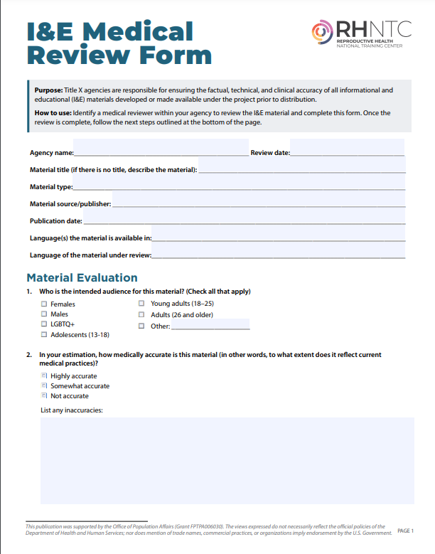
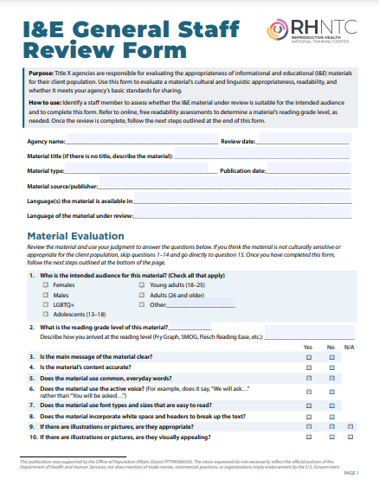
Review form examples
Notes:
Angie: Here is what the Title X I&E Medical Review form and Title X I&E General Staff Review Form look like. These review forms are labeled “I&E” because they support the review of informational and educational or I&E materials.
Even though the I&E Medical Review form is designed for Title X grantees, TPP grantees may find it to be a helpful model for their own tool that reviewers can use to evaluate medical accuracy. Mathematica has another example of this in an Excel spreadsheet and OPA has included a template in their guidance too. So, there are several templates to choose from.
TPP grantees may find the I&E General Staff Review form to be a helpful model for evaluating the other criteria. You can also refer to online, free readability assessments to determine a material’s reading grade level, as needed. Flesch-Kincaid readability scores are among the most widely used and heavily tested measures of readability. Other healthcare setting readability assessment tools include the Fry Readility Graph, McLaughlin’s SMOG grading, and the Gunning Fog Index.

Slide 11
Materials Review Documentation Recommendations
Notes:
Angie:
Next, let’s review some of the documentation recommendations.

Slide 12
Document the materials review process
Review completed date
Review coordinator
List of reviewers (include area of expertise)
Description of review process
Notes:
Angie:
All grantees should document the following review information:
Review completed date
Review coordinator (this is the person assigning reviews and collecting review results, include their name and role/title on the grant):
Name of all reviewers (include discipline and/or area of expertise for each)
Description of review process (e.g., is this reviewer focusing on one particular area, such as age- appropriateness, are they reviewing multiple items, are they a sole reviewer or are they reviewing alongside others, etc.)
You may be wondering WHY should you document this information. OPA does not require it. However, you will need to report the findings and how the findings were addressed as part of your SAPR and the process should be reflected in your work plan. Documenting this review information could also help you track your materials review more easily or more frequently and may allow you to use a continuous quality improvement or CQI process to update the structure, the reviewers, etc.

Slide 13
Document information about each material reviewed
Intervention/material name
Type of material
Edition
Author/publisher
Copyright date
Target audience and setting for program implementation
Components
Number of pages or minutes
Paragraph or exhibit
Does the intervention/material include medical information? (Y/N)
Brief description of the intervention/material and how it will be used in the funded project
Notes:
Angie: Reviews should be done on all project-related materials, not only EBPs or innovative and promising interventions. This may include but is not limited to public service announcements, supplemental material, awareness campaign materials, pamphlets, presentation, etc. Before sending the review tool to a reviewer, the review coordinator should fill out the following for each item that will be reviewed:
Intervention/material name:
Type of material (e.g., curriculum, video, brochure):
Edition:
Author or publisher:
Copyright date:
Target audience and setting for program implementation:
Components (e.g., workbook, handout, facilitator manual):
No. of pages/minutes (total and per component)
Paragraph or exhibit
Does the intervention/material include medical information (yes or no)
Brief description of the intervention/material and how it will be used in the funded project

Slide 14
Document review findings and recommendations
Whether the material meets OPA’s criteria
Issues and recommended changes to each material
Notes:
Angie:
Document whether the materials meets OPA’s criteria.
Document issues and recommended changes to each material, including the original language, the modified language, and where the edit was made (i.e., page number, location of change). For documentation suggestions, see the Sample Materials Review Form in OPA’s materials review guidance.
It might be helpful to think about the following questions:
What topic does this cover?
What are the issue area(s) (e.g., medical accuracy, age appropriateness, cultural & linguistic appropriateness, or trauma-informed)?
What are the details of the issue?
What is your recommendation to address the issue?
If reviewing a video, include the title of video you are reviewing
For each of the suggestions or issues noted, document the following:
Minute number:
Description of Scene:
What topic does this cover?
What issue area(s) (e.g., medical accuracy, age appropriateness, cultural & linguistic appropriateness, or trauma-informed)?
What are the details of the issue?
What is your recommendation to address the issue?
Ask members of the intended population to review the changes. This helps ensure that changes to each material reflect and resonate with the priority audience.

Slide 15
Grantee Share: University of Texas Health Science Center -
Teen Health
Notes:
We are excited to have Jenn Todd with us from the UT Teen Health today. Welcome, Jenn! Thank you for joining us today to chat about your program’s experience in building out your materials review process, particularly ensuring the medical accuracy of your materials.

Slide 16
University of Texas Health Science Center -
Teen Health
Jennifer San Pedro Todd, J.D., RN Director University of Texas Health Science Center at San Antonio
UT Teen Health
Notes:
Introduce Jenn with brief bio.
Jenn is a San Benito, Texas native that has called San Antonio home for the last 18 years. She is a registered nurse and attorney who has worked on positive youth development for over 25 years. Her nursing background focused on neuroscience. Jenn is the Director at UT Teen Health and has provided oversight for more than $35 million in federal and state grants to focus on teen pregnancy prevention, youth mental health, and youth development in school districts, youth-serving organizations including foster care and juvenile justice. She has served the Bexar County community as a primary link between program components, community partners/schools and clinics, promotes community mobilization, and educates the program stakeholders in non-legislative policy. Through federal and state funding, UT Teen Health has been able to provide $6.5 million back to community partners in subawards.
Jenn has created various trainings programs for parents, teachers, coaches, and caregivers on how to better communicate with teens about teen-relevant topics such as the benefits of delaying sexual activity, the risks of sexually transmitted diseases, utilizing trauma informed approach, and is co-author of a curricula designed for teens, as well as co-author of several published articles. Jennifer enjoys working to build staff capacity, mentoring teens, and utilizing best practices especially when she is not traveling or outdoors hiking and backpacking.

Slide 17
Tips and tricks
Determine the experts needed to review your project’s materials.
Look for a community leader to review for cultural appropriateness.
Use community members as review committee members.
Formalize the review process and check-in every 6 months to determine if members want to continue on the team.
Combine TPP and Title X materials reviews, if appropriate.
Use physical copies of review materials that reviewers can mark up.
Following the review, put together highlights of the findings and modifications and share with members.
Notes:
Jenn & Angie Q&A Style Discussion:
Okay, Jenn. Let’s dig into some of the tips and tricks you’ve learned while developing your program’s materials review processes. We’ve included some of the tips and tricks you’ve mentioned over the past couple months, but we’d love to hear more specifically how these came about during the initial development.
Q: Can you tell us how you determined who to recruit for the materials review team?
A: First we look at the curriculum and consider the gaps we have on our materials review team. We then brainstorm the type of person such as: teacher, clinician, expert in trauma informed practices, community leader, student; brainstorm names of who we know that fit into the type of person we are looking for and we email and call them.
Q: How did you determine which type of experts to include?
A: Bullet #1 For example, if we know that the curriculum is going to be used by a juvenile justice population, we will want to include an expert in the field like a probation officer, advocate, or someone who has worked with the juvenile population. Or if the curriculum is heavy on medical terms or has contraceptives, we want to be sure we include a clinician or medical or nursing student.
Q: What about community members? How did you go about recruiting community members and leaders to participate?
A. Bullet #2-3 We first reach out to our stakeholder leadership team and community partners that we have established relationships with and let them know about the medical review team, the commitment, and why it is important. We have at times identified specific partners and called them to participate. We ask for a commitment to review the entire curriculum, the findings, and provide feedback.
Q: What about your tips for formalizing the review process and for learning the process (or having a more efficient process)?
A: Bullets #4-5 We let partners know from the beginning that every curriculum that is utilized by our partners will need to undergo an annual medical accuracy review and we may be calling on them to participate. We let them know the average time for review (3 weeks to 1 month/per curricula), introduce our template, provide a supplemental findings template, what resources to use, and the materials to be reviewed. We usually do a check in at the 6 month mark to see if they would like to continue to be part of the team.
Q: One of the tips you’ve shared that worked for your program was to use a hard copy or physical copy of the documents. Can you share more about how you did this?
A: Bullets #6-7 When we can, we have label a physical hard copy of the curriculum as “For Medical Accuracy Review” This curriculum has flags (red for needing medical accuracy attention), yellow for cultural/trauma informed approaches, and at times we will mark up the physical copy with pencil or highlighter. We have a stickie note with all our initials and it is checked off once we have review it. This helps us identify who still needs to review the curricula. Each person has 2 days to 1 week depending on the urgency to review. We work on a shared folder to put together the medical accuracy findings document and ask for feedback.

Slide 18
Medical accuracy deep dive
Identify and address gaps in types of reviewers.
Ensure the medical accuracy reviewers have had sex ed training.
Use rotating medical or nursing students.
Provide medical accuracy reviewers with a list of recommended resources they can reference.
Notes:
Jenn & Angie Q&A Style Discussion:
Q: When it comes to ensuring the medical accuracy portion of review, what tips and tricks do you have for programs just getting started? A1: Jenn to answer using bullet points #1-#3
A: Start with your templates, curriculum that is going to be most utilized first. Then identify the gaps in reviewer types and find your low hanging fruit- such as a community advocate or parent that is a physician or nurse to develop your medical review team. If you have nursing schools or medical schools in the same city; utilize their public boards to ask for medical review of sexuality education curriculum; use primary resources such as Contraceptive Technology- that reviews the latest efficacy of contraceptives (both human use and lab rates); and do not be afraid to ask other grantees for their medical accuracy review of the curriculum you are conducting your review on. This will help you get started and help you identify those areas first. However, please be sure to utilize your community members and youth leadership council to review for cultural appropriateness; and understand your state laws with regards to teaching about human sexuality.
Q: Are there specific resources you found helpful?
A: Use your resources! So, if you are a FYSB PREP grant, review their resources too!
A2: Have Jenn reference the FYSB webinar in her talking points (we removed from slide due to inability to share link out). We are a FYSB PREP grantee also and have found the TA resources on provided by that program have been helpful in supporting how we conduct medical accuracy review. Check out the Exchange https://teenpregnancy.acf.hhs.gov/events/fysbapp-grantee-medical-accuracy-review-mar-training if you’re a PREP grantee too.

Slide 19
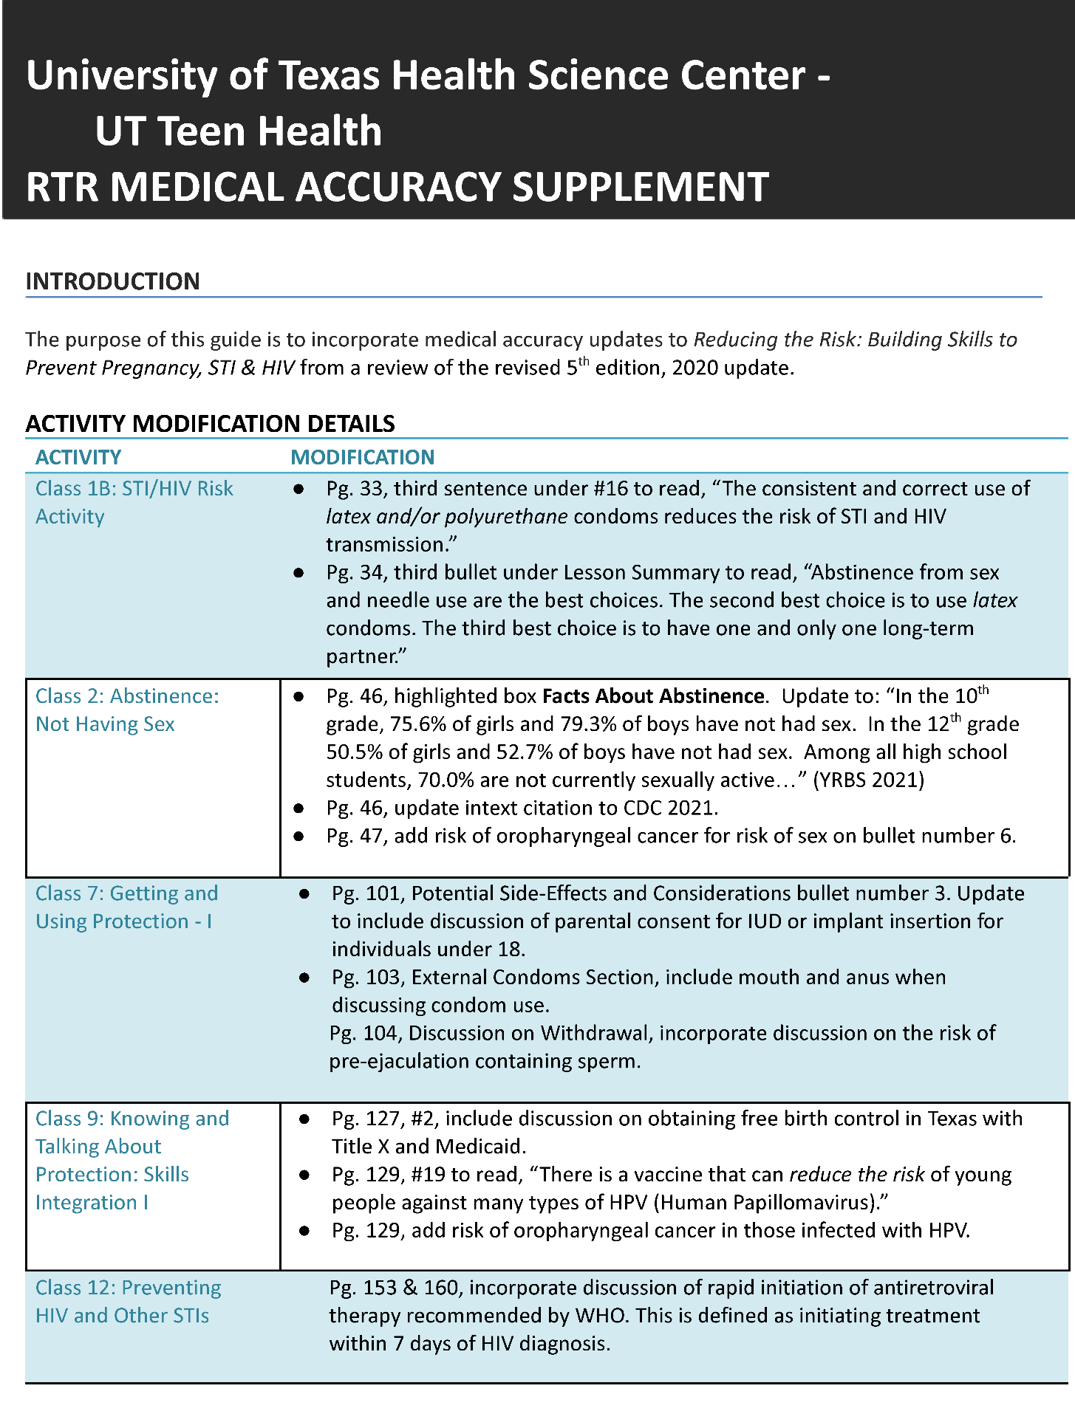
RTR Medical Accuracy Supplement
Notes:
Jenn & Angie Q&A Style Discussion:
Q: Can you walk us through the medical accuracy supplement we are sharing on the screen and the specific example, Reducing the Risk: Building Skills to Prevent Pregnancy, STI & HIV, that is being reviewed here?
A1: Absolutely, so after we complete the Medical Accuracy Review Template, we put together a Medical Accuracy Supplement that we utilize at all our trainings for that curriculum. We ask that facilitators take time to make the changes in their curriculum AND staple this to the front of their books. This is the Reducing the Risk Medical Accuracy Supplement. The introduction always states our purpose and the edition and publication date.
Then, you see the name of the activity on one column and the modification on the next column. For example, the Activity for Class 2: abstinence: not having sex- needed modification pg. 46 the highlighted box on Fact about Abstinence to reflect the updated YRBS data; and the reference is also listed. You will also notice on Activity –Class 7- contains updated discussion about parental consent for IUD and implant insertion for under 18 individuals; this is based on Texas law.

Slide 20
Challenges in Texas
Have expert reviewers review for cultural appropriateness and trauma-informed language following the review for medical accuracy and age appropriateness.
Trauma-informed care (TIC) reviewers should have formal training in TIC concepts (i.e., licensed counselor trained in ACEs and Level I TI).
Notes:
Jenn & Angie Q&A Style Discussion:
Angie: Grantees often say that hearing from grantees’ challenges and successes helps them better understand an expectation or new guidance. Would you share a few challenges to implementing the materials review process your team has experienced?
Jenn: A1:
One challenge was just as we would get started with the review, their was a ‘latest version of the curriculum’ that had come out. So now we reach out to the developers first to find out when they plan to update their curriculum. Reviewer fatigue is another challenge, this is why we may have two-three members that are the leads, and rotate/identify the content area reviews that rotate every 6 months or annually.
Have expert reviewers review for cultural appropriateness and trauma-informed language following the review for medical accuracy and age appropriateness
Trauma-informed care (TIC) reviewers should have formal training in TIC concepts (i.e., licensed counselor trained in ACEs and Level I TI)

Slide 21
Successes in Texas
Involve members of a youth leadership council after these reviews to see how language resonates compared to original language
Use RHNTC resources in conjunction with CDC resources
Plan for the review in TPP’s “slower” months
Provide incentives
Notes:
Jenn & Angie Q&A Style Discussion:
Angie: How about successes, Jenn? Would you like to share some of your successes too?
Jenn: A1:
One success was having our youth leadership alumni participate on the review team for curriculum they were familiar with and providing the end user feedback on cultural appropriateness and ensuring staff and community members are TIC certified or have training on trauma informed approaches. Incentives also help, we will give UT Teen Health swag and a thank you note for helping our community with their review.
Involve members of a youth leadership council after these reviews to see how language resonates compared to original language
Use RHNTC resources in conjunction with CDC resources
Plan for the review in TPP’s “slower” months
Provide incentives
…Thank you for letting me share! I’ll pass it back to Angie.
Angie: Thanks again, Jenn, for joining us on this panel. We appreciate your expertise and willingness to share your program’s experiences with the development of the materials review team and processes.

Slide 22
Grantee Share: Bethany Christian Service of Michigan
Notes:
Angie: Now, I’d like to introduce our next grantee guest, Latrece McDaniel. Welcome, Latrece! Thank you for joining us today to chat about your program’s experience in getting started on the materials review journey and ensuring the medical accuracy of your materials, and in ensuring materials are trauma-informed.

Slide 23
Bethany Christian Service of Michigan
Latrece McDaniel
Director of Programs
Notes:
Angie: Introduce Latrece with brief bio.
Latrece McDaniel is a Licensed Clinical Social Worker, Certified Advanced Alcohol & Drug Counselor, and an experienced non-profit leader with a passion for making a positive impact in people’s lives. During her 15 years of experience, she has dedicated her career to helping individuals overcome challenges and unlock new paths. Latrece’s journey has been filled with countless inspiring stories of resilience and growth, fueling her commitment to empower others to reach their full potential. Latrece works at Bethany Christian Service and is the Director of Programs for the Youth Services at the Grand Rapids Center for Community Transformation in Michigan.
Welcome, Latrece! Thank you for joining us today to chat about your project’s materials review experiences.

Slide 24
Tips for getting started
Use existing partners, advisory councils, and activities.
Use the materials review process to guide curriculum choice.
Start the material review process sooner than later.
Don’t overthink the curriculum.
Use existing feedback from stakeholders.
Use the TPPER medical reviews to help guide initially.
Consider providing incentives.
Invite students to be review members.
Be realistic about the amount of content to be reviewed and reviewers’ available time.
Notes:
Latrece & Angie Q&A Style:
Angie: Latrece, Let’s dig into some of your tips for getting started with the materials review. Would you like to share a little bit about each of these tips?
Latrece: Yes, my first tip is to use partners you already work with. Those that are on your existing advisory councils and active in your programming.
You should also consider using the materials review process to guide your program’s choice of curriculum. Some of the other tips to keep in mind include:
Start the material review process sooner than later
Don’t overthink the curriculum
Use existing feedback from stakeholders
Use the TPPR medical reviews to help guide initially
Consider incentives
Invite students to be review members
Be realistic about amount of content to be reviewed and available time
Angie: I like how one of your tips is to use the materials review process to your advantage when choosing curriculum. Can you share a little more about how this worked for you all?
Latrece: Provides an answer.
Angie: Could you share what you mean by the TPPR medical reviews?
Latrece: Provides an answer.
Angie:Are there any other tips that you’d add to this list now?
Latrece: Provides an answer.

Slide 25
Medical accuracy and TIC
Use internal TIC and medical experts.
Have a clear definition and outline of the materials review process.
Define “expert” and “expert review.”
Add a disclaimer to put medical experts at ease in regards to signing off on the review of materials.
Notes:
Latrece & Angie Q&A Style:
Angie: We hear from grantees that ensuring medical accuracy can be challenging, as well as ensuring materials are using trauma-informed language. Can you tell us about your program’s experiences with ensuring that all of your TPP educational materials are medically accurate and trauma-informed?
Latrece: A1: Provides an answer.
Angie: Could you share a little more about what you mean by a disclaimer to put medical experts at ease for the review?
Latrece: A1: Provides an answer.

Slide 26
Challenges in Michigan
The medical accuracy review is the biggest lift
Ensuring cultural and linguistically appropriate materials
Notes:
Latrece & Angie Q&A Style:
Angie: Let’s talk about some of the challenges you’ve experienced with the materials review process.
Latrece: Provides an answer using bullet points on slide.

Slide 27
Successes in Michigan
Reviewer compensation
Recruitment of reviewers
Notes:
Latrece & Angie Q&A Style:
Angie: Let’s talk about some of the successes or improvements you’ve made, specifically around how to compensate reviewers and how and where you recruit reviewers.
Latrece: Provides answers using bullet points on slides. Internal review members bill normal work hours, external reviewers may have less flexible timelines and/or need more reminders to get to completion.
Recruitment of reviewers:
Student Leadership Advisory Board (materials review process is built into the cadence of their board work)
Parent focus groups
Angie: Latrece, I really want to thank you for joining us today and for sharing your experiences and expertise with the materials review. I think this will be helpful to other grantees who are finding it challenging to get started with this process and providing some tips for how to review for medical accuracy and trauma-informed care.
Latrece: Thanks for inviting me to share. I’ll hand it back to you, Angie and Annie, to review some of the RHNTC materials review resources available and to close out the webinar.

Slide 28
Resources
OPA materials review guidance (available on rhntc.org and Connect.gov)
Materials Review Guidance for TPP Tier 1 Grantees
Materials Review Guidance for TPP Program Tier 2 Rigorous Impact Evaluation
RHNTC materials review resources
Tier 1: Expectations Tool for TPP23 Tier 1 Project Directors → Materials Review
Tier 2 RI: Expectations Tool for TPP23 Tier 2 Rigorous Impact Evaluation Project Directors → Materials Review
Tier 2 Innovation Hubs: materials review resources pending
Notes:
Angie: I want to thank our guest speakers today, Jenn and Latrece. We appreciate the time and effort they put into being available during the planning phases of this webinar and for today. Thanks again, Jenn and Latrece!
This webinar has been full of real-life experiences developing and implementing a TPP program materials review process. We hope you all have enjoyed learning and listening, as much as we have. We also want to share a few additional resources you will likely find helpful while developing your own processes and practices for this TPP Expectation.
You can find the materials review guidance on both rhntc.org and Connect.gov.
The RHNTC also has a tool with resources organized by expectation - one for Tier 1 granteesone for Tier 2 rigorous impact grantees and one for Tier 2 Innovation Hubs. The expectations tool (or wheel) provides a clear blueprint to support recipients in achieving their TPP goals by providing resources related to each of the expectations. Also, please note that the Tier 2 Innovation Hubs will also have materials review resources coming out in the near future.

Slide 29
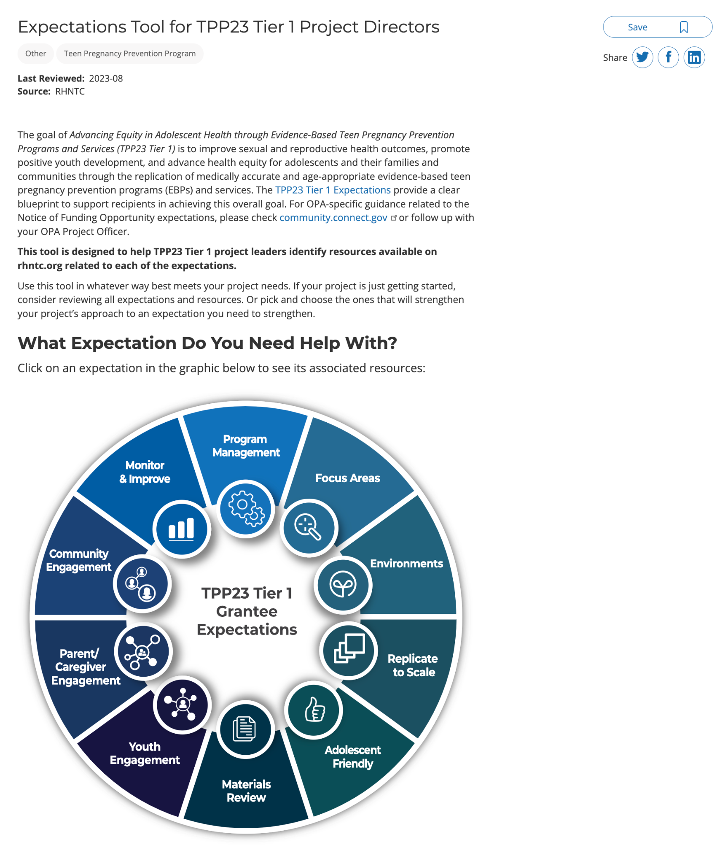
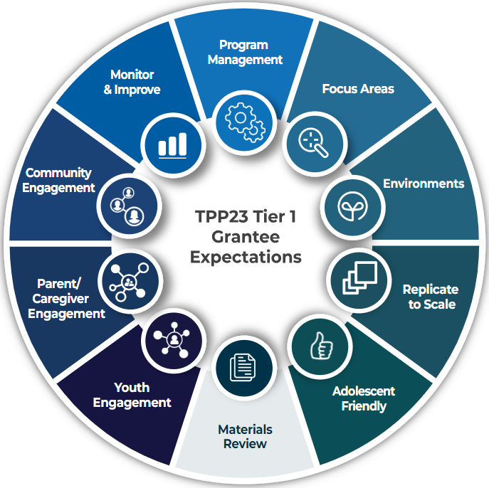
Expectations Tool for Tier 1 Project Directors
Notes:
Angie: Here’s the Tier 1 expectations tool.

Slide 30
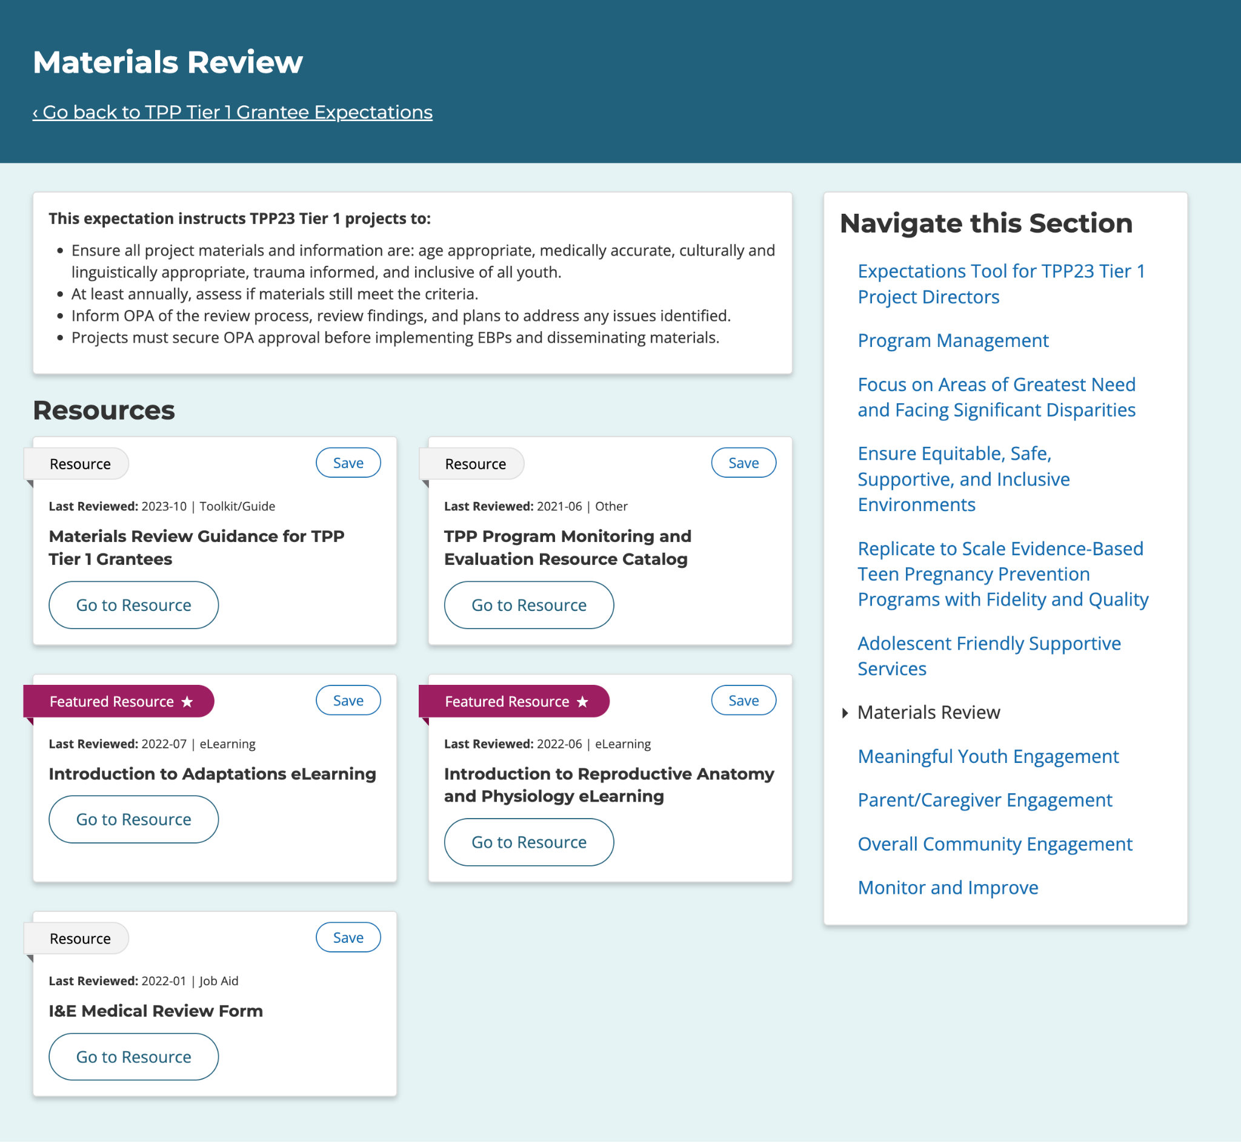
Expectations Tool for Tier 1 Project Directors - Resources
Notes:
Angie: Under the Tier 1 Materials Review tab on the expectations wheel, you’ll find:
RHNTC’s Establishing Your TPP Materials Review Process Tip Sheet - This job aid provides tips to help Teen Pregnancy Prevention Program (TPP) staff develop a system for managing the materials review process.
OPA Toolkit: Materials Review Guidance for TPP Tier 1 Grantees
Mathematica’s TPP Program Monitoring and Evaluation Resource Catalog
Introductions to Adaptations eLearning
Introduction to Reproductive Anatomy and Physiology eLearning

Slide 31
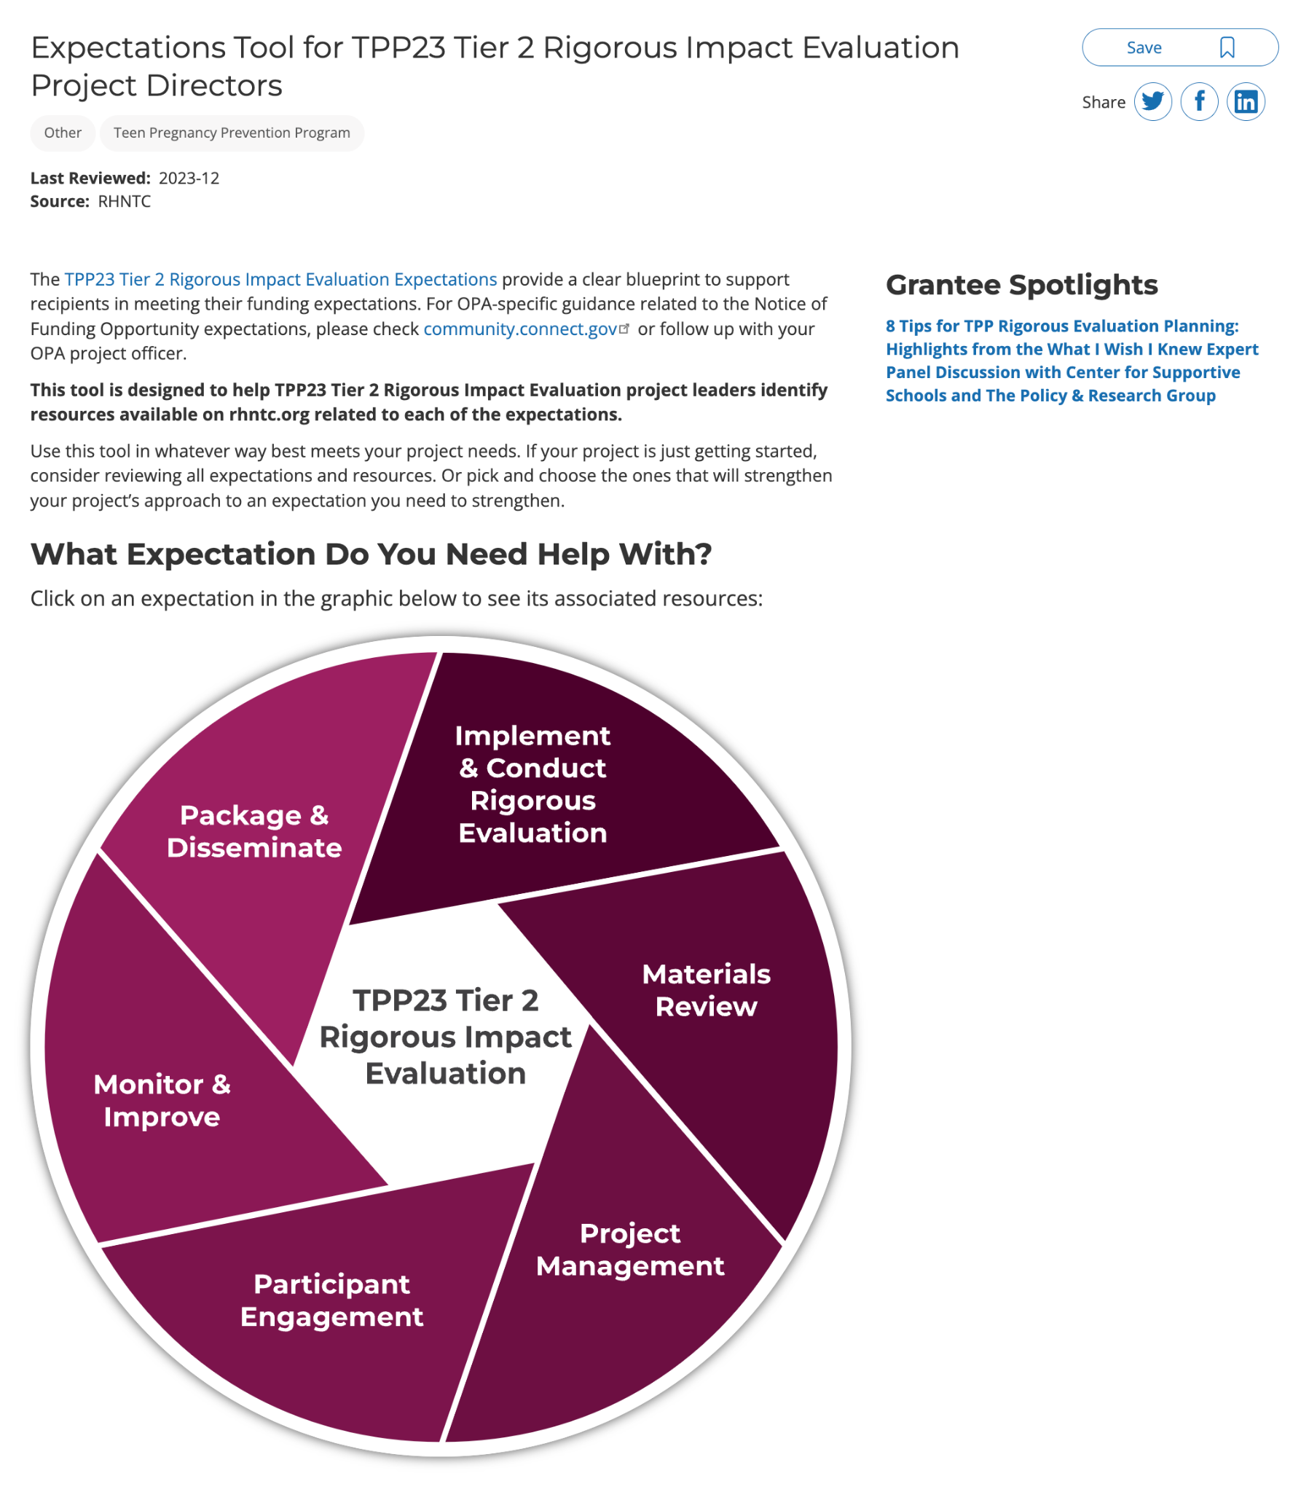
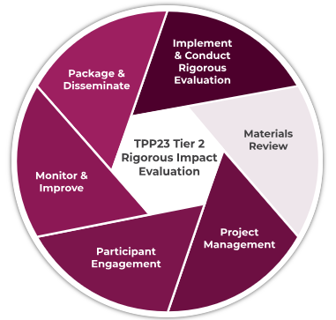
Expectations Tool for Tier 2 RI Project Directors
Notes:
Angie: And here’s the expectations tool for TPP Tier 2 Rigorous Impact Evaluation Project Directors.
Source: https://rhntc.org/resources/expectations-tool-tpp23-tier-2-rigorous-impact-evaluation-project-directors

Slide 32
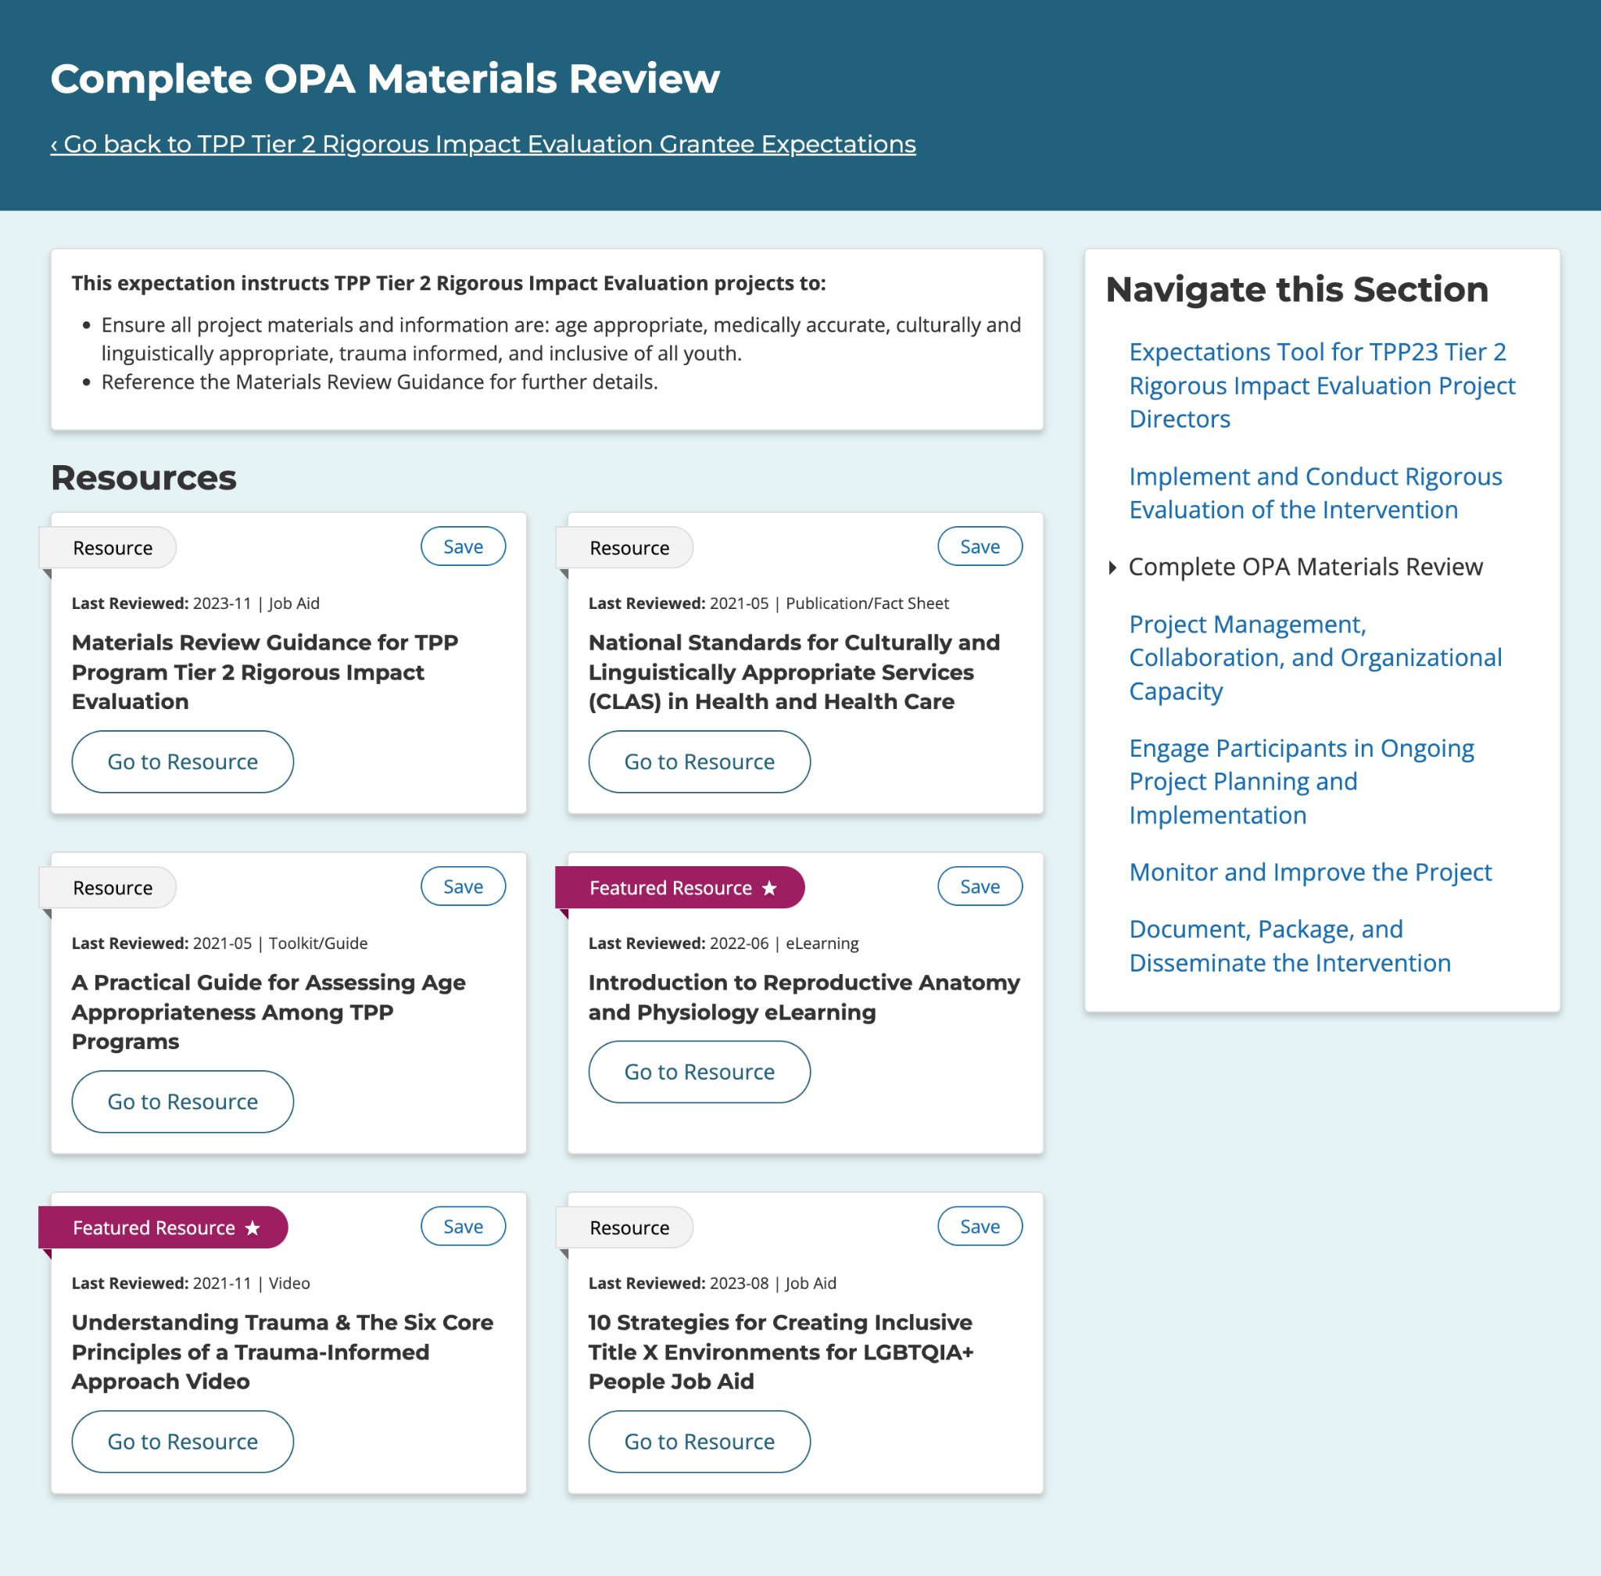
Expectations Tool for Tier 2 RI Project Directors
- Resources
Notes:
Angie:
Under the Materials Review tab on the Tier 2 Rigorious Impact expectations wheel, you’ll find:
RHNTC’s Establishing Your TPP Materials Review Process Tip Sheet - This job aid provides tips to help Teen Pregnancy Prevention Program (TPP) staff develop a system for managing the materials review process.
OPA Toolkit: Materials Review Guidance for TPP Program Tier 2 Rigorous Impact Evaluation
National Standards for Culturally and Linguistically Appropriate Services (CLAS) in Health and Health Care
A Practical Guide for Assessing Age Appropriateness Among TPP Programs
Introduction to Reproductive Anatomy and Physiology eLearning
Understanding Trauma & The Six Core Principles of a Trauma-Informed Approach Video
And the 10 Strategies for Creating Inclusive Title X Environments for LGBTQIA+ People Job Aid

Slide 33
More resources
In the expectations wheel for each tier, you’ll find…
Establishing Your TPP Materials Review Process Tip Sheet
TPP Program Monitoring and Evaluation Resource Catalog (Mathematica)
Introduction to Adaptations eLearning
Introduction to Reproductive Anatomy and Physiology eLearning
Other related RHNTC resources
Tier 1: Evidence-Based TPP Programs at a Glance Job Aid
I&E Medical Review Form
I&E General Staff Review Form
Notes:
Angie: We also want to call out another RHNTC resource available to support your materials review process.
Tier 1 grantees may want to use as a starting point the Evidence-Based TPP at a Glance Job Aid, which provides a snapshot of program models that have undergone a Teen Pregnancy Prevention Evidence Review (TPPER) and have been approved as evidence-based programs or EBPs. Latrece mentioned this resource as a helpful resource.
As stated earlier, you may also find it helpful to reference or use some resources developed for the Title X Program’s materials review.

Slide 34
Engage with Us
Subscribe to the RHNTC Monthly eNewsletter at rhntc.org/enewsletter
Contact us on rhntc.org
Sign up for an account on rhntc.org
Follow us on LinkedIn
Subscribe to the RHNTC podcast podcast.rhntc.org
Notes:
Annie:
That’s everything. There are lots of ways to engage with the RHNTC and to stay up-to-date on our resources!
You can subscribe to our RHNTC Monthly eNewsletter
Contact us on rhntc.org
Sign up for an account on rhntc.org
Follow us on LinkedIn
Subscribe to the RHNTC podcast

Slide 35
THANK YOU!
Please fill out the evaluation form after the webinar!
rhntc@jsi.com
This webinar was supported by the Office of Population Affairs (Grant TPSAH000006). The views expressed do not necessarily reflect the official policies of the Department of Health and Human Services; nor does mention of trade names, commercial practices, or organizations imply endorsement by the U.S. Government.
Notes:
Annie: Thank you so much for joining us! We hope to see you soon.

