Slide 1
Endocrine Disrupting Chemicals and
Maternal Health Outcomes
Tamarra James-Todd, PhD, MPH
Mark and Catherine Winkler Associate Professor of Environmental Reproductive Epidemiology,
Harvard T.H. Chan School of Public Health
Notes:
Hello, and welcome everyone. I'm Fonda Ripley with the Reproductive Health National Training Center, and I'm pleased to have you all here today for our webinar about Endocrine Disrupting Chemicals and Maternal Health Outcomes. Before we get started, I have a few announcements that I would like to share. Given the number of folks participating today, we've muted everyone on the webinar. We do plan to have time today for questions later in the hour, and so you can ask questions in the chat at any time. Just add those into the chat, and we'll be collecting those, and we'll raise those when we get to the question and discussion time. We are recording the webinar today, and the recording, as well as the slide deck and a transcript, will be available on rhntc.org within the next few days. Closed captioning is enabled, and you can view that by clicking on the CC icon at the bottom of your screen. We're gonna chat into add an evaluation link into the chat. And your feedback is really important to us at the RHNTC. It's been helpful in allowing us to make improvements in the work that we've done and based on comment shared, particularly our webinars. And so I'll ask you all to take a moment to open that link in the chat and consider completing the evaluation in real time. I'll give you just a moment or a few seconds to open that link, and I welcome folks to give a thumbs up on the screen when you have it open. And then I just wanna note that in order to obtain a Certificate of Completion for attending the webinar today, you must be logged into rhntc.org when you complete the evaluation. And thanks all for raising your hand or giving a thumbs up, that's helpful. Then, finally, I'd like to share that this presentation is supported by the Office of Population Affairs and the Office on Women's Health. Its contents are solely the responsibility of the speakers and do not necessarily represent the official views of OPA, OWH, or HHS.

Slide 2
Continuing education
JSI Research & Training Institute, Inc. is approved as a provider of nursing continuing professional development by the Northeast Multistate Division Education Unit, an accredited approver of continuing nursing education by the American Nurses Credentialing Center’s Commission on Accreditation.
No individuals in a position to control content for this activity have any relevant financial relationships to declare.
There is no commercial support being received for this event.
This activity has been approved for a total of 1 contact hour. Activity #RHNTC43
Notes:
Continuing education credits are available for those who are interested, and this webinar has been approved for a total of one contact hour.

Slide 3
Meet your speakers
Fonda Ripley, MHS, RHNTC
Tamarra James-Todd, PhD, MPH
Notes:
As I said earlier, I'm Fonda Ripley with the RHNTC. I'll be your moderator for our webinar today. And I work with the RHNTC as a training and TA coordinator, as well as a grantee liaison. And I'm joined today by our speaker, Dr. Tamarra James-Todd. Dr. James-Todd is the Mark and Catherine Winkler Associate Professor of Environmental and Reproductive Epidemiology. She leads research on how hormone-disrupting chemicals might affect people's heart and metabolic health during pregnancy and contribute to disease later in life. She directs the Environmental Reproductive Justice Lab, which investigates the role of consumer product chemical exposure on reproductive and cardiometabolic health and health disparities. And she also runs several randomized control trials to improve environmental health literacy of consumer product chemicals as a strategy to reduce risk of adverse health outcomes and health disparities. She's the principal investigator of several studies, including the Environmental, Reproductive, and Glucose Outcomes Study, as well as the PI for the Community Engagement Core of Superfund Research Center at Harvard. Dr. James-Todd, we're really pleased to have you with us today, and I'll pass the mic to you.

Slide 4
Learning objectives
By the end of the presentation, participants will be able to:
Define endocrine disrupting chemicals (EDCs), their sources,
and exposure routes
Describe examples of how EDCs can negatively affect reproductive health
Explain how unequal environmental exposure to EDCs contributes
to racial disparities in negative maternal health outcomes
Describe at least 2 strategies for reducing exposure to EDCs, which
sexual and reproductive health providers can discuss with clients
Notes:
We're gonna start off with a poll, actually, and then I'll give the presentation, and then we'll end with a poll, and I'm really interested in some of the questions that you might have from this. But to kind of kick things off, we're hoping that by the end of the presentation, participants will be able to define endocrine-disrupting chemicals, or EDCs. You're gonna hear me say that acronym a lot throughout this presentation. And so EDCs, their sources and exposure routes. We'll also wanna make sure that you all can describe examples of how EDCs can negatively affect reproductive health and be able to explain how unequal environmental exposures to EDCs contribute to racial disparities in negative maternal or adverse maternal health outcomes. And I'll say to you that it's not just... In this presentation, I'm gonna highlight racial disparities, but there are many other types of disparities that one could speak to in the context of the other social determinants of health. And then finally, describing at least two strategies for reducing exposure to EDCs, which sexual and reproductive health providers can discuss with their clients.

Slide 5
Poll time! 1
How confident are you that you can:
Describe how exposure to EDCs can negatively affect reproductive health
Describe at least 2 strategies for reducing exposure to EDCs, which sexual and reproductive health providers can discuss with clients
Notes:
But to kick us off, love to have you all do a poll. And the question is: How confident are you that you can describe how exposure to endocrine-disrupting chemicals, or EDCs, can negatively affect reproductive health? And then if you scroll down, there's the second question, which is: How confident are you that you can describe at least two strategies for reducing exposure to EDCs, which sexual and reproductive health providers can discuss with clients? So I'm gonna give us a moment to complete this... Questions. And I should have said that the scale is one to five, so feel free to change if you need to. Scale's one to five, where one is not at all confident and five is very confident, so. Okay, so I think that the majority of you all have gotten a chance to answer some of this. And I'll just note, and I'm not technically very surprised that many of you said kind of not particularly confident, maybe even not at all confident. And few people said, "I'm very confident about this if any," and so that's why we're here today. And so I'm excited to help boost that confidence, hopefully, as we kind of go throughout this. All right.

Slide 6
Meet Janine
Notes:
Okay, but I wanna start with a kind of a story. And the truth is that I often speak during Grand Rounds and other meetings to clinicians like you all, and I often lead with a question about how many of you feel like or how many of you ever been approached by a patient who is really curious? And so about what should they be using maybe during pregnancy. Or prior to pregnancy, they're interested in becoming pregnant, but they don't know what to do. And just about everyone raises their hands in that context. So here, I'd love for you to meet Janine. Janine's fictitious, but maybe someone similar to maybe someone with a client that you may meet. And Janine is about 38 years old and she already has a child who's three years old. She and her partner are really interested in having a second child and they've started trying to become pregnant, but it's been about six months and they're having a lot of difficulty. And Janine knows that she is of advanced maternal age, being 38, and is willing to figure out some of the strategies to increase her chances of becoming pregnant. And recently, Janine was speaking with a friend who mentioned that she heard that some of the ingredients in personal care products may make it hard to become pregnant. And her friend said that she might want to discuss stopping the use of some products like perfume or cosmetics, nail polish, or even some hair products. Janine is concerned because first, she's never heard of this at all, but she also doesn't know what ingredients are actually the culprit, or even how to avoid them. And Janine has a doctor's appointment coming up, and so she decides that she wants to bring this up to her healthcare professionals just to see if she should stop using any of these products, and particularly what are the ingredients she should be on the lookout for. And so Janine comes to you, her healthcare professional, and she asked if she should stop using hair oils, and perfume, and her favorite lipstick in order to increase her chances of becoming pregnant. And I'm wondering if you in the chat right now, might be able to say... What would you say to her? If this was your patient, what would you say? Feel free to use the chat and kind of plug some things in. Would you recommend that she stops, or yeah? Yeah, let me look into it for you. Download an app that may be able to help provide some recommendations. Not really feeling like they're... Confident about being able to provide any advice at all. Yeah, these are all what I feel like I've heard before among clinicians, and I think it's a really important point. How do we kind of streamline that? How do we improve what we might be able to say and feel more confident? So thank you for providing some of those, how you might handle that.

Slide 7
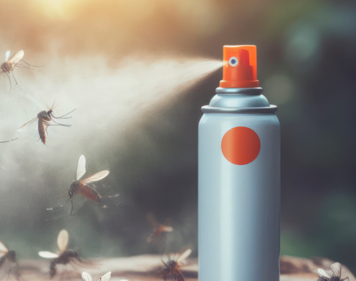


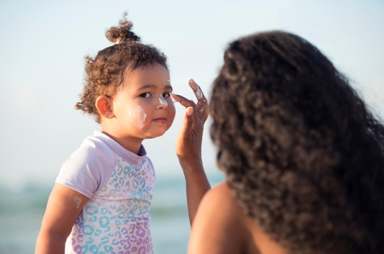




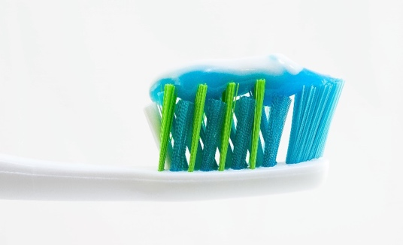

Chemical ingredients in consumer products
Pesticides
Plasticizers
Surfactants
Phenols
Flame retardants
Notes:
So the reason why I bring this up is because, oftentimes, Janine's not wrong. We are indeed exposed to many chemicals every day. And so her quest to try to figure out, "Well, what should I be on the lookout for?" is actually one of the challenges. And part of that is because there are chemicals everywhere and there are hundreds of chemicals often put into our consumer products. Here, I have multiple kind of classes or categories of different types of consumer products. And you're gonna hear, as I said at the beginning, we talk about a particular type of chemical that is often included in some of these consumer products, known as endocrine-disrupting chemicals, or EDCs. And these are commonly used in many of the products that we use every day, ranging from pesticides that we may use in our homes as we turn to the summer season, and ants come out, and other little critters, to pesticides that we might use in our gardens or even we go to grocery stores and may purchase foods that have had pesticides actively used on them. So plasticizers, which include this like very word, it's very difficultly-spelled word called phthalates that are included in these kind of plasticizer-like chemicals in their replacements. And so those are found in things like food packaging, and cosmetics, and perfumes. They hold fragrance in to various products, including some of the personal care products that we use regularly that may, quote, unquote, smell good or smell clean or fresh. So even in our household cleaning products, for example. To surfactants, which have become a hot topic. Increasingly, people are becoming familiar with things like per and polyfluoroalkyl substances. Again, another mouthful, but also known as PFAS chemicals. And they're used for their ability to be water-resistant, grease-resistant, and so on. So they can be found in food packaging. A lot of PFAS are found in things like microwave popcorn, but also those kind of boxes that you might get from kind of food stores and restaurants that... Pizza boxes and such. But sadly, they have been contaminating our waterways as well due to industrial use. They are found in things like firefighter foam. So certain occupations have higher exposure to these. So if you live near a military base or an airport, another source, unfortunately, of these surfactant chemicals. To females, which are used in things like sunscreens, which we will increasingly use in the months to come. And other things like toothpaste or even creams and lotions. Tortillas and muffins because they have an antimicrobial property. For example, in the phenolic chemicals. So things like parabens, you'll see like things that say paraben-free, they're oftentimes swapping parabens out with something else that may also be harmful. But bisphenol A is perhaps one of the most famous of the phenols. It was used in the canning process and also on receipts. And then flame retardants, which we're all sitting looking at our devices right now. They do oftentimes contain flame retardants. Clothing, some clothing and other household furniture as well can contain flame-retardant chemicals in it as well. So these are just some examples of consumer product chemicals that are known to disrupt the endocrine system.

Slide 8
What are endocrine disrupting chemicals (EDCs)?
Natural or human made chemicals that may mimic, block, or interfere with the body’s hormones,
which are part of the endocrine system
https://www.niehs.nih.gov/health/topics/agents/endocrine
Notes:
So the question is: What exactly are endocrine-disrupting chemicals, or EDCs, and these natural or human made chemicals that have the ability to mimic, or block, or interfere with the body's hormones, which are a part of the endocrine system.
National Institute of Environmental Health Sciences. Endocrine Disruptors. https://www.niehs.nih.gov/health/topics/agents/endocrine

Slide 9
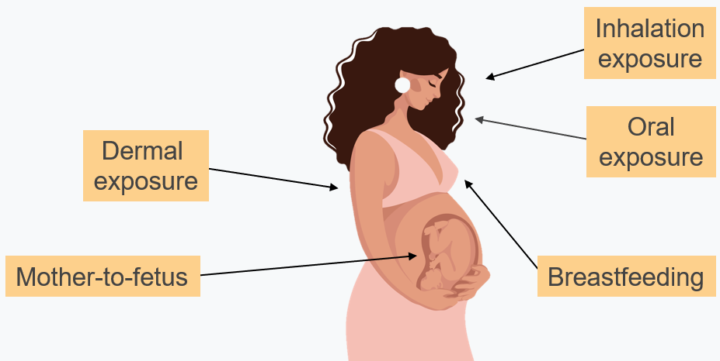
Routes of exposure to EDCs
Adapted from Sharpe et. al., BMJ 2004
Notes:
There are a variety of routes of exposures to these chemicals, ranging from inhalation, I mentioned perfume use, for example, or other fragranced products. To oral, I mentioned food packaging. So because these chemicals are not tightly bound, they kind of migrate into the foods that we eat, and so we can intake them, and they can enter our body and our bloodstream that way. Dermal exposure. So again, I mentioned like creams, and sunscreen, lotions, and so on that are sources of exposure to some of these chemicals. But they're also able to migrate to other tissues and have impact not just on us as individuals, but also on other generations. So these chemicals can also enter into amniotic fluid. So if a pregnant person, for example, uses these, they're able to migrate, and the developing venous can ingest them through that process. They can cross the placenta as well, in some cases. Not all of them, but some. And then also they can enter into breast milk. And so I mentioned those surfactant chemicals, for example, the PFAS chemicals that are used for their water-resistant and stain-resistant purposes. And PFAS chemicals tend to accumulate in breast milk, for example. So some of these are more readily found in certain tissues than others due to this.
Sharpe RM, Irvine DS. How strong is the evidence of a link between environmental chemicals and adverse effects on human reproductive health? BMJ. 2004 Feb 21;328(7437):447-51. doi: 10.1136/bmj.328.7437.447.

Slide 10
EDCs mechanisms of action
Direct action on hormone receptor and receptor function
Interfere with hormone transport and feedback
  Sex hormone binding globulin
  Thyroid hormone
Alter hepatic catabolism
Agonist or antagonist of endogenous nuclear receptors
  Estrogen receptors
  Peroxisome proliferator-activated receptors
Epigenetic changes through alterations of gene expression
Non-endocrine-mediated pathways (e.g., immune)
Systemic toxicity
Notes:
So there are a variety of mechanisms of action for these chemicals, ranging from the direct action on hormone receptors and receptor function. So their ability to actually disrupt or perturb things like the estrogen receptor or the progesterone receptor, and you'll hear me talk about that a little later. To their ability to interfere with hormone transport and feedback. So they actually disrupt sex hormone-binding globulin or thyroid hormone, which are obviously needed for a variety of endocrine and reproductive processes. They also have the ability to alter hepatic metabolism. So they're not just disrupting the endocrine system, but they're also disrupting the body's metabolism through changes in lipids and other things related to the liver. They have the ability to either act as agonist or antagonist of the body's nuclear endogenous nuclear receptors. So they, in addition to the estrogen receptor, they also disrupt the peroxisome proliferator-activated receptors, which are involved in like the upregulation of obesity or the development of adipose tissue, as well as the handling of glucose metabolism and lipid metabolism. So there are studies showing associations with an increased risk of obesity, diabetes, and other cardiovascular-related diseases. They also have the ability to alter epigenetic changes that impact gene expression. And despite the fact that they're often called endocrine-disrupting chemicals, they have the ability to operate on non-endocrine-mediated pathways. So also immune disruptors, they can actually amplify inflammation and inflammatory pathways and have a variety of other ways in which they can operate, including systemic toxicity.

Slide 11
What do EDCs have to do with reproductive health?
Notes:
So what do EDCs have to do with reproductive health? I just kind of gave a list of a variety of different things, ranging from cardiovascular disease, to diabetes, and so on, but what about reproductive health, specifically?

Slide 12
The female reproductive life course
Puberty
Adolescence/ young adulthood
Pregnancy
Midlife/ peri- menopause
Older age/ post- menopause
Notes:
So... I wanna walk you through this by thinking about the reproductive life course. And for today's talk, I'm specifically focusing in on female reproductive life course. There are absolutely studies out showing the role of endocrine-disrupting chemicals on male reproductive health outcomes. And in fact, that field, when looking at endocrine-disrupting chemicals, the field of male reproductive health outcomes was actually studied much more vigorously than looking at female reproductive health outcomes. And it's just in the last kind of 10, 15 years that this has really taken off considerably. So I wanna kind of just walk us through so that you all have some background as to what some of these associations are across the life course. So from puberty to adolescent and young adult health to pregnancy is the main focus of today, but it's worth noting that it's particularly with the most recent funding and interest around midlife, perimenopause, and older age postmenopausal health for female reproductive health that there's an increasing, but smaller literature, that speaks to the role of endocrine-disrupting chemicals as it relates to later life, in midlife health. So I'm specifically gonna be highlighting some of the points in these first three, though.

Slide 13
Examples of EDCs and puberty
Endocrine disrupting chemical | Association with pubertal outcomes
Pesticides (Atrazine) | Early puberty
Plasticizers (phthalates) | Early puberty Premature thelarche Delayed pubic hair development
Phenols (Bisphenol A [BPA]) | Premature thelarche
Surfactants (Perfluorooctanoic acid [PFOA]) | Delayed pubertal development
Lucaccioni et al., 2020
Notes:
So some examples of endocrine-disrupting chemicals and pubertal outcomes include studies that have found associations between pesticides, particularly atrazine as it relates to early puberty. And so on the left-hand side, I'm giving you a sense of like the different classes or types of endocrine-disrupting chemicals and their associations with pubertal outcomes. So for example, for the second row, there's a number of studies that have highlighted plasticizers, these phthalate chemicals again, and they're linked with early earlier onset of puberty, premature thelarche, as well as delayed pubic hair development. So kind of on either end, not that there's some early onset and some delayed onset with respect to pubertal outcomes. So it's kind of some sort of altering. Also with respect to those phenols or those antimicrobial chemicals, as well as chemicals that are used as these kind of in these... The resin process for canning and other things. So bisphenol A, for example. There's been associations with premature thelarche. And then those surfactant chemicals, those again, that we are familiar with those PFAS chemicals that are used for their anti... Like their lipid, or rather grease-resistant and water-resistant properties, excuse me, and delayed pubertal development. So this kind of like a review of literature as it relates to puberty. So a number of studies have shown these associations.
Lucaccioni L, Trevisani V, Marrozzini L, Bertoncelli N, Predieri B, Lugli L, Berardi A, Iughetti L. Endocrine-Disrupting Chemicals and Their Effects during Female Puberty: A Review of Current Evidence. Int J Mol Sci. 2020 Mar 18;21(6):2078.

Slide 14
Examples of EDCs and gynecologic health
Endocrine disrupting chemical | Association with gynecologic outcomes
Organochlorine pesticides | Endometriosis
Phthalates (Dibutyl phthalate [DBP]) | Fibroids Fertility Pregnancy loss
Phenols (BPA) | Ovulatory dysfunction
Surfactants (PFOA) | Polycystic ovarian syndrome
Cho et al., Obstet Gyn Sci 2020; Hammarstrand et al., Env Int 2021
Notes:
If we move on to examples of endocrine-disrupting chemicals, or EDCs, and gynecologic health, and here thinking in the context of adolescent, or young adulthood, or any state outside of pregnancy, frankly, you can look at the association between endocrine-disrupting chemicals and gynecologic outcomes. And there's been a variety of studies, for example, that have shown associations again with pesticides, particularly organochlorine, pesticides and endometriosis. And there's also been studies that have shown associations between phthalates, particularly metabolites that are biologically active ingredients that can be found for these dibutyl phthalates that are used. So for example, these are used in nail polish, but there's been links with fibroids, fertility-related issues, and pregnancy loss. With respect to phenols, again, another example of bisphenol A, we see associations with ovulatory dysfunction, so links, for example, to fertility status. And for these surfactants, we see associations with polycystic ovarian syndrome. I should know that throughout these couple of slides, that I am citing literature, and that can be where you can find additional about these.
Cho YJ, Yun JH, Kim SJ, Kwon HY. Nonpersistent endocrine disrupting chemicals and reproductive health of women. Obstet Gynecol Sci. 2020 Jan;63(1):1-12. doi: 10.5468/ogs.2020.63.1.1.
Hammarstrand S, Jakobsson K, Andersson E, Xu Y, Li Y, Olovsson M, Andersson EM. Perfluoroalkyl substances (PFAS) in drinking water and risk for polycystic ovarian syndrome, uterine leiomyoma, and endometriosis: A Swedish cohort study. Environ Int. 2021 Dec;157:106819.

Slide 15
Examples of EDCs and pregnancy health
Endocrine disrupting chemical | Association with pregnancy outcomes
Phthalates | Preterm birth Hypertensive disorders of pregnancy Gestational diabetes
Phenols (BPA) | Some evidence linked to preterm birth
Surfactants (Per- and polyfluoroalkyl substances [PFAS]) | Preterm birth Hypertensive disorders of pregnancy Fetal growth restriction
Szilagyi et al., Curr Env Hlth Rep 2020; Kek et al., Repro Tox 2024
Notes:
Finally, some examples that come from endocrine-disrupting chemicals and pregnancy health. And here, I'm showing you associations with pregnancy outcomes, specifically, where you can see associations between phthalates, and there's been a number of studies highlighting this with preterm birth. So higher concentrations of some of these phthalate chemicals and preterm birth, hypertensive disorders of pregnancy, and gestational diabetes. There's associations with those same phenol chemical that I mentioned to you earlier, BPA, with some evidence of preterm birth. And again, the surfactant chemicals with preterm birth, hypertensive disorders of pregnancy, and fetal growth restriction.
Szilagyi JT, Avula V, Fry RC. Perfluoroalkyl Substances (PFAS) and Their Effects on the Placenta, Pregnancy, and Child Development: a Potential Mechanistic Role for Placental Peroxisome Proliferator-Activated Receptors (PPARs). Curr Environ Health Rep. 2020 Sep;7(3):222-230.
Kek T, Geršak K, Virant-Klun I. Exposure to endocrine disrupting chemicals (bisphenols, parabens, and triclosan) and their associations with preterm birth in humans. Reprod Toxicol. 2024 Apr;125:108580.

Slide 16
Are there groups at higher risk due to higher exposures to EDCs?
Notes:
Okay, so it's important to know that those associations exist. And hopefully, by the end of this, you could ask yourself, like that's a lot of alphabet soup, a lot of chemicals, how do you figure out what contains what? But I think there's an important question about: Are there certain groups that are higher risk of being exposed to these chemicals? And importantly, are there certain groups that are at higher risk of having some of those adverse health outcomes that we could target reducing their exposures? So do those two groups of higher exposure, higher health outcome risk, do they overlap? And that's what these next set of slides are gonna kind of talk about.

Slide 17
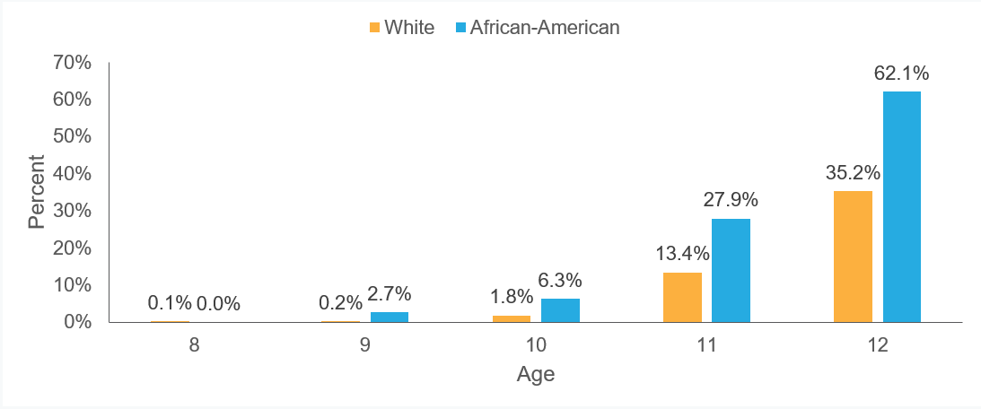
Age at menarche by race
Herman-Giddens et al., Pediatrics, 1997
Notes:
So let's answer the first question. Do we know that there's certain groups that may have a higher risk of the adverse reproductive health outcomes that we might be interested in? And so these are older data that come from a pediatric network that really was looking at documenting age at menarche and who had completed menarche based on white versus African American girls. And across the x-axis, here at the bottom, you see age ranging from eight to 12 years of age. And on the y-axis, you see the percentage of girls who had reached menarche by that particular age, ranging from 0% to 70%. And so if you look for example out here at age 12, you see the orange bar representing the white girl population for this particular study. By age 12, 35% approximately had reached age at menarche, compared to 62% of the blue bar, which represents African American girls. So much higher percentage having reached menarche. And when I started doing research in this area now about 20 years ago, I actually wanted to look at the historical context of this because many studies kind of stopped here and didn't go on to really try to understand the why behind this, as if there is some sort of biological difference based on race/ethnicity. Of course, we all know that that is not the case, that there's social... Race is a social construct, and in fact, historically, if you look back prior to the 1950s, this was actually the reverse. So African American girls actually reached puberty or menarche at a much later age than white girls. So it was around mid-century that this kind of leveled off and then it actually flipped. And there's a variety of proposed reasons why that happened. But one thing that I would like to highlight in this talk is that maybe it's also the products, the chemicals that we are exposed to, to the products that we use.
Herman-Giddens ME, Slora EJ, Wasserman RC, Bourdony CJ, Bhapkar MV, Koch GG, Hasemeier CM. Secondary sexual characteristics and menses in young girls seen in office practice: a study from the Pediatric Research in Office Settings network. Pediatrics. 1997 Apr;99(4):505-12.

Slide 18
Prevalence of fibroids by race and ethnicity, 2005-2014
Yu et al., Am J Obstet Gynecol., 2018
A line graph titled Uterine fibroid incidence rate per 10,000 person-years. The x-axis spans from 2005 to 2014 in one-year increments. The y-axis ranges from 0 to 300 in increments of 20. All data is approximate.
2005: Unknown, 70; White, 135; Asian/NH/PI, 168; Hispanic, 170; Native American, 185; Black, 255.
2006: Unknown, 85; White, 138; Asian/NH/PI, 180; Hispanic, 155; Native American, 140; Black, 240.
2007: Unknown, 75; White, 130; Asian/NH/PI, 158; Hispanic, 150; Native American, 190; Black, 265.
2008: Unknown, 70; White, 120; Asian/NH/PI, 150 Hispanic, 158; Native American, 170; Black, 205.
2009: Unknown, 60; White, 140; Asian/NH/PI, 170; Hispanic, 165; Native American, 120; Black, 285.
2010: Unknown, 105; White, 137; Asian/NH/PI, 150; Hispanic, 120; Native American, 162; Black, 220.
2011: Unknown, 90; White, 128; Asian/NH/PI, 155; Hispanic, 128; Native American, 165; Black, 245.
2012: Unknown, 60; White, 120; Asian/NH/PI, 142; Hispanic, 178; Native American, 145; Black, 290.
2013: Unknown, 65; White, 115; Asian/NH/PI, 140; Hispanic, 129; Native American, 138; Black, 195.
2014: Unknown, 85; White, 90; Asian/NH/PI, 125; Hispanic, 154; Native American, 156; Black, 195.
Notes:
But moving forward, moving beyond puberty into the next window that we talked about with respect to reproductive life course into kind of this adolescent, young adulthood, and kind of the non-pregnancy time point. Here, I'm presenting data that is highlighting the prevalence of fibroids by race/ethnicity between 2005 and 2014. And we're looking at the Hispanic, Asian/Pacific Islander, non-Hispanic white, Native American, and Black populations, as well as those of unknown race and ethnicity. And you find a higher uterine incidence per rate per 10,000 person years for the non-Hispanic Black individuals across all years. And that's represented here in the kind of forest green line here that I'm kind of showing you all.
Yu O, Scholes D, Schulze-Rath R, Grafton J, Hansen K, Reed SD. A US population-based study of uterine fibroid diagnosis incidence, trends, and prevalence: 2005 through 2014. Am J Obstet Gynecol. 2018 Dec;219(6):591.e1-591.e8.

Slide 19
Disparities in fertility outcomes by race/ethnicity
Up to 10-15% of individuals of reproductive age experience infertility
Studies have shown that Black individuals have up to a 2-fold increase in odds of infertility
Disparities exist in who receives fertility treatments, with Black and Hispanic individuals having a delay in receiving fertility treatments
Both Black and Asian individuals are more likely to experience a miscarriage following fertility treatments
Harb et al., Fertility and Sterility, 2014; Weiss et al., Obstetrics & Gyn, 2022
Notes:
So kind of along those same lines, if you look at fertility-related issues, while fibroids can contribute to some fertility-related issues, it's worth noting that there are many other conditions, such as polycystic ovarian syndrome, that can impact the ability for an individual to become pregnant and have a live birth. In fact, about 10 to 15% of reproductive age individuals experience infertility in the US. And studies have shown that Black individuals may have up to a twofold increased risk of infertility. However, other data suggests that this disparity might not exist. So it may depend on the population that's understudy. That said, disparities do exist for who is able to successfully navigate identifying and obtaining fertility treatment. And Black and Hispanic individuals have delays of approximately 20 months longer, compared to non-Hispanic white individuals in seeking out fertility treatment. And once pregnant, both Black and Asian individuals are more likely to miscarry, with a risk of up to 80 to 90% for miscarriage following fertility treatment. And there's been some really stellar studies, including the EARTH Study that has focused on looking at subfertile populations and finding that these chemicals that I am talking about today are linked to fertility-related outcomes, including pregnancy loss, for example. So this is important when you're considering how might you counsel someone who's really interested in pregnancy and who may be dealing with fertility-related issues.
Harb HM, Al-Rshoud F, Dhillon R, Harb M, Coomarasamy A. Ethnicity and miscarriage: a large prospective observational study and meta-analysis. Fertility and Sterility. 2014 Sep 1;102(3):e81.; Weiss MS, Marsh EE. Navigating Unequal Paths: Racial Disparities in the Infertility Journey. Obstetrics & Gynecology. 2022 May 5:10-97.

Slide 20
Preterm birth rates in the U.S. by race/ethnicity, 2020-2022 average
March of Dimes 2024
A bar graph titled Preterm birth rates in the U.S. by race/ethnicity, 2020-2022 average. Data is listed from left to right on the x-axis.
Hispanic, 10.0%; White, 9.4%; Black, 14.6%; American Indian / Alaskan Native, 12.2%; Asian / Pacific Islander, 9.2%; Total, 10.3%.
Notes:
So with respect to in the context of pregnancy, kind of moving forward into this additional window, here, we're looking at data from the March of Dimes, and we're looking at the percent of live births for preterm by race/ethnicity in the United States for 2020 through 2022. On average, what you're seeing here is we're looking at Hispanic, non-Hispanic white, Black, American Indian/Alaskan Native, Asian/Pacific Islander, and the total, and you find that Black individuals and Indigenous individuals have up to 50% higher rates of preterm birth. In fact, among the many different pregnancy complications, the most common being preterm birth, small for gestational age, hypertensive disorders of pregnancy and gestational diabetes, many of these you see a much higher burden of these complications within non-white groups. And so, again, we see these linkages, what might we be able to do and counsel people about?
March of Dimes. Prematurity Profile. https://www.marchofdimes.org/peristats/reports/united-states/prematurity-profile. 2024.

Slide 21
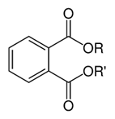
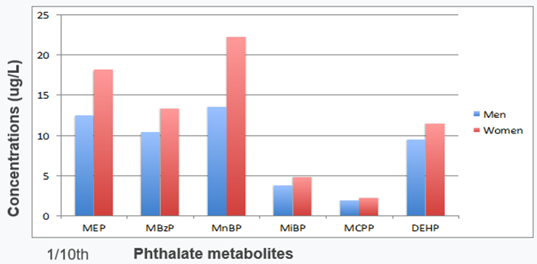
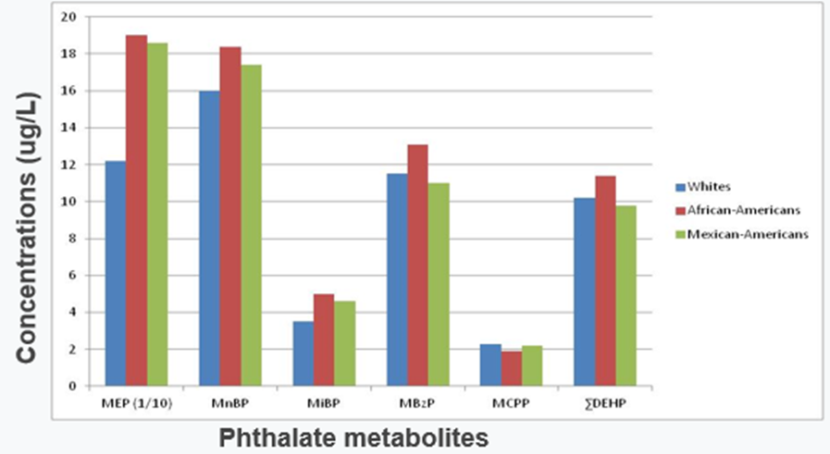
Example: Inequities in EDC exposures by race and ethnicity
Phthalates
Examples:
Personal care products
Diet/food packaging
Medical tubing/medication/plastics
NHANES 2001-2008
Huang et al, Environ Health, 2014
Notes:
Okay, so I've given you context about these disparities, which may be many of you already knew, but I wanted to set the stage for that so that I could also describe inequities that we see with respect to exposure to endocrine-disrupting chemicals also by race/ethnicity. And again, I'm highlighting that today 'cause I only have an hour with you all. So there are other disparities that we could have looked at, but here, these are data from the National Health and Nutrition Examination survey. And again, knowing that there's this link that I highlighted in the tables earlier, I wanted to show you what an example might be for these plasticizer-like chemicals or phthalates. And the data here is from 2001 through 2008. It's just for kind of point of kind of principle concept. We actually do see these... very much these same disparities ongoing, if not increasing, in more recent years. Examples, again, of where phthalates might be found are these personal care products, as well as diet and food packaging. They're also used in medical tubing, medication, and other plastics. And I'm showing you a variety of different types of chemicals here. Our six urinary phthalate metabolite concentration. So we measure these chemicals, this particular class in urine, that is our gold standard. And these six stands for monoethyl phthalate, or MEP; monobenzyl phthalate, or MBZP; monobutyl phthalate, or MBP; monoisobutyl phthalate, or MIBP; mono-carboxypropyl phthalate or MCPP; and di-2-ethylhexyl phthalate metabolites, or the sum of the DEHP metabolites. I'm showing you this by men versus women based on how NHANES classifies this with respect to gender. And I'm also showing this by race/ethnicity for non-Hispanic white, African American, and Mexican American, again, based on the classifications from NHANES, which is a surveillance of the health of the US population. So they monitor our health status and they measure these chemicals in our urine. And this is from the Centers for Disease Control and Prevention. And what you'll note on your far left-hand side is red and blue bars representing men and women, with women having higher concentrations of these personal care product-associated phthalate. So this MEP, MZBP, and MNP, which are used either to hold fragrance in, they're used as solvents in various personal care products and things like nail polish, for example. And so thinking about how we socialize people and what we do with respect to gender. But there's also much higher concentrations of these same chemicals in the non-white population, particularly African American and Mexican American individuals. Again, for this fragrance-associated MEP, which I can only show you 1/10 of because we are very much exposed to this in the US and then also for some of these other personal care product-associated chemicals.
Updated citation: Huang T, Saxena AR, Isganaitis E, James-Todd T. Gender and racial/ethnic differences in the associations of urinary phthalate metabolites with markers of diabetes risk: National Health and Nutrition Examination Survey 2001–2008. Environmental Health. 2014 Dec;13:1-0.

Slide 22
Racial/ethnic disparities in urinary phthalate metabolite concentrations across pregnancy
James-Todd et al, JESEE, 2016
Two line graphs. In both graphs, the x-axis is labeled Time period during pregnancy includes four ranges of weeks: 8 to 10 weeks, 16 to 18 weeks, 22 to 26 weeks, and 33 to 35 weeks.
The first graph is titled Panel A: Mono-butyl phthalate. It’s y-axis, labeled Least squares geometric means of MBP (micrograms per liter), ranges from 0 to 40 in increments of 5. A line labeled Hispanics starts at (8 to 10 weeks, 33), peaks at (16 to 18 weeks, 35), and falls to (22 to 26 weeks, 32) and (33 to 35 weeks, 31). Non-Hispanic blacks starts at (8 to 10 weeks, 17), peaks at (16 to 18 weeks, 22), falls to its lowest at (22 to 26 weeks, 14), and ends at (33 to 35 weeks, 20). Non-Hispanic whites starts at (8 to 10 weeks, 19), falls to (16 to 18 weeks, 17), (22 to 26 weeks, 17), and ends at (33 to 35 weeks, 20).
The second graph is titled Panel B: Mono-ethyl phthalate. It’s y-axis, labeled Least squares geometric means of MEP (micrograms per liter), ranges from 0 to 400 in increments of 50. A line labeled Hispanics starts at (8 to 10 weeks, 290), peaks at (16 to 18 weeks, 340), and falls to (22 to 26 weeks, 225) and (33 to 35 weeks, 200). Non-Hispanic blacks starts at (8 to 10 weeks, 250), falls to (16 to 18 weeks, 225), (22 to 26 weeks, 225), and ends at (33 to 35 weeks, 250). Non-Hispanic whites starts at (8 to 10 weeks, 95) and rises to (16 to 18 weeks, 100), (22 to 26 weeks, 100), then ends at (33 to 35 weeks, 120). All data is approximate.
Notes:
I wanna note also that I was showing you a non-pregnant population. This is looking in pregnancy and looking across pregnancy. So here, I'm presenting data from the life course pregnancy cohort, evaluating racial and ethnic disparities in the urinary phthalate metabolite concentrations across pregnancy. And for this we collected and measured urine samples at four time points during pregnancy, at eight to 10 weeks gestation, 16 to 18 weeks gestation, 22 to 26 weeks gestation, and 33 to 35 weeks gestation. The y-axis represents the concentrations of the chemicals in the format of a least square geometric mean because these are highly-skewed chemicals. So we have to calculate this in looking at the geometric mean, and we're doing this looking at micrograms per liter. And the solid line represents the concentrations of the chemicals in the Hispanic individuals, the dash line for non-Hispanic Black individuals concentrations and the dotted line representing the non-Hispanic white concentrations. And what I'm showing you here are two of these personal care product-associated chemicals. So again, monobutyl phthalate, which is used in things like nail polish, and monoethyl phthalate used in things that hold fragrance. And so for these two panels, and you can kind of see across the board, across the all time points in pregnancy that the Hispanic population maintains significantly higher concentrations of that nail polish-associated chemical in panel A. And then for panel B, you see both the Hispanic and the non-Hispanic Black populations having significantly higher concentrations compared to the non-Hispanic white population across all time points in pregnancy with this dip that occurs in mid-pregnancy. And when we've looked into that a bit, what we see is changes in product use. So kind of a decrease in product use within that subset of the population.
Updated citation: James-Todd TM, Meeker JD, Huang T, Hauser R, Seely EW, Ferguson KK, Rich-Edwards JW, McElrath TF. Racial and ethnic variations in phthalate metabolite concentration changes across full-term pregnancies. Journal of exposure science & environmental epidemiology. 2017 Mar;27(2):160-6.

Slide 23
It’s time to ask WHY
Notes:
Okay, so again, if the goal that I'm hoping that I leave you all with is that you all are able to not just know what endocrine-disrupting chemicals are, who might have the highest concentrations of these, and what are the linked health outcomes, but to really actually be able to do something about it in the context of working with the patients. I really think it's time to ask why. And I wanna walk you through a way that we think about this and how you may be able to integrate trying to help people like Janine at the beginning of this, figure out what's best for them as they kind of try to find safer or reduce their chemical exposures and find safer products.

Slide 24
Environmental health equity framework: A solutions-oriented approach
James-Todd et al, under review, 2024
A pyramid diagram. Listed from top to bottom: Goal, Health Equity; Multi-level Interventions, Designing and testing possible solutions; Solution-oriented research, Asking "why" to identify drivers of environmental health inequities for intervention development; Traditional Discovery Research, Asking "what," "who," "where," and "when" to understand what the environmental exposure is and how it works to affect disease risk; Observation, Identification of an existing or new environmental health inequity.
Notes:
So if you think about this in the context of... We are all exposed, but there's some people that are more exposed to these chemicals than others, then we really wanna take an approach that it like embodies thinking about environmental health equity and using a framework that allows us to really identify solutions. And you all as clinicians, really being able to see yourselves as champions of identifying solutions. And so I hope that in thinking about this, we can start at... I've given you a lot of hopeful, and hopefully observations, some fortunate observations, that include identifying existing environmental health inequities. So we see, for example, that the identification of an existing, or maybe even to some of you new, issues around: Who is more exposed? What are these chemicals linked to with respect to health outcomes? And so we observe that, but then we have to kind of, again, if the goals achieving health equity, then we have to move up to kind of asking questions. And I'm a scientist, I'm a researcher, I ask a lot of these questions, traditional discovery-related questions that really get at: What are these chemicals? Who's at greatest risk? Where might we find these chemicals? It turns out that in the US, we use a lot of that fragrance-associated chemical, that MEP, but in countries in Asia, they use a lot more of those butyl phthalates that I mentioned in the kind of the nail polish and so on, as opposed to MEP. So where matters. But also thinking about when. So is it childhood that matters for the reproductive health outcomes you all counsel about? Is it adolescence? Is it only during pregnancy? What are some of the time periods we need to be thinking about to understand what the environmental exposure is and how it works to affect disease risk? And once we have that, which I think that we have a pretty robust amount of information now to understand these traditional discovery questions, we wanna start moving towards solution-oriented questions. And so that's why I'm really asking the why, like: How can we identify the drivers of environmental health inequities for intervention development? And a part of the intervention could even be how we counsel patients, so that we can help in being able to kind of increase agency or helping to change the laws and policies around things to making sure that, for example, laws that prior to December of 2022 had not changed since 1938 around what was allowed to be put into our personal care products. How can we be a little bit more active at the federal? That's at the federal level. Certainly, there are states like the state of California that have really tried to lead the charge around better regulations around what is put in our products, but how do we do that more effectively? And so developing multi-level interventions and designing and testing those, so that we can really think about achieving health equity.
Fonda Ripley:
Dr. James-Todd, I just wanted to chime in just to remind folks as we move into talking about solutions, to remind folks to chat in questions that you may have that are coming up for you. And then also note, we'll aim to transition to questions and discussion in about five minutes or so.

Slide 25
Conceptual model: Discriminatory processes in environmental injustice
Modified from Chan et al., EHP, 2023
A flowchart titled Discriminatory processes in environmental injustice.
Structural-level factors:
Historical process (e.g., laws, policies, beliefs, systems) flows to Contemporary process (e.g., structural and environmental) or Assigned group membership (e.g., race, SES, ability, appearance), both options flow to
Neighborhood/community-level factors:
Neighborhood/community characteristics (e.g., overburden of toxic factors and limited health promoted resources) flows to
Individual-level factors:
Environmental exposures (EDCs), Health outcomes (preterm birth) or Behavioral factors (e.g., use of products) which flows to Environmental exposures (EDCs), Health outcomes (preterm birth).
Notes:
Dr. Tamarra James-Todd:
So I want you to think about this conceptual model as we're considering this. And so we have here the individual level, which I've talked about, like: How do you counsel your patients? And so thinking about the environmental exposures like EDCs, the health outcomes like preterm birth, and what people are doing and using, the behavioral factors with respect to that. But also thinking about these neighborhood-level factors and community-level factors. The overburden of having maybe more harmful things, like more fast food restaurants or less access to safer products within your neighborhood, or community, and local stores. So there's limited health-promoting resources in those settings. To the structural factors. So again, those laws and policies that not only assign group membership, such as race, ethnicity, or socioeconomic status, like SES and ability level, but also really hold the belief system about what governs beauty, social acceptance, and other things, as we're thinking about this.
Chan M, Parikh S, Shyr D, Shamasunder B, Adamkiewicz G, James-Todd T. Evaluating Neighborhood-Level Differences in Hair Product Safety by Environmental Working Group Ratings among Retailers in Boston, Massachusetts. Environ Health Perspect. 2023 Sep;131(9):97002.

Slide 26
Racial/ethnic inequities in EDC-associated personal care product use
Preston et al., Env Res, 2021
A bar graph titled Proportion of users, Perfume. The y-axis ranges from 0 to 0.8 in 0.2 increments. Data is listed from left to right on the x-axis. All data is approximate.
Non-Hispanic White, 0.38; Non-Hispanic Black, 0.56; Non-Hispanic Asian, 0.2; Hispanic, 0.75.
A bar graph titled Proportion of users, Nail Polish. The y-axis ranges from 0 to 0.8 in 0.2 increments. Data is listed from left to right on the x-axis, data is approximate.
Non-Hispanic White, 0.2; Non-Hispanic Black, 0.37; Non-Hispanic Asian, 0.1; Hispanic, 0.35.
A bar graph titled Proportion of users, Colored Cosmetics. The y-axis ranges from 0 to 0.8 in 0.2 increments. Data is listed from left to right on the x-axis, data is approximate.
Non-Hispanic White, 0.61; Non-Hispanic Black, 0.22; Non-Hispanic Asian, 0.3; Hispanic, 0.5.
A bar graph titled Proportion of users, Hair gel. The y-axis ranges from 0 to 0.8 in 0.2 increments. Data is listed from left to right on the x-axis, data is approximate.
Non-Hispanic White, 0.24; Non-Hispanic Black, 0.35; Non-Hispanic Asian, 0.03; Hispanic, 0.43.
Notes:
Also thinking about the context of like who uses products, I'm just showing you here the proportion of users for four different types of products. So this is racial/ethnic inequities in endocrine-disrupting-chemical-associated personal care products. And the blue represents the non-Hispanic white group; red, non-Hispanic Black; green, non-Hispanic Asian; and purple, Hispanic individuals. And kind of across the board, you see differences, and I just, I will bring your attention, for example, to perfume use, that much higher usage in the Hispanic and Black population. That's the same for nail polish use and hair gel use. Whereas colored cosmetics are more commonly used among the non-Hispanic white population.
Preston EV, Chan M, Nozhenko K, Bellavia A, Grenon MC, Cantonwine DE, McElrath TF, James-Todd T. Socioeconomic and racial/ethnic differences in use of endocrine-disrupting chemical-associated personal care product categories among pregnant women. Environ Res. 2021 Jul;198:111212.

Slide 27
Association between race/ethnicity and hair product use
James-Todd, et al., J Immigr Minor Health, 2012
A bar graph titled Association between race/ethnicity and hair product use. The y-axis ranges from 0 to 100 in 20 increments. Data is approximate.
Hair oils: African-Americans, 97; African-Caribbeans, 90; Hispanic, 75; White, 36.
Hair lotion: African-Americans, 42; African-Caribbeans, 42; Hispanic, 37; White, 21.
Leave-in conditioners: African-Americans, 62; African-Caribbeans, 61; Hispanic, 57; White, 41.
Root stimulators: African-Americans, 18; African-Caribbeans, 8; Hispanic, 2; White, 0.
Perms: African-Americans, 70; African-Caribbeans, 61; Hispanic, 19; White, 10.
Notes:
There's certain associations between race/ethnicity and hair product use that may be, again, more culturally driven in what people use. I'm showing you here data from the Greater New York Hair Products Study that we conducted some years ago looking at African American, African Caribbean, Hispanic, and white individuals. And across the board, again, you can see that Black and Hispanic populations using more of these products.
James-Todd T, Senie R, Terry MB. Racial/ethnic differences in hormonally-active hair product use: a plausible risk factor for health disparities. J Immigr Minor Health. 2012 Jun;14(3):506-11.

Slide 28
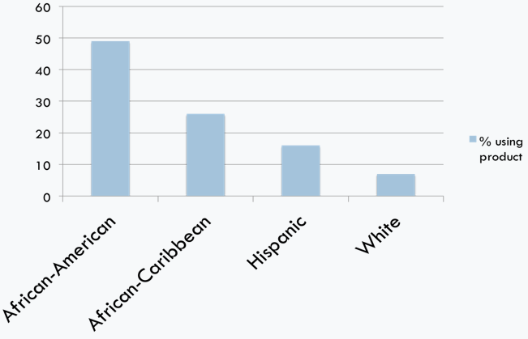
Race/ethnicity and use of hair products with EDCs
James-Todd et al., J Immigr Minor Health, 2012
Notes:
With respect to what's in the products, the US does not require that full disclosure is made. In fact, we have trademark agreements that don't allow... That they don't require companies to fully disclose, but there are some things that you will always find on products for the most part, and that includes seeing things like fragrance or parabens listed on products and placenta listed on products. So this was looking at labels, and we found that about 50% of African Americans were using hair products that contained a labeled information of containing an endocrine-disrupting chemical compared to only about 7% of white. Individuals in African Caribbean and Hispanic individuals were somewhere in between for this.
James-Todd T, Senie R, Terry MB. Racial/ethnic differences in hormonally-active hair product use: a plausible risk factor for health disparities. J Immigr Minor Health. 2012 Jun;14(3):506-11.

Slide 29
Hormonal activity of commonly used hair products
 | Estrogen receptor | Androgen receptor | Progesterone receptor | Glucocorticoid receptor
Hair lotion | + | 0 | - | 0
Leave-in conditioner (sample 1) | 0 | - | +/- | -
Leave-in conditioner (sample 2) | +/- | - | - | -
Hair oil (sample 1) | - | - | +/- | -
Root stimulator | + | 0 | 0 | -
Hair oil (sample 2) | - | - | 0 | 0
James-Todd et al., JESEE, 2021
Notes:
For hormonal activity, when we look at the most commonly used hair products from the Greater New York Hair Products Study, we sent them out to look at... Again, these products are chemical mixtures, there's a lot in them. And so we found that every single one of them was able to disrupt the estrogen receptor, androgen receptor, progesterone receptor, or the glucocorticoid receptor. So these were products on the shelves. Just, you could go into your local pharmacy drugstore and just purchase a hair lotion, a leave-in conditioner, hair oil, or root stimulator. And this was what was happening there. The plus sign represents that they were upregulating, making it more active, these receptors. The negative sign means that they were reducing the activity and the zero means it didn't really have an impact. But if you look across all of them, they all had an impact.
James-Todd T, Connolly L, Preston EV, Quinn MR, Plotan M, Xie Y, Gandi B, Mahalingaiah S. Hormonal activity in commonly used Black hair care products: evaluating hormone disruption as a plausible contribution to health disparities. Journal of exposure science & environmental epidemiology. 2021 May;31(3):476-86.

Slide 30
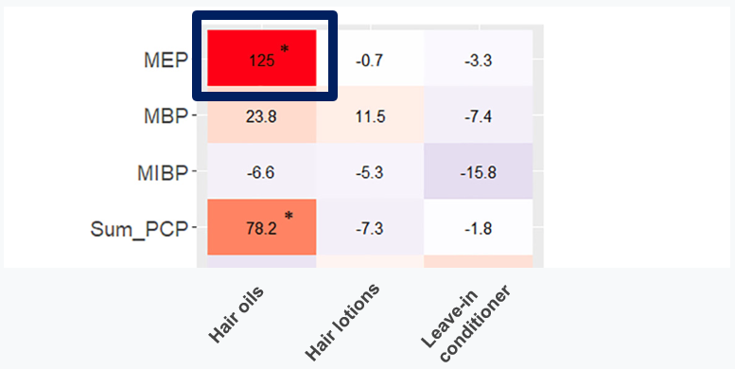

Product use and urinary phthalate metabolite concentrations
Fruh et al, Env Res, 2022
Notes:
And then finally, these products have the ability to increase the circulation in our bodies. So we're looking here at people who used hair oils, hair lotions, or leave-in conditioner. And I wanna draw your attention on the left-hand side to these are the different kinds of phthalates, again, those MEP, MBP, MIBP, and then the sum of all of them together. So all these personal care product, again, the fragrance-associated one, MEP. People who used hair oils daily had concentrations of that particular fragrance-associated chemical circulating in their body. They were excreting it out 125% higher than people who did not use these. So again, being able to dermally be absorbed into the body.
Fruh V, Preston EV, Quinn MR, Hacker MR, Wylie BJ, O'Brien K, Hauser R, James-Todd T, Mahalingaiah S. Urinary phthalate metabolite concentrations and personal care product use during pregnancy–Results of a pilot study. Science of The Total Environment. 2022 Aug 20;835:155439.

Slide 31
Associations between hair product use and reproductive health
Hair oil and relaxer use in childhood is associated with earlier age at menarche
Hair oil use is associated with shorter gestational age and lower birth weight
Hair relaxer use is associated with breast cancer, uterine cancer, and infertility
James-Todd et al., Annals of Epi, 2011; McDonald et al., Env Hlth, 2018; Preston & Fruh et al., Env Hlth, 2021; Chan et al., Env Rsch, 2023; Llanos et al., Carcinogenesis, 2017; Bertrand et al., Env Rsch, 2023; Wise et al., American Journal of Epi, 2023
Notes:
And so we found associations with those hair products. Hair oil and relaxer use in childhood was associated with earlier age at menarche. It's also associated with shorter gestational age and lower birth weight. And most recently, studies have shown here relaxer use is associated with breast cancer, uterine cancer, and infertility.
James-Todd T, Terry MB, Rich-Edwards J, Deierlein A, Senie R. Childhood hair product use and earlier age at menarche in a racially diverse study population: a pilot study. Annals of epidemiology. 2011 Jun 1;21(6):461-5.; McDonald JA, Tehranifar P, Flom JD, Terry MB, James-Todd T. Hair product use, age at menarche and mammographic breast density in multiethnic urban women. Environmental health. 2018 Dec;17:1-8.; Preston EV, Fruh V, Quinn MR, Hacker MR, Wylie BJ, O’Brien K, Mahalingaiah S, James-Todd T. Endocrine disrupting chemical-associated hair product use during pregnancy and gestational age at delivery: a pilot study. Environmental Health. 2021 Dec;20:1-9.; Chan M, Preston EV, Fruh V, Quinn MR, Hacker MR, Wylie BJ, O'Brien K, Williams PL, Hauser R, James-Todd T, Mahalingaiah S. Use of personal care products during pregnancy and birth outcomes–A pilot study. Environmental Research. 2023 May 15;225:115583.; Llanos AA, Rabkin A, Bandera EV, Zirpoli G, Gonzalez BD, Xing CY, Qin B, Lin Y, Hong CC, Demissie K, Ambrosone CB. Hair product use and breast cancer risk among African American and White women. Carcinogenesis. 2017 Sep 1;38(9):883-92.; Bertrand KA, Delp L, Coogan PF, Cozier YC, Lenzy YM, Rosenberg L, Palmer JR. Hair relaxer use and risk of uterine cancer in the Black Women's Health Study. Environmental Research. 2023 Dec 15;239:117228.; Wise LA, Wang TR, Ncube CN, Lovett SM, Abrams J, Boynton-Jarrett R, Koenig MR, Geller RJ, Wesselink AK, Coleman CM, Hatch EE. Use of chemical hair straighteners and fecundability in a North American preconception cohort. American Journal of Epidemiology. 2023 Jul;192(7):1066-80.

Slide 32
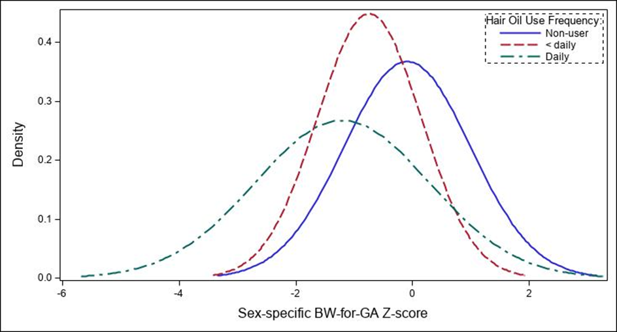

Association between hair product use and pregnancy outcomes
300-gram lower birth weight among daily users compared to never users
Chan et al., Env Res, 2023
Notes:
We found associations with birth weight. And so here, I'm showing you distributions of birth weight and looking at that by how frequently people use products. And so what I'm showing you is the daily users have babies that were born 300 grams lower birth weight compared to never users of hair oils. And if you look closely, the tails are thicker here, meaning like much lower birth weight infants for daily users at these products. So again, these products contain phthalates and other chemicals, they disrupt the body's hormone systems and so on.
Chan M, Preston EV, Fruh V, Quinn MR, Hacker MR, Wylie BJ, O'Brien K, Williams PL, Hauser R, James-Todd T, Mahalingaiah S. Use of personal care products during pregnancy and birth outcomes - A pilot study. Environ Res. 2023 May 15;225:115583.

Slide 33
Disparities in safer hair product availability by neighborhood
Communities that had a greater percentage of people of color and of individuals living below the poverty line were less likely to have safer products, based on Environmental Working Group’s SkinDeep risk score
These same communities were more likely to have products that were leave-in instead of rinse-off
Chan et al., EHP, 2023
Notes:
I just wanna note that I talked a lot about the individual and place matters. So these are disparities in safer hair product availability within neighborhoods. I have an amazing doctoral student who works in my lab, Doctor... Not Doctor, soon to be Doctor, but Marissa Chan, who has found that neighborhoods that have a higher percentage of people of color and lower-income individuals, unfortunately, have less access to safer products based on the Environmental Working Group SkinDeep risk score, which generates a risk score based on the ingredients in the product. And that these same communities have many more leave-on products, meaning people are putting these products on their bodies and not rinsing them off because that's the way they're intended to be used, which means people are more burdened by these chemical exposures in these neighborhoods.
Chan M, Parikh S, Shyr D, Shamasunder B, Adamkiewicz G, James-Todd T. Evaluating Neighborhood-Level Differences in Hair Product Safety by Environmental Working Group Ratings among Retailers in Boston, Massachusetts. Environ Health Perspect. 2023 Sep;131(9):97002.

Slide 34
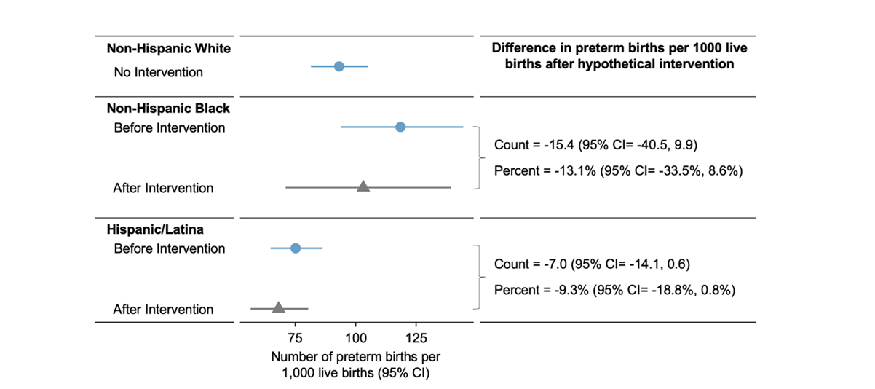
Hypothetical intervention: Predicted probability of preterm birth based on phthalate intervention
Welch et al., EHP, 2023
Notes:
Hypothetical interventions have been able to show, and actually I may skip over this slide, but just wanna note that the hypothetical intervention where we looked at predicted probability of preterm birth based on phthalate interventions shows that if we were to reduce the non-Hispanic Black and Hispanic Latina populations, concentrations of phthalates down to the non-Hispanic white population, which has the lowest concentrations of these chemicals, we would reduce preterm birth significantly by... On the order of anywhere from seven to 15 preterm births per 1,000 live births in a hypothetical intervention.
Welch BM, Keil AP, Buckley JP, Engel SM, James-Todd T, Zota AR, Alshawabkeh AN, Barrett ES, Bloom MS, Bush NR, Cordero JF, Dabelea D, Eskenazi B, Lanphear BP, Padmanabhan V, Sathyanarayana S, Swan SH, Aalborg J, Baird DD, Binder AM, Bradman A, Braun JM, Calafat AM, Cantonwine DE, Christenbury KE, Factor-Litvak P, Harley KG, Hauser R, Herbstman JB, Hertz-Picciotto I, Holland N, Jukic AMZ, McElrath TF, Meeker JD, Messerlian C, Michels KB, Newman RB, Nguyen RHN, O'Brien KM, Rauh VA, Redmon B, Rich DQ, Rosen EM, Schmidt RJ, Sparks AE, Starling AP, Wang C, Watkins DJ, Weinberg CR, Weinberger B, Wenzel AG, Wilcox AJ, Yolton K, Zhang Y, Ferguson KK. Racial and Ethnic Disparities in Phthalate Exposure and Preterm Birth: A Pooled Study of Sixteen U.S. Cohorts. Environ Health Perspect. 2023 Dec;131(12):127015.

Slide 35
What can we do to make change?
Notes:
So what can you do about it?

Slide 36
Clinical guidance
Sexual and reproductive health providers must:
Be knowledgeable about toxic environmental agents and ways to assess risk, reduce exposure, and provide clinical counseling
Ask clients about environmental exposures
(at home, work, and play)
Integrate this information into training and practice
Promote the need for improved policies to address toxic
environmental agents
American College of Obstetrics and Gynecology and American College of Nurses’ and Midwives committee statement
Notes:
So as sexual and reproductive health providers, the American College of Obstetrics and Gynecology and the American College of Nurses and Midwives released a committee statement on environmental chemicals. And they recommended and it provided guidance that you should be knowledgeable about toxic environmental agents in ways to assess risk and reduce exposure and provide clinical counseling, as well as ask clients about their environmental exposures at home, in the workplace, and at play. They should integrate this information into training and practice and promote the need for improved policies to address toxic environmental agents.
You can use the RHNTC’s Preconception Counseling Checklist to guide asking about exposure to environmental toxins: https://rhntc.org/resources/preconception-counseling-checklist
American College of Obstetricians and Gynecologists’ Committee on Obstetric Practice. Reducing Prenatal Exposure to Toxic Environmental Agents: ACOG Committee Opinion, Number 832. Obstet Gynecol. 2021 Jul 1;138(1):e40-e54.
https://www.acog.org/clinical/clinical-guidance/committee-opinion/articles/2021/07/reducing-prenatal-exposure-to-toxic-environmental-agents

Slide 37


Improving environmental health literacy of health care providers
Environmental health not a part of the medical school curriculum
Limited awareness about environmental chemicals and health
Opportunity for intervention
Notes:
We are doing some of this because we recognize in our lab that this is not a common increasing awareness around environmental health literacy as it relates to endocrine-disrupting chemicals is not commonly done as a core competency area in medical or nursing school. And so we have two randomized control trials. The IHEHLP Study and the Deep Study, one focused on licensed clinicians, the other one focused on doulas to increase environmental health literacy for clinicians and doulas. And that subsequently increase patient environmental health literacy as it relates to endocrine-disrupting chemicals using a narrative-based educational intervention.

Slide 38

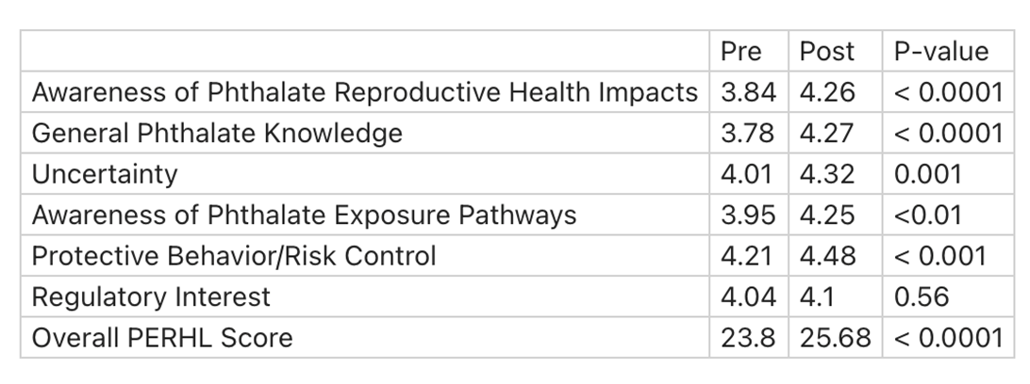
Pre- vs. post-test environmental health literacy scores
Individuals who had higher phthalate environmental reproductive health literacy (PERHL) scores for protective behaviors and regulatory interest had lower concentrations of certain phthalate metabolites.
Tomsho et al., EHP, 2024
Notes:
This is some preliminary data just highlighting pre and post. We evaluate environmental health literacy prior to our intervention and after our intervention. And I'm showing you that across the board, from awareness of phthalate reproductive health impacts to general phthalate knowledge, and as well as protective behaviors and regulatory interests, that we do indeed see improvements in environmental health literacy for clinicians that participated in our study. And so what can you do when you're counseling clients to reduce their burden of environmental chemicals? You could run a checklist, environmental checklist with them. You can counsel clients on limiting their exposure. I mentioned several products that we know, for example, perfumes that you might be able to recommend people use less of, for example. Maybe they don't take it completely away, but use less of. So use non-toxic cleaning products within the home and minimize some of the personal care products that, particularly other things that contain fragrance as well. As well as minimizing consumption of fast foods and eating more fresh foods and vegetables when possible.
Tomsho KS, Quinn MR, Adamkiewicz G, James-Todd T. Development of a Phthalate Environmental Reproductive Health Literacy (PERHL) Scale. Environmental Health Perspectives. 2024 Apr 26;132(4):047013.

Slide 39
Counseling clients to reduce EDC exposures
Use an environmental checklist with clients
Counsel clients on limiting their exposure
Suggest actions such as:
  Use non-toxic cleaning products
  Minimize use of personal care products and cleaning products that contain fragrance
  Minimize consumption of fast and processed foods; eat more fresh foods
  For more info check out the RHNTC’s Understanding Endocrine Disruptors and Fertility Video at: https://rhntc.org/resources/understanding-endocrine-disruptors-and-fertility-video
Notes:
And so what can you do when you're counseling clients to reduce their burden of environmental chemicals? You could run a checklist, environmental checklist with them. You can counsel clients on limiting their exposure. I mentioned several products that we know, for example, perfumes that you might be able to recommend people use less of, for example. Maybe they don't take it completely away, but use less of. So use non-toxic cleaning products within the home and minimize some of the personal care products that, particularly other things that contain fragrance as well. As well as minimizing consumption of fast foods and eating more fresh foods and vegetables when possible.
For more info check out the RHNTC’s Understanding Endocrine Disruptors and Fertility Video at: https://rhntc.org/resources/understanding-endocrine-disruptors-and-fertility-video

Slide 40
Counsel clients on EDCs and fertility
Check out the RHNTC’s Understanding Endocrine Disruptors and Fertility Video at: https://rhntc.org/resources/understanding-endocrine-disruptors-and-fertility-video
Notes:
It's also worth noting that RHNTC has a video that "Understanding Endocrine Disruptors and Fertility" video located at this link that could assist you in counseling clients on EDCs and fertility.
For more info check out the RHNTC’s Understanding Endocrine Disruptors and Fertility Video at: https://rhntc.org/resources/understanding-endocrine-disruptors-and-fertility-video

Slide 41
Promote change
Continue learning about local, state, and federal policies governing chemical ingredients in consumer products
Just because it is on the shelf does not mean it is safe for use
Recognize the critical role you play in informing policy change
Notes:
And promote change. So continue learning more both at the local level, as well as the state and federal level, around the governing of these chemicals and consumer products. I mentioned earlier to you prior to about a year ago, laws and policies have not changed since the late 1930s, and we still need more changes. It's worth noting that here in the US, we regulate or ban around 11 chemicals compared to the European Union, which is more like in the thousands. So we have a ways to go based on our scientific evidence. And just because it's on the shelf does not mean it's safe. And recognizing the critical role that you all play in informing policy change as change agents.

Slide 42
Summary
EDCs are prevalent and are present in many of the products we use every day
These chemicals are linked to adverse reproductive health outcomes
Some populations that have a higher burden of adverse reproductive health outcomes also have a higher burden of exposure to EDCs
Clinicians can provide guidance on strategies for reducing exposures to EDCs prior to, during, and after pregnancy
Notes:
So in summary, EDCs are prevalent, they're everywhere, they're in the products that we use every day, they're linked to adverse reproductive health outcomes. And some populations have a higher burden of adverse reproductive health outcomes and a higher burden of exposure to these chemicals. So we have a real opportunity here to reduce exposure that may impact the reduction of reproductive health disparities. And clinicians can really provide guidance on strategies for reducing exposures to EDCs prior to, during, and after pregnancy.

Slide 43
Poll time! 2
How confident are you that you can:
Describe how exposure to EDCs can negatively affect reproductive health
Describe at least 2 strategies for reducing exposure to EDCs, which sexual and reproductive health providers can discuss with clients
Notes:
So now for our final poll, can I ask you the same question? How confident are you that you can describe how exposures to EDCs can negatively affect reproductive health? And describe at least two strategies for reducing exposure to EDCs, which sexual and reproductive health providers can discuss with clients. So I really like that we move the needle. We have fewer ones, twos, and threes and more, threes, fours, and fives. And with that, I would like to open up for questions that you all may have.

Slide 44
Q&A
Any questions?
Notes:
Fonda Ripley:
Thank you, Dr. James-Todd. Really appreciate the wealth of information that you shared to orient us all to endocrine-disrupting chemicals, routes of exposure, differences in exposure, and what that means for reproductive health. So we have just a minute or two for questions. We had lots of great questions come in by chat, as well as during registration. So I think I'll raise one question, and also welcome you, Dr. James-Todd, if there are any other questions that you saw come in that you really would like to speak to. Can take that second. The first one I'll raise is: What is the most important action that someone can take during pregnancy or before pregnancy to protect their children from the effects of endocrine-disrupting chemicals?
Dr. Tamarra James-Todd:
Yeah, so I mean this probably goes without saying. It's probably oftentimes what you all would say. Eating a healthy diet and making sure that you're in the healthy... By healthy diet, it's like to the greatest of your ability, reducing ultra-processed foods, which often contain these harmful chemicals. And also making sure that people are aware that there are kind of day-to-day chemicals that we are being exposed to, and are cleaning, and other things that... I often get the feedback, "Oh, these things, these safer chemicals are too expensive, so it's not okay for everyone." And I think that there are safer alternatives that are less expensive, including making your own products that are available. And there are a variety of resources now ranging from environmental working group to others that you all even mentioned in the comments that I think folks should have access to as they seek out safer products.
Fonda Ripley:
And I'll raise one more question that came in by chat. Do you have a list of top of mind, a list of common endocrine-disrupting chemicals to avoid when someone might be choosing lotions, or shampoos, or household supplies?
Dr. Tamarra James-Todd:
Yes, so there's a variety of different resources, again, ranging from environmental working group to, and I'm not affiliated with them in any way, but... To others. But I will say the Non-Toxic Black Beauty Project, which the breast cancer prevention partners in California, has put together a really nice list, it's called the Red List, that details out a variety of chemicals that one should avoid in personal care products. That may be a helpful list or tool for folks to use.
Fonda Ripley:
Thanks so much. Maybe I'll raise one more question that I'm particularly interested in myself. Someone inquired products with lavender and tea tree oil. Should they be avoided altogether or are they only harmful in a large amount?
Dr. Tamarra James-Todd:
Yeah, it's a great question. I get asked that a fair amount. In the context of reproductive health, I think that there are other things that folks could use as opposed to lavender. We know that lavender has an estrogenic... The lavender essential oil has an estrogenic property to it. So depending on different stages and windows of life, it may be particularly harmful. So I would identify other safer chemicals or products that natural products that folks could use, as opposed to advocating for tea tree oil or lavender, which both, again, have that kind of estrogenic property to them.

Slide 45
What’s one action you will take as a result of this discussion?
Notes:
Okay, thanks for shedding light on that. So I'm going to move us into closing up. Before we close up, I would love to hear from you all on an action that you'll take as a result of our discussion today. If you could take a moment to chat in something that you will do or something that you would like to share as a result of the webinar. We're very interested in hearing what's top of mind for you. So we'll take just a minute for you all to add to the chat. Share information with coworkers, be mindful of your own use of products, discuss with others, educate others. Great, glad to see what's standing out for you all that you can act on following today's webinar.

Slide 46
THANK YOU!
Please fill out the evaluation form after the webinar!
CONTACT US
rhntc@jsi.com
This webinar was supported by the Office on Women’s Health (Grant ASTWH2000-90-01-00). The views expressed do not necessarily reflect the official policies of the Department of Health and Human Services; nor does mention of trade names, commercial practices, or organizations imply endorsement by the U.S. Government.
Notes:
So I wanna take a moment to, again, thank Dr. James-Todd for her time today and sharing a lot of great information with us to orient us to this topic. Thank you all for taking time to join us today. As a reminder, we'll have the slides, and a recording, and the transcript from the webinar today available on rhntc.org in just a few days. If you have additional questions on the topic, you can email those to us at rhntc@jsi.com. A final ask that you please do take a moment to complete the evaluation. The link is in the chat, and it'll also appear when you leave the webinar, and it will be emailed to you following the webinar. So lots of ways to access that evaluation. And again, we really appreciate your feedback to inform our future sessions. A reminder that if you would like to obtain a Certificate of Completion for attending today, you need to be logged into rhntc.org when you complete the evaluation.

Slide 47
Engage with Us
Subscribe to the RHNTC Monthly eNewsletter at rhntc.org/enewsletter
Contact us on rhntc.org
Sign up for an account on rhntc.org
Follow us on LinkedIn
Subscribe to the RHNTC podcast
podcast.rhntc.org
Notes:
And lastly, stay engaged with us. You can subscribe to our monthly newsletter, you can contact us via email on rhntc.org, you can follow us on LinkedIn, and you can subscribe to our podcast. So with that, thank you all again for joining us today, and that concludes today's webinar.

