Slide 1
The Benefits of Person-Centered Contraceptive Counseling
Christine Dehlendorf, MD, MAS
Professor, Department of Family & Community Medicine
University of California, San Francisco (UCSF)
Notes:
Caitlin Hungate:
Hi everyone, this is Caitlin Hungate with the Reproductive Health National Training Center. And I'm delighted to invite and welcome you all and many of you are still joining to today's webinar about the benefits of person-centered contraceptive counseling. We have a few announcements before we get started. Everyone on the webinar will be muted given the large number of participants. We do plan to have time for questions at the end of the webinar and you can ask your questions using the chat at any time, and we will get to them at the end. A recording of today's webinar, the slides and a transcript will be emailed to participants and available on rhntc.org within the next few days. Closed captioning has been enabled for this webinar. To view, you can click on your closed captioning icon at the bottom of your screen.
And your feedback is very important to us and it has enabled the RHNTC to make quality improvements based on your comments. Please take a moment to open the evaluation link. And thank you Nancy for chatting it out, it was just put in the chat. You're welcome to open it up and complete it in the course of our hour together and then close it when we're done. In order to obtain a certificate of completion for attending this webinar, if you need that, you must be logged into rhntc.org when you complete the evaluation. And last but not least, the presentation was supported by the Office of Population Affairs or OPA. Its contents are solely the responsibility of the authors and do not necessarily represent the official views of OPA or WH or HHS.

Slide 2
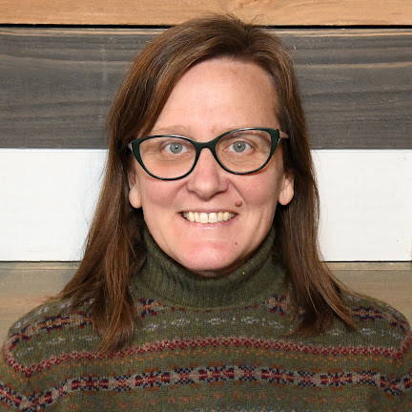
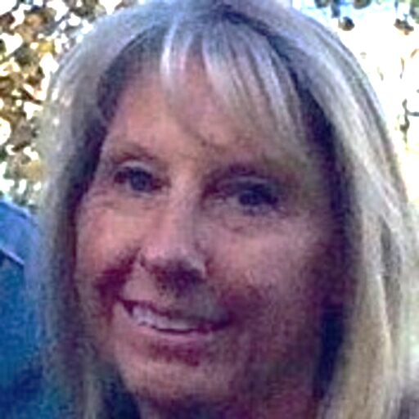
RHNTC Team
Caitlin Hungate (she/her)
TTA Provider and Fiscal Lead
Angie Fellers LeMire (she/her)
TTA Provider and Clinical Lead
Yashi Thakurani (she/her) Program Support
Nancy Thomas (she/her)
TTA Provider
Notes:
Caitlin Hungate:
I am joined by wonderful colleagues at the training center as well. Myself, I'm the training and technical assistance provider and fiscal lead and Angie Fellers LeMire, next slide please. Angie, can you wave? I don't know if you want to say hi so people can see you, but Angie is also a training and technical assistance provider and clinical lead. We're joined by Yashi Thakarani, Program Support. Yashi, thank you so much for joining. And last but not least, Nancy Thomas is a training and technical assistance provider and we're really honored to be with you all this afternoon. And I'm going to turn it over to Dr. Christine Dehlendorf and the team at UCSF to introduce themselves and get going with the webinar. Thanks so much.

Slide 3
UCSF Team Person-Centered Reproductive Health Program
Christine Dehlendorf, MD, MAS (she/her), PCRHP Director
Lindsey Gibson, MPH (they/she), Senior Project Manager
Sonja Goetsch-Avila (she/they), Project Coordinator
Beckie Kriz, RN, MS (she/her), Program Director
Notes:
Christine Dehlendorf:
Thank you so much, Caitlin. We are all thrilled to be here. So I am Christine Dehlendorf, she, her pronouns, and I'm a family physician and a professor in the University of California San Francisco and director of the Person-Centered Reproductive Health Program. And I'm going to ask our team to introduce themselves. Lindsey, can I get started with you?
Lindsey Gibson:
Absolutely. Hi everyone. My name is Lindsey Gibson. I use they, them or she, her pronouns either are fine. I'm a senior project manager at PCRHP where I work on our performance measures portfolio and I'll pass it over to Sonya.
Sonya Goetsch-Avila:
Good afternoon everybody. My name is Sonya Goetsch-Avila. I use she and they pronouns. I'm a project coordinator with the Person-Centered Reproductive Health Program, also working on our performance measures portfolio. And I'll pass it over to Becky.
Beckie Kriz:
Hi, I'm Beckie Kriz, I am the program director for the Person-Centered Reproductive Health Program and I'm a nurse by training. I'll pass it back to Christine.
Christine Dehlendorf:
Wonderful, thanks so much. We have such a great team and we're all so excited to be here to talk about our shared passion for person-centered contraceptive care and measurement. So next slide please. So our learning objectives are to talk about those things about why we care about person-centered care and why we think it's important to be able to measure it. And we think you'll come away with some real actionable insights into that from this webinar

Slide 4
Learning Objectives
Identify at least one reason why assessing patient experience is important in the provision of high-quality, equitable, client-centered Title X contraceptive services
Describe the Person-Centered Contraceptive Counseling (PCCC) measure
Identify at least one resource to support the implementation of the PCCC
Describe upcoming PCCC resources and learning opportunities from the RHNTC in partnership with UCSF
Notes:
Christine Dehlendorf:
Wonderful, thanks so much. We have such a great team and we're all so excited to be here to talk about our shared passion for person-centered contraceptive care and measurement. So next slide please. So our learning objectives are to talk about those things about why we care about person-centered care and why we think it's important to be able to measure it. And we think you'll come away with some real actionable insights into that from this webinar.

Slide 5
What is patient-centered care?
“Patient-centered care is care that is respectful of and responsive to individual patient preferences, needs, and values.”
– The Institute of Medicine
Recognized by IOM as a dimension of quality
Associated with improved outcomes
Communication is a core component of patient-centered care
Notes:
Christine Dehlendorf:
Okay, so we're first going to start with what is patient-centered or person-centered care. And obviously we know that all of you know and care about patient-centered care, but we do really want to start with providing a foundation to make sure we're all on the same page.
And part of the reason for that is because it is always somewhat shocking to people that the concept of centered care is actually relatively new in the healthcare ecosystem. And in fact, it really gained prominence in 2001 when the Institute of Medicine published its publication crossing the Quality Chasm. And in that publication they define patient centeredness as a core domain of quality. And that really was the first time that it had been lifted up in that way. And in this publication, they defined patient-centered care as care that is respectful of and responsive to individual patient preferences, needs and values. And it's really quite interesting if you look for example at publications related to patient-centered care in PubMed, you'll see that it was really right around 20th century that this started being something that was talked about in the health literature and prior to that it had not been.
And this is really important because what this tells us in points to is the fact that our healthcare system has not been historically or in an ongoing way structured around patient centeredness. That is not where we started, that is not where we came from. We come from a lot of clinical priorities and public health priorities. And this is reflected in both structural and process aspects of our healthcare delivery, including, for example, the hours of healthcare delivery, which are often very inconvenient for patients, but also the things that we prioritize and measure in healthcare. And the example I always like to give as a family physician is diabetes care. And so in diabetes care, what we usually focus on, for example, is measures of hemoglobin A1C, which is blood sugar control over a three month period. And that is a marker of quality care and what we aim for. But from a patient-centered perspective, what we neglect when we pay only attention to that number and that numeric outcome is patient's experience of diabetes and their experience of diabetes care.
Are they experiencing low blood sugar? Are they going to the emergency room? Are they having problems with their side effects of their pills or their injections? And all of those things contribute to their diabetes related quality of life. And when we focus only on the clinical priority, which we often focus on in healthcare of hemoglobin A1C, we miss the big picture and we definitely miss the vote on patient-centeredness. But one of the things that's also really important about patient-centered care is that studies have found that when we focus on what patients care about themselves, their experience of low blood sugar, their experience of side effects, whatever it might be, in fact they do better with respect to the clinical outcomes that we historically and traditionally measure things like hemoglobin A1C. So this is not an either or, this is really we are missing the opportunity to improve patients clinical health outcomes when we don't engage with them and their need values and preferences in the way that we should be doing from an ethical perspective regardless.
And we really focus on our team on the fact that communication is a core aspect of patient-centered care. That you can't be providing patient-centered care in which people feel comfortable sharing their needs, values and preferences if you don't have quality communication skills. And you also need to be able to communicate back to patients about how those needs, values, and preferences relate to their clinical options for treatment or management. And so we really, really want to foreground the fact that we need to be really focusing on an often underappreciated aspect of clinical care delivery, which is our ability to communicate with patients in an effective and patient-centered way.

Slide 6
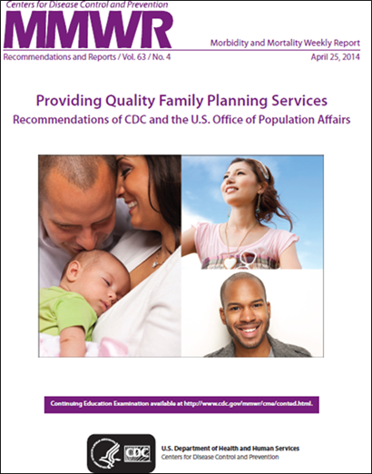
What is quality in contraceptive care? Recommendations from CDC and OPA
People who wish to delay or prevent pregnancy should have access to a broad range of contraceptive methods, preferably on a same-day, on-site basis.
It is important that contraceptive services are provided in a patient-centered manner, providing accurate, easy-to-understand information based on the needs and goals identified by the client and reflecting the client’s preferences and values.
Notes:
Christine Dehlendorf:
So what does this look like in contraception when we think about quality and contraception care? Is patient-centeredness something we should be thinking about? Well, clearly our team thinks that it is, but I will tell you that also the CDC and the Office of Population Affairs agrees. And I know that we all know about the quality and family planning guidelines that were published in the MMWR in 2014. And in this publication they defined quality, there was a much longer document obviously, but if you distill it down, quality had two main components. One was access to a broad range of contraceptive methods, preferably on a same day onsite basis. But it was also really prioritized that these services should be provided in a explicitly stated patient centered manner, which is defined as providing accurate, easy to understand information based on the needs and goals identified by the client and reflecting the client's preferences and values.
And as I think you all know, there's going to be a revision of the QFP coming out soon, and I will tell you that I fully expect that it will have an even more enthusiastic backing of a patient centered approach in the new revision.

Slide 7
What is the goal of person-centered contraceptive care?
To prevent unintended pregnancy??
To meet people’s needs as they themselves define them (reproductive autonomy)
To recognize and respond to the diversity of perspectives and desires about reproduction
To communicate respect and build trust
Notes:
So to understand how to think though about actually doing this in contraceptive care and really having a patient-centered perspective in contraceptive care delivery, we have to really think deeply about some of the built-in assumptions that we have in reproductive health and contraceptive care delivery and how they're really built on and reflect some clinical and public health priorities that can be in conflict with patient centeredness. So to make this point, I want to really highlight the contrast between thinking about the goal of person centered or patient centered contraceptive care being to prevent unintended pregnancy, which I think we often think of it as being and which is kind of built into a lot of our mission statements and other documents.
But what the literature increasingly shows us is that in fact the concept of unintended pregnancy is not patient-centered for all people. That in fact people have a diversity of perspectives related to their reproduction that don't always reflect the planning framework. And I can't go into this in full in this webinar, but what I will tell you is that for some people, the happy accident is a very real concept and I think most of us will either have had a personal experience or friends or family members for whom that has been the case. And so the approach to thinking that we are providing contraceptive care with the goal of preventing unintended pregnancy misses the fact that people in fact have a diversity of perspectives around their reproduction and that it should be from a patient centered perspective. Our goal to really meet patients' needs as they themselves define them in the diversity of ways that they think about what they want their reproductive health and health outcomes to look like.
And so I think that that is a really critical shift in perspective similar to the one that I described around diabetes care, that our goal is not just to bring down hemoglobin A1C at all costs, but it is in fact to meet patients where they're at, to understand their goals, preferences and experiences and help them to achieve the goals that they have for their health and it's the same with reproductive healthcare and contraceptive care. And then I also just really want to highlight too that as we think about contraceptive care and patient-centered care, a really core feature of this is to communicate respect and build trust. We know, and I'll get into this more in a second, that there has been issues with counseling and care that is not patient-centered, that is not focused on patient's needs, values and preferences, and that damages patient's relationship with the healthcare system over the long term, including with respect to their ability to get longitudinal reproductive healthcare that they want.
And so to provide person-centered contraceptive care is part of our efforts to make sure that patients know that they can get the care that they need and be respected in the process throughout their reproductive life course.

Slide 8
Why focus contraceptive services quality improvement on patient experience?
There are demonstrated gaps in patient-centeredness in contraceptive care
Communication and patient-centeredness receive lower ratings than other aspects of family planning quality
In one study, patient preferences for contraceptive methods were elicited in less than 50% of visits (n=342)
Patients recently encountering provider enthusiasm for/resistance to removing IUDs and implants
Becker D, et al., “The Quality of Family Planning Services in the United States: Findings from a Literature Review,” Perspect. Sex. Reprod. Health 39 (2007); Amico J, et al., “Providing LARC in an Academic Family Medicine Center,” Fam Med 47; 9 (2015).
Notes:
So in addition to that ethical reason why it's important to provide person-centered contraceptive care focused on patients' own needs, values and preferences, I say that phrase a lot and it really foregrounds reproductive autonomy and patient's own views of their reproduction. Another reason why it's really important to focus on contraceptive services and patient-centered care is that we know that we're not always doing a good job, that there are opportunities for improvement in the patient-centeredness of contraceptive care. And this has been documented in a range of ways by several groups and researchers including our team. And these studies have found, for example, that communication and patient-centeredness receive lower ratings than other aspects of healthcare quality.
And this, for example, things like physical comfort and access to appointments is usually rated relatively high, but the communication and patient-centeredness has more room for improvement. We did a study at our team where we actually audio recorded 342 contraceptive counseling visits with wonderful providers here in the Bay Area who were very well-intentioned and wanted to do a good job. And despite that, what we found is that they elicited patient preferences for contraceptive methods in less than 50% of the visits, which tells us that there are structural and cultural norms around care delivery that interfere with our ability to provide patient-centered care even when people are wanting to do their best and are well-intentioned.
And then this is particularly important, this issue of patient-centeredness and contraceptive care in the context in the last few decades, which I'm sure many of you have been part of an experience of the upswell of support, enthusiasm for long-acting reversible contraceptive methods or IUDs and implants. And the upswell in clinical spaces and public health spaces of support and enthusiasm for these methods has as we know, translated to in some cases problematic counseling behaviors or problematic experiences of care that patients have had. And this is something that we really need to be thinking about as we continue to want to make sure that we provide access to these methods because access to the full range of methods is really important. We have to be reckoning with the fact that the way that these methods have been introduced into our healthcare system, has actually damaged trust with communities.

Slide 9
They just keep promoting these long-term methods. It’s like they’re getting a commission or something. I always wondered that. They were really, really trying to push this product….It was like they were selling me…. Like, “You should try it.” No. I don’t want to.
Mann, Contraception, 2019
Notes:
Christine Dehlendorf:
This is a quote from a qualitative study that was done out of South Carolina in the context of an IUD initiative where the researchers talked to a patient who said that her experience of contraceptive counseling was that they just keep promoting these long-term methods. It's like they're getting commission or something. I always wondered that they were really, really trying to push this product. It was like they were selling me like, "You should try it." "No, I don't want to." And I always like to point out that it is not that these providers probably had bad intentions, but they thought these methods were the best and they wanted this patient to think this method was the best. And how it was received by the patient was that her autonomy was not being respected and being lifted up and that this was not a patient-centered experience.
In addition, we've also seen this around resistance to removals of IUDs and implants, which is a very profoundly non-patient centered experience and one that is very much of something that is impinging on reproductive autonomy when this happens. So this is from a study that was done with interviewing patients around their experience trying to get, for example, IUDs or implants removed. And this one patient said, "My provider was really hesitant to remove the IUD. She kept telling me, well, we should wait three months and see if your symptoms have worsened. And I waited three months and she's like, no, you should wait some more. And I'm like, take it out or I'm going to a different doctor." And this literature has really shown us that, well again, providers are probably like, "Well ride it out, it'll get better and you'll be really happy with the method." And come from a perspective of thinking that side effects often can get better. The experience of patients is that they are not having their needs, values and preferences prioritized and this damages trust.
So the problem, this gap in quality and this gap in patient centeredness that we've seen over the last few decades in the context of this enthusiasm and promotion of IUDs and implants in many spaces has led to a very understandable reactions by community and particularly by communities of color who've experienced reproductive oppression in the past. And for an example of this, this is from the National Women's Health Network and SisterSong released a joint statement of principles on LARCs responding explicitly to this experience of over promotion of these methods. And what they called for in this was a commitment to ensuring that people are provided comprehensive, scientifically accurate information about the full range of contraceptive options in a medically ethical and culturally competent manner in order to ensure that each person is supported in identifying the method that best suits their needs.
So in this quote, you can really see the allegiance and alliance between reproductive justice perspectives of helping people to have the children they want, not have the children they don't want, and to raise their children in safe and sustainable communities, reproductive justice perspective with the person centered or patient centered perspective, which is about people's own needs, values and preferences, and how we in the healthcare system can serve in service of those needs, values and preferences or as an obstacle to people achieving those needs, values and preferences.

Slide 10
My provider was really hesitant to remove the ParaGard [IUD]. She kept telling me, “Well, we should wait 3 months and see if your symptoms have worsened.” And I waited 3 months and she’s like “Well, you should wait some more.” And I’m like “No. So take it out, or I’m going to a different doctor.”
Becker, Perspectives in Sexual and Reproductive Health (PSRH), 2007
Dehlendorf, PSRH, 2014
Notes:
In addition, we've also seen this around resistance to removals of IUDs and implants, which is a very profoundly non-patient centered experience and one that is very much of something that is impinging on reproductive autonomy when this happens. So this is from a study that was done with interviewing patients around their experience trying to get, for example, IUDs or implants removed. And this one patient said, "My provider was really hesitant to remove the IUD. She kept telling me, well, we should wait three months and see if your symptoms have worsened. And I waited three months and she's like, no, you should wait some more. And I'm like, take it out or I'm going to a different doctor." And this literature has really shown us that, well again, providers are probably like, "Well ride it out, it'll get better and you'll be really happy with the method." And come from a perspective of thinking that side effects often can get better. The experience of patients is that they are not having their needs, values and preferences prioritized and this damages trust.
So the problem, this gap in quality and this gap in patient centeredness that we've seen over the last few decades in the context of this enthusiasm and promotion of IUDs and implants in many spaces has led to a very understandable reactions by community and particularly by communities of color who've experienced reproductive oppression in the past. And for an example of this, this is from the National Women's Health Network and SisterSong released a joint statement of principles on LARCs responding explicitly to this experience of over promotion of these methods. And what they called for in this was a commitment to ensuring that people are provided comprehensive, scientifically accurate information about the full range of contraceptive options in a medically ethical and culturally competent manner in order to ensure that each person is supported in identifying the method that best suits their needs.
So in this quote, you can really see the allegiance and alliance between reproductive justice perspectives of helping people to have the children they want, not have the children they don't want, and to raise their children in safe and sustainable communities, reproductive justice perspective with the person centered or patient centered perspective, which is about people's own needs, values and preferences, and how we in the healthcare system can serve in service of those needs, values and preferences or as an obstacle to people achieving those needs, values and preferences.

Slide 11
Person-Centered Care: a Reproductive Justice Issue
https://www.nwhn.org/wp-content/uploads/2017/02/LARCStatementofPrinciples.pdf
Notes:
Christine Dehlendorf:
So the problem, this gap in quality and this gap in patient centeredness that we've seen over the last few decades in the context of this enthusiasm and promotion of IUDs and implants in many spaces has led to a very understandable reactions by community and particularly by communities of color who've experienced reproductive oppression in the past. And for an example of this, this is from the National Women's Health Network and SisterSong released a joint statement of principles on LARCs responding explicitly to this experience of over promotion of these methods. And what they called for in this was a commitment to ensuring that people are provided comprehensive, scientifically accurate information about the full range of contraceptive options in a medically ethical and culturally competent manner in order to ensure that each person is supported in identifying the method that best suits their needs.
So in this quote, you can really see the allegiance and alliance between reproductive justice perspectives of helping people to have the children they want, not have the children they don't want, and to raise their children in safe and sustainable communities, reproductive justice perspective with the person centered or patient centered perspective, which is about people's own needs, values and preferences, and how we in the healthcare system can serve in service of those needs, values and preferences or as an obstacle to people achieving those needs, values and preferences.

Slide 12
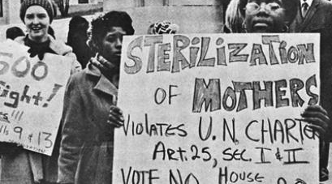
Context of Reproductive Injustices
Nonconsensual sterilization of poor women and women of color
Targeted marketing of DMPA
Unethical testing of oral contraceptive pills in Puerto Rico
150 incarcerated women in California coercively sterilized from 2006–2010
Notes:
Christine Dehlendorf:
So like I said, this response from reproductive justice organizations and communities of color have really come from a reality of longstanding historical and ongoing reproductive injustices enacted on people whose reproduction is devalued in our society. And this is called stratified reproduction. And I think the reality is that this is something that has happened culturally and policy-wise writ large, but also has been manifested in the healthcare delivery system. And that is a part of the reality of racial oppression that we in the healthcare delivery system have to really reckon with as we move forward with providing care that is person centered. I am not going to be able to do justice to this reality and the historical experiences, but just to briefly touch on this, I really encourage people to read Killing the Black Body by Dorothy Roberts as a full treatment of this history. But some examples are non-consensual sterilization of poor women and women of color that happened throughout the 1900s. My state of California was a particularly problematic state in this respect.
In the 1990s when DMPA was first approved by the FDA, it was targeted towards low income communities of color, particularly urban low-income communities of color. And Nikki, I see your question and it was Killing The Black Body by Dorothy Roberts. If someone could put it in the chat, that would be great. And then as described by Dorothy Roberts in this book, when the oral contraceptive pills were first being tested, the high high dose, like 100 micrograms of estrogen pills were first released in Puerto Rico in an experimental way without anyone being informed that they were still experimental and people experienced bad outcomes as a result. And this isn't something that is only in the distant past, these really explicit examples of reproductive oppression in the healthcare system, including the fact that in the California penal system in the last decade there was uncoercive and unconsented sterilization. We also know that this has happened in the immigration system just in the past few years. So this is the reality that people are living with this context of reproductive injustices.

Slide 13
Not Just History… Disparities in Patient Experience
Low-income women of color more likely to report being advised to limit their childbearing than white women
Black clients more likely than white clients to report having been pressured by a clinician to use contraception
In a survey of Black women, 28% reported being pressured to start one type of method when they preferred another
Black and Latina women more likely to have the IUD recommended than White women
Dehlendorf: AJOG, 2010
Downing: Am J Public Health, 2007
Becker: Perspect Sex Reprod Health, 2008
Thorburn: Women Health, 2005
Notes:
Christine Dehlendorf:
these really explicit and overwhelmingly tragic examples of reproductive oppression are one part of the story, but it is also true that we impinge on people's reproductive autonomy and impinge on people's experiences of their reproductive health in other somewhat more subtle ways, but that are still very damaging. And the research has really shown that there are gaps in patient centeredness and care writ large like I said, but that this is also particularly manifested for people again, whose reproduction is devalued in our society. And examples of research that have shown this include that low income women of color are more likely to report being advised to limit their childbearing than white women. And this study was done in the context of actually peripartum care. So these were pregnant people and reporting on their experiences of contraceptive care and women of color were more likely to feel that their future reproduction was discouraged.
Studies have also shown that black clients are more likely to white clients report being pressured to use contraception in general. And in a survey of 500 black women, 28% reported being pressured to start one type of method when they preferred another. So it's kind of across the board encouraging people to limit their fertility to use contraception or to use a specific method. So these studies are all about people's subjective experiences, which are incredibly important and I always make that point. It's really important, people's experience of this care is really important. Our team also did a study to document provider, in fact from the provider perspective, in fact what their behaviors were in terms of differential recommendations by race ethnicity. And we use standardized patients using a randomized design to show these videos to providers and ask them whether they would recommend specific methods to patients varying by race ethnicity.

Slide 14
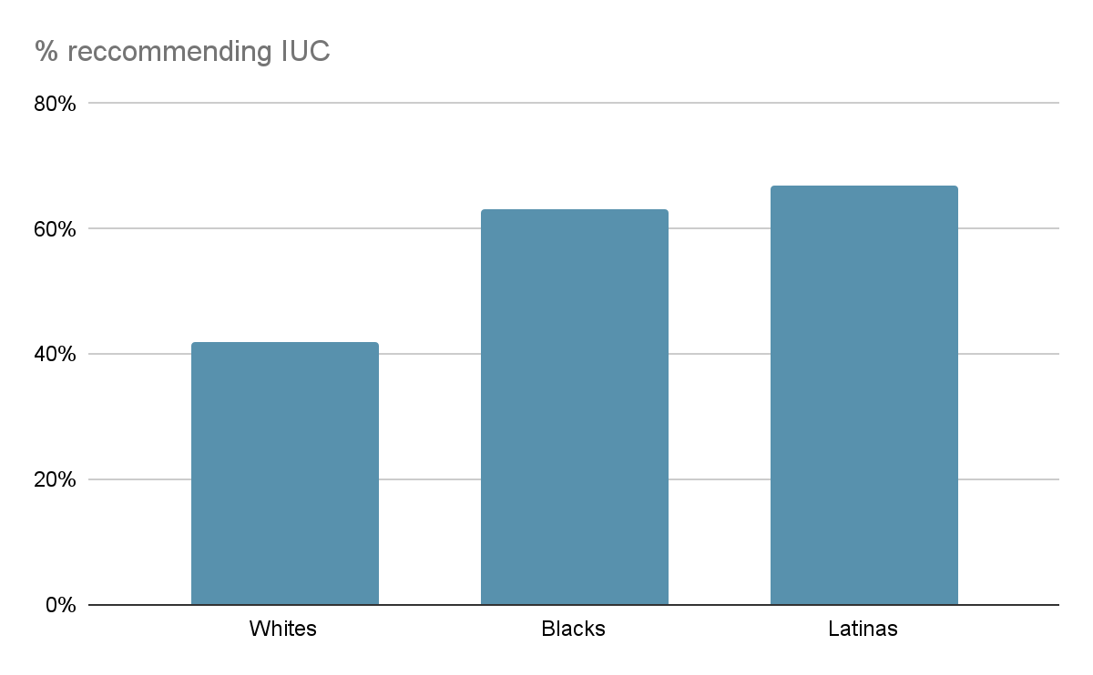
Percent of Providers Recommending IUC to Low SES Women, by Race/Ethnicity (n=173)
Dehlendorf, et al. AJOG, 2010
Notes:
Christine Dehlendorf:
And on the next slide, what you can see is that providers in this randomized study that we published in the American Journal of OBGYN in this randomized design, you can see that providers were more likely to recommend the IUD to black patients and Latina patients, again, standardized videos than to white patients. And what this really indicates is that this non-patient centered push for using these methods because of the over enthusiasm for them was actually being differentially applied towards people who in a historical and ongoing manner have had their reproduction devalued.

Slide 15
The Person-Centered Contraceptive Counseling Measure (PCCC)
PCRHP developed and validated a patient-reported outcome performance measure (PRO-PM)
Designed to capture patient experience of contraceptive counseling
Goal of the measure: Evaluate patients’ experience of contraceptive counseling at the provider and facility level
Notes:
Christine Dehlendorf:
So this was our motivation as a team. This is what we were sitting with when we were thinking about what can we do to shift the needle towards patient-centeredness in the way that we deliver care, recognizing that the vast majority of us, I would argue in the reproductive health system, want to do patient-centered care, want to provide care that is focused on patient's need values and preferences. And I will tell you that when I first started talking about this maybe a decade or more ago, I had many people, particularly in the Title 10 community come up to me and we're so glad to be hearing this pushback against the LARC narrative because it was very distressing, because it was so not aligned with our values. So we're all part of this ecosystem where this LARC promotion had been happening. How do we shift that narrative? How do we hold ourselves accountable to meeting patients' needs as they themselves define them?
Christine Dehlendorf:
And we recognized in our team the value of measurement to be able to allow us to do this right? We measure hemoglobin A1C and because we measure hemoglobin A1C, that is the thing we focus on. We measure unintended pregnancy and because we measure unintended pregnancy, that is the thing we focus on, even if it's not what patients themselves are most interested in. And I will just share with you that there is a new measure I'm working on with some colleagues from Pittsburgh and Tennessee on around developing a measure of pregnancy acceptability as an alternative to pregnancy intention. Recognizing that what we care about is whether patients are okay with their pregnancies or happy with their pregnancies, not whether they were planning their pregnancies.
So recognizing the importance of measurement in counseling specifically in the context of LARC over enthusiasm, we developed and validated a measure of patient experience of person-centered contraceptive counseling that we developed it as a measure of patient experience and then we validated it as a performance measure that can be used at the provider or the facility level as a feasible and really actionable way to document the quality of care that's being provided and also to track it over time as we continue to work to improve the quality of care.

Slide 16
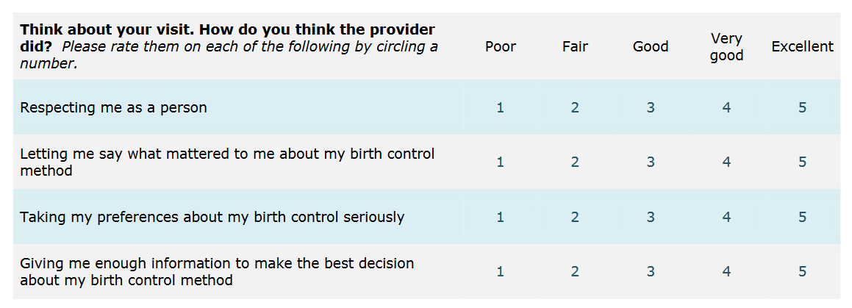
The Person-Centered Contraceptive Counseling Survey (PCCC)
Notes:
Christine Dehlendorf:
So we really worked when we were developing this measure to be as succinct as possible in the questions that we developed and asked. And the reason for that is because we know that patient experience surveys are a pain point in many healthcare systems and part of that is because they're very lengthy and they aren't very specific. And so you end up getting very small sample sizes for questions that you don't know what to do with. So we really wanted to do something that was different by creating a specific measure for contraceptive counseling that could be actionable with respect to contraceptive counseling specifically. But that also was short for items to allow for patients to be able to answer it quickly and get out the door after their visit without it being a big burden.
And we also worked really hard to ensure that we didn't diminish the way that we actually measured the construct, that we didn't come at the cost of actually measuring what we cared about. And I will tell you that we've had very good luck with this measure being only four items as you can see here. We've had a lot of luck with response rates with our pilot study for example, finding about an 80% response rate, which as those of you who are in the patient experience survey space will know that anything over 10% is considered a win. So 80% was incredibly high and very gratifying that our approach was appropriate. And so as you can see here, the four questions are respecting me as a person, letting me say what mattered to me about my birth control method, taking my preferences about birth control seriously, and giving me enough information to make the best decision about my birth control method.
And you can really see that this reflects the concept of patient or person-centered care and that it was what patients wanted to know. Not giving me all the information that could possibly be provided about birth control, but giving me enough information as I define it myself, taking my preferences seriously, letting me say what mattered and I will just lift up that respecting me as a person came up time and time again in all of our work as the most important thing, which I think generally reflects the reality of respect and the healthcare interaction being really critical and the fact that there's a gap in patient experience around respect.

Slide 17
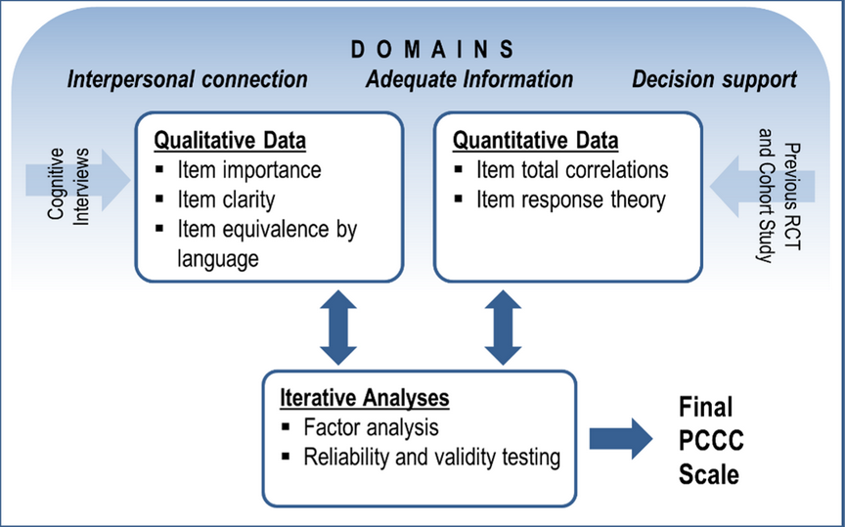
Measure Development
Dehlendorf C, et al., “Development of a patient-reported measure of the interpersonal quality of family planning care,” Contraception 97;1 (2018); Dehlendorf C, et al. “Birth Control Connect: A randomized trial of an online group to disseminate contraceptive information,” Contraception 101; 6 (2020).
Notes:
Christine Dehlendorf:
All right, next slide. I won't bore you with all the statistical and psychometric details of how we develop this measure, but the thing that I wanted to say is that we didn't just pick these four items out of the sky. And when we're really working on having this measure be something that's used, we really wanted to make sure that it was like I said, feasible and that it really reflected patients' voices and priorities for what they cared about with contraceptive counseling. So the diagram you can see on the left is from qualitative work that our team did early on to really understand what patients cared about in contraceptive counseling. And what came out of that qualitative work was these three domains of patient experience. Interpersonal connection, adequate information and decision support. And importantly the decision support domain included interacting with patients and giving them feedback and thoughts about how their preferences related to their options, but leaving the ultimate decision up to the patient.
And then what you can see on the right is a diagram describing how we then took those three domains and you can see the three domains across the top and use both qualitative and quantitative methods to generate items that we are capturing those three domains and then reduce those items down to a final PCCC scale of the four items. And you can see that the qualitative data included things like item importance and item clarity. Again, really trying to foreground patient experience and make sure patient voice was lifted up. And we also looked at item equivalence by language. So the PCCC is available in both Spanish and English in a validated manner. We also encourage people to do translations in other languages, but we really did a lot of deep work on the English to Spanish translation. We also did the quantitative data, psychometrics, like I said, and ultimately that allowed us to triangulate our scale to come up with this final patient-centered scale that was valid and reliable and really reflected patient's priorities for their experience of care and contraception.

Slide 18
Intended Use of the PCCC
To evaluate patient experience of care in the specific context of contraception and identify opportunities for QI
To track and address inequities in counseling
To communicate to patients that their experience is prioritized
To monitor patient-centeredness when initiating new programs or initiatives related to contraceptive access, such as LARC training
Notes:
Christine Dehlendorf:
So how do we think that the PCCC can be used to accomplish the goals that we want to have of increasing patient's positive experience of contraceptive care and their trust in the healthcare system? Well obviously the most obvious use of this scale or this measure is to evaluate patient experience of care to document just where we're at on an individual provider or individual facility level. And I will say that when we've used the scale around the country now we are seeing ranges on a facility level from 30% to 94% in terms of how we score the scale. So there is a broad range. And then what that enables people to do once they get that information about what their scores are, it enables them to identify opportunities for quality improvement. And so for example, in the case of agencies that have been in the 30% range, they have work to do to overall improve their quality of care.
In the context of people who are in the 94% range, we consider 80% to be a threshold based on the work we've been doing so far. When people are at 94%, they can still, for example, have inequities and for example, by language or race ethnicity and we have seen that. And so when we stratify the PCCC by demographic characteristics, we can track and address inequities in counseling, which we have seen in both national and clinic specific data reflect these disparities in patient experience that have been seen in other studies where people with disabilities, people with diverse gender identities, people who are not heterosexual, people who identify as people of color and Spanish speaking patients have lower scores on the PCCC overall. And again, the national survey of family growth has found this and we've also seen this in our clinic specific data. So it's an opportunity to work to address these inequities.
Another thing that we've really seen in our use of the PCCC is that when we just very active asking patients the questions of distributing the survey to patients is an intervention in and of itself because patients know that when we do this that their experience of care is being prioritized and their experience of care is being prioritized around reproductive health specifically. We know from the conversation about maternal and infant mortality morbidity in this country that reproductive health is an area where people often feel disrespected, where there's a lot of room for improvement in community and individual level trust. And the act of prioritizing this aspect of care really helps to make sure that we are both doing the work of building trust and improving care and that patients know that we are doing that work. I just saw the question about being anonymous, I'll come back to that, but yes, absolutely for the reasons that I'm sure was behind your question, which is that social acceptability bias is very real and we do not want people feel pressured to give high scores.
And then another reason that we really think that the PCCC is absolutely critical is because we know that there are ongoing efforts to enhance access to all contraceptive methods. And of course we think that that's really important. From a patient-centered perspective, people should have access to the full range of contraceptive methods. And we also know that when that happens, and including when people use the existing contraceptive provision performance measures that are based on claims data, that there can be an unintentional effect of incentivizing directive counseling towards specific methods. And so when doing these type of initiatives or using these performance measures that track contraceptive provision, it is incredibly important to track patient-centeredness because if you're not tracking it, then you're not prioritizing it and it will take a hit as you prioritize contraceptive provision over the experience of care.

Slide 19
PCCC Implementation
Patient identification
Survey distribution
Data collection and management
Notes:
Christine Dehlendorf:
So we will not get into this in detail here in terms of implementation, but there's always implementation questions as shown by the anonymous question. So we will just say that our experience of developing this measure, of doing the validation study and now having done learning collaboratives and other projects related to this has allowed us to develop robust guidance for how to implement the PCCC in diverse clinical settings with diverse needs and processes. Whether you have, for example, the ability to have a formal checkout process or not, whether or not you who's doing counseling can vary, et cetera, all of those things we have built in that flexibility into a guidance for how to implement the PCCC data collection broken up into these three buckets of patient identification, survey distribution and data collection and management.

Slide 20
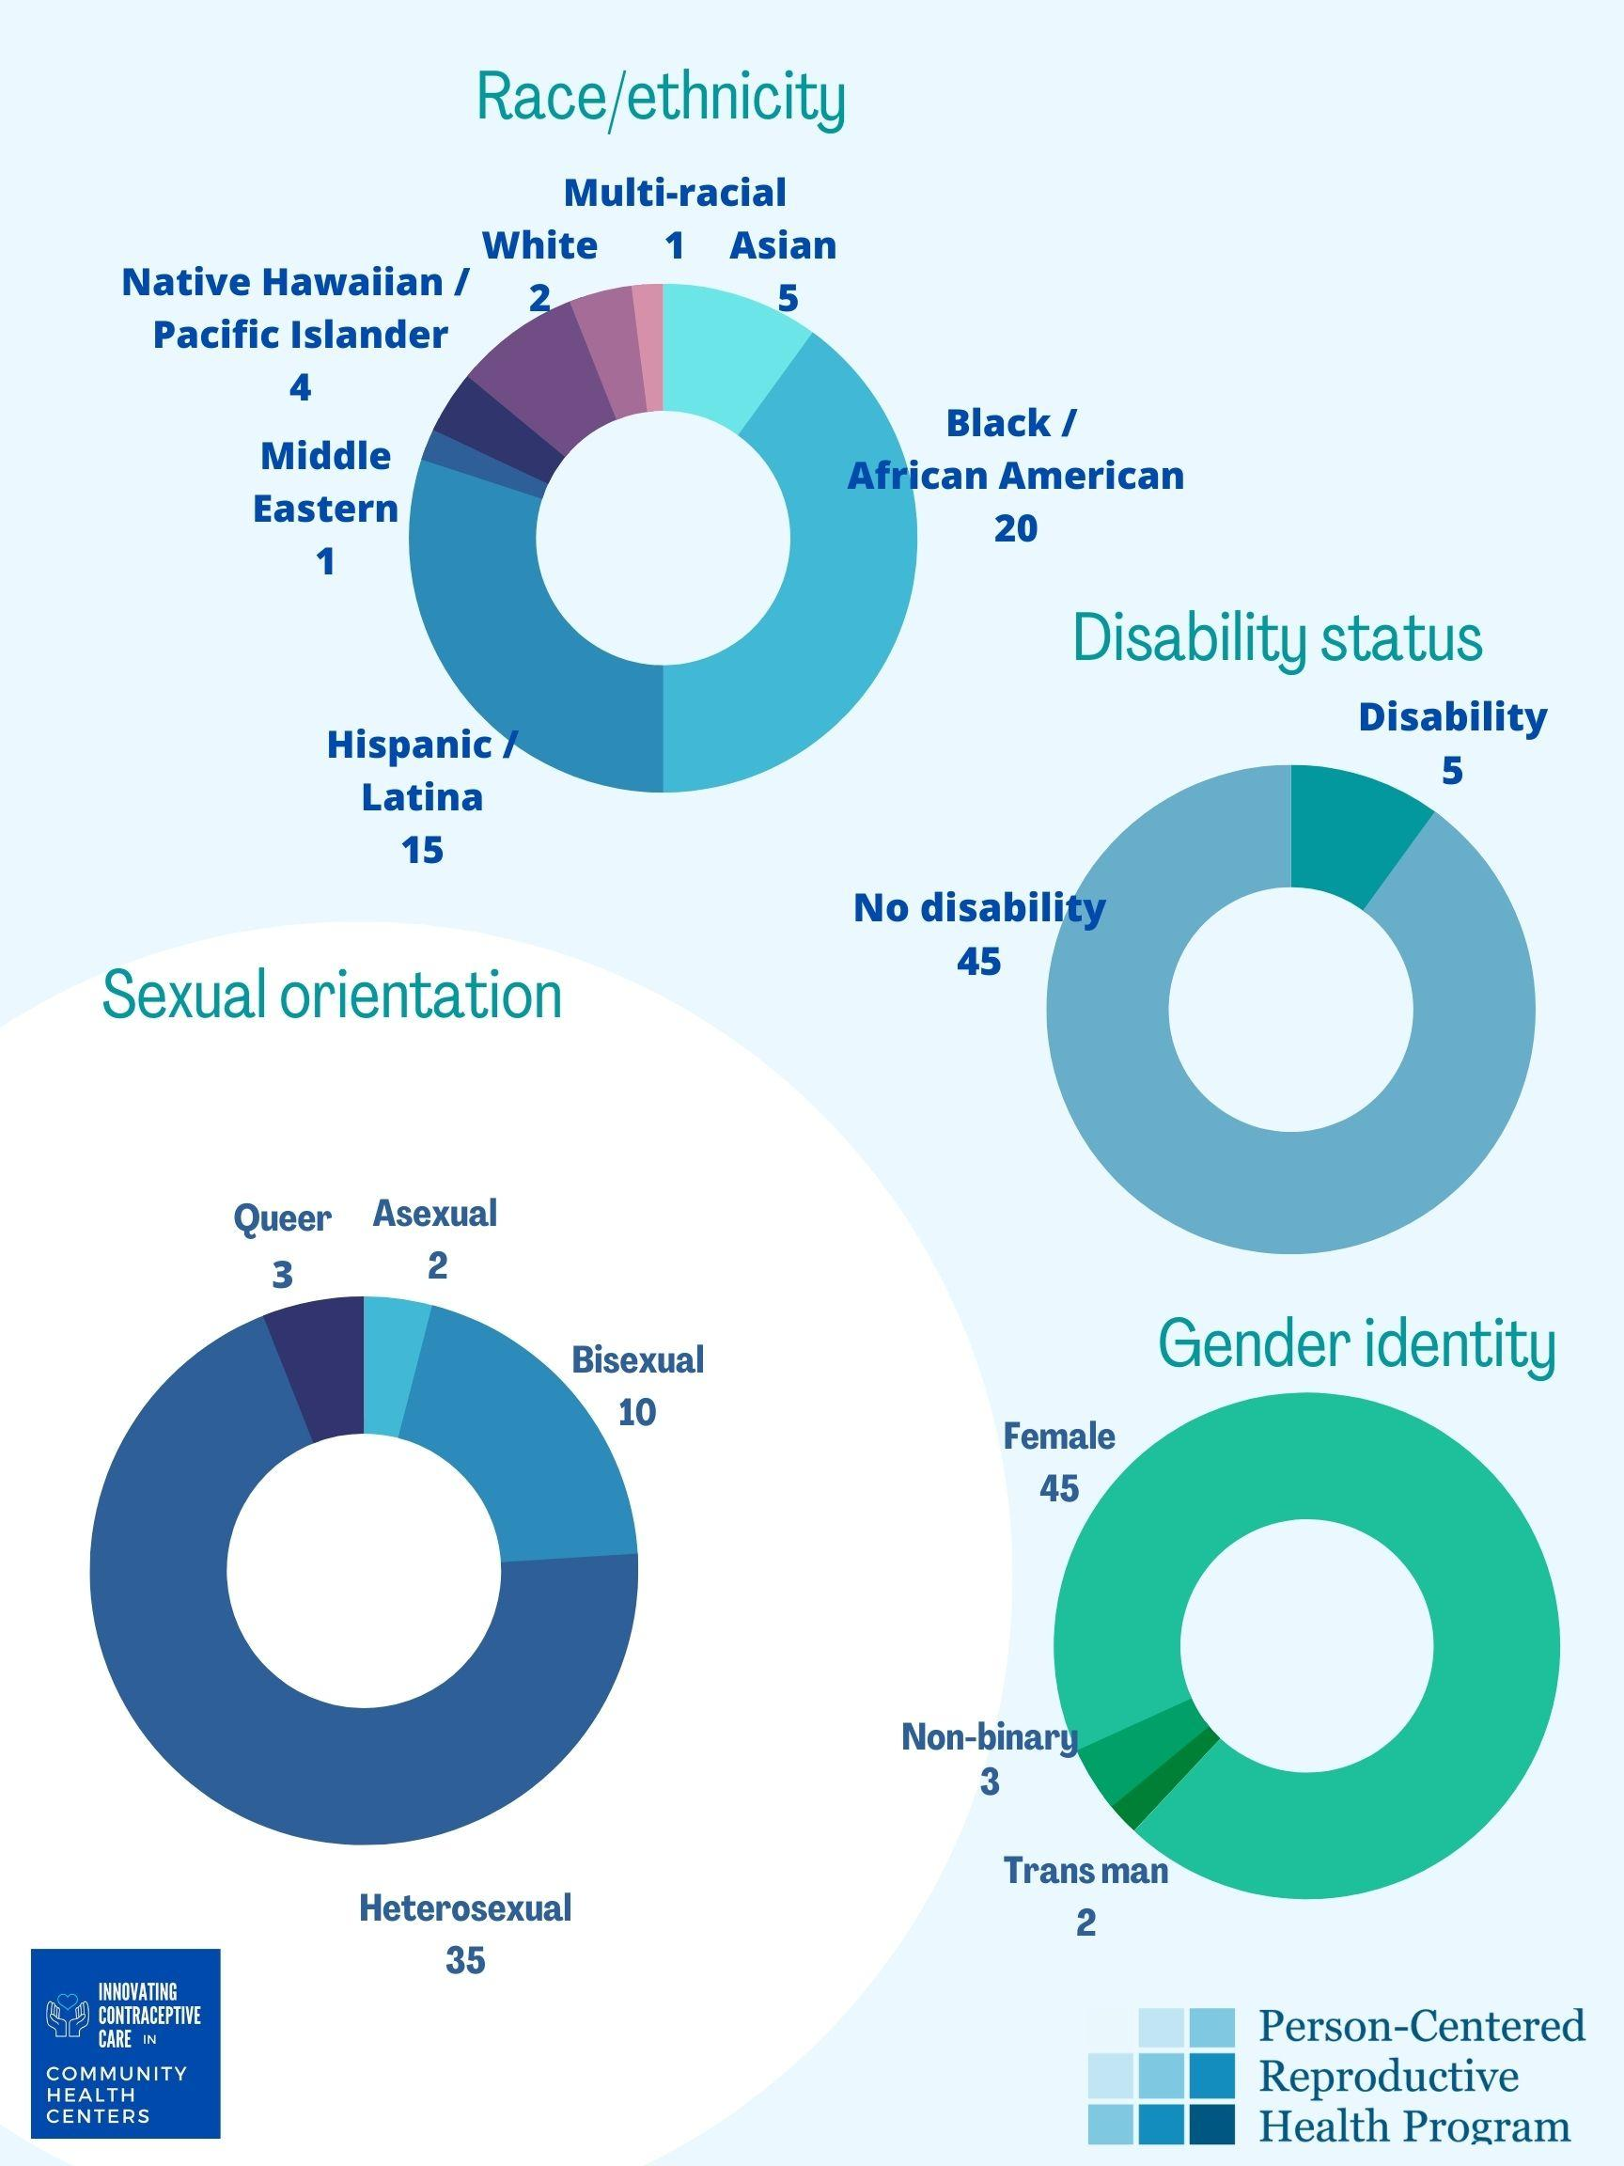
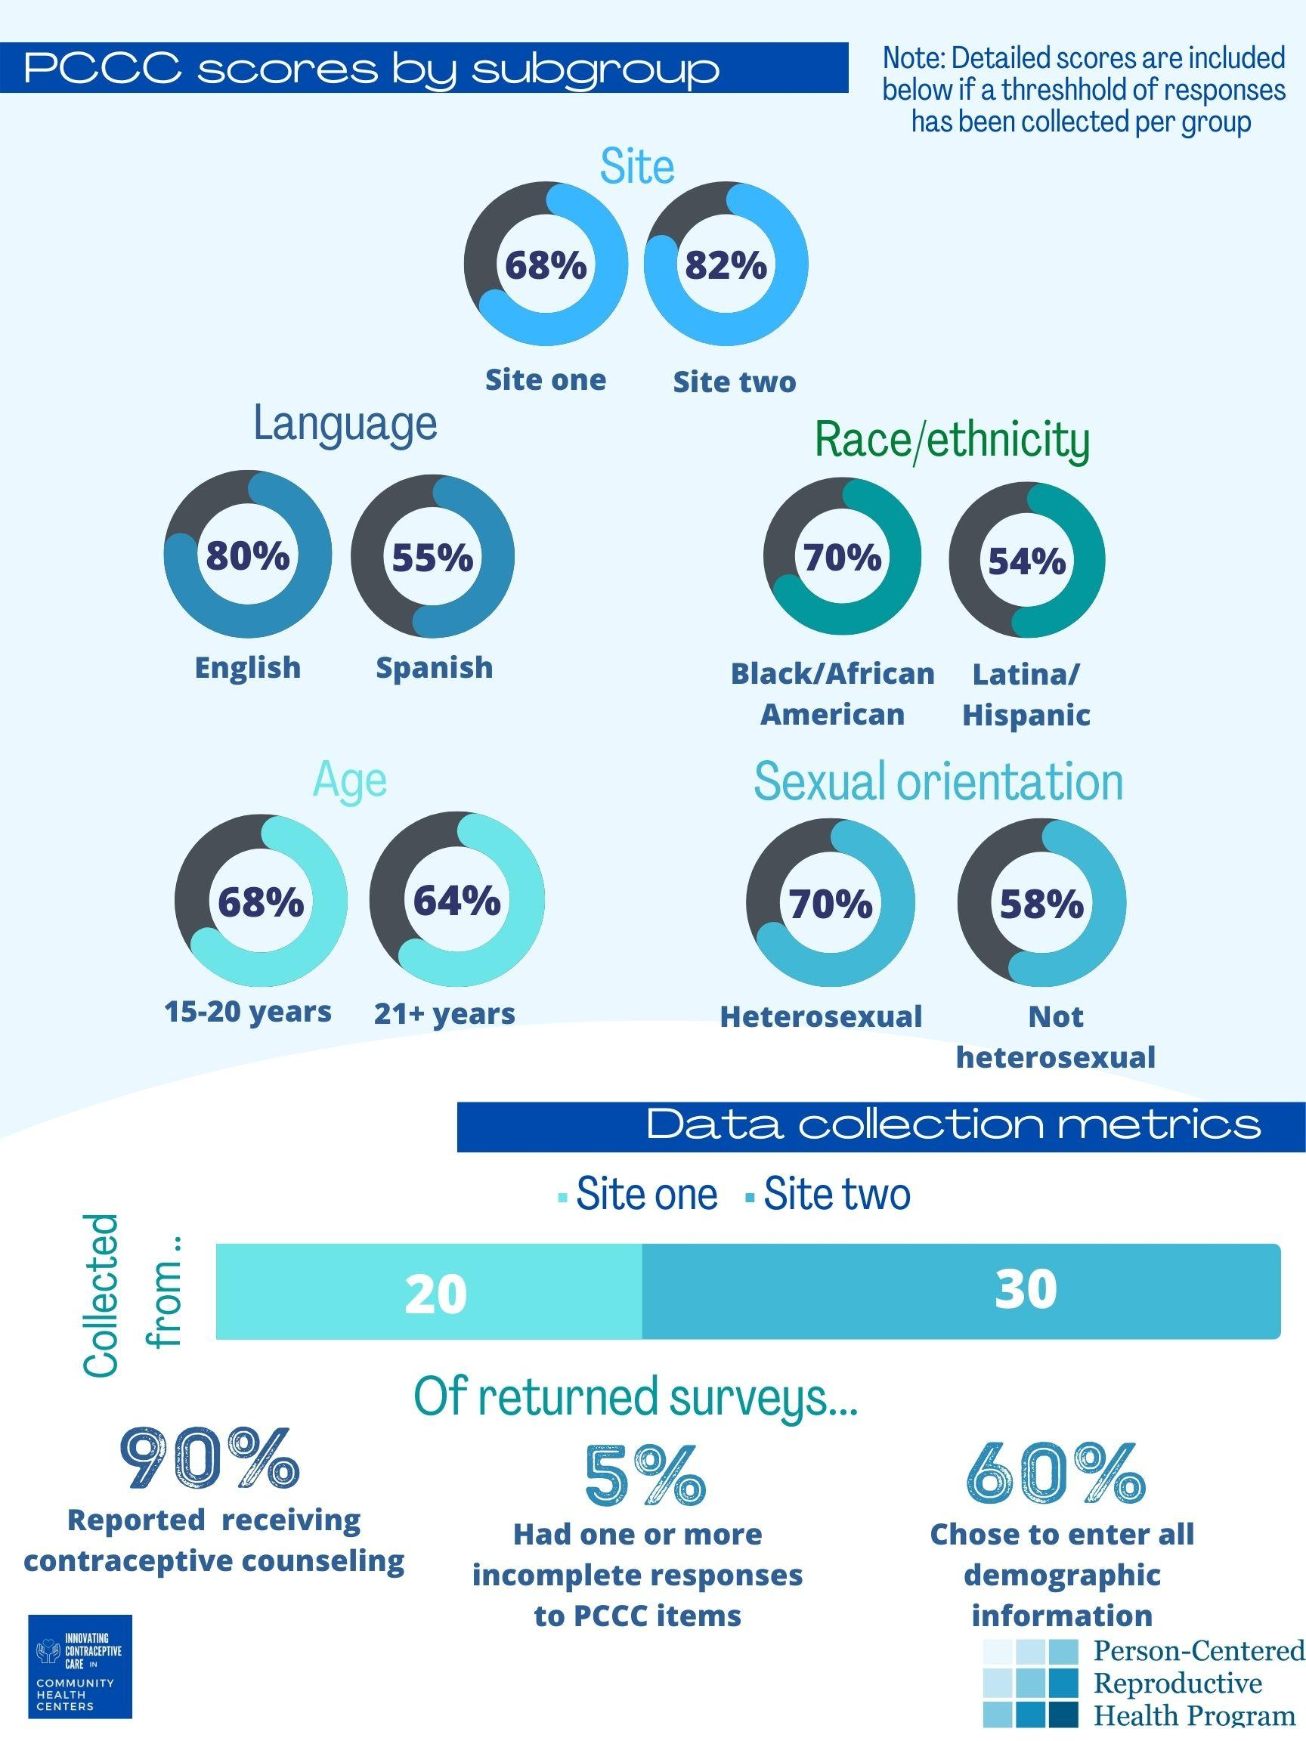
Sample PCCC Report
Notes:
Christine Dehlendorf:
So we also just wanted to share with you the last bucket there that we described was data collection management. And one of the things we've worked to develop is how data is reported to the facilities to allow them to be able to understand and therefore use the PCCC results to inform quality improvement. So this is just an example of what we've developed and what you can see is that it gives us an overall score over on the far left where you are with respect to the benchmark that we aim for of 80%. It also breaks it down by each individual question. So you can see if there's particular question like whether or not your information provision is a particular pain point, for example.
And then we work to stratify results by demographic characteristics again to address inequities. We do that with caution, making sure that we do not get down to a cell size that's so small that people can be identified. Again, recognizing the importance of anonymity in the collection and reporting of these results. But we think it's incredibly important to report on inequities so that people can have actionable insights to improving care, particularly for people whom they're the most obstacles to getting care that focuses on their needs, values and preferences.

Slide 21
PCCC Considerations
Use in prenatal and postpartum care?
Not developed or studied in pregnancy care
We do want to have a measure for contraceptive care in peripartum context—stay tuned!
Use in trans populations and cisgender men?
Can be used for anyone, although validated with those identified as “female” in medical record
Can do stratified reporting
Notes:
Christine Dehlendorf:
So just a few last points that often come up when we're talking about the PCCC and how it can be used to do what we all want to do, which is to provide patients with care that respects their reproductive autonomy and allows them to achieve their reproductive goals.
So one of the questions is can we use this in the context of pregnancy care? Well, you can. It hasn't been developed or studied for that context, but it has been used in that context and has found really profound opportunity in the positive frame, opportunities for improvement in the contraceptive care that's provided peripartum. So that said, we are working to develop a measure for contraceptive care in the peripartum period specifically, I'm working with folks at the University of Michigan around that. So that is something that we're thinking would include some additional domains related to the specific physiologic and psychologic transitions that are related to birthing, and we will be hopefully getting that validated in the future.
And another question that comes up is around use in trans populations and cisgendered men. There is no gendered language in the PCCC, and so anyone can receive contraceptive counseling, can have this measure used for them depending on what the context is and the care delivery system. It was originally tested for those identified as female in the medical record, recognizing the limitations in our reporting of so G data in many cases. So you can definitely use it in the broad range of folks with gender identity and can do stratified reporting to identify inequities for people whose reproductive health and reproductive priorities may be less valued. All right, so with that, I think I hand it off to Caitlin.

Slide 22
Upcoming Events
PCCC Implementation Program
3 virtual webinar sessions
1 in-person, full-day session (May 15, 2024)
Technical assistance available with UCSF experts
PCCC collection support and final PCCC data report, created by UCSF team
Notes:
Caitlin Hungate:
Yeah, thanks so much, Dr. Dehlendorf. So we are really excited and honored to be sharing that the training center, RHNTC, in partnership with UCSF will be opening up a PCCC implementation program or series and you can learn more and apply. The link is live, so learn more. So we will be having three virtual sessions and one in person full day session on May 15th in Denver, and throughout the series of folks and teams can receive technical assistance from UCSF, and then you'll also get support around the PCCC collection support and final data report. And so we understand that there's probably going to be a lot of questions around this, so a couple things. This is really geared for folks who are providing direct clinical services.
So a site or subrecipient can register or apply and we'll just let a grantee know. If you are a Title 10 grantee and you do not provide direct services, you do not have to participate. It is for your sites that provide direct clinical services as Dr. Dehlendorf was talking about that patient clinical provider experience, that's really, we want to make sure that we're having those folks in the room. So when you learn more, consider applying as a team, consider various clinical roles, administrative roles and or quality improvement or a QI champion to register or apply as a team. We do intend to leave this open until March 28th or when we hit 36 teams that apply because we have space for 12 teams. So we're going to close it once we hit 36 applications. So this is again for the in-person session, the RHNTC will provide stipends to ensure travel to Denver. And Amanda, great question. If you're a nonprofit clinic, as long as you receive title 10 funding, you'll see that there is an application and there's some key questions that we ask of you and your team, so sorry about that.
Caitlin Hungate:
Unfortunately, Title 10 funding is the baseline in terms of participation. We're really excited about this opportunity and at this time we have plenty of time for questions. So feel free to use the chat to ask your questions of Dr. Dehlendorf about this series.

Slide 23
Q&A
What questions do you have for us?
Notes:
Caitlin Hungate:
And in the meantime, Dr. Dehlendorf, I can ask you some of the questions that have already come in as we triage what's coming through the chat now. So one of the questions that, when you talked about the differential application of methods, does this also apply, this differential application vary by demographics of the provider? Their gender, their race, their ethnicity, not just the gender, race, or ethnicity of the patient?
Christine Dehlendorf:
Yeah, that's a great question. And we do know that in general, racial ethnic concordance between provider and patient is something that is associated with more patient-centered care, including better patient provider communication and more ability to have open-ended questions and develop rapport in general. That has not been studied specifically in the context of contraceptive care services. And I will share our particular study looking at IUD recommendations was we couldn't look at it because of the demographics of the provider sample because we do not have good diversity in our provider pool in general that we were able to survey. So that is something that is, I absolutely believe that diversity in patient populations is something that is or provider care populations is something that's incredibly important. And I think that we are also dealing with a culture of care that is bigger than just specifically racial demographics or gender dynamics and we're all impacted by that and that we all need to rethink what we are focusing on when we're providing contraceptive care across the board.
Caitlin Hungate:
Great. Thanks so much. So you saw the question in real time, but I'm curious if you wanted to say anything more about the PCCC being an anonymous measure. I know that you mentioned briefly, but I wanted to give time and space for talking more about that.
Christine Dehlendorf:
Yes, thank you. Social acceptability bias is a real issue in extension experience surveys in general. People don't want to say that they're dissatisfied with their care. People are very wary about making their providers angry and about being critical. And so everything we can do to make sure that patients know that we want the truth and that this is anonymous and that this is because this is something we really value in hearing patient voices. And so one concrete way to do that is to make sure that it's anonymous. Another is to make sure that the provider themselves that provided the counseling is not the one distributing the survey. So there's a lot of different things we think about with that.
Caitlin Hungate:
Great. And thank you all. We see the questions coming, so keep them coming. And I also just want to acknowledge we may not get to everyone, but we will try to get to as many as we can. Okay, let's see. The next one. You talked about the LARCs and the methods, and there's several questions around the history of inequities around use. So one person said that they're not a clinician. Are there pharmaceutical company incentives for certain methods? Is this from grants, policies, all of the above? Can you talk to some of the systemic factors that play into this?
Christine Dehlendorf:
Yes. I think that this major systemic factor is paternalism and misogyny in clinical care delivery that was enabled by the availability of these methods in the 2000s. And I was someone who did family planning fellowship in '06 to '08, so witnessed it firsthand that basically the availability of these highly effective methods that people could not discontinue on their own and that providers had control over was very seductive and appealing to providers who felt like people having reproduction that they shouldn't have was both a personal and a societal failure. So I think it's mostly a cultural thing. I think there probably are some financial incentives on providers that they might get some money for LARC insertions for example, but that was not the primary thing that I saw.
Most of these were salaried providers that were just caught up in the idea that they knew what was best for the patient and that people should be using these methods and didn't recognize because they hadn't been taught about this ongoing reality of reproductive oppression and stratified reproduction, were not being critical about the ways that that actually was not consistent with patient-centered care and the values that many of them hold very dear. And it was very painful for many people in our field to reckon with the inconsistencies between the ways that IUDs and implants were embraced and promoted and what people felt that they were actually trying to do by providing family planning care with the belief that that was supporting reproductive autonomy when in fact they were negatively impacting it.
Caitlin Hungate:
Thanks. And I just want to remind folks that Dr. Dehlendorf shared Killing The Black Body as one foundational educational resource to kind of dig into learning these histories that you mentioned. So thank you. I just want to reiterate and we put the link to that book in the chat. So this is a question about the PCCC series, so I'll answer this one, but welcome other folks on the line to just jump in as well. So this is going to be, Yashi if you want to go back to the next slide or the prior slide actually. So we'll have three virtual sessions from April through September. The May session is going to be in person in Denver, Colorado, and we'll have July and August off.
So no live sessions, no expectations, but Title 10 funded sites can receive technical assistance from the UCSF team. So the series is for a Title 10 agency that receives funding and provides direct services. So this could be a grantee if you provide direct services, if you have a sub-recipient or a service site, as long as it's where the clinical services are provided and will be in partnership over the next many months for quality support around the PCC. So Dr. Dehlendorf or Lindsay or Sonya, do you want to share more from your perspective about the series? Feel free.
Christine Dehlendorf:
I'll hand over to Lindsay.
Lindsey Gibson:
Sorry, I was trying to find a way to unmute. Yeah, we have a ton of information on the website about which topics we'll be covering for which sessions. We'll have some background information on collecting PCCC, we'll also work on work plans with folks specifically in person. We'll provide some hands-on TA on how to collect the PCCC and how to interpret scores as well as identifying patients to receive the PCCC. So anything I missed, Sonya?
Caitlin Hungate:
All right, awesome. Thanks Lindsay. And one other minor question. There is no fee to participate, so it is just your time and your time like your team. So a clinical services provider, quality improvement person and frontline staff. It is just your time. So we realize it's time away from your other responsibilities. So that is the cost is your time. And for the in-person event in Denver, we will be providing stipends to travel. So I am going to turn back to some other questions to ask about the PCCC. Let me see. Are there success stories around improving the PCC measure or any other examples of success with the PCCC?
Christine Dehlendorf:
Yeah, that's a great question because you really want to measure that's feasible and acceptable, reflex patient stories and that you can do something about right that is the key to quality improvement. And so I will say that when we originally were developing the PCCC, we in fact developed it in the context of a randomized trial where we were implementing a contraceptive decision support tool where the contraceptive decision support tool called my birth control moved it significantly the measure of PCCC. So that was actually a key factor in us considering this something that should be used for quality improvement.
We've been working, Lindsay, Sonya, Beckie and I have all been working on a learning collaborative over the past year and a half with health centers from around the country and have also seen that with dedicated teamwork and champions and time people absolutely can both move the needle on the PCCC and on inequities in care. And we have quality improvement materials, action plans, structures, processes that we've developed to support that. And that is something that we're very hopeful in the future we can continue to work with. This is the first phase and then we were hoping we can continue to roll out more broadly the quality improvement aspect of this.
Caitlin Hungate:
And thank you Dr. Dehlendorf. And I just want to remind folks, please follow along in the chat. There's some really great comments and perspectives around LARC options and the questions around incentives for the system. So please jump in with your perspectives and your knowledge because we're all learning from you. So thank you for your contributions. One more question about the PCCC series itself, and Lindsay, maybe I can direct this question to you. If a team can attend the virtual session, so let's say there's three or three or four folks in the virtual session, but only one or two people can attend the in-person, is that okay?
Lindsey Gibson:
Yeah, I would definitely say so. And just to repeat one more time, Caitlin, you said one or two people to attend the in-person session.
Caitlin Hungate:
Yep. So if the full team, let's say cannot attend the in-person, but a portion of the team.
Lindsey Gibson:
Yeah, I think that would be fine. Again, in the in-person, we're going to be doing a lot of work plan coaching and walking through how to actually implement the PCCC at site. So as long as the one or two folks who can attend have the ability to sort of spread the learnings that they are learning with us, then that should be fine.
Caitlin Hungate:
Awesome. And if folks have questions about the PCCC implementation series after the webinar, please feel free to email the training center rhntc@jsi.com or use the contact us button on rhntc.org and we can answer and triage your questions as you consider applying. I want to direct another question, Dr. Dehlendorf, to you. Have you seen any specific learnings for young people? So this is an adolescent provider and really feels this tool is crucial for underscoring the importance of respect. So do you have any insight around supporting young people's experience with care in the PCC?
Christine Dehlendorf:
Yes. I absolutely think that the young people aspect of this is critical because we have a tendency to be more directive with adolescents in care delivery and we promote more reactants and damage trust more when we do that. There's this great paper by one of my colleagues called I Wouldn't Be This Firm If I Didn't Care, which is direct quote from a provider to a patient, adolescent patient talking to them about their birth control options. And I think that we just absolutely need to recognize that reproductive autonomy does not have an age limit and that we need to be meeting patients where they're at in their reproductive journeys. And if we don't, we are going to do long-term damage to their care.
And that it's absolutely critical that we remember that our job is to meet patients' needs as they themselves define them, even recognizing the cognitive and developmental limitations of an adolescent. Those things can all be true and we can adjust our communication strategies accordingly and ensure that they are getting the information they need. But that does not alter the reality of how we need to be focusing our attention, which is on how they define their needs, values, and preferences in the context of full information and support.
Caitlin Hungate:
Thank you. That's awesome. Thank you for that. Let me go back to this person is noticing that they receive questions from a recent training regarding the terms patient centered versus person centered care. And this person is noticing the change that we've made to person centered. And could you share when and why or help us understand the evolving language around that?
Christine Dehlendorf:
That's such a great question. So the patient-centered language is really where it came from out of the health communication literature. And that is from the perspective of meeting patients where they're at in the healthcare context. And the shift to person-centeredness has been broad. It's not just in the reproductive health context. The World Health Organization uses patient-centered care and their frameworks for healthcare quality improvement. But I think in reproductive healthcare specifically, we've really wanted to shift that language because we want to recognize that we are engaging with people in the full context of their lives and not just when they're in front of us as patients. And it really shifts that narrative that they're not patients, they are people and we are meeting them where they're at in terms of being centered around them as full people and not just as patients.
Caitlin Hungate:
Okay. Here's another question for particular populations. Do you have any documentation of this measure being used with individuals experiencing homelessness?
Christine Dehlendorf:
That is a great question. I don't remember that being a particular focus. I mean, I will say that I have done research and particularly interested in patient centeredness in the context of unhoused populations, recognizing that those are people who are, again, have their reproduction stigmatized and are less likely to identify to their providers if they want to have a pregnancy because they're concerned about the judgment that that would engender. So I don't think we have anything. Team, jump in if you remember anything specifically, but I think that would be a very important population.
Beckie Kriz:
I don't think that's ever been anything that's been added to the demographic questions, but if you were focusing on them that could be easily added to the demographic questions so that you could parse out the data that way.
Caitlin Hungate:
Thanks, Beckie. I see there's so much chatter in the chat around just history, so please keep sharing. I think we'll, let me try to find one more question, but team jump in if there's anything that I missed. Lindsay and Sonya, perhaps you can clarify just what the series will cover. So one person is asking if a site needs training to improve PCCC scores, are we doing that training? Will that be part of the TA? Can you tell us a little bit more about what that TA may look like for teams that participate?
Lindsey Gibson:
For sure. And thank you for the question, I just saw that one. I will say that we are not providing specific training on quality improvement. We will be sharing a ton of resources that we have around quality improvement. Like Christine mentioned, we just wrapped up a quality improvement learning collaborative that we had with community health centers and we have an abundance of resources to help folks if they were interested in improving quality after seeing their PCCC scores. So while we will not have specific training, we will be providing resources.
Christine Dehlendorf:
And that is something we would be interested in continuing to have conversations with the RHNTC and others about in the future.

Slide 24
Engage with Us
Subscribe to the RHNTC monthly eNewsletter at rhntc.org/enewsletter
Contact us on rhntc.org
Sign up for an account on rhntc.org
Follow us on LinkedIn
Subscribe to the RHNTC podcast podcast.rhntc.org
Notes:
Caitlin Hungate:
Absolutely. Absolutely. Well, thank you everyone. I know that we're near the top of the hour, so thank you for your active contributions in the chat with your questions, with your commentary, with your knowledge, your experience around the PCCC, with systemic inequities around LARC utilization and use. This has been a really vibrant conversation and thank you all for joining. So actively in the conversation, please make sure to engage with the training center. If you haven't already subscribed to our monthly e-news, contact us. You can sign up for an account and make sure to follow us on various pages. And before we all hang up, thank you so much for joining us today and I hope you'll join me and thanking Dr. Dehlendorf, Lindsey, Sonya, Beckie for the team at UCSF for your collaboration. We will chat out the evaluation once again and we ask that you complete the evaluation today.
We really value your feedback. It's how we inform and improve as the training center, and it should only take you a minute to complete. As a reminder, we will have the evaluation or the archive material, so today's transcripts, slides, and recording posted on rhntc.org within the next couple days. And if you have additional questions about the PCCC implementation series, please feel free to contact us at rhntc@jsi.com. We will be able to triage your questions as quickly as possible knowing that there's an amazing amount of enthusiasm for the PCCC. So please feel free to send us your questions as you consider applying for the series. And to stay in touch, like I said, sign up for our e-newsletter. Thank you again for joining us, and this concludes our webinar and hope to see many of you in the series in the coming months ahead. So thank you again.

Slide 25
THANK YOU!
Please fill out the evaluation form after the office hours!
rhntc@jsi.com
This webinar was supported by the Office of Population Affairs (Grants FPTPA006030, TPSAH000006) and the Office on Women’s Health (Grant ASTWH2000-90-01-00). The views expressed do not necessarily reflect the official policies of the Department of Health and Human Services; nor does mention of trade names, commercial practices, or organizations imply endorsement by the U.S. Government.
Notes:
Thank you all for joining us today and I hope you’ll join me in thanking our speaker(s).
[Chat out evaluation link] We ask that you please complete the evaluation today. The link is in the chat. We really value your feedback and we use it to inform future sessions so we really appreciate you taking a minute to fill that out before you leave. In order to obtain a certificate of completion [if applicable: or CNE’s] for attending this webinar, you must be logged into rhntc.org when you complete the evaluation.
As a reminder, we will have the materials from today’s session emailed to participants and available on RHNTC within the next few days.
If you have additional questions for the RHNTC, please don’t hesitate to email us at rhntc@jsi.com.
To stay in touch with us subscribe to our monthly eNewsletter by visiting rhntc.org backslash newsletter; contact us through our website (rhntc.org); sign up for an account on our website; and, finally, subscribe to our podcast at podcast.rhntc.org or in your favorite podcast app.
Thank you again for joining us. That concludes today’s webinar.

