Slide 1

Mental Models for
Creating Systems Change
Sheri Marlin
Waters Center for Systems Thinking
Pittsburgh, PA
Notes:
Yvonne Hamby: Hello everyone. This is Yvonne with the Reproductive Health National Training Center and I’m delighted to welcome you all to today’s webinar about Mental Models for Creating Systems Change. I have a few announcements before we begin. Everyone on the webinar today is muted, given the large number of participants. We plan to have some time for questions at the end of the webinar today. You can ask your questions using the chat at any time during the webinar. If applicable: We’ll also be asking for your participation at a few points during the webinar. You can respond in the “Audience Chat” pod, which is green and can be found at the bottom of your screen. A recording of today’s webinar, the slide deck, and a transcript will be available on RHNTC.org within the next few days. Your feedback is extremely important to us and has enabled the RHNTC to make quality improvements in our work based on your comments. Please take a moment to open the evaluation link in the chat and consider completing the evaluation real-time. In order to obtain a certificate of completion for attending this webinar, you must be logged into rhntc.org when you complete the evaluation. This presentation was supported by the Office of Population Affairs (OPA) Its contents are solely the responsibility of the authors and do not necessarily represent the official views of OPA, OWH or HHS.

Slide 2
Objectives
Poll: How confident are you in recognizing a mental model?
Expert
Intermediate
Beginner
Never heard of it before now
By the end of the session, participants will be able to:
Define mental models and their impact on TPP programs
Describe the importance of mental models in a systems approach
Apply the ladder of inference to identify mental models
Notes:
We’re excited to continue our journey to better understanding systems thinking. One of the first stops in that journey is mental models. I want to share that this webinar content was developed for a TPP Program audience. I recognize that we have folks who registered for this session may not be affiliated with the TPP program. That’s okay. All are welcome. Just keep in mind that the presentation is tailored for the TPP audience.
All that in mind, at the end of this event we hope that you will be able to:
Define mental models and their impact on TPP programs (Mental models (everyone's) are continually at play and most definitely have an impact.)
Describe the importance of mental models in a systems approach
Apply the ladder of inference to identify mental models
Before we get started, Let’s do a quick poll to help us understand your confidence level with mental models
How confident are you in recognizing a mental model?
Expert
Intermediate and have used these concepts
Beginner
Never heard of it before now

Slide 3
Presenter
Sheri Marlin
Waters Center for Systems Thinking
Notes:
We have a wonderful guide on this journey! We are so fortunate to have Sheri Marlin. She is the Chief Learning Officer for the Waters Center for Systems Thinking. writes, speaks and collaborates with others to apply systems thinking in real-world contexts. She has taught preschool through graduate school and has worked as a building principal and district curriculum specialist. Sheri finds tremendous satisfaction in facilitating teams of people as they develop shared vision and achieve desired results. By providing resources and sparking curiosity, Sheri keeps learning at the center of everything she does. She believes that when people understand and apply the tools and habits of systems thinking, they are more likely to engage in meaningful, life-long learning and innovation. Sheri is co-author of the Habit-forming Guide to Becoming a Systems Thinker. The Waters Center helps people understand what systems thinking is and how to incorporate the Habits, tools and concepts of systems thinking into their work and life to achieve desired results.
Sheri Marlin: All right. Thank you, Yvonne. It is great to be with you. It really is a fun topic because mental models are just so much at play in everything we do. I want to start sort of saying that I know sometimes on Zoom, we think it's a time to listen. This is not a time to listen. Even though you will be muted for most of the time, we would love your cameras. So if you would follow Vicky and Megan and Alana's example. And again, if you're in some place we don't need to see, I get that. But if you are in a location where you can turn on your camera, and that would be awesome, because I want you to see one another. And there's going to be a lot in the chat. Get that chat open so that you can put in things as we go through. You also need to grab a scrap piece of paper while I'm giving some of these brief introductions, because we're going to start with an exercise. We're going to do like three exercises in rapid succession. And having that piece of scrap paper is going to be really handy. So thank you to JSI and the Reproductive National Health Training Center and OPA for having us. And we're just going to launch into mental models. So this may feel like you're at a baby shower, bridal shower or something along those lines. I'm going to show you a slide in just a minute. It has 10 words on the slide. I'm going to let you look at it for 10 seconds, and then I'm going to stop sharing my screen. Then you may pick up your pencil and write as many of those words as you can. Now again, I don't see a lot of cameras. I don't want to have to make any judgment assumptions that you're cheating on this exercise. So turn those cameras on, grab your pencil so I know you're ready and can see when you're done. And we understand, those of you in the offices with masks, we get that. So are you ready?

Slide 4
Remember these…
Pillow
Night
Blanket
Pajamas
Snooze
Slumber
Dream
Bed
Quiet
Nap
Notes:
Pencils down. You're going to look at this slide for 10 seconds. Okay, I'm going to stop the share. Now, you have 10 seconds to write as many of those 10 words as you can remember. All right, I'll give you just a couple more seconds. Again, thanks for having those cameras on so I can see where you are. And pencils down, pencils down. All right. I want you to check your score here. How many words do you have? Let me surface my chat. And then the next thing I'd like you to look for and pay attention to, did anybody write any words that aren't actually on the list? So when you wrote from memory... Oh, Vicky's confessing right away. Go ahead and stick those in chat if you wrote any extra words other than the 10 words. Six, right. We're getting the scores, I love it. Do we have any perfect tens? I wrote nap twice. I Love it. Cloud, very fitting where I am. Nothing extra. Okay, I see asleep, bedtime. Great. Anything I missed? And Yvonne, feel free to, if I miss something. So sleep. And this exercise is actually called 'Everything But Sleep', because sleep is not on the list. And yet all those words... And I love cloud too, 'cause there's no better sleep than on a cloudy day. But all of those words suggest sleep.

Slide 5
What is a Mental Model?
Mental models are deeply ingrained assumptions, generalizations, or even pictures or images that influence how we understand the world and how we take action.
Peter Senge
Notes:
So our brain is designed to put those kinds of things in groups and in categories. And so it is very natural that you would write sleep when you're thinking in those kinds of ways. And so that fundamentally, we can almost stop right here and say, you've had an introduction to mental models. Because that is the way mental models work. But we're going to go a little deeper. This is the most commonly held definition. It was written by Peter Senge in his book, "The Fifth Discipline," where there are five disciplines. Systems thinking is the fifth discipline, but mental models is one of those five disciplines. And he defines mental models as deeply ingrained assumptions, generalizations, or even pictures or images that influence how we understand the world and how we take action. So as you may imagine, we have thousands of mental models, images, ideas, beliefs in our head all the time. And they're really important. They are neither good nor bad, but what I hope at the end of this session, not only do you recognize your own mental models and those in others, but sometimes pause and recognize when a mental model is serving you really well, or sometimes when a mental model, your mental model or the mental model of someone else is not achieving the desired result that you're after. So part of identifying mental models is being able to change our perspective. So again, feel free to use chat, interact with each other. I love what I'm seeing.

Slide 6
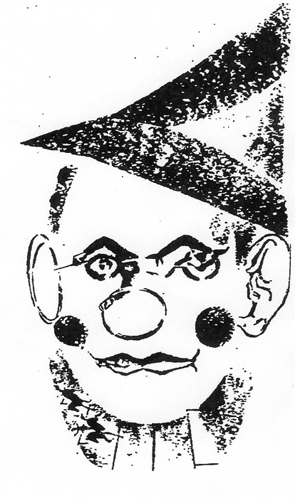
What Do You See?
Notes:
What do you see in this image? Just put it in chat. Quickly, quickly. What do you see? Clown, clown, clown. A scary clown. A tin, ooh, okay. Little "Wizard of Oz" influence. Expressionless clown, excellent. Lots of clowns, exactly what we might expect.

Slide 7
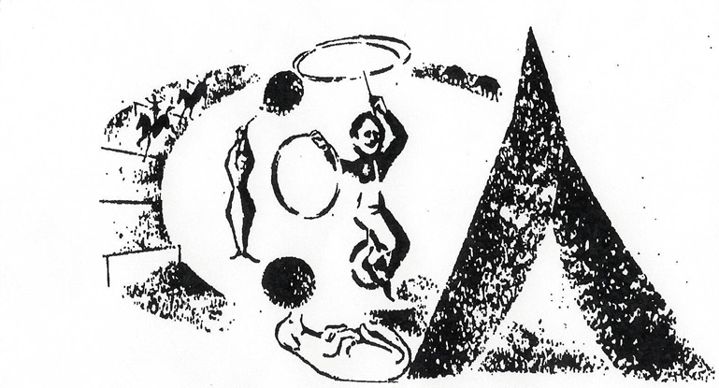
A Different Perspective
Notes:
And now what do you see? A dog, I agree. Acrobats. The circus? Yes, the circus. A unicyclist. Look at those things and take a minute to find those things in the picture. Now I promise you, this is the exact same image. Do you see them now on its side? Turned on its side, and we go from seeing the clown to seeing the circus. From seeing the detail, to being able to hold the big picture by changing our perspective.

Slide 8
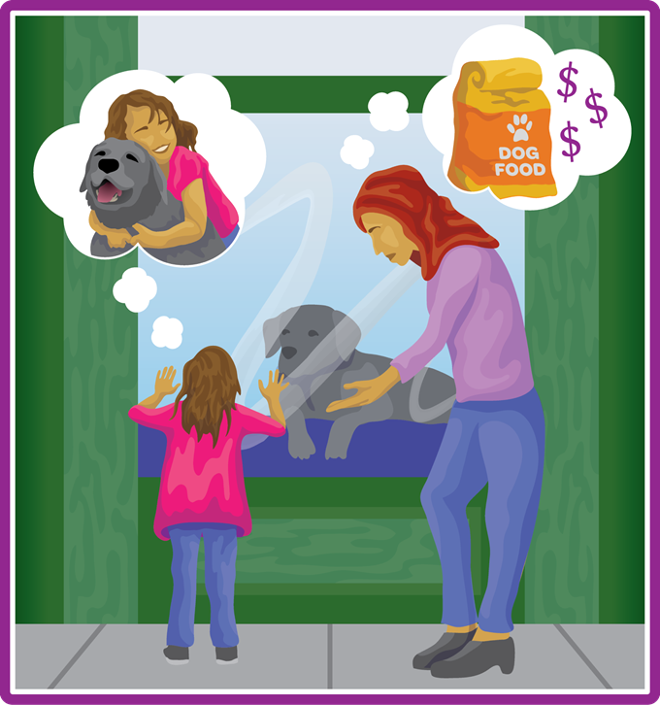
Consider How Mental Models Affect Current Reality and the Future
Notes:
You received in the email access to the habits of a systems thinker. And at the Waters Center, that's a bulk of our work because we believe that systems thinking, by definition, is not a thing. It really is something you do. It's something you can practice. And just like good health habits, you can practice good thinking habits. So we've already talked about three of them, mental models, changes perspectives, holding the big picture. And so it is exciting that you were able to see these different things. This is one of the images. This is the image for the mental models card. It shows, I'm going to assume, a mom and a child looking at that pet. And the child sees fun and love and affection, and the mom sees a whole lot of work and expense and mess. And so that's considering how mental models affect current reality and the future. And so you can probably immediately begin to go to the work you do with clients and partners and stakeholders and see how sometimes there can be different mental models. People can have the best of intentions, but there can just be different mental models about how things are going to affect our future.

Slide 9
Words Matter
You will need a scrap piece of paper to write on
and a pen or pencil.
When you hear me say a word, write down the first word that pops into your mind.
Do not pause to consider what you want to write.
Go with your first thought. Your response should be spontaneous and instantaneous.
We will do this 4 times and then debrief.
Notes:
One more exercise. So get that scratch piece of paper handy. Let me give you the directions here. I can advance on slides. You're going to need a scrap paper and pencil. When you hear me say a word, just like word association, we're going to write down the first word that comes to your mind. I'm going to actually ask you not to put these in chat yet. We'll do that after we go through about four rounds of this. Do not pause to consider what you want to write. Go with your first thought. Make your response spontaneous and instantaneous. Are you ready? We're going to do four words.

Slide 10
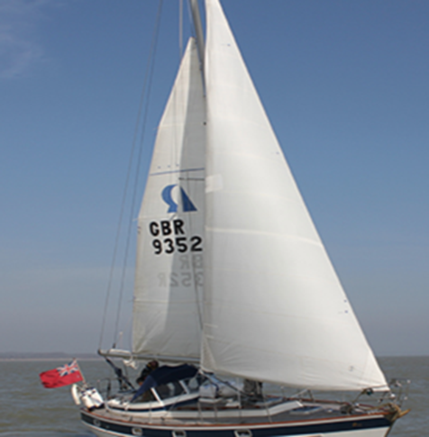

Words Matter Example One
1
2
Notes:
Word number one. Word number one is sale, sale. We're number two, waste. Waste. Word number three, patience. Patience. And word number four is red. Red. Okay. Again, pencils down. What are some of the words you wrote when I said sale? Go ahead. Shop. Cheap. Boat. Good deal. All right, so again, we see two pretty distinct images for sale. The idea of boating or the idea of shopping. A breezy ride. Money, okay. Like a person. Sarah, great. So sale, salesman. You went actually to that human being, and words do that. They create this... Ooh, a game. Okay, excellent. So already, you guys are generating different ideas.

Slide 11


Words Matter Example Two
1
2
Notes:
What did you say for waste? Go ahead and throw those in chat. What were some words you put for waste? Recycle, not. Scale, there we go. Trash management. Garbage. Waste basket. Finishing phrases, beautiful. Simple word homonym, yes, but lots of different images even within the context of those homonyms. Wastewater, all right.

Slide 12

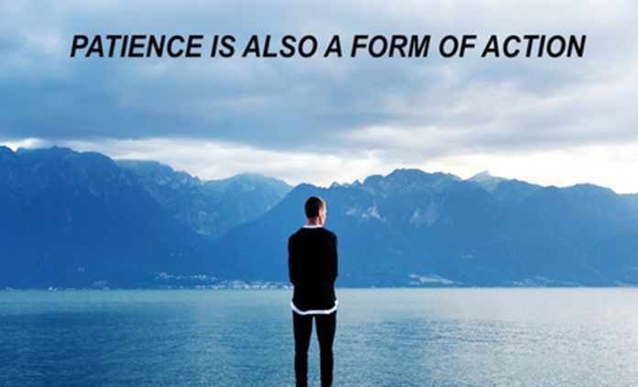
Words Matter Example Three
1
2
Notes:
Let's do patience. Calm. My mother of virtue. Oh beautiful. Look at all those wonderful mothers. kindness. Let's hope my children would say that. Moment, calm, teachers, virtue. Now this one, there can be a slight difference in pronunciation, but sometimes we also get patients, particularly now during the pandemic and this hospital overflows patients, as well as patients. So perhaps my pronunciation maybe gave that one away 'cause usually we get both.

Slide 13
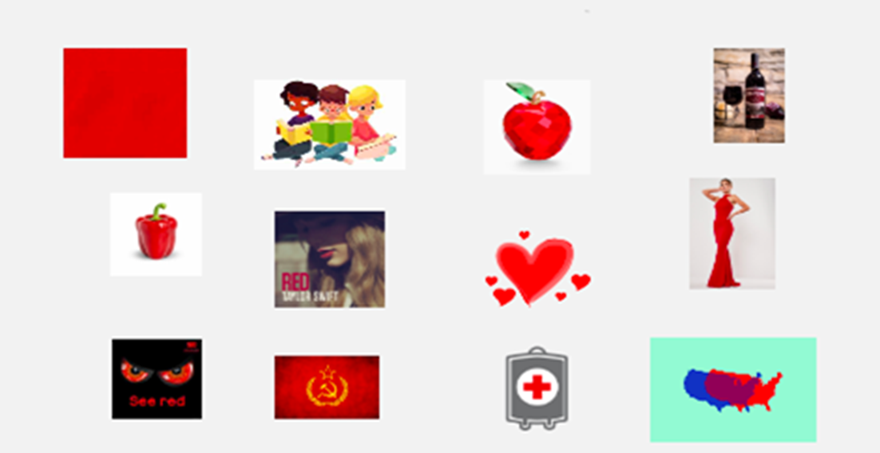
Words Matter: Red, read or …?
Notes:
And then I think this is one of the most interesting ones. So I'm not going to click to this slide just yet, but go ahead and put in chat what you wrote for red, red. Blue, hot, anger, light, color, listen. Apple, rose, book. Okay, so we got both. We got the color and associations with the color, and we got the homonym of reading a book, but then we get all of these other... And red is a really fascinating one, because then red begins to illustrate for us how these can be real ideologies too. So communism, red state, blue state. I heard, with some of the controversy in this country, people talking like, "I'm on the red team." And they're suggesting that their mental models embody all of the red team or the blue team. Apple, we had wine. People have said Taylor swift, okay. So a red dress, a little red dress, a little black dress. So those are all images we have.

Slide 14
Your Words Matter
What are some words you use with participants that could create varied mental models?
Notes:
Now I want you to take a minute... And again, you're doing a great job. Keep using chat here to go to this question. And I want to take a minute to think, and then to put into chat, what are some words you use with your participants, your clients, your partners that may be creating varied mental models? What are some words that you use that could be creating varied mental models with the people that you interact with, your stakeholders? Evaluation, safe. Sex, relationship, pregnancy, engagement, big one. Partner. Reproductive justice, reproductive rights. Evidence-based, I hear that a lot. What is evidence-based? Family planning. Audit.

Slide 15
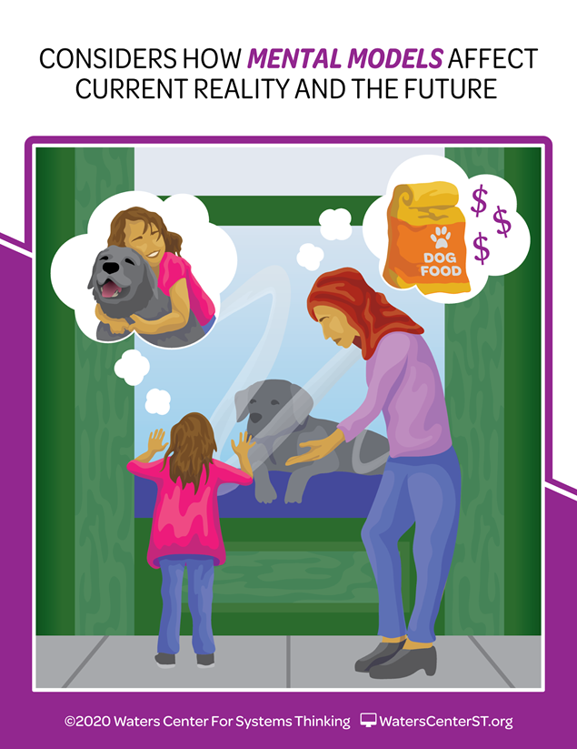
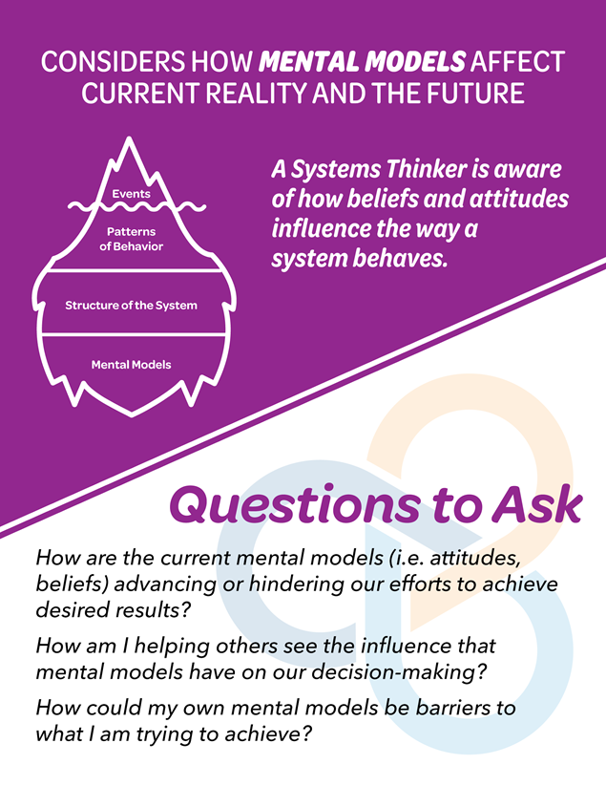
Mental Models
Notes:
So I want you to kind of keep that chat handy, and you can save chat with those three, but keep your chat open as we go in a little while to breakouts. So you're going to want to go back to some of these ideas. And you're going to have some time in your breakout rooms to really talk about how these words that we think are pretty straightforward and clear can really create different models from your participants. And we're going to give you a tool to do that with. So at the Waters Center, we have taken our 14 habits and we have habits cards. Again, you have a link in your email to be able to access these on our website. You can access the front and the back by hitting that flip button, because the images and the habits on the front are really powerful and will give you a lot of content and a lot of information about what this elusive systems thinking is. And the questions on the back can be really powerful as you begin to use and apply these habits in your work, in your life at home. Like that's the part about systems thinking is we don't take off our system thinking hat when we become a parent or when we engage with our community. We can be systems thinkers in all aspects of our life and work. So a systems thinker is aware of how these mental models, these beliefs and attitudes influence the way a system behaves. And I would really encourage you to, even as we go through this webinar and you're just moving from brand new exposure to beginner, or beginner to intermediate, or those of you that are intermediate pushing up to expert, as we wrap up this time together, how do current mental models advance or hinder your efforts to achieve your desired results?

Slide 16
Why are mental models important?
An illustration of an iceberg that is broken down into four labeled sections. The sections read as follows:
Top, above waterline: Events. What happened? What is Seen.
Second layer, under the waterline: Patterns of Behavior. What has been happening? What are the trends? What changes have occurred? Deeper Learning. What is Unseen.
Third layer: Structure of the System. What has influenced the patterns? (e.g. policies, laws, physical structures). What are the relationships among the parts?
Fourth layer: Mental Models. What assumptions, beliefs, and values do people hold about the system? Leverage.
Notes:
And at this moment in the session, I really encourage you to think about your mental models. Are there times when maybe it's mental models about a client? I mean, again, mental models are these images or beliefs. For some of us, those can be snap judgements. We can go immediately... And again, sometimes we have to make a decision for personal safety. We encourage clients to have good judgment about finding themselves in situations where they can be safe and make the appropriate choices, all those words that you just put in chat. But sometimes we make judgements that are harmful or wrong about people, or an organization as a whole. They would never be supportive of our work because of that. And so what are the mental models that could be hindering the work that you do? How do I help people understand their mental models? And then I think this last question is really powerful. How could mental models be a barrier, my mental models be a barrier to the work that I'm trying to do? We're not going to ask you to do a lot of confession in this big work, but I would say jot that question down. Think about that as you leave this afternoon. We really do have to assess because we have them too. Again, we have good ones. We have mental models that serve us really, really well, and celebrate those and be honest about the mental models that may not be serving you as well as you would like. That's what we want to do. Now, here's another reason that mental models are really important. In systems thinking, we use an iceberg. We use it as a metaphor. It is the framework, and it is technically a systems thinking tool. For this session, for the time we have, we really want to think about it as a metaphor. And this is the metaphor of the iceberg. Scientists tell us that these great big, giant masses of ice out in the ocean, 10% of that iceberg is visible above the water, and 90% of that massive ice structure lies below the surface of the water. And it was not the 10% on top of the water that sunk the Titanic. It was the 90% below. And that's a metaphor for systems thinking. Too often, when we look at an issue or a concern, or we attempt to meet our grant objectives or give evidence to the programs that we're using, we're looking at the top 10%. We're looking at what we call the event level of the iceberg. What's easy, what we see, what we have access to. And we don't always consider the 90% of the things that lie below the surface of the water. Things like patterns and trends, the structures of our system, a little foreshadow. We have one coming up where we're really going to look deeply at this idea of a system structure. But sometimes, we just don't get to that point. But notice on this iceberg, even when we're just thinking of it as a metaphor, in terms of the tool, the deepest level of the iceberg are mental models. And here's what we know as systems thinkers, and one principle of systems thinking. If you want to affect long-term, sustainable, meaningful change, you have to influence people's mental models. We can put programs in place, we can have structures, we can get some good results, we can get some metrics that we turn in on our grants that look good. But at the end of the day, if you want those clients to make fundamentally different decisions, have fundamentally different outcomes in their life, if you want the service providers to see their clients in ways that are most effective to achieving your outcomes, you have to impact their mental models. So I often share the story, as a building principal, like Yvonne said in my intro. I could make teachers do things. I had positional power. I could tell them to use certain programs to do specific things. But at the end of the day, if I didn't influence the way they really viewed their children and how children learned, that wasn't as important as helping them change their mental model about children and their learning.

Slide 17
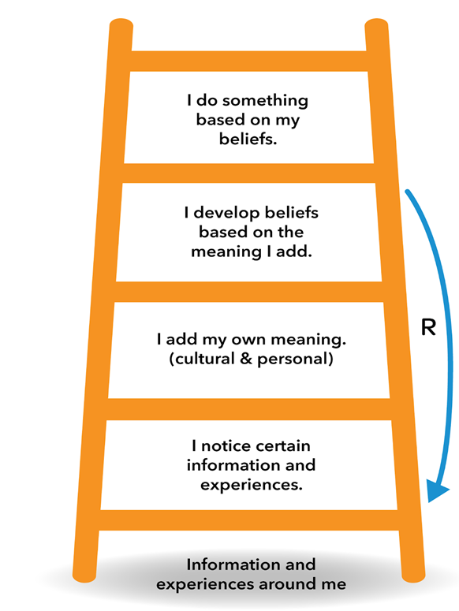
Using the Ladder of Inference
My beliefs affect what I choose to notice in the future.
Poll: How often have you used the ladder of inference in your decision-making?
All of the time
Most of the time
Sometimes
Never
Notes:
So we're going to go here to the ladder of inference, which is our tool. And so Yvonne, we have another poll. Do you want to introduce this poll?
Yvonne: Sure. So again, we'd like to just get a pulse on how familiar and comfortable you are in using the ladder of inference. So my beliefs affect... Oh, no. How often have you used the ladder of inference in your decision-making? All of the time, most of the time, sometimes, or never? And so far, we're mostly in the never, about 50%. Then we have a big grouping around sometimes and most of the time. And we have 3%, which is one person so far, all of the time. I'm impressed with that. I'm excited to learn more about this and start using it.
Sheri: So yeah, I think that all of the time person, I need to turn the microphone over to them. Since you're stuck with me for a little while, but the thing is, yeah, please help, 'cause I don't think I use it all the time. But here is the idea of the la... But it's impressive. And again, it can be... I think what's really exciting about that poll and telling, and kudos to you is that it becomes that automatic, that you recognize that all of the time, you're thinking about your mental models and the mental models of other people, and holding that big picture like the clown. You just get in the habit where you see the sideways view, or you think about the words you're choosing and how they influence people. So here's the ladder of inference. And again, you have it in your actual handout of this and the iceberg. So you have these as PDFs to go back and reference in your email. But in the ladder of inference, you see that little gray circle. It's kind of light there, where it's the information and experiences all around us. And I'd like to say that is the puddle of all the experiences that we've had. The ladder was developed by a gentleman by the name of Chris Argyris out of Harvard. It was popularized by Peter Senge, who we've quoted here in the book, "The Fifth Discipline". But that puddle, we all have a puddle. It's where we went to school, the families we were raised in, the places we've traveled, the books we've read, the television we've watched, Everything that's been input into our lives literally from before we were born has impacted that puddle. And so then our ladder sits in that and we spend all of our life going up and down the ladder. We notice certain things based on the experiences that we've had. We add meaning to those things. We develop beliefs. And then it's very common in the tradition of many cultures and religions to recognize that our beliefs drive our actions. Scientists and social scientists tell us we're happiest when our beliefs and our actions are in alignment, when we're able to act according to our conscience, according to the way we believe. But that blue arrow that you see is really the key to the ladder of inference. It says that what we believe reinforces what we pay attention to. So our experience is already influencing what we pay attention to. But now, as we notice certain things, and, hear this, fail to notice others, it causes us to reinforce our own beliefs. I think one of the simplest examples, as we have seen recently, again, in the social media, we tend to have social media pages that look like us, that look like our pool of experience. So what we're seeing reinforced are ideas that agree with us, which make us believe that we're even more right than we thought. Now, let me give you a very practical look of this ladder of inference. We're going to go up this ladder twice, and you'll be able to see these steps in the story. So I have a colleague and I have noticed in the past that she tends to complain, maybe even a little bit of a hypochondriac, always has some kind of a physical ailment or problem, or something that distresses her in some way. So one day, she walks into my office, back in the days when we were in the same building, and she says, "I have a headache." And I say, "Oh, I'm sorry. I hope you feel better." Barely looked up from my computer. Think my belief is that, "And what's different than today and every other day? You always have some kind of a complaint." And my action is that I do absolutely nothing. That was a quick split-second judgment. I was gracious. I said, "I hope you feel better." But that was it. I had another colleague come in and she says the same words, "I have a headache." I have never heard this colleague complain about anything ever in her life. So I stop, I look up. Her color's not good. The intonation in her voice was not sound... She didn't sound like herself. I asked a couple more questions. I get her to sit down, I get her a drink of water. Her speech continues to deteriorate. I now have a belief that this is not a headache. This is a serious medical emergency. And I may go so far as to take the action of calling 911, because every indication I have says there's something really wrong here. Now, those words were exactly the same, "I have a headache." One, based on my experience, led me to go, "Yeah, and what else is new?" One, based on my experience with the person, led me to call for emergency rescue assistance, because my experience with those two people had been so different. Now, that's probably a little dramatic. And if my first colleague really was gray and not speaking, I would attend to that. But those are the kinds of quick decisions that we make. Think about somebody texting in a meeting. So you can think, "Oh, how?" Depending on your experience, perhaps. A lot of our mental models are based in generalities about age or gender. So you might think, wow, that person is so efficient. Look at what they're getting done. Look at how much information they're getting out about this meeting on Twitter. Or if you have a different puddle, you may go, "That person is so incredibly rude? Like why can't they pay attention to what I'm saying? I think they're a worthless colleague." So again, we go to the judgment based on very little information. So the ladder of inference is a tool, and those are the steps. And hopefully in this short time, those illustrations will stick with you and help you see how you can go up and down. Important caveat, you don't always have to go up and down the ladder rungs in order. You can identify an idea, a belief in action, and you can go up or down from there. So it's not uncommon for someone to say in our organization where we use this a lot, "Whoa, I'm way up the ladder here. Can you help me walk down my ladder and to understand what it is that I'm paying attention to?" Sometimes, I think if you're looking at a strong belief, like maybe you have a partner organization that has a mission, vision, belief statement, and you kind of want to work backwards and say, "So what do we think that they pay attention to that allowed them to develop that belief?" Or maybe in a program that you're teaching, in one of your TTP programs, you have an outcome. It's a belief you want people to have. So you can go up and down that ladder about experience and personal meaning in order to make some decisions about what might they be paying attention to, or what experiences might they have had that contribute to that particular belief.

Slide 18
Ways to Use the Ladder of Inference
Reflect
Inquire
Advocate
Notes:
So those are some ways to use the ladder. It does not have to be linear. Chris Rogers, the developer, would say that there are three major ways to use the ladder. The first is to reflect personally. It's a personal tool that I use, that I keep in my toolbox. I've heard it said, and my colleagues like to say, "To slow down my thinking." Just before I go off and accuse that colleague who's texting of being worthless to say, "Well, maybe they really are doing something highly productive. They're not playing Candy Crush. They are really doing something productive on that phone, and I need to slow down before I make that judgment and say something really unkind that's going to damage that relationship. So you can just use it as a tool for personal reflection. The second is to inquire. You don't want it to be artificial. But it's okay to say, "Can you help me understand how you came to that belief? What experiences have you had that led you to believe XYZ?" Maybe you're in agreement and you're looking for support. Maybe more often, you're not understanding that belief. Or, "When you did such and such, what were you thinking kindly? What had you been thinking about that led you to take that action?" And maybe it had a consequence that has already come out as being undesirable. So what were you paying attention to? So you can reflect personally, you can inquire gently, and then you can advocate. You guys are advocates. You are advocates for positions about reproductive health. And so you want to be able to state those positions clearly. You want to be influencers. You want to influence the mental models of your clients to think in alignment with those beliefs that you articulate. So how can you use the ladder to say, "This is what we believe in and this is why. This is in our experience, in that evidence-based research that we've done, in the people that we've talked to. We see this transcends different cultures, because we've had experience with these different groups. You can actually use those rungs as support for advocating for a particular position that you believe is right, and for mental models that you are attempting to influence and to get changes.

Slide 19
Ladder Practice
Think about one of your program partners. Identify one or more of their beliefs about your goal of improving adolescents’ well-being through the lens of sexual and reproductive health.
Where is their close alignment?
Where might you need to broaden their “puddle of experience” to help them understand your mission?
What questions can you ask to help them pay attention to new information?
Notes:
So that is a very short introduction to the ladder of inference. It is a powerful tool. And we really want you to have a few minutes to practice with this. So you're going to get into four breakout rooms. You are going to have a facilitator. More of you are going to turn on your cameras, that is my mental model. You will be un-muted. So this is a conversation, and it should be great. We'll have but there'll be about 12 people. So you're going to have 12 people in your breakout rooms. Please engage with those 12. It'll be a much more exciting breakout time. And I want you to think about a program partner. And again, title 10 if you need to. But in the pregnancy prevention, we know that you have partners, people that you work with and support your work. And we're asking you in this exercise to start with the belief. You don't always have to start there, but for this exercise, you're starting with the belief. Identify one or more of their beliefs that connects to your goal of improving adolescents wellbeing through the lens of sexual and reproductive health. Identify a specific partner, identify a specific belief. And then in your breakout rooms, and this will help everybody in your breakout room to be able to talk about where is their close alignment. And probably if you have a lot to choose from, choose one where there's not super close alignment, like where you really may want to, especially those of you that were like, "I do this a lot. I do this all the time." Challenge yourself. Challenge yourself to think about a mental model where there could be not a lot of close alignment. Where might you need to broaden their puddle of experience in order to help them understand your mental model? And what questions can you ask to help them pay attention to new information? You can also use the questions on the back of the habits parts. How is your mental model influencing? If this partnership has been long-term, how has it influenced them in the past? So we are right on time. You have 10 full minutes for your breakout room. I think they'll allow me to drop in. And certainly, you can signal if you have questions. Again, you have a facilitator in there. Have a great conversation. Hopefully, we'll be able to capture a few pearls of wisdom when you come back in the chat, and we'll see you back in 10 minutes. Have a great conversation.
We're back. And so I am going to share my screen one more time. I changed my settings, just a minute.
John: And Sheri, if you can ask the people if we should be back in about like 10 seconds, but we haven't gotten all the
Sheri: All right. Thank you, thank you, John. If you are back and you would like to put... Like if you had an insight on how that mental ladder helped you identify mental models, please feel free to put that in the chat. This would be a great time to do that. And I can open my chat. Great, love it. Any insights?
Megan: Well, as people are joining, I facilitated one of the group, and we talked primarily about partnering with schools and the mental models that applied to the scenarios, whether it be from a school in partnering with a TPP program or teachers that are open to this, but the mental models that the administrators have for the teachers are just challenging and really exploring the existing mental models using the ladder in that scenario, so.
Sheri: Thank you, Megan. Yvonne.
Yvonne: That was similar to ours too, Sheri. There were a few of our participants that were partnering with schools and there's some misalignment of language and kind of the approach. Everyone wants to create healthy space for adolescents to be healthy, but you might be going at it a slightly different way. So a few of our group participants talked about using the mental models and the ladder of inference as a icebreaker or as an exercise, and in a meeting as a safe place or a safe way to sort of get at those mental models and try to create some alignment.
Sheri: Well, and again, thank you, Vicki sharing your personal aha moment. I think that's really critical is that we have to identify our own mental models, and see where they're, again, hindering or helping our mission. Sarah asked excellent questions in our session as well. We talked about juvenile justice specifically and how the justice system oftentimes has some mental models that are entrenched and different, youth leadership. And then the idea of, Amy says, trying to find common ground. Absolutely making progress when they don't align, because I said it too, you may not get... We use the extreme example with juvenile justice. "Yes, let's lock up every child who dropped a piece of paper and litters," to, "We shouldn't ever penalize any child because they're young." And somehow, we have to work together and have a system that brings those things together.

Slide 20
Habits of a Systems Thinker
A collage of 14 illustrations with the title, "Habits of a Systems Thinker". Each illustration includes text appearing at the top, and read as follows:
Seeks to understand the big picture: Image of a man looking at a landscape with the sun shining on the left and a thunderstorm on the right.
Observes how elements within systems change over time, generating patterns and trends: A line graph with 3 figures of a female superimposed over it. The figures are of a baby, a child and an adult.
Considers an issue fully and resists the urge to come to a quick conclusion: A woman having a thought bubble of a scale.
Uses understanding of system structure to identify possible leverage actions: A person bracing their foot an a boulder for leverage to pull a large fish from a lake with a fishing pole.
Checks results and changes actions if needed: "Successive Approximation.“: An image of a man standing over a stovetop tasting a pot of food. He thinks it needs more seasoning.
Surfaces and tests assumptions.: An illustration of a man and woman discussing a line graph.
Changes perspectives to increase understanding.: Illustration depicting a man standing next to a little girl with a question mark over his head, then kneeling next to the little girl as they look off into the distance.
Recognizes the impact of time delays when exploring cause and effect relationships.: An image of a woman drinking a soda while thinking of getting dental work done.
Identifies the circular nature of complex cause and effect relationships.: A man thinks about the relationship between bees and flowers.
Considers how mental models affect current reality and the future.: A mother and daughter look at a dog in a shop window. The daughter is thinking of hugging the dog, while the mother is thinking of the cost of dog food.
Recognizes that a system's structure generates its behavior.: An image of a man flying a kite and a woman holding a pinwheel.
Considers short-term, long-term and unintended consequences of actions.: An image of a man holding money. He thinks of either placing the money in a savings bank, or a smartphone, headphones and shoes.
Pays attention to accumulations and their rates of change.: An illustration of a woman using a water hose to fill a bird bath while the sun evaporates the water.
Makes meaningful connections within and between systems.: An illustration of a man with 5 icons around him. The icons have arrows pointing to each of the other icons. The icons read as follows: School, Work, Faith, Home and Family.
Brought to you by Water Center For Systems Thinking. This work is licensed under the Creative Commons Attribution-NonCommercial-NoDerivatives 4.0 International License. To view a copy of this license, visit http://creativecommons.org/licensed/by-nc-nd/4.0/ or send a letter to Creative Commons, PO Box 1866, Mountain View, CA 94042, USA. CC. BY. NC. ND. Copyright 2020 Waters Center for Systems Thinking. WatersCenterST.org.
Notes:
So on your screen now, these are all 14 of our habits. I can say we have definitely looked at mental models today. We've talked about the big picture. We've also this changes perspectives. That's what I really see in your chat right now. We redid our artwork on April 1st of 2020. I can always remember that date for a host of reasons, but this was my favorite change in the changes perspectives. That idea of the adult really getting down to see things from the child's perspective, and the idea that it's more for us, changing perspectives is more than empathy. It's more than feeling with someone. It's really seeking to understand their perspective, and then being willing to change our own perspective in some way. I can say I'm open to other's perspectives, but am I opening to change my perspective based on what that person shares? I mean, we've touched on all of these. And that's sort of the power of the habits of systems thinking is that they're a body of work, and they all connect, and we interact with all of them all of the time. So again, thank you, Vicki for sharing a really powerful... I mean, again, we could spend another four hours unpacking these mental models, and they're real, and they're palpable, and you deal with them all the time.

Slide 21
Q&A
What questions do
you have for Sheri?
Notes:
So it is time to move to questions. I haven't seen any come in the chat. You're welcome. But again, I think you do have the capacity to unmute and ask or raise hand and we can get you unmuted, or put that in the chat. Whoops. Whoops, sorry. There we go, questions and answers. Anybody? Yes. So Megan's nodding. Yvonne, I'll let you respond to that. And so you can be very specific about how and where.
Yvonne: We will be packaging the slides and the handouts that we had shared ahead of the webinar and posting it on our RHNTC website. It usually takes a few days, so maybe early next week before they get packaged and get cleared through 508 and all of those steps, but they will be posted. And I'm not sure, team. Do we send out an email letting people know that it's been posted, or just keep an eye out on the website?
Megan: Let's just keep an eye out on the website, usually takes about a week following the webinar for us to pull together the transcript and stuff, but look forward in about a week. And yeah, loved that ice breaker idea.
Yvonne: And then we have a question, Sheri. Do you have any favorite resources to learn more about the ladder of inference?
Sheri: So the ladder of inference is probably the one that you are going to see referenced more than any systems tool. So now that it isn't difficult, how do you talk about that at work? Uses a version of the ladder where it's more in steps. Elena Aguilar, if you do any coaching, in her book, "The Art of Coaching" gives a pretty extensive explanation of the ladder of inference with some questions. And then the Waters Center has a ton of free resources that we call the thinking tools studio. And there's a whole course about the ladder of inference. There's a course about mental models. So certainly, we'd be happy to have me come over to the Waters Center. it's watercenterst.org, and check that out on the website as well. Thank you, Megan. Local setting with partners. Yeah, Sarah, I think we definitely touched on that in our group just a little bit about it takes time. I will tell you the thing about surfacing mental models, the ladder of inference is a great tool. There are some exercises like we did that help people recognize their mental models, but then it just takes time because those stories that make up our puddles, they have to be shared. And we have to take the time, make the time, to create conditions where people are comfortable sharing some of those stories. And that's how you're going to level set, when people get that we all have experiences. It does depersonalize it a little bit. I mean, this is my story. This is what it's causing me to pay attention to, this is the meaning I added, and this is the belief that I've come to. You may disagree with my belief, but you can't disagree with my story. So if we take some time to understand that, it really does help. All right, I am going to turn it... Thank you all for your attention. It has been a delight. I'm going to turn it over to Yvonne for some final words and announcements.

Slide 22
How to Engage with Us
Subscribe to the RHNTC monthly eNewsletter at rhntc.org/enewsletter
Contact us on rhntc.org
Sign up for an account on rhntc.org
Follow us on Twitter @rh_ntc
Notes:
Yvonne: So thank you all for taking the time to join us today. These are all the ways that you can stay in touch with us that you're seeing on your slide. And I hope you all will join me in thanking Sheri for spending time with us. And we're lucky enough to have her for two more webinars. This is the first in a series of three webinars. We'll be back together in March, as well as back in August to finish out the series before we kick off a peer learning group around systems thinking. So thank you Sheri for spending time with us and all the prep work that you put into this. And then as a reminder, we'll have all of the materials from today's session posted in a few days to maybe early next week. And then if you have any additional questions that you'd like to pose around the systems thinking and mental models in particular, don't hesitate to email us at rhntc@jsi.com, and we will compile those. And that can certainly help guide our prep for our next webinar in this series. And my colleague, Nancy will chat out the evaluation link again, if she hasn't already. So please take some time to complete that evaluation link and give us feedback. We will use it to improve any webinar, but in particular, the next webinar in our systems thinking series. Thank you again for joining us and spending an hour with us. And this concludes our webinar today. Thank you.

Slide 23
THANK YOU!
Please fill out the evaluation form after the webinar!
CONTACT US
rhntc@jsi.com
This webinar was supported by the Office of Population Affairs (Grants FPTPA006030, TPSAH000006) and the Office on Women’s Health (Grant ASTWH2000-90-01-00). The views expressed do not necessarily reflect the official policies of the Department of Health and Human Services; nor does mention of trade names, commercial practices, or organizations imply endorsement by the U.S. Government.

