Slide 1
High Impact Practices to
Address Cardiac Conditions and Improve Maternal Health Outcomes
Diana Wolfe MD, MPH
Meg Sheahan MSN, CNM, MPH
Miasha Gilliam-El, RN
December 14, 2023

Slide 2
Continuing Education
There is no fee for a continuing nursing education (CNE) certificate upon successful completion of this activity.
JSI Research & Training Institute, Inc. is approved as a provider of nursing continuing professional development by the Northeast Multistate Division Education Unit, an accredited approver of continuing nursing education by the American Nurses Credentialing Center’s Commission on Accreditation.
No individuals in a position to control content for this activity have any relevant financial relationships to declare.
There is no commercial support being received for this event.
This activity has been approved for a total of 1 contact hour. Activity #RHNTC36.
Notes:
For those who are interested in continuing education credits, this webinar has been approved for a total of one contact hour.

Slide 3
Meet Your Speakers
Meg Sheahan
MSN, CNM, MPH
Miasha Gilliam-El, RN
Diana Wolfe MD, MPH
Notes:
Meg Sheahan isa senior clinical consultant at the Reproductive Health National Training Center, and is a certified nurse midwife. Among other endeavors, she has been a hospitalist midwife and I directed the Title X program in the Virgin Islands for about 10 years before joining the RHNTC.
Miasha Gilliam-El is a woman of many talents. She is a best-selling author, international speaker, and an advocate for peripartum cardiomyopathy awareness, who survived a near miss in 2012.
Dr. Wolfe is also a woman of many talents! She has a dual academic appointment at Albert Einstein College of Medicine, in the departments of obstetrics and gynecology and the division of cardiology. She established the Maternal-Fetal Medicine / Cardiology Joint Program at Einstein/Montefiore Medical Center in New York. She was a core contributor to the Alliance for Innovation in Maternal Health Patient Safety Bundle on Cardiac Conditions in Obstetrical Care.

Slide 4
Objectives
By the end of this session, participants will be able to:
Describe the impact of cardiac conditions on maternal health, including their impact on racial disparities in maternal morbidity and mortality
Describe high impact practices that sexual and reproductive health providers can implement to address cardiac conditions for improved maternal and overall health outcomes
Describe at least two resources that sexual and reproductive health providers can use to implement high impact practices for addressing cardiac conditions
Notes:
We’re going to launch a poll to ask you to rate your confidence on a 1 - 5 scale, where 1 is not at all confident and 5 is very confident.
Poll question 1: How confident are you that you can…..
Describe the impact of cardiac conditions on maternal health, including their impact on racial disparities in maternal morbidity and mortality
Describe high impact practices that sexual and reproductive health providers can implement to address cardiac conditions for improved maternal and overall health outcomes

Slide 5
Maternal Mortality in the US
Maternal mortality in the US is increasing
Maternal mortality rates are highest among non-Hispanic
Black women and women over the age of 40
More than 80% of all pregnancy-related deaths (2018–2020), regardless of cause, were preventable, including those caused
by cardiac conditions in pregnancy

Slide 6
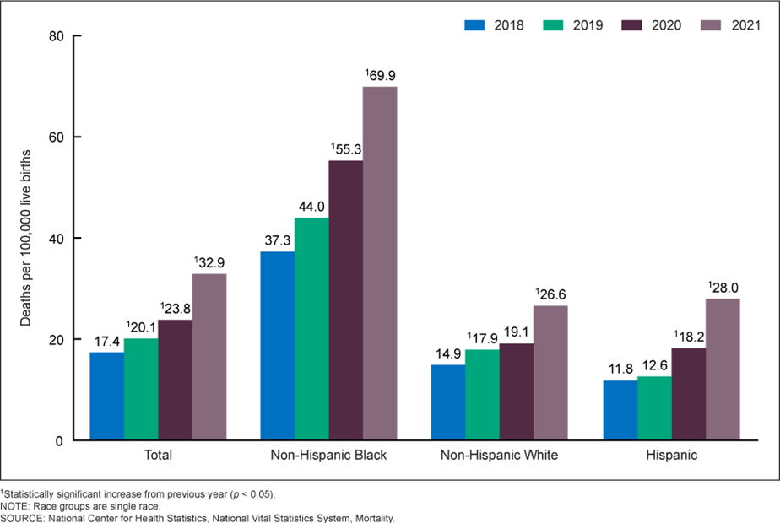
Maternal Mortality Rates, by Race and Hispanic Origin:
United States, 2018–2021
A bar graph titled Maternal Mortality Rates, by Race and Hispanic Origin: United States, 2018–2021. X-axis is divided into four groups: Total, Non-Hispanic Black, Non-Hispanic White, Hispanic. Ranges from 2018 to 2021 in one-year increments. The Y-axis is labeled deaths per 100,000 live births and ranges from zero to 80 in increments of 20. Legend: (1) Statistically significant increase from previous year (p<0.05); Note, Race groups are single race; Source, National Center for Health Statistics, National vital Statistics System, Mortality.
Total: 2018, 17.4; 2019, 20.1 (1); 2020, 23.8 (1); 2021, 32.9 (1). Non-Hispanic Black: 2018, 37.3; 2019, 44.0; 2020, 55.3 (1); 2021, 69.9 (1). Non-Hispanic White: 2018, 14.9; 2019, 17.9 (1); 2020, 19.1; 2021, 26.6 (1). Hispanic: 2018, 11.8; 2019, 12.6; 2020, 18.2 (1); 2021, 28.0 (1).
Notes:
This graph clearly depicts racial disparities in recent maternal mortality rates. Each bar shows the number of deaths per 100,000 live births in a given year, separated out by race and hispanic origin.
First, the number of deaths is rising steadily and steeply, year after year.
Second, the rates for non-hispanic Black women are rising much more precipitously than the rates of non-hispanic white women and hispanic women.
Third, the maternal mortality rate of non-hispanic Black women is much, much higher than that of the other groups.

Slide 7
Cardiac Conditions and Maternal Mortality
Cardiovascular disease (CVD) is the leading cause of maternal mortality and morbidity in the first year postpartum
Cardiac conditions account for approximately one third of all pregnancy-related deaths, with a disproportionate number of deaths among non-Hispanic Black people
Deaths from cardiac conditions continue to rise
More than 80% of all pregnancy-related deaths (2018–2020), regardless of cause, were preventable, including those caused by cardiac conditions in pregnancy
Addressing CVD in pregnancy and postpartum requires early identification to coordinate care
Notes:
Data on maternal mortality by race confirms a statistically significant increase in deaths per 100,000 live births each year from 2018 to 2020.
While pregnancy-related deaths of hemorrhage, hypertensive disorders of pregnancy, embolism, anesthesia declined, the contribution of Cardiovascular conditions and infection increased.
This suggests a change in risk profile of the birthing population
Cardiac conditions refer to disorders of the cardiovascular system that may affect maternal health. Such disorders may include congenital heart disease and acquired heart disease in pregnancy and 12 months postpartum, including but not limited to cardiac valve disorders, cardiomyopathies, arrhythmias, coronary artery disease, pulmonary hypertension, and aortic dissection.
Pregnancy acts as a physiologic cardiovascular stress test by virtue of the hemodynamic changes that occur. Moreover, pregnancy may aggravate underlying cardiac disease or may result in de novo cardiomyopathy or peripartum cardiomyopathy.

Slide 8

Miasha Gilliam-El (1 of 4)

Slide 9
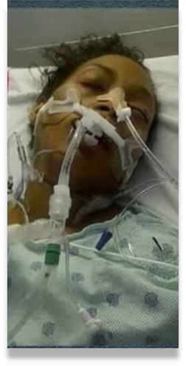

Miasha Gilliam-El (2 of 4)

Slide 10




Miasha Gilliam-El (3 of 4)

Slide 11

Miasha Gilliam-El (4 of 4)

Slide 12
Why focus on the outpatient sexual and reproductive health setting?
The 2018 California Pregnancy-Associated Mortality Review (CA-PAMR) found:
A majority of pregnant and postpartum people who died of cardiac conditions (2002-2006) did not have a cardiac condition diagnosis before death, but most had underlying risk factors, and had presented with signs and symptoms suggestive of cardiac disease.
The majority of maternal deaths due to CVD occurred in the postpartum period.
To reduce maternal morbidity and mortality, sexual and reproductive health providers must recognize maternal signs and symptoms as potentially cardiac in nature.
https://www.cdph.ca.gov/Programs/CFH/DMCAH/CDPH%20Document%20Library/PAMR/CA-PAMR-Report-1.pdf
Notes:
Other obstetric complications, such as preeclampsia and gestational diabetes, are associated with future cardiovascular disease risk >> opportunity for prevention/recognition through good hx taking
The majority of maternal deaths due to CVD occurred in the postpartum period, when a SRH provider may be seeing them

Slide 13
Opportunity to Improve Maternal Health Outcomes
Sexual and reproductive health settings, including Title X clinics:
Are often clients’ only or usual source of care
Provide preconception care, pregnancy testing and options counseling, and contraception services
Engage with partners and the community
  Provide effective referrals and linkages to care, including to prenatal and other services
Often see clients within a year of pregnancy
Notes:
SRH settings provide preconception care, including screening for chronic conditions and cardiac risk factors before a potential pregnancy and provide appropriate guidance and referrals
SRH settings provide pregnancy testing and counseling services as a routine care component, which presents an opportunity for screening for cardiac conditions unbiased options counseling
That said, we've got some strengths and some opportunities to make a positive impact here. Outpatient sexual and reproductive health providers, especially Title X providers, deliver care to a diverse population including individuals who may be at risk for CVD.
More than half of all women who obtain healthcare from a Title X family planning provider consider that provider to be their only or their usual source of care. This is a two-sided coin. On one side, it means that if that client doesn't receive services from that title provider, they're very possibly not going to receive it anywhere else. On the other hand, we have an opportunity, and that's a golden opportunity, to improve outcomes by addressing cardiac conditions.
We also know that sexual and reproductive healthcare providers are often well engaged with the community, so can promote the availability of services that are appropriate to those served and also provide effective referrals.
I want to say this though about referrals. We know from a study published in the Journal of Women's Health, and we also know from our own personal experience working in this space, that while most Title X clients who needed referrals related to cardiovascular health received them, few of these clients actually follow through with attending the referral appointment. So we have this opportunity, again, to improve outcomes by providing referrals and also strengthening our referral systems to make sure that there's follow-through.
SOURCE: Outcomes of Cardiovascular Disease Risk Factor Screening and Referrals in a Family Planning Clinic

Slide 14
Addressing Cardiac Conditions in the SRH Setting
Involve multidisciplinary teams, including teams who care for people in the postpartum period
Based on the priorities of your community, start small by testing a few ideas
Understand that every team will be at a different point in this work
Consider the evidence-based practices presented in the
High Impact Practice Sets (HIPS) for a menu of options

Slide 15
High Impact Practice Sets (HIPS) (1 of 2)
RHNTC and ACOG adapted AIM’s Patient Safety Bundles* (PSBs) to create High Impact Practice Sets (HIPS)
HIPS highlight evidence-based practices that can be implemented in the outpatient sexual and reproductive health setting to improve maternal health outcomes
*Alliance for Innovation on Maternal Health (AIM) PSBs are collections of clinical condition-specific best practices to improve maternal and overall health outcomes. https://saferbirth.org/patient-safety-bundles/
Notes:
AIM PSBs are multidisciplinary, clinical-condition specific patient safety bundles to support best practices that make birth safer
HIPS were adapted from the AIM PSBs by RHNTC and ACOG
HIPS highlight evidence-based practices that can be implemented in the sexual and reproductive health outpatient setting to improve maternal health outcomes.
Resources
Patient Safety Bundles (https://saferbirth.org/patient-safety-bundles/)

Slide 16
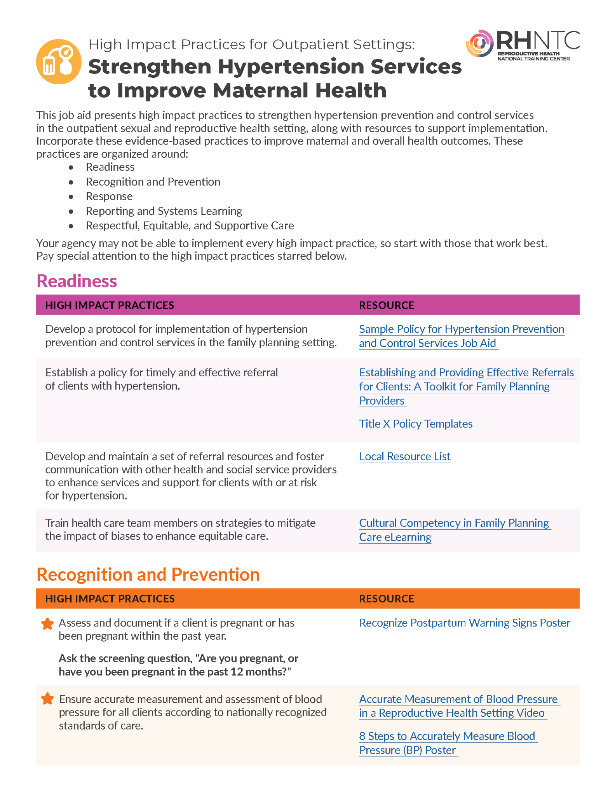
High Impact Practice Sets (HIPS) (2 of 2)
HIPS focus on five areas:
  Hypertension
  Cardiac conditions
  Substance use disorders
  Mental health conditions
  Postpartum transition
Notes:
HIPS focus on five topics relevant in the outpatient SRH setting; this webinar focuses on the second: cardiac conditions
HIPS resources to support strengthening hypertension prevention and control services and on addressing cardiac conditions are available on the RHNTC website
Resources to support strengthening services around substance use disorders, mental health conditions and the postpartum transition will be available in the coming months

Slide 17
The 5 Rs
Information/Data from Alliance for Innovation on Maternal Health. Measurement of Respectful Care in AIM Statement. Accessed November 20, 2023. https://saferbirth.org/measurement-of-respectful-care-in-aim-statement/
A diagram. Readiness, Recognition and Prevention, Response, Reporting and Systems Learning- all placed on an arrow point right to Respectful Care.
Notes:
The way the AIM bundles are structured is structuring them in a very consistent way across all those conditions with what we call the five Rs. We've taken that model and used that for the HIPS as well. Similar to the AIM bundles that are, again, implemented primarily in the inpatient setting, we're taking this to the outpatient setting and including a structure that many clinicians have really become familiar with. The structure that this allows implementation that's consistent and, importantly, measurement that can be consistent in each of these categories.

Slide 18
Readiness (1 of 3)
RED FLAGS
for Pregnant and Postpartum Individuals
  Shortness of breath at rest
  Severe orthopnea ≥ 4 pillows
  Resting HR ≥120 bpm
  Resting systolic BP ≥160 mm Hg
  Resting RR ≥30
  Oxygen saturations ≤94% with or without personal
  history of CVD
Train clinical staff to:
Conduct key screening tests for monitoring cardiovascular health according to guidelines.
Identify and respond to potential pregnancy-related cardiac conditions.
PROMPT EVALUATION and/or hospitalization for acute symptoms
plus
CONSULTATIONS with MFM and
Primary Care/Cardiology
©California Department of Public Health, 2017; supported by Title V funds. Developed in partnership with California Maternal Quality Care Collaborative Cardiovascular Disease in Pregnancy and Postpartum Taskforce. Visit: www.CMQCC.org for details
Notes:
Train clinical staff to conduct key screening tests for monitoring cardiovascular health according to guidelines.
Implementation of a screening test for cardiac conditions for pregnant and postpartum people is a key step toward reducing the burden of maternal mortality due to cardiac conditions.
A cardiovascular risk assessment algorithm developed by the CMQCC (California Maternal Care Quality Collaborative) stratifies pregnant and postpartum patients into low risk and high risk for cardiovascular disease.
The algorithm can be applied to all pregnant and postpartum people at their first clinical encounter

Slide 19
Cardiovascular
Disease Assessment in Pregnant and Postpartum Individuals
A flowchart with labeled text boxes.
Text boxes labeled Symptoms, Vital Signs, and Risk Factors flow to a central text box: greater than or equal to 1 Symptom plus greater than or equal to 1 Vital Signs Abnormal plus less than or equal to 1 Risk Factor or ANY COMBINATION ADDING TO less than or equal to 4. A box labeled **Physical Exam flows to the central text box with an arrow labeled No and to Consultation indicated (MFM and Primary Care/Cardiology) with an arrow labeled Yes.
Text within labeled boxes:
Symptoms (*NYHA class is greater than or equal to II):
Suggestive of Heart Failure: Dyspnea, Mild orthopnea, Tachypnea, Asthma unresponsive to therapy.
Suggestive of Arrhythmia: Palpitations, Dizziness/syncope.
Suggestive of Coronary Artery.
Disease: Chest pain, Dyspnea.
Vital Signs:
Resting HR greater than or equal to 100 bpm.
Systolic BP is greater than or equal to 140 mm Hg.
RR greater than or equal to 24.
Oxygen sat less than or equal to 96%.
Risk Factors:
Age is greater than or equal to 40 years.
African American.
Pre-pregnancy obesity (BMI greater than or equal to 35).
Pre-existing diabetes.
Hypertension.
Substance use (nicotine, cocaine, alcohol, methamphetamines).
History of chemotherapy.
**Physical Exam:
ABNORMAL FINDINGS.
Heart: Loud murmur or
Lung: Basilar crackles.
The central text box flows to Consultation indicated and to a text box containing Obtain and Consider details.
Obtain: EKG and BNP.
Echocardiogram plus or minus CXR if HF or valve disease is suspected, or if the BNP levels ar elevated.
24 hour Holter monitor, if arrhythmia suspected.
Referral to cardiologist for possible treadmill echo verses CTA versus alternative testing if postpartum.
Consider: CXR, CBC, Comprehensive metabolic profile, Arterial blood gas, Drug screen, TSH, etc.
Follow-up within one week.
The Obtain and Consider text box flows to Results negative (signs and symptoms resolved, Reassurance and route follow-up) and Results abnormal (CVD highly suspected), which flows to Consultation indicated.
Copyright California Department of Public Health, 2017; supported by Title V funds. Developed in partnership with California Maternal Quality Care Collaborative Cardiovascular Disease in Pregnancy and Postpartum Taskforce. Visit: www.CMQCC.org for details.

Slide 20
Readiness (2 of 3)
Train health care team members on strategies to mitigate
the impact of biases in order to enhance equitable care.
Develop and maintain a standard policy and protocol to identify and respond to potential pregnancy-related
Notes:
Train health care team members on strategies to mitigate the impact of biases in order to enhance equitable care.
An actual or suspected cardiovascular condition exposes patients and families to increased stress and trauma, which may include difficult prognoses or unexpected news.
Training professionals on techniques to support trauma-informed care, is important to engrain these principles into clinical care.
Training in trauma informed care, implicit bias, and anti-racism may optimize health care professionals’ approaches to care and increase awareness of patient groups who are vulnerable to discrimination related to race, ethnicity, education level, weight, English language proficiency, or other identities and factors that can affect care.
Develop and maintain a standard policy and protocol for the identification of potential pregnancy-related cardiac conditions and response.
Early identification of cardiac deterioration in pregnant and postpartum patients and rapid intervention is essential to safe, effective care.
Pregnant or postpartum people presenting with cardiac symptoms, such as shortness of breath, palpitations, or chest pain, should be referred for evaluation for peripartum cardiomyopathy and significant cardiac conditions.

Slide 21
Readiness (3 of 3)
Establish or strengthen your system for timely and effective consultation and referral or transfer to the appropriate level of care.
Develop and maintain a set of referral resources, and foster communication with other health and social service providers to enhance support for clients with or at risk for cardiac conditions.
Notes:
Establish coordination of appropriate consultation and referral or transfer to appropriate level care.
A coordinated approach to co-management or consultation or both to ensure that each patient has access to the appropriate level of care at the appropriate time, including transfers to appropriate levels of maternal and newborn care, must occur.
These clinical pathways, such as how to access subspecialists and maternal transport, should be established in advance to allow for timely support when a pregnant person in cardiac distress presents to the clinic.
Processes for transfer should be established in advance and include modes of transport with continuous availability.
Develop and maintain a set of referral resources and communication pathways with other health and social service providers to enhance services and supports for clients with or at risk for cardiac conditions.
Patients experiencing complications due to cardiac conditions and their support networks may require material, emotional, and social supports as they cope with sequelae of the emergency.
Develop and maintain a resource inventory of services.

Slide 22

Recognition and Prevention (1 of 2)
Obtain the client’s pregnancy and cardiac histories.
Assess and document if the client is pregnant or has been pregnant within the past year.
Notes:
Obtain a pregnancy and cardiac history.
A recent pregnancy may not be apparent to a health care professional or recognized by a patient themselves as relevant to their current symptoms.
Obtaining a focused pregnancy and cardiac history for reproductive-aged patients presenting for care is vital to understanding an individual’s cardiac risk in all care settings.
Questions to ask patients may include, “Are you currently pregnant, or have you been pregnant within the last year?” and “Do you have a personal history of cardiac disease?”
Referral to a cardiologist may be indicated depending on the significance of obstetric and cardiac factors identified during the assessment.
A history of adverse pregnancy outcomes may guide patient counseling about risk of future cardiac disease and recommendations for immediate or follow-up care.

Slide 23
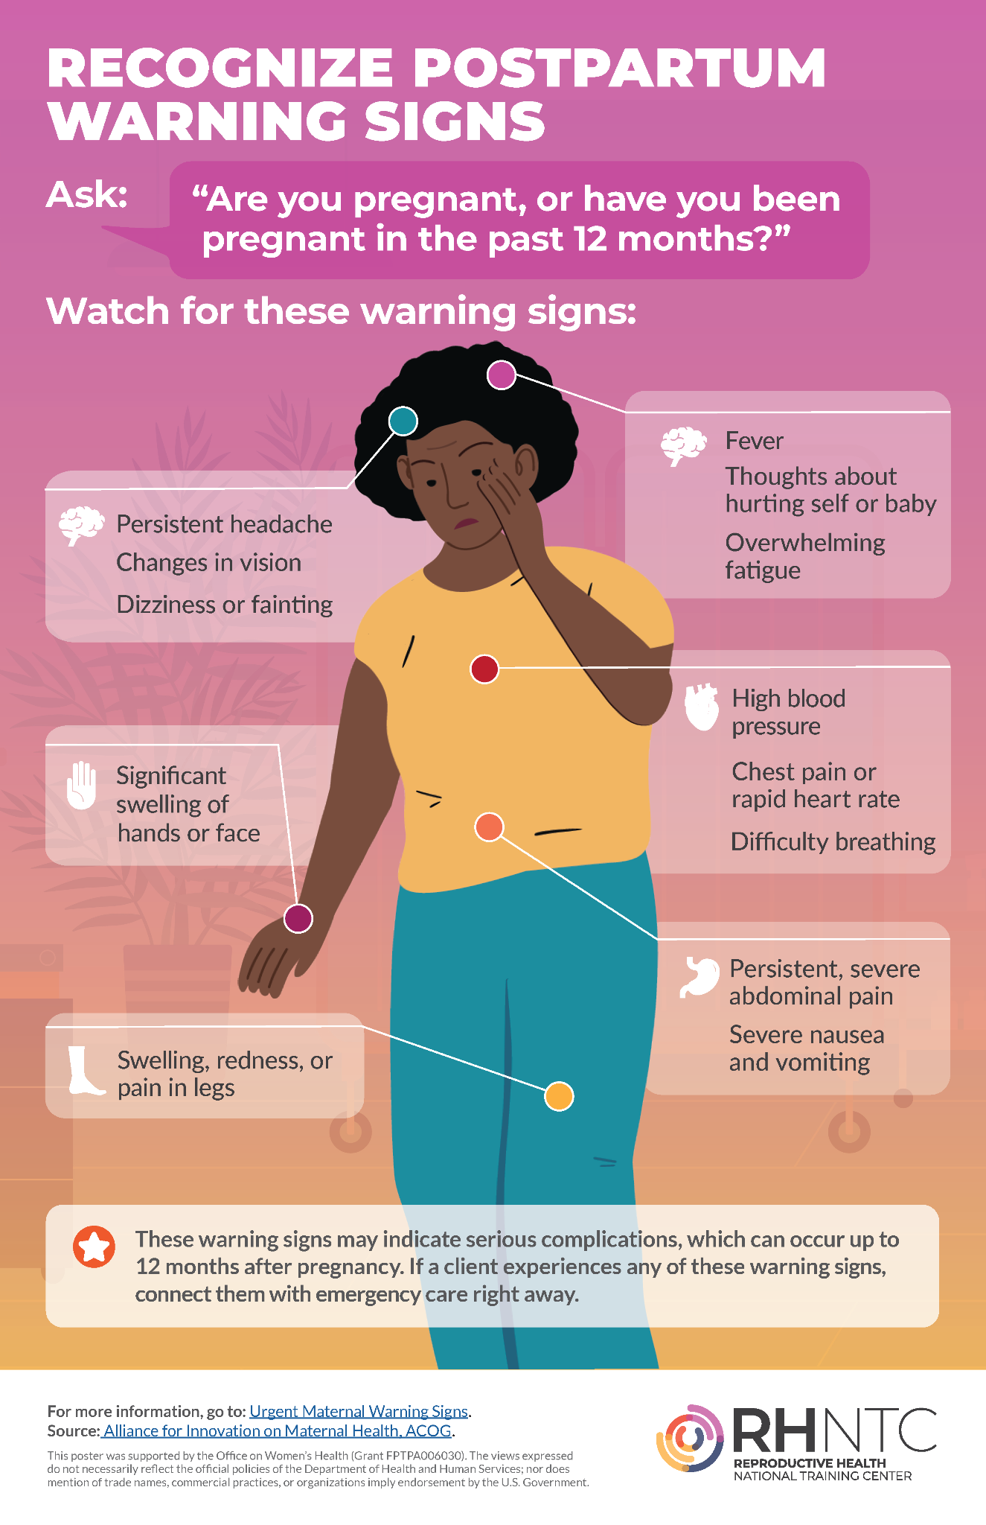
Recognition and Prevention (2 of 2)
Assess if warning signs of cardiac conditions are present, and respond according to protocols.
Notes:
Assess if warning signs of cardiac conditions are present and respond according to protocols.
Pregnant and postpartum people presenting to any care setting with acute cardiac symptoms or abnormal examination findings should be evaluated promptly for cardiac disease.
Warning Signs for an Imminent Cardiac Event
Shortness of breath at rest
Severe orthopnea using 1 or more pillows
Resting heart rate 120 bpm or higher
Resting systolic blood pressure 160 mm Hg or higher
Resting respiratory rate 30 or higher
Oxygen saturation rate 94%
Screen each person for condition-associated risk factors and provide linkage to community services and resources.
Medical conditions such as anemia, asthma, bleeding, embolism, infection, thyroid disorders, metabolic disorders, and hypertensive disorders of pregnancy may mimic the symptoms of cardiac conditions in pregnancy and postpartum or present as comorbidities.
Screening for comorbid conditions and risk factors for cardiovascular disease may allow for identification and linkage with treatment
For example, substance use can be associated with cardiac conditions, such as arrhythmias (cocaine, opioids, amphetamines, chronic alcohol use), hypertension (cocaine, amphetamines), endocarditis or valvular heart disease (intravenous drug use), acute heart failure (amphetamines), and dilated cardiomyopathy (amphetamines).
Patients who have experienced cardiac conditions during the peripartum period may experience mental health comorbidities after their cardiac diagnoses.
Pregnant and postpartum patients should therefore be screened for mental health disorders and referred to appropriate follow-up care if they screen positive.

Slide 24
Response
Offer reproductive life planning discussions and resources, including access to a full range of contraceptive options for which the client is medically eligible.
Educate all clients who are pregnant, or who have been pregnant in the past year, on postpartum complications and early warning signs. Provide instructions of who to notify if they have concerns.
Notes:
Patients with chronic conditions have increased understanding of risk in pregnancy when provided with a reproductive life plan and supportive counseling.
This process includes counseling regarding reproductive risks with a given medical condition.
Several standardized tools are available to support reproductive life planning discussions between patients with cardiac conditions.
This conversation may best include the individual’s cardiology and obstetric care professionals.
In patients with pre-existing cardiovascular disease, risk assessment may be performed using existing tools such as CARPREG II, ZAHARA, and mWHO (Modified World Health Organization Classification of Maternal Cardiovascular Risk) to counsel patients about anticipated risk to allow for informed decision making.
Contraception planning and education requires input from the obstetrician–gynecologist, cardiologist, and patient, especially for patients with complex congenital heart conditions.
Tools such as the U.S. Medical Eligibility Criteria for Contraceptive Use and guidance from the American Heart Association (see https://www. ahajournals.org/doi/full/10.1161/CIRCULATIONAHA.111.070607) may be used to determine eligibility for and contraindications to different methods of contraceptive care for patients who do not want to become pregnant.
Reproductive planning may also include unbiased options counseling and access to abortion care for those who choose not to continue a pregnancy.

Slide 25
Reporting and Systems Learning
Monitor outcomes and process data related to cardiac conditions.
Disaggregate data by race and ethnicity, given known disparities
in rates of cardiac conditions experienced by Black and Indigenous pregnant and
postpartum people.
A screenshot of two sections titled: High Impact Practice Set (HIPS) to Address Cardiac Conditions Measurement Tool; Policies and Procedures.
High Impact Practice Set (HIPS) to Address Cardiac Conditions Measurement Tool.
This tool is designed to assist sexual and reproductive health agency/service site staff in collecting and using data to address cardiac conditions during pregnancy and postpartum. Please fill in the shaded cells to the best of your ability. Reporting all data for all measures is not necessary to make improvements but is highly encouraged. If your agency has more than one service site, please use one Excel workbook for each individual site. For guidance, see the Data Entry Instructions worksheet tab below.
Today's date: 8/31/2023.
Period start date: 1/1/2023.
Period end date: 3/31/2023.
Agency/service site name: Agency/Service Site. This info populates automatically from the Data Entry Instructions worksheet.
Your name: Full Name.
Your title: Title.
POLICIES AND PROCEDURES
1.a. Do you have a written policy or procedure containing all of the minimum recommended components?
Enter Yes or No: No.
The minimum recommended include:
• A standard protocol for the identification of potential pregnancy-related cardiac conditions and response
• Coordination of appropriate consultation and
1.b. Date on which the written policy or policies containing all of the minimum
recommended components was put in place or last updated.
Enter "mm/dd/yyyy" or "Not Yet In Place.“: 8/23/2023.

Slide 26
Respectful, Equitable, and Supportive Care
Screen for structural and social drivers of health that might impact clinical recommendations or treatment plans. Link the client to resources that align with their health literacy, cultural needs, and language proficiency.
Provide person-centered, trauma-informed communication and care to support the client in understanding recommendations and options.
Notes:
Screen for structural and social drivers of health that might impact clinical recommendations or treatment plans and provide linkage to resources that align with the client's health literacy, cultural needs, and language proficiency.
Health systems should have mechanisms to consistently screen pregnant and postpartum people for structural and social determinants of health (SDOH) incorporated into clinical care and quality-improvement efforts.
Standardized tools exist for screening for SDOH needs, such as the PRAPARE tool (Protocol for Responding to and Assessing Patients’ Assets, Risks and Experiences), The EveryONE Project, and the Centers for Medicare & Medicaid Services’ AHC-HSRN (Accountable Health Communities Health-Related Social Needs Screening Tool).
Referral should be tailored to patients’ unique needs, and resources should be accessible to patients with different literacy and language proficiencies and cultural needs.

Slide 27
Resources

Slide 28
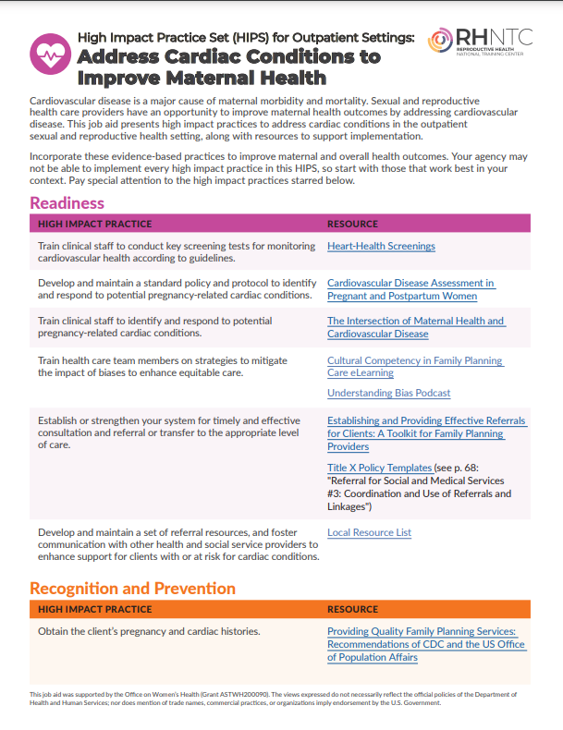
RHNTC Resources (1 of 2)
High Impact Practice Set (HIPS) for Outpatient Settings:
Address Cardiac Conditions to Improve Maternal Health Job Aid
Notes:
I’ve got some resources to share with you all…the links to these resources are contained in a slide toward the end of the deck, which you’ll have access to.
This job aid, available on the RHNTC website, presents high impact practices to address cardiac conditions in the outpatient sexual and reproductive health setting, along with resources to support implementation.
The high impact practice set is organized around the 5 Rs that we discussed today. Again, your agency may not be able to implement every high impact practice, so start with those that work best in your context. Pay special attention to the high impact practices starred, which we think have the potential to be the little hinges that swing the big doors.

Slide 29
RHNTC Resources (2 of 2)
HIPS to Address Cardiac Conditions Measurement Tool
A screenshot of two sections titled: High Impact Practice Set (HIPS) to Address Cardiac Conditions Measurement Tool; Policies and Procedures.
High Impact Practice Set (HIPS) to Address Cardiac Conditions Measurement Tool.
This tool is designed to assist sexual and reproductive health agency/service site staff in collecting and using data to address cardiac conditions during pregnancy and postpartum. Please fill in the shaded cells to the best of your ability. Reporting all data for all measures is not necessary to make improvements but is highly encouraged. If your agency has more than one service site, please use one Excel workbook for each individual site. For guidance, see the Data Entry Instructions worksheet tab below.
Today's date: 8/31/2023.
Period start date: 1/1/2023.
Period end date: 3/31/2023.
Agency/service site name: Agency/Service Site. This info populates automatically from the Data Entry Instructions worksheet.
Your name: Full Name.
Your title: Title.
POLICIES AND PROCEDURES
1.a. Do you have a written policy or procedure containing all of the minimum recommended components?
Enter Yes or No: No.
The minimum recommended include:
A standard protocol for the identification of potential pregnancy-related cardiac conditions and response
Coordination of appropriate consultation and
1.b. Date on which the written policy or policies containing all of the minimum
recommended components was put in place or last updated.
Enter "mm/dd/yyyy" or "Not Yet In Place.“: 8/23/2023.

Slide 30

Hear Her
Notes:
Over 700 women die each year in the U.S. from issues related to pregnancy or delivery. Two thirds of these pregnancy-related deaths could be prevented if people were better informed. Women know their own bodies better than anyone and can often tell when something does not feel right. The Hear Her campaign supports efforts to prevent pregnancy-related deaths by sharing potentially life-saving messages about "Urgent Maternal Warning Signs." The campaign also seeks to encourage everyone who supports pregnant and postpartum women to really listen when she tells you something doesn't feel right. This includes partners, friends, family, co-workers, and providers. Acting quickly could help save her life.
Hear Her is a CDC project. This project is supported through a partnership with the CDC Foundation and funding from Merck through its Merck for Mothers Program. Hear Her is a trademark of the U.S. Department of Health and Human Services.
SOURCE: https://www.cdc.gov/hearher/index.html

Slide 31
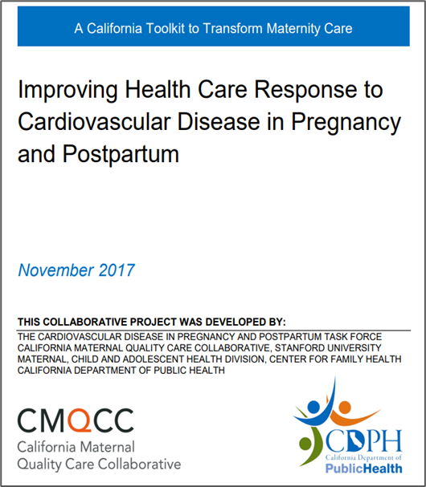
Toolkit: Improving Health Care Response to Cardiovascular
Disease in Pregnancy and Postpartum
An algorithm for symptomatic or high-risk pregnant
or postpartum people to guide stratification and
initial workup
Clinician resources on contraception counseling, cardiovascular medications, and breastfeeding
Key points about racial and ethnic disparities among cardiovascular diagnoses
Information and infographics for women diagnosed with, or at risk of, CVD
Info about future risk of CVD and long-term health issues
Educational handouts on contraceptive options and planning a pregnancy with CVD
https://www.cmqcc.org/resources-toolkits/toolkits/improving-health-care-response-cardiovascular-disease-pregnancy-and
Notes:
Toolkit is available through a simple registration process
The Improving Health Care Response to Cardiovascular Disease in Pregnancy and Postpartum Toolkit was developed by the Cardiovascular Disease in Pregnancy and Postpartum Task Force as a resource for obstetrics, primary care and emergency medicine providers who interact with women during prenatal care or the postpartum period. The toolkit includes an overview of clinical assessment and comprehensive management strategies for cardiovascular disease based on risk factors and presenting symptoms.
Key elements include:
An algorithm for symptomatic or high-risk pregnant or postpartum women to guide stratification and initial work up
Clinician resources on contraception counseling, cardiovascular medications and breastfeeding
Key points about racial and ethnic disparities among cardiovascular diagnoses
Information and infographics geared directly for women diagnosed with, or at risk of, cardiovascular disease
Future risk of cardiovascular disease and long-term health issues
Educational handouts for women on contraceptive options and planning a pregnancy with known cardiovascular disease
The toolkit is available to download after logging into CMQCC's website. If you do not already have a CMQCC Account, you will need to complete a brief survey to initialize an account.
SOURCE: https://www.google.com/url?q=https://www.cmqcc.org/resources-toolkits/toolkits/improving-health-care-response-cardiovascular-disease-pregnancy-and&sa=D&source=editors&ust=1699033129914346&usg=AOvVaw23qDuArjKmTUhnRHYYcLrY

Slide 32
Questions?

Slide 33
Poll Time!
How confident are you that you can:
Describe the impact of cardiac conditions on maternal health, including their impact on racial disparities in maternal morbidity and mortality
Describe high impact practices that sexual and reproductive health providers can implement to address cardiac conditions for improved maternal and overall health outcomes
Notes:
As this session comes to a close, we’d like to check back in and see how, if at all, the group’s confidence has changed.

Slide 34
What’s one thing you’ll do—or do differently—as a result of this discussion?
Notes:
Next, I'd like to invite you to share an action that you want to take as a result of what you learned today. We’re going to launch another poll where we’ll ask you to please enter one action item you will take, one action or anything you feel like sharing as a result of this webinar that you are ready to go ahead and do differently or take on a new action that you weren’t previously.

Slide 35
Resource List
High Impact Practice Set (HIPS) for Outpatient Settings: Address Cardiac Conditions to Improve Maternal Health Job Aid
HIPS to Address Cardiac Conditions Measurement Tool
Recognize Postpartum Warning Signs Poster
HEAR HER Campaign
Improving Health Care Response to Cardiovascular Disease
in Pregnancy and Postpartum
Notes:
Again, the recording, the slides, the transcript will all be posted on rhntc.org.

Slide 36
THANK YOU!
Please fill out the evaluation form after the webinar.
CONTACT US
rhntc@jsi.com
This webinar was supported by the Office of Population Affairs (Grants FPTPA006030, TPSAH000006) and the Office on Women’s Health (Grant ASTWH2000-90-01-00). The views expressed do not necessarily reflect the official policies of the Department of Health and Human Services; nor does mention of trade names, commercial practices, or organizations imply endorsement by the U.S. Government.
Notes:
Thank you so much for joining us! I hope you’ll join me in thanking Dr. Wolfe. And before you go, please take just a minute to fill out that evaluation that should be already open! We really value your input and will use it to inform future sessions. We have a new shorter form, so let us know what you think! As a reminder, the slides and recording of this webinar will be emailed to you and posted to RHNTC in a few days. If you have additional questions or ideas for the RHNTC, please don’t hesitate to email us at rhntc@jsi.com. In order to obtain a certificate of completion or CNE’s for attending this webinar, you must complete the evaluation and you must be logged into rhntc when you complete the evaluation.

Slide 37
Engage With Us
Subscribe to the RHNTC monthly eNewsletter at rhntc.org/enewsletter
Contact us on rhntc.org
Sign up for an account on rhntc.org
Follow us on LinkedIn
Subscribe to the RHNTC podcast
podcast.rhntc.org
Notes:
To stay in touch with the RHNTC, we hope you will subscribe to our monthly eNewsletter by visiting rhntc.org backslash enewsletter; contact us through our website (rhntc.org); sign up for an account on our website; follow us on LinkedIn. Thank you again for joining us. That concludes today’s webinar.

