Slide 1
Brand Building for Change in Your Community: For Teen Pregnancy Prevention Grantees
Nicholas Sufrinko & Allison Tomai Felsen
Healthy Teen Network
Notes:
Aisha Moore: Welcome to today's webinar. My name is Aisha Moore, and I am a grantee liaison with the Reproductive Health National Training Center's Teen Pregnancy Prevention program. We're recording today's webinar and the slide deck as well as the transcript will be available on the rhntc.org website within the next few days, following the webinar. So my colleague will also be chatting out the evaluation link to you all. So we want you to have it handy and ready to give your feedback because we really appreciate that you do. It's so important to us, and it's really helped us to make quality improvements in our work based on your comments. So please take a moment to open the evaluation link that gets chatted out, and you can complete your evaluation as soon as we finish the webinar. And in order to obtain a certificate of completion, you must be logged into rhntc.org when you complete the evaluation. I want to thank the Office of Population Affairs for supporting this presentation, and this content is solely the responsibility of the authors and does not necessarily represent the official views of OPA or HHS. Now let's get in today's topic, powerful brands. So in our line of work, brands can change the world, and you play a crucial role in crafting them. So in this workshop, we hope that all the TPP program directors, managers, implementation staff, will learn how to use brands in developing positive youth development programs and other products. So today you're going to learn how, when you craft a brand very carefully, you can build emotional brand loyalty and support your program recruitment, retention, and so many other things.

Slide 2
Speakers
Nicholas Sufrinko
he, him
Creative Direction & Product Design Manager
Healthy Teen Network
Allison Tomai Felsen
she, her
Communications Manager
Healthy Teen Network
Notes:
Aisha Moore: So now I will turn it over to Nicholas Sufrinko, Creative Director and Product Design Manager for Healthy Teen Network, and Allison Felsen, Communications Manager at Healthy Teen Network.
Nicholas Sufrinko: Thanks, Aisha. So, hello, everyone. Thank you for joining us today for Brand Building for Change in Your Community. We're going to get started. I'm Nick. I use he/him pronouns.
Allison Felsen: And I'm Allison. I use she/her pronouns.
Nicholas Sufrinko: And Allison and I have worked on a lot of projects over the years at Healthy Teen Network, and a lot of these projects involved branding. So I'm going to give you a sneak peek of one of those projects today before we get into more of the meat of the presentation. And we hope that you'll be able to use these branding strategies on your TPP projects too. In fact, the project I'm going to talk about was a TPP project. So we're going to do a quick overview of branding today, but we'll also be talking about office hours and TA opportunities later in the webinar where we can really dive a little deeper into your specific projects and needs.

Slide 3
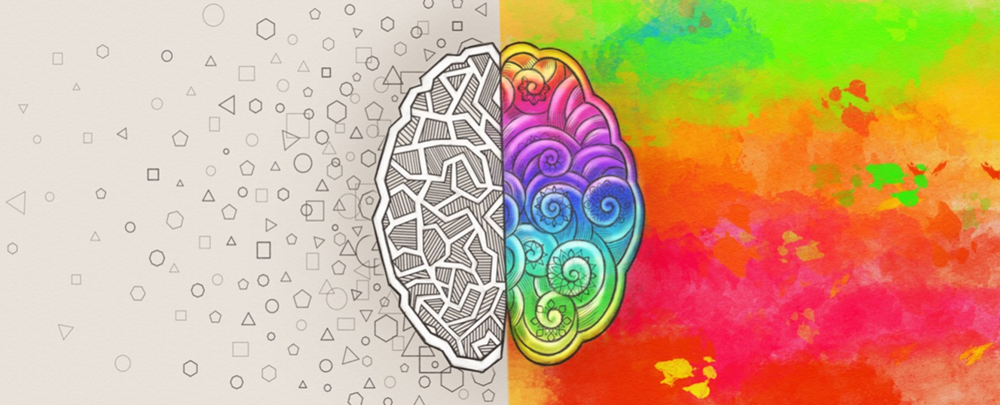
Who is this for?
Notes:
Nicholas Sufrinko: But before we go any further, I want to address the question of who is this webinar for, because a lot of people think that branding is just a domain of creative industry folks. So called right brain thinkers. Sort of designers, illustrators, artists, copywriters, but Allison and I are here to say no, that all types of folks have a stake in branding. Left and right-brained folks alike, and that includes program managers, program staff, and the like. And while it's true that some parts of branding like designing a logo do require some right brain skills, we want to demonstrate today that brand building is about creating a shared vision of what a brand could look and act like with everybody in the room. So for the creative folks that might be here today, we think that this is a super important step, building a shared vision. Because when you build a shared vision, critiques become less subjective. They don't become... They're no longer taste based, they're no longer, I like this, I don't like this. Instead, conversations become more about, I think this is on brand, and I think it's on brand because X, Y, and Z, or I think it's off brand, and I think it's off brand because of X, Y, and Z.

Slide 4
Roadmap
10 minutes
Welcome & Introductions
10 minutes
A TPP Case Study
5 minutes
A Very Hairy Challenge
10 minutes
Crafting Personas
7 minutes
Selecting an Archetype
13 minutes
Setting Voice, Styles, & Values
5 minutes
Creating a Mood Board
5 minutes
Choosing a Name
5 minutes
What’s Next
20 minutes
Q+A
Notes:
Nicholas Sufrinko: So with that said, this is our roadmap for today. Right now, we're at the beginning. In a bit, I'm going to give you a case study of a TPP project that Allison and I branded at Healthy Teen Network. Then, Alison is going to introduce you to a very hairy challenge that we'll use today to practice brand building. And for now, I'll leave it at that except to say that this character on the right, the one smelling the daisies, well, he might just make an appearance today in that challenge. Then we'll get to the meat of the presentation. We'll share a lot of information with you all. We'll do some exercises around crafting personas, choosing a brand archetype, and establishing voice, style and values. Can we click onto the animation? Then we'll talk about creating mood boards, and we'll spend just a little time on what makes a good brand name. Finally, we'll wrap it all up. We could talk about what you'll hand off to a designer or copywriter before they ever create a ogo, before they ever create a tagline. And we'll end with some information on office hours and TA. We'll leave some time for Q&A at the end. So this is meant to be a little bit of a fast-paced introduction to branding, but if you all have questions as we go, either you could leave them in the chat and Allison and I will try to answer them as we go along too. So next slide.

Slide 5
In the chat…
When you think of the word “brand” or “branding,” what comes to mind?
Notes:
Nicholas Sufrinko: But actually to start off, I want to ask, you all a question. So when you hear the words brand or branding, what words come to mind for you? You could use the chat to tell us the first words that come to mind when you think of the word brand or branding. Ownership, yeah. Products, advertising. Advertising, representation, name, colors, identity. Yes. Personality, that's a great one. Style, associations. Awesome. Ownership. Yeah. Branding is a lot of things. We can go to the next slide. Image, cohesive messaging, consistency. Yeah, we'll be touching on a lot of these topics today.

Slide 6
What Is Branding?
A diagram of an iceberg with accompanying text. Above the water level is labeled: Logo, Colors, and Typefaces. Below the water is: Experience, Values, Positioning, Promise, Voice, and Personality.
Notes:
Nicholas Sufrinko: Yeah, so branding is a lot of things. And I quite like this image of the iceberg to think about branding because, you know, branding is not just what you see, the logo, the color, the typefaces, right? It's also what you don't see, sort of what lurks below the surface. So I think of some of you already mentioned some of these, but we're talking about experience, we're talking about the brand values, the brand voice, the brand positioning, positioning how it sort of differs from similar brands. Talking about the brand promise as well. So we're going to talk about both sides of this iceberg today. We're going to talk about some of, you know, choosing colors, typefaces, logos, et cetera, but also about sort of what you see below or what might be below the surface in branding. Okay.

Slide 7
Brand
The known identity for a product, service, or messaging campaign; the personality of a product, service, or campaign.
Notes:
Nicholas Sufrinko: So this is just one definition of a brand. "The known identity for a product, service or messaging campaign." The personality, I saw that word come in the chat. "The personality of a product, service or campaign." So in our field, you might think of a product, it could be something like a new sexual health app, for example, right? That could be one product that you could brand. Perhaps another product is a subscription box for condoms, let's say, that comes monthly. Services, well, maybe that's a special after school operating hours for a clinic. Let's say it's just for those under 18, or for those LGBTQ. A messaging campaign in our field might be something like a behavior change campaign that promotes the uptake of a specific behavior like condom use or explicit consent. You could also combine these things, product, services and campaigns, and brand that as a sort of company or organization. I also wanted to call out the word personality that somebody mentioned in the chat here as well. Because when we're engaging in branding exercises, sometimes it feels like we're talking about a real character or real person. That's intentional.

Slide 8
Why build a brand?
#1
Connect.
#2
Build your audience.
#3
Be remembered.
#4
Brand ambassadors.
#5
Create a shared vision.
#6
Stay focused.
#7
Spark change.
Notes:
Nicholas Sufrinko: So on the next slide, we can talk about why we might build a brand. For one, branding helps you connect with audiences on deep emotional levels. You'll see how we do that soon when we talk about archetypes. Branding can also help you build your audience. So let's say you're a TPP program that has so far only been studied and you soon need to disseminate, branding is an important step in getting your intervention out into the world. The third one here, good branding is always remembered. Someone in your audience, if someone in your audience seen your intervention once or twice, they should remember it when they see it for the third or fourth time. Consistent branding will help you do that. So the fourth one is that a strong brand can also help you motivate project staff to coalesce around one approach. So let's say you're talking with youth about STIs. Are the staff, when they're talking about this, are they being humorous or are they being serious? Good branding can help you set that direction, a consistent direction. Number five, I think this is a super important one. At Healthy Teen Network, for our brands, we often have many people working on them, maybe five or 10 people. Taking an approach like the one we discussed today can help you build a shared vision for your brand, and with everyone on the same page, that will make your brand seem consistent, even though many people are working with it. And then along those lines, good branding helps you stay focused. It can prevent mission group. So if you declare your brand attributes early, and we'll talk about brand attributes, that'll help you decide, for example, what you respond to and what you don't. This is especially important I think for brands with social media presences, where so many comments come in everyday, every week, or even every hour. And then finally, we think branding adds to your project by doing all these things. It adds to your project, it helps you achieve your goals. And in that, it helps spark change.

Slide 9

A TPP case study
Notes:
Nicholas Sufrinko: So to begin, I'm going to tell you a project of a story, or I'm going to tell you a project that Allison and I worked on called True You Maryland. True You Maryland wasn't always called True You Maryland. In fact, that's a name that came out of the branding process. Previously, it was called MOAHP, M-O-A-H-P. The Maryland Optimal Adolescent Health Project, which honestly doesn't roll off my tongue as you could hear. So what True You Maryland really is, is a project that champions the transformational impact of sex education in rural Maryland. It's a collaboration between schools and health systems, universities and community organizations, and six rural counties in Maryland. At its core, it's about the implementation of one evidence-based intervention. And so we're doing this in the west of Maryland, high in the Appalachian Maryland, and on the east, in the counties that Maryland calls the Eastern Shore. And we are doing this in all sorts of landscapes. So farmlands, woodlands, rural, marshes, waterways, these are the sorts of areas that we're doing this intervention in. And we knew that we needed a brand name and a look that resonated resonated with those here in rural Maryland. So how did we create this?

Slide 10
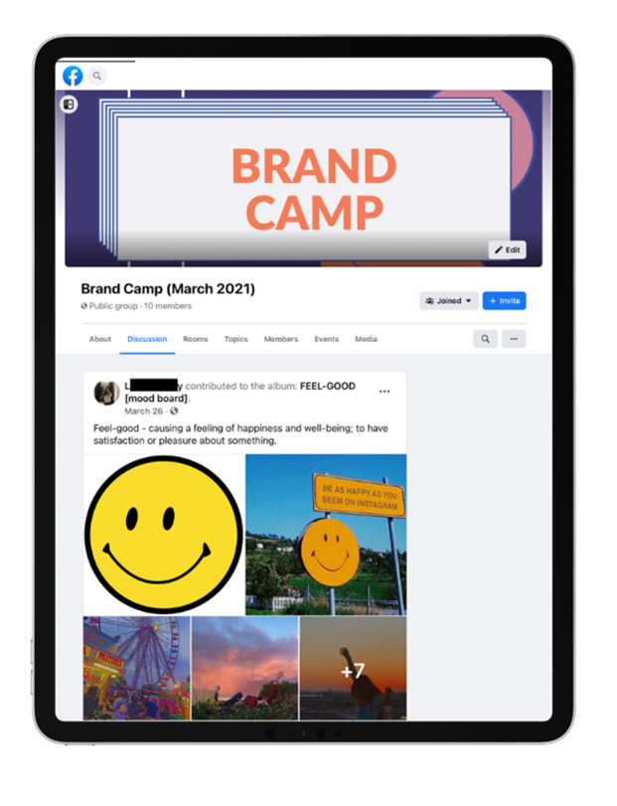
Brand Camp
5 videos and 5 short activities
Notes:
Nicholas Sufrinko: So on the next slide, we'll talk about that. So with our partner's help, we recruited youth in these six counties and we held what we called the Brand Camp. And we held it over five days in a private Facebook group. And all of us, the youth and adults on this private Facebook group, we engage in activities to help set the voice, style, and values of True You Maryland. And in the end, we even picked that name, True You Maryland. And if you want to get into exactly of like how we did this, how we recruited, how we structure the activities, that will be what our first office hours is dedicated to, and we'll share some information about that office hours in the end. But for now, suffice it to say that in brand camp, everyday, youth and adults watched a short video about branding and did a short activity. Some of these activities are the same ones we're going to do today. And in the end, we created True You Maryland, an affirming sex positive brand about finding, expressing, and celebrating your true self in the rural Maryland landscape.

Slide 11

Brand Book
Notes:
Nicholas Sufrinko: At the end of this process, this is what we have, the True You Maryland Brand Book. Brand books are super important. In a sense, they'll codify everything that we're going to cover today. So they'll codify the archetype you choose, they'll codify your voice, your style, your values. And if you have a new stamp staffer, you could hand over this brand book before they even start creating posters for, say, your social media campaign, or interact with youth in, say, like after hours clinic program. Now, I'll share with you some of the pages of the True You Maryland brand book just to show you what it entails.

Slide 12
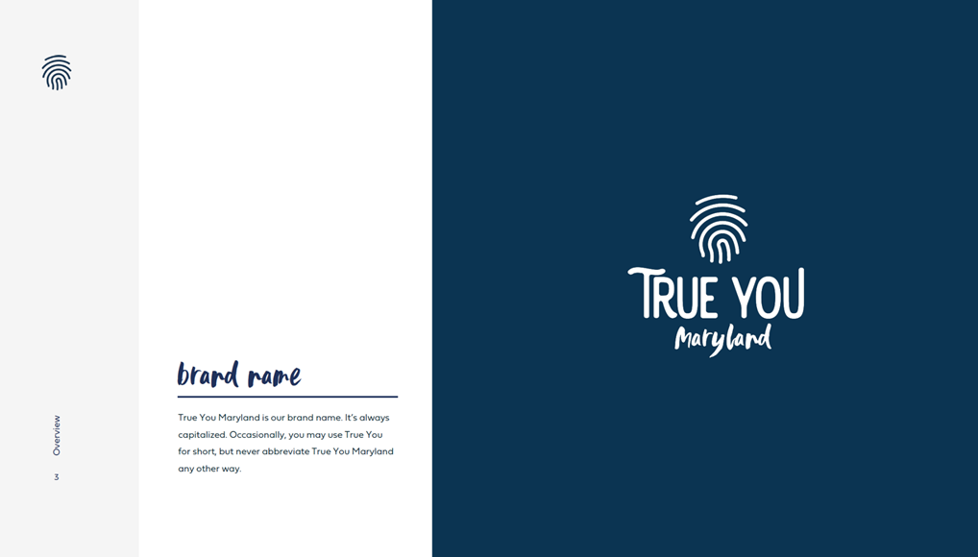
Brand Name
Notes:
Nicholas Sufrinko: So we begin with the obvious, that sort of top of the iceberg type of stuff. Here, we have the brand name and the logo. For True You Maryland, our logo is comprised of a thumbprint. That's meant to call both to mine, a fingerprint to sort of represent identity, but also the lines of a topographic map. That's because True You Maryland fuses, the idea of the brand of True You Maryland fuses identity and the landscape, making the case that one's identity and the landscape are one, that one's identity is in part where they live.

Slide 13
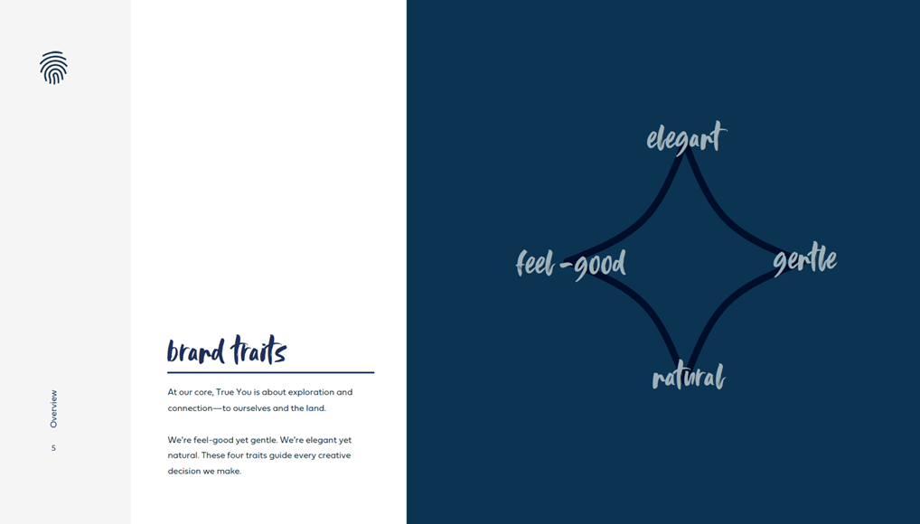
Brand Traits
Notes:
Nicholas Sufrinko: So here are some of the brand traits we define for True You Maryland. With youth and brand camp, we set these traits. These four traits guide every creative decision we make, from copywriting to visuals. And they're sort of like, they exist in tension, so they're on this little star here. So for example, feel good might on its own suggest energy. Like, let's say, the drop of a rollercoaster or an outdoor concert. But when it's combined with gentle, I think a different feeling emerges, calm as it is satisfying. What does it mean to be at once feel good and gentle? That's what we're going for with True You Maryland. Similarly, elegant and natural exist in tension, right? Elegant to some might be seen as the antithesis of natural. Think the big city, no grit, no dirt. But what does it mean to be at once elegant and natural? That's where True You Maryland lives.

Slide 14
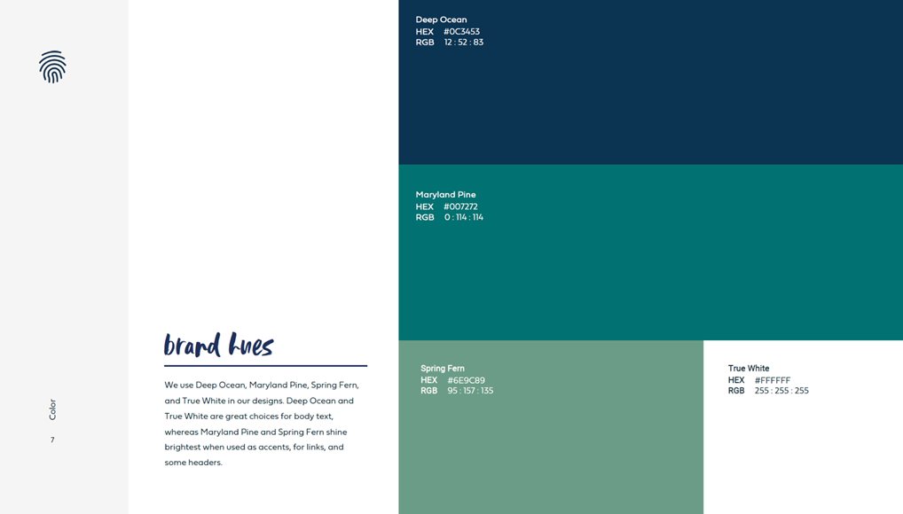
Color Palette
Notes:
Nicholas Sufrinko: So we also define the color palette. This is our color scheme. It's inspired by the Maryland landscape, the rural Maryland landscape. So we have deep ocean, Maryland pine, and a few other colors, and we provide guidance on where to use each color and in what proportions to use each color.

Slide 15
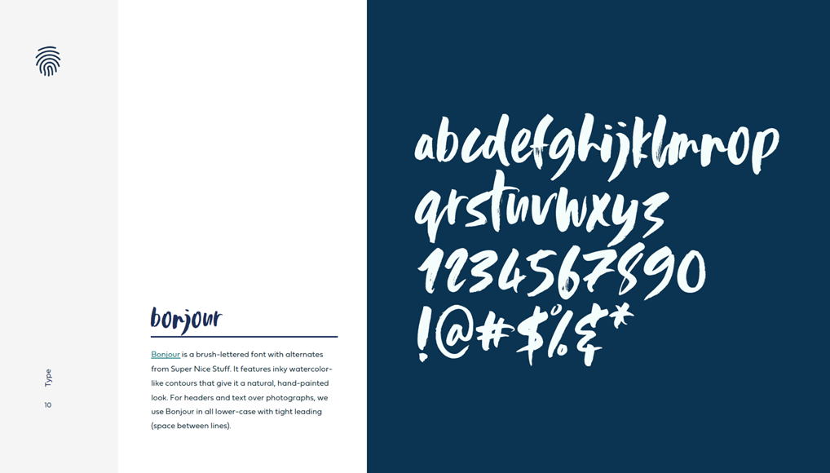
Typeface Selection
Notes:
Nicholas Sufrinko: We also have some guidance on some type choices or font choices. So for example, on the next slide, we use this one with the handwritten quality to emphasize the true selves for a brand called True You Maryland.

Slide 16
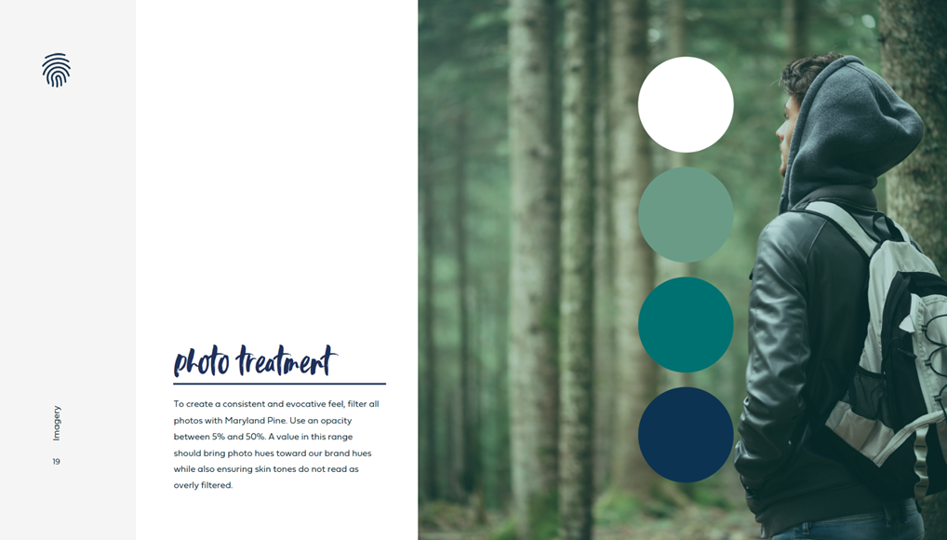
Photo Treatment
Notes:
Nicholas Sufrinko: We also provide some information on photo treatment. So we have some guidance on selecting photos, suggesting single subject photos to enhance the intimacy between the viewer and the subject. And we also provide some instructions for a photo filter. So we give all our photos a similar treatment, making them seem like a cohesive set even though they're pooled from stock websites.

Slide 17
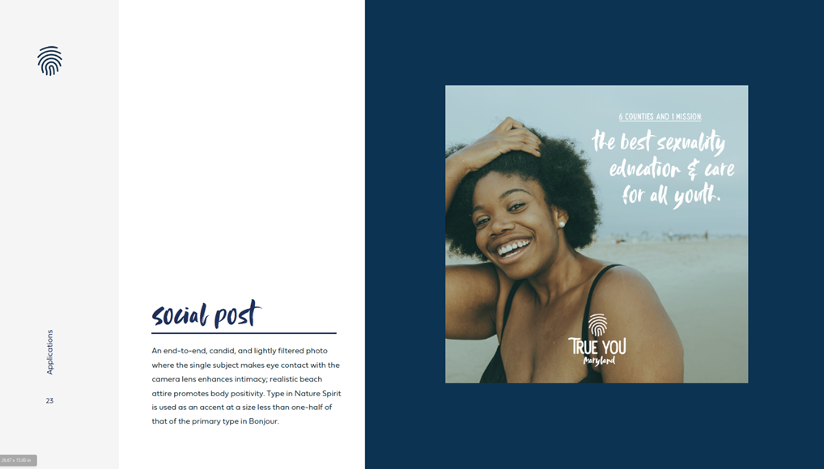
Sample Social
Notes:
Nicholas Sufrinko: Finally, we show how this all might be executed when it's brought together. So here we have some body positive photography filtered for a moody effect. We also have some handwritten type with custom alignment to enhance the uniqueness of handwriting.

Slide 18
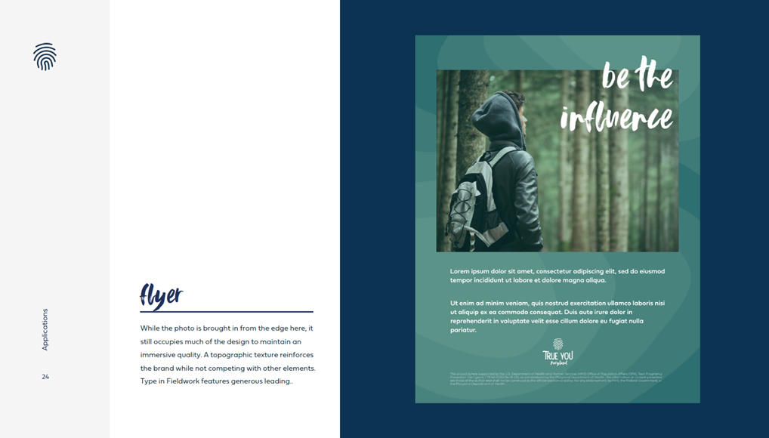
Sample Flyer
Notes:
Nicholas Sufrinko: Or on this next slide, we give this example. It's not only a single subject photo and handwritten type, but it also includes a background that further ties into the landscape. It has a topographic texture, echoing the lines of our logo. So all combined, this brand book helps us stay true to our brand, True You Maryland. This is... Again, this is a TPP brand, and it is our shared vision for what we look, sound and act like. But how did we get here? How did we create this brand book? That's what we're going to walk you through today. Alison.

Slide 19
A very hairy situation…
Notes:
Allison Felsen: All right. Thank you, Nick, for walking us through the True You Maryland branding example. Now we're going to jump into our challenge. So we're going to use it to practice branding as a group during the rest of the webinar. So here it is, our challenge. You've been hired as a brand expert for a national park that has been experiencing significant decline in visitors. Maybe it's time for a refresh to attract more people to the park, but what's the catch? Why are visitors not coming? Rumor has it that the park is home to a legendary and mysterious creature. That's right. You guessed it. Bigfoot seems to have taken up residents in this park. In fact, sightings have increased 3000% since the pandemic began. And while the hunt for Bigfoot has been going on since the 1950s, it's not something that necessarily attracts crowds of people. Our challenge is to rebrand the park to welcome a new generation of millennial and Gen Z visitors. Of course, using the brand, we'll have to address our friend, Bigfoot, in some ways. So we have chosen to do this branding exercise outside of our field to help you stretch your creative muscles and so we're not overthinking our answers by trying to align them with your individual projects. We hope that going through these steps to rebrand a national park, you'll feel comfortable enough to apply them to your TPP projects. We'll even be able to later... We'll be available later for some office hours and TA to really help you dig into the branding process. By the end of our session, you'll have some new skills to add to your branding toolkit and get to play in the process.

Slide 20
Let’s dig into…
Personas
Notes:
Allison Felsen: So to begin to tackle this branding challenge, we're going to talk about personas.

Slide 21
Persona
A persona is a collection of personality traits, attitudes, and values used to create a fictional, or imaginary, profile.
Notes:
Allison Felsen: So this is the first step in your branding process. A persona is an imaginary character made up of personality traits, attitudes, and values that you create based on the audience you're trying to reach.

Slide 22
Why craft personas?
#1
Identify who you want to reach
#2
Narrow your target audience
#3
See what your audience has in common
Notes:
Allison Felsen: So why craft a persona? You will identify who you want to reach, you narrow your target audience, and you see what your audience has in common. So rather than creating a single person, we are looking to craft a fictional profile that represents a group of similar people in our audience.

Slide 23
Persona examples
Notes:
Allison Felsen: So to get our creative juices going for dreaming up some fictional personas for our park visitors, we're going to show you a couple of examples that the youth came up for True You Maryland during their brand camp. We asked them to think about a type of young people that they wanted to reach, and these were their personas.

Slide 24
Daniel
17 years old, straight
He only knows what he has been taught in health class. He goes to school all day, and after he has debate team, he goes home to do homework. This will be a learning experience for him, and he'll be able to talk about things he might not be able to with others.
Notes:
Allison Felsen: So the first one we have is Daniel. He's 17 years old, and only knows what he's been taught in health class. This will be a learning experience for him to be involved in True You Maryland, and he'll be able to talk about things he might not be able to with others. Let's check out one more example before we dig deeper into creating personas for our challenge.

Slide 25
Layla
16 years old, doesn't identify with a sexuality
She grew up with a strong religious background regarding abstinence and doesn't know much about sex education outside of that. She loves drawing, reading, singing in church. Layla is looking for a trustworthy and reliable brand, hears good things from others who have sought out advice through this outlet.
Notes:
Allison Felsen: So our next example is Layla. She's 16 years old and grew up with a strong religious background, and her sex education consists of learning about abstinence. Layla is looking for a trustworthy and reliable brand, hears good things from others who have sought out advice through this outlet. So the brand campers came up with these two personality types that they wanted to sort of encompass their buckets for their audience. So these personas can help us get inside the head of the people that we want to reach with our brand. That way, when we think about how to reach our audience on a more personal level to deliver messages, that will make a difference to them.

Slide 26
In the chat… 2
Give our persona a name and age.
Notes:
Allison Felsen: Now that we've seen a few examples from True You Maryland, let's create a persona for a fictional national park. Okay, so let's build a persona. First, let's think about the audience our park wants to reach. It's the millennials and Gen Z-ers. Let's give our visitor a name and an age. Share your names in the chat. Any name. We've got Lindsay, Lucy, 35. Sandra. Nick, any of these striking your fancy?
Nicholas Sufrinko: I mean, they all are.
Allison Felsen: Kind of. Winona, I love it.
Nicholas Sufrinko: Is Winona our persona?
Allison Felsen: I think so. Winona, 26. Let's go with Winona. I do love a good callback name. All right, so we're going to go the Winona.
Nicholas Sufrinko: Thank you, Harmony.
Allison Felsen: Who is 26. All right.

Slide 27
In the chat… 3
What do they look like?
Notes:
Allison Felsen: Okay, so let's think about what they look like. Sometimes you want to think about what your persona looks like as the first step. So, what do they look like? Share in the chat. Athletic, non-binary, rugged, natural red hair. So just as a reminder, we also want to think about not just physical characteristics, but consider like how they dress maybe. Like, what...
Nicholas Sufrinko: Country music star. I think...
Allison Felsen: Country music star. I think... Yeah, I think so.
Nicholas Sufrinko: I'm getting jeans vibes for...
Allison Felsen: Yeah.
Nicholas Sufrinko: Winona, age 26.
Allison Felsen: You got a creative bunch here. Just like a "Euphoria" character. I have not watched that show yet, so don't quite get that reference, but... Flannel and jeans. Yeah. All right. With a three-year-old Jack Russell. I'm into it. I'm into it.
Nicholas Sufrinko: Is Winona for my hometown?
Allison Felsen: Maybe. All right, let's go to the next side.

Slide 28
In the chat… 4
What are their beliefs?
Notes:
Allison Felsen: So let's get in Winona's head. What do they believe? Share in the chat. Tattoos for sure. Wild and free spirit. Coffee first. Free thinker, free spirit. Bigfoot is scary. Believes in Bigfoot. Agnostic, Buddhist, open-minded. Believes pineapples don't go on pizza. Wiccan, naturalist. Okay, so I'm getting like a definite, free spirit, kind of do your own thing vibe. Eco-conscious. Only eats meat. They get themselves from nature. Alright.

Slide 29
In the chat… 5
What are their pet peeves?
Notes:
Allison Felsen: Okay, so let's go onto the next one. So what are Winona's pet peeves. And let's remind ourselves that we're talking about like a national park visitor. Pineapple on pizza. Harmony is like really offended by this pineapple. Littering. People do not... Okay, not recycling, no bullying, single-use plastics. Dishonest, judgemental people, cigarette butts. I think that's supposed to be safety fires, maybe safety first? False information. Safety first, got it. Feeding the wild animals. Non-biodegradable straws. Carving in trees. That is one of my pet peeves. Repetitive sounds. Okay. Moving rocks or other natural habitats. Over consumption. Music without headphones.
Nicholas Sufrinko: Children.
Allison Felsen: Is this me? Just kidding. All right.

Slide 30
In the chat… 6
What are their hobbies?
Notes:
Allison Felsen: Okay, let's to the next one. And finally, we'll consider, what are Winona's hobbies? What does Winona like to do in her free time? Playing guitar and singing, people watching, reading, hiking, craft brews, baking, dirt bike. Like a little bit of rebel. Yoga, poetry slams. Canning veggies. Beatboxing. Arguing. Oh. You guys are good at this. this is definitely, this is going to be a very interesting persona. All right, so, got down all your answers here. This is definitely going to be an interesting thing. So we've got Winona who's 26, who may or may not be a budding country music star, wears cutoff jeans, maybe some plaid, maybe has some tattoos, is a free spirit, naturalist. Pet peeves, feeding wild animals, carving in trees, single-use plastics, music without headphones. Maybe is not caring for children so much. Hobbies include pottery, beatboxing, yoga, dirt bike, reading. I like it. All right. All right.

Slide 31
Let’s dig into… 2
Archetypes
Notes:
Allison Felsen: So now we're going to move on to Nick, and we're going to tackle our brand archetype. Take it away, Nick.
Nicholas Sufrinko: All right. Thanks, Allison, and thank you all for really giving us a great picture of Winona. I kind of want to meet them.

Slide 32
The Magic of Brands
Notes:
Nicholas Sufrinko: But for now, I want you to think of some of your favorite brands. And so whether you have favorite brands that are like a tech brand like Apple, or a streetwear brand like Supreme, or an entertainment brand like Disney, pictured here, all these brands have one thing in common. These brands connect with audiences on deep levels. We all feel a sense of loyalty or even love for brands like these. Disney, Supreme, Nike, et cetera. These brands are seductive. And having these feelings for these kinds of brands is no mistake. After all, companies like Apple, Supreme, and Disney spend a ton of money and time cultivating their brand, telling us their stories with just the right media and experiences.

Slide 33
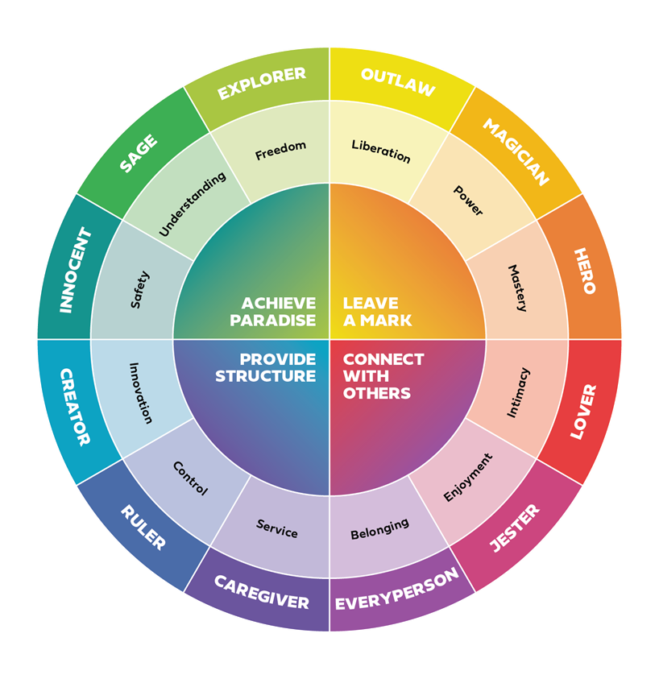
Brand Archetype
A recognizable character type or role that a brand can embody.
Notes:
Nicholas Sufrinko: So you might be wondering, how do they do it? How do they have this magic? One way to create an emotional connection with your audience is through brand archetypes. A brand archetype is a recognizable character type or role that a brand can embody. They're built from archetypes or specific character types that are said to exist across art, literature, film, even religion. Archetypes are sometimes said to transcend time and place, or even be universal or instinctual. And many of you probably know that the concept of archetypes was popularized by the Swiss psychoanalyst, Carl Jung, about a hundred years ago. Archetypes tap into deep seated human desires that we all share. Desires like intimacy, safety, and freedom. But here's the key for branding. Using archetypes in branding allows you to anchor your brand to ideas already embedded in the conscious or the subconscious of humanity. So there are 12 archetypes we commonly talk about in branding. So, now we're going to go back to our challenge.

Slide 34
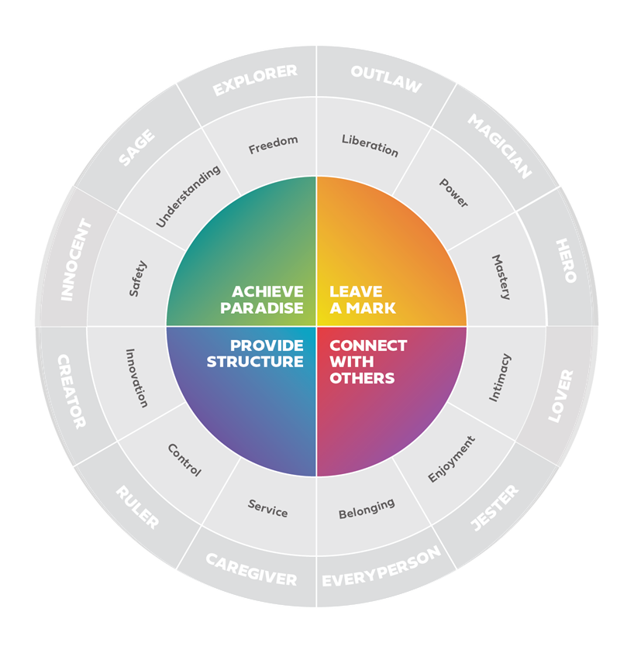
The 4 Orientations
In the poll…
Choose one orientation.
Notes:
Nicholas Sufrinko: How are we going to choose an archetype for our fictional national park who has a certain Bigfoot problem? Well, one way to start to choose an archetype is to first choose one of the four cardinal orientations. You can see them on the screen here. So I want you to think of Winona, age 26, country music star, doesn't like single-use plastic, tattoos, flannel. Think of Winona, and now look at these four cardinal orientations. Which one of these four will our park help Winona do? Will going to our park help Winona leave her mark or leave their mark? Will going to our park help Winona connect with others? Will going to our park help Winona provide structure? Will going to our park help Winona achieve paradise? Which one of these orientations you think might be most desirable for Winona? We're going to launch a poll. Oh, I see... Some are coming in. We're going to... Ooh, clear favorite, as I drink out my single-use plastic.
Allison Felsen: Nicholas!
Nicholas Sufrinko: Winona hates me. I could feel it. Okay, so achieve paradise seems to be a clear winner with around 55%. Connect with others is the second, leave a mark is third, and provides structure with 3%. Okay, so let's say that our orientation is achieve paradise.

Slide 35
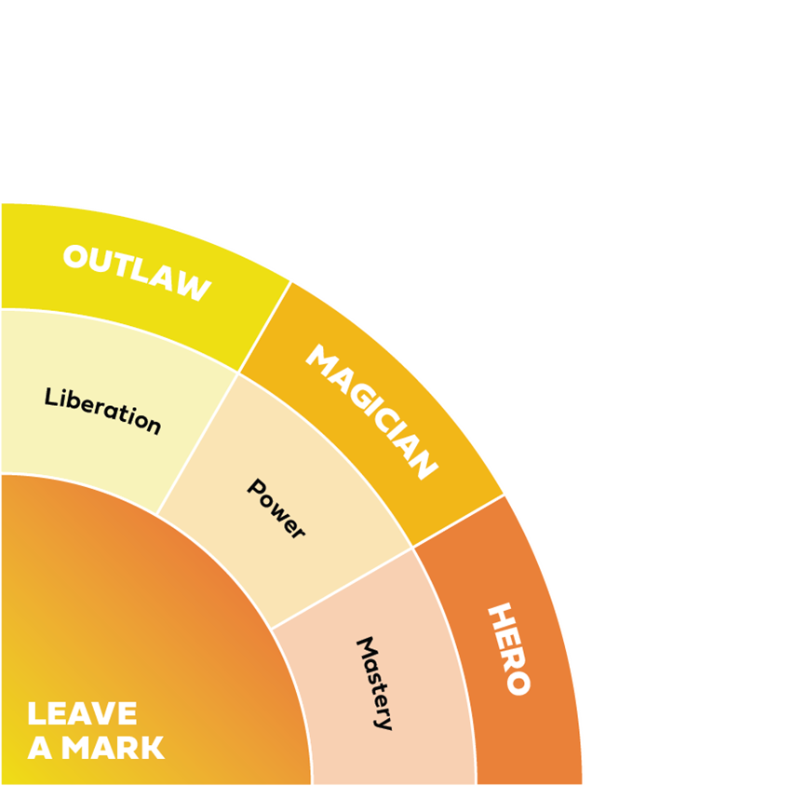
The Ego Archetypes
Notes:
[Skipped because of poll results]

Slide 36
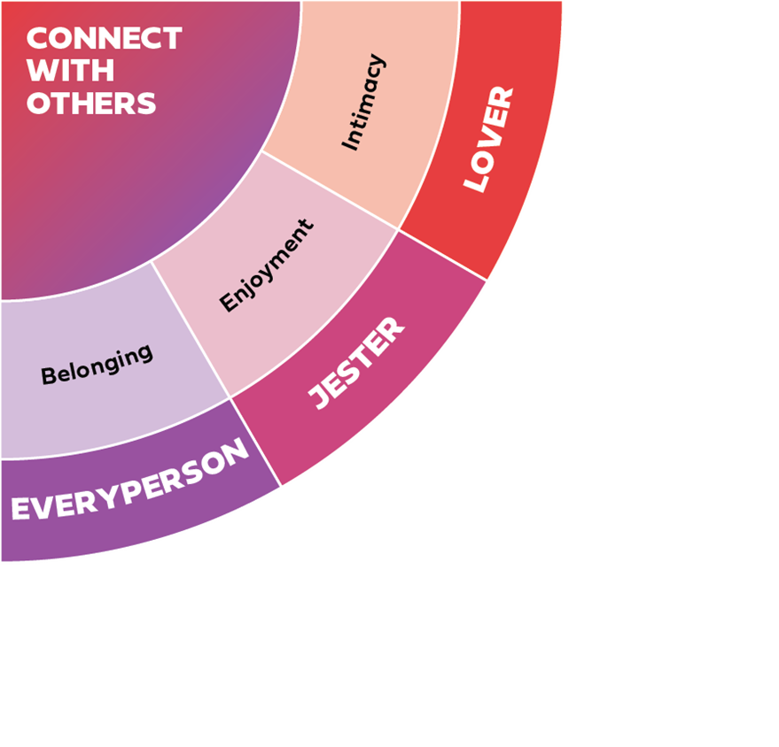
The Social Archetypes
Notes:
[Skipped because of poll results]

Slide 37
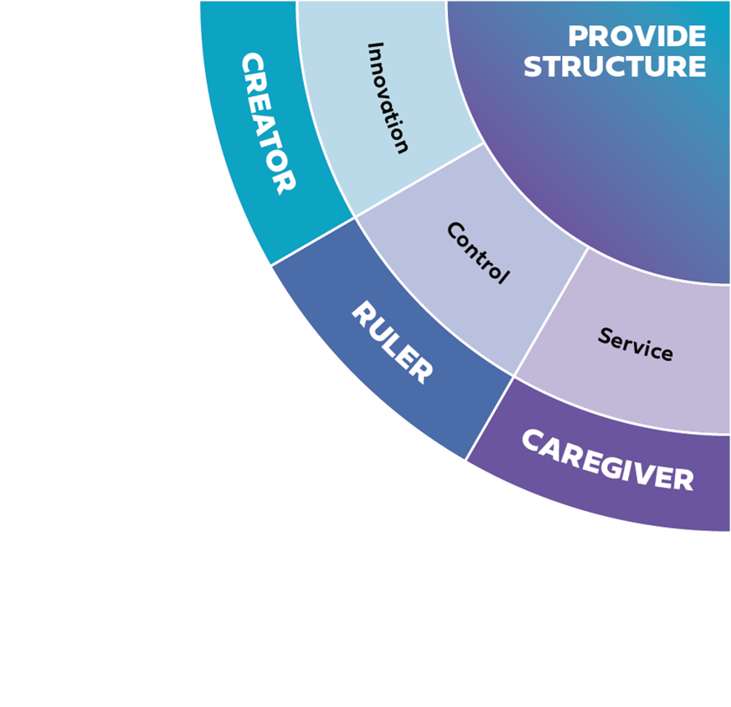
The Order Archetypes
Notes:
[Skipped because of poll results]

Slide 38
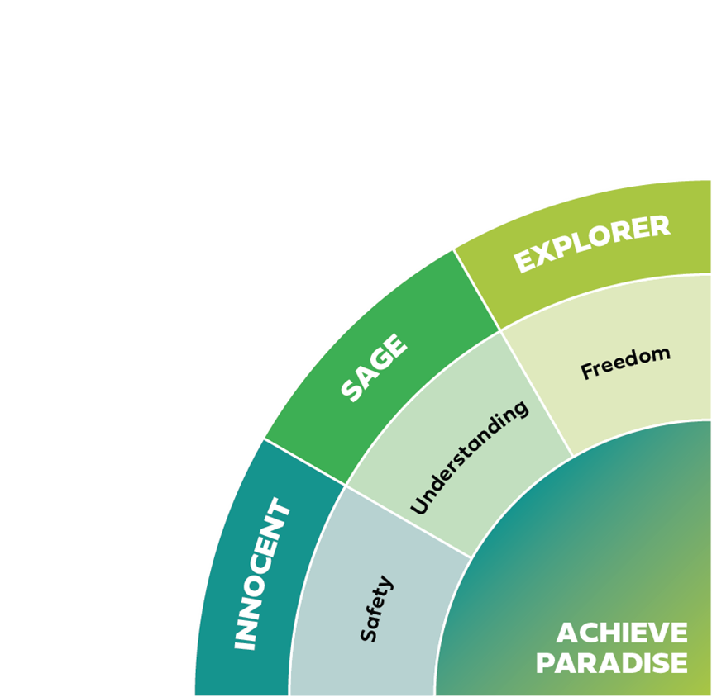
The Freedom Archetypes
Notes:
Nicholas Sufrinko: So, now that we've done that, we could dive a little deeper. So the orientation of our archetype is achieve paradise. Now I want you to look at this middle ring here. We have the following human drives, safety, understanding and freedom, which of these will our park help Winona achieve? Will she achieve safety, understanding or freedom by coming and visiting our park with, of course, Bigfoot? So it seems like freedom is the winner. So that means that our archetype is the explorer archetype. So let me tell you a little bit about the archetype we just chose. So the explorer issues boundaries and limits. Don't ever box them in. They're nonconformist, iconoclast, nomads, and pilgrims. So for a brand example, to help you sort of make it real, think about Harley Davidson. Think about... Actually, millennial weekend warriors with sleeve tattoos. Kind of sounds like Winona, right? At the core of this brand promise for the explorer is freedom. Their customers can go wherever they want, whenever they want. That is the explorer archetype. So now that we have the explorer archetype chosen for our brand, for our national park, I want to just dive a little deeper into some of the strategies we use at Healthy Teen Network when picking archetypes. So for that, we'll go to the next slide, the 30-70 rule. Yeah.

Slide 39
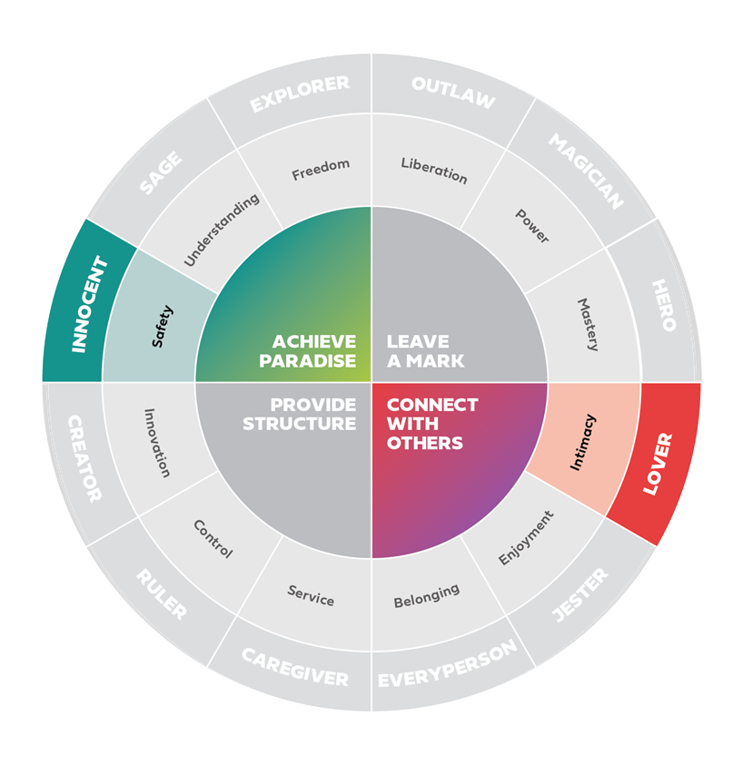
The 70-30 Rule
How might you combine archetypes in interesting and generative ways?
Notes:
Nicholas Sufrinko: So, for example, with True You Maryland, we didn't just pick one archetype, instead we picked two archetypes, and actually the youth in our brand camp chose two archetypes, and you could see them highlighted here. They chose the innocent and the lover, and I kind of think these are like the perfect archetypes that were chosen for our particular project, for a sexual health brand, right? That's a human drive of both intimacy and safety at the same time. And so the reason why we choose sometimes two archetypes is that, like a real person that's sort of multidimensional and complex, we want our brand to be multidimensional and complex. So putting two archetypes together to think of what does it mean to both crave intimacy and safety helps us create a sort of interesting multidimensional brand. So we're not going to choose another one here, but we're going to suffice it to say that that the explorer is our archetype. And with that in mind, I'm going to turn it back over to Allison to go over some voice, style, and values considerations.

Slide 40
Let’s dig into… 3
Voice, style, & values
Notes:
Allison Felsen: All right. Now that we've chosen our archetype, explore, it's time to bring our brand to life using voice, style, and values. We'll then show you how to use a brand star as well as how to create your own list of dos and don'ts or guidelines to help you stay true to your vision for your brand. All right, so these are your brand attributes.

Slide 41
Brand Attributes
Voice
Style
Values
“Sounds like”
Copy
“Looks like”
Visuals
“Acts like”
Experience
Notes:
Allison Felsen: So let's start with voice. A brand's voice... I'm sorry. Brand's voice, style, and values help set a creative direction for your brand. So we've purposely oversimplified this framework for this introduction, because in reality, it's a little bit more complicated, but since this is an intro, we figured this would be an easy way to comprehend this. So let's start with brand voice. The brand voice, or what you sound like, typically, comes across in the words that you use for your brand, which is also called copy. This could be these descriptive texts that you used on your website, taglines on social media campaigns, or even emails that you send out to your supporters or subscribers to let them know about the services you provide. But it's not just the words that make up your voice, it's also the tone or how you say something. For example, is your tone emotional or is it humorous? Let me give you an example. Let's say you're branding a product. Let's go back to the app example. So your app, you're branding an app that's supposed to be youth friendly with sexual health information and services. You might choose a brand voice that is confident and upbeat because you want your app to reflect the information that it contains as being factual and accurate. So you want to sound confident in your copy, but because the subject matter might tend to be sensitive or sometimes downright scary, you want to carry on a more upbeat tone that makes for a stronger campaign. So let's move on to style, or what a brand looks like. So this is a brand's visual identity. These are your colors, photography choices, illustrations, graphics, but also type face choices that you would associate with your brand. This will come across in the brand's logo design, graphics for social media campaigns, your website, a slide deck template, or even other resources. You might be thinking, how would a person with vision impairment be able to recognize a brand style? So style could also go beyond visuals with things like music, or maybe some sort of tactile element. For this example, let's imagine we're designing a campaign. For it, we want to make a poster that talks about consent. Posters are meant to draw the eye, so we might choose a bold style. Maybe consider a large uppercase one-word headers, and an eye catching font with some accompanying icons. For photography style, go bold by choosing closeup portraits that portray a lot of emotion. Consistent brand style builds recognition and fosters trust with your audience. And then thirdly, brand values. We want to identify our brand values or what we act like. So this is where interactions with community, schools, partners, and populations you intend to serve come into play. So this is probably the most obvious in services. Let's say you're creating a clinic for young men. Do you want staff-patient interactions to feel serious or professional, casual or fun? In addition to services, campaigns and products also act. So for example, a social media campaign acts when they respond to comments. Do you respond to every comment on social media, which is more of like a combative, or not, which is passive? Another example would be an app like Snapchat, which was designed to be casual and fun, it acts fun with a goofy in-app animations. Like, when the ghost icon shoots off into outer space. So those are just some examples. Now that we know voice, style and values will bring a brand to life, let's turn our attention back to our challenge. In the interest of time, today only focusing on voice and style.

Slide 42
Establish your voice.
In the chat…
Choose a few distinct descriptors from the list to describe our brand voice.
What should we sound like?
List of adjectives:
Accessible. Adaptable. Ambitious. Adventurous. Artistic. Authentic.
Bold. Brave. Breezy.
Calm. Capable. Caring. Casual. Charming. Cheerful. Convenient. Chic. Clever. Comfortable. Confident. Courageous. Creative.
Daring. Delicate. Delightful. Determined. Dramatic
Eager. Earthy. Eccentric. Efficient. Elegant. Enchanting. Endearing. Energetic. Ethereal. Exciting.
Fabulous. Familiar. Festive. Flexible. Flirty. Frank. Fresh. Friendly. Funny.
Lively.
Generous. Gentle. Glamorous. Graceful.
Hilarious. Historic.
Impactful. Informal. Innovative. Inspiring. Intense. Intentional. Inviting. Irreverent
Jolly. Joyous.
Majestic. Mature. Modern.
Natural. Nostalgic
Playful. Plucky. Powerful. Professional. Proud.
Quirky.
Radiant. Rebellious. Reflective. Relaxing. Retro. Romantic. Rustic.
Scholarly. Secure. Sensitive. Serious. Silly. Sincere. Sleek. Smart. Soothing. Sophisticated. Stimulating. Striking. Strong. Stunning. Sustainable.
Trustworthy.
Unconventional. Upbeat. Unique
Versatile. Vintage.
Whimsical. Wild. Wise. Wistful. Witty.
Notes:
Allison Felsen: So let's establish a voice. For our national park where Bigfoot might be lurking, which he's just sort of hanging out on the branch there, what makes our audience, millennials and Gen Z-ers, want to visit our park? Are there great hiking trails, scenic overlooks? Do we have great spots for selfies and social media influencer pictures? Are we promoting Bigfoot sightings as a reason to visit and uncover the mystery? So let's recall Winona. She's our person that we created, and then our chosen archetype of explorer. So we want to choose a few adjectives from the list on the screen that you feel best captures the brand voice for our park or what we like. So let's share them in... We have celebrity monsters. I just saw that there. So let's choose some adjectives of what we sound like and share them in the chat. We've got confident. Whimsical, fresh, gentle, calm, adventurous, quirky, unique, enchanting, unconventional, bold, natural, fresh, lively. Strong. Brave. Chic. Any of these sticking out to you, Nick?
Nicholas Sufrinko: Whimsical, quirky, lively, fresh, adventurous.
Allison Felsen: I like all of these. Obviously, we can't use them all. That would make for a very confusing brand. Let's see. Let's go with whimsical.
Nicholas Sufrinko: Majestic.
Allison Felsen: I've seen natural a couple times. All right. Write those down. Okay. And then let's go to our next slide.

Slide 43
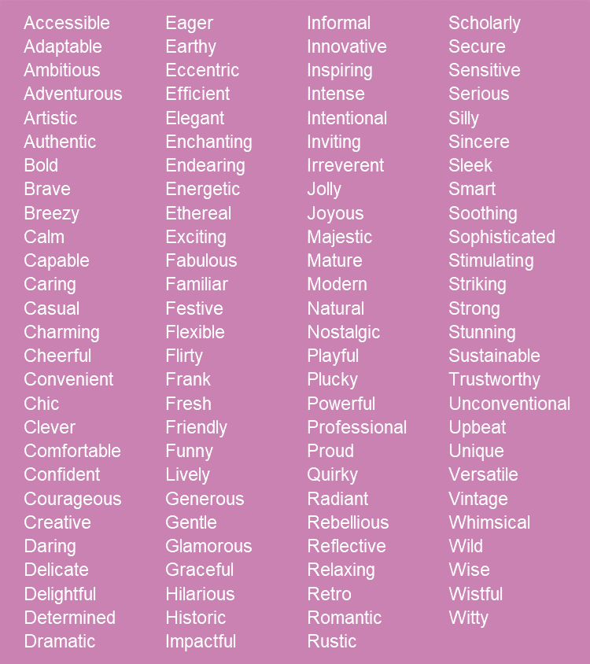
Establish your style.
In the chat…
Choose a few distinct descriptors from the list to describe our brand style.
What should we look like?
Notes:
Allison Felsen: So we know you've not created personas or selected archetypes for your own interventions, but you can also use this opportunity to think about your own projects and what adjectives you might choose to represent your own voice and style. You don't need to share. Just kind of roll that around in the back of your head. So this is a very curated list of adjectives, basically, what would fit on the side. The possibilities are pretty endless. There's lots and lots of adjectives out there. But always remember that descriptors you use or you choose should evoke an emotional feeling or reaction, and it's what will elevate your brand and make it memorable. So Nick, I'm going to go with whimsical and...
Nicholas Sufrinko: Natural?
Allison Felsen: Natural. That came up a couple of times. Okay, so let's go with that for a voice. Now let's choose, the same list, choose a few descriptors for our brand style. So this is what we look like, and you can share those in the chat. Lively. Adventurous. Plucky, wild. Radiant. Couple for adventurous. Centric, aspiring, authentic, capable, familiar. I do like wild. I do like wild.
Nicholas Sufrinko: Wild and familiar are an interesting pair.
Allison Felsen: Yeah. Let's go with that. All right. Thank you guys so much. Write those down. Those are some great choices. Like I said, we're going to skip over values for now, and then we're going to move on now to the brand star and guidelines. And Nick's going to tell you about the brand star.

Slide 44
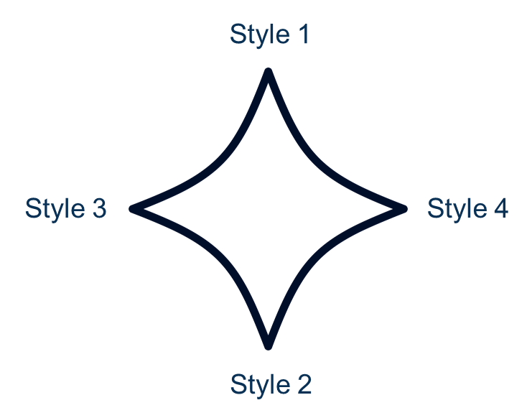
Brand Star
A generative diagram that places your brand’s voice, style, and values in tension.
Notes:
Nicholas Sufrinko: Yeah, thanks, Allison. Yeah, so sometimes, especially if you're working on a brand with a team, you end up with way too many adjectives that you could possibly use, right? You don't want to have 15 different adjectives. You would never be able to move forward. It would just be... it would be way too much to handle 15 at any one time to sort of create copy from, or create designs from. So one way of sort of being able to pair down all the adjectives that a team picks is by plotting them on a brand star. And so with the brand star, you typically have four or five points. And like I alluded to a little bit before with the True You Maryland example, you select adjectives basically that exist in tension. So, for example, we just selected wild and familiar, right? Like wild is one thing, but what does it mean to be both wild and familiar? I think there's some tension there because they seem like opposites in some sense. Similarly, we selected whimsical and natural, right? Like, whimsy has this sort of element of fantasy, but natural is sort of like not fantasy, right? It's what objectively exists. So how can something be both whimsical and natural at the same time? So with the brand star, you could do two things. One, you could put, you could have it just for style. So you could create a brand star that's just about your style, right?

Slide 45
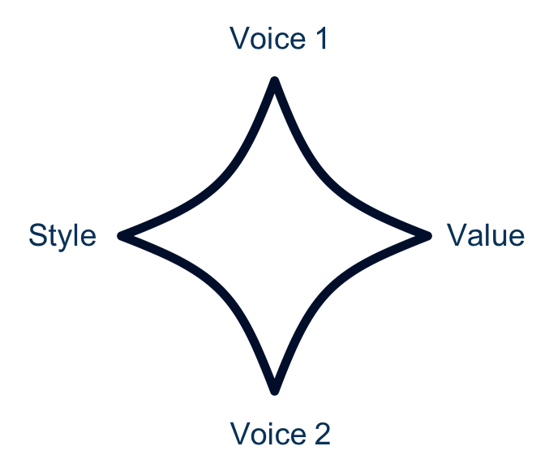
Brand Star 2
A generative diagram that places your brand’s voice, style, and values in tension.
Notes:
Nicholas Sufrinko: Or, on the next slide here, you could also create a brand star that combines style, voice, and values, and just have four adjectives ultimately, or five adjectives if it was a five pointed star. Using a brand star, essentially, you're creating some tensions where you get some creative ideas, but it helps you really narrow down on your adjectives for voice, style and values.
Allison Felsen: Especially, as you can tell from your answers in the chat, lots of people have varying opinions about what they think when they hear something. And I have to tell you, when we did this as a staff, as an exercise for our website, we had a lot of people going to bat for a lot of pretty widely varying adjectives. So trying to corral it and distill it down, we used this brand star. And if we hadn't, I don't know how we would've arrived where we arrived. Would've taken a lot longer.

Slide 46
Brand Guidelines
Happy
Dos | Don’ts
Use sans serif typefaces featuring rounded shapes and a feeling of movement | Use script typefaces
Use warm and vibrant pastel tints | Use too many dark shades or grays
Use candid photos of smiling subjects | Overly filter photos for a moody effect
Notes:
Allison Felsen: So let's talk about brand guidelines. So this is also meant to help you sort of keep things together, keep people on the same path. So we frame these as sort of dos and don'ts. You can frame them as like guardrails. For the purpose of this, we did dos and don'ts. So this will keep your branding consistent. As I said before, sometimes you have a team of two people, so it's really easy. You know what you're doing, some give and take, or sometimes there's 20 people producing content for your brands, so you need to have very firm guidelines so they know what they can and cannot do. So let's suppose your TPP project is focused on improving sexual health outcomes for high school youth, and you're going to run a social media campaign this summer focused on STI testing. This project has chosen a happy style for their campaign because they want to reflect that fun, carefree summer vibe. Some guidelines that might be helpful for here: these are dos and don'ts for a happy style. So maybe you do use sans serif typefaces featuring rounded shape that have a feeling of movement, but you don't use script typefaces because you don't want to appear too formal. You do use a warm and vibrant sort of pastel tint. You don't use too many dark shades or grays. You do use candid photos of smiling subjects, and you don't want to use overly filtered photos for sort of a moody effect. So those are fairly simple dos and don'ts. Sometimes the list can be shorter, sometimes it can be longer, depending on how many parameters you want to throw up.

Slide 47
Let’s dig into… 4
Mood Boards
Notes:
Allison Felsen: So let's dig into mood boards, which I'm sure most people have probably heard of.

Slide 48
Mood Board
A visual tool to help inspire and articulate your brand’s voice, style, and values. Often includes typefaces, photography, illustrations, and copy.
Notes:
Allison Felsen: Mood boards are made up of images, text, color palettes, fonts, photos, textures, patterns, or any other kind of visual inspiration that captures the vibe of your brand. Mood boards can help bring your brand voice and style to life. Aside from being fun to put together, why are they important? You want to be able to tell a visual story of the descriptive words you've chosen for your brand's voice, style and values that acts as an important step to building a shared vision of your brand. So just because we've chosen whimsical and natural as a voice style or wild and familiar as, sorry, as a style, that doesn't mean the same thing to everybody. So you want to be able to visualize that and sort of have a cohesive, shared representation. So the first step is to find inspiration. You want to start out by Googling descriptive words that you have come up with and look at Google images in your search. Find things that speak to you. You can check out different websites that curate design content like Pinterest, Dribbble, Behance are good examples of that. It's also really helpful to include short explanations about why you included something to begin with for yourself, and so when you're explaining it later, you can add context to those items. If you're working as a team, that way in your debrief you can say, this is why I chose this. And then don't forget to refer back to your dos and don'ts to focus your searches. Every item you place on your board should be a reflection of the audience for your intended brand. So don't forget about Winona.

Slide 49
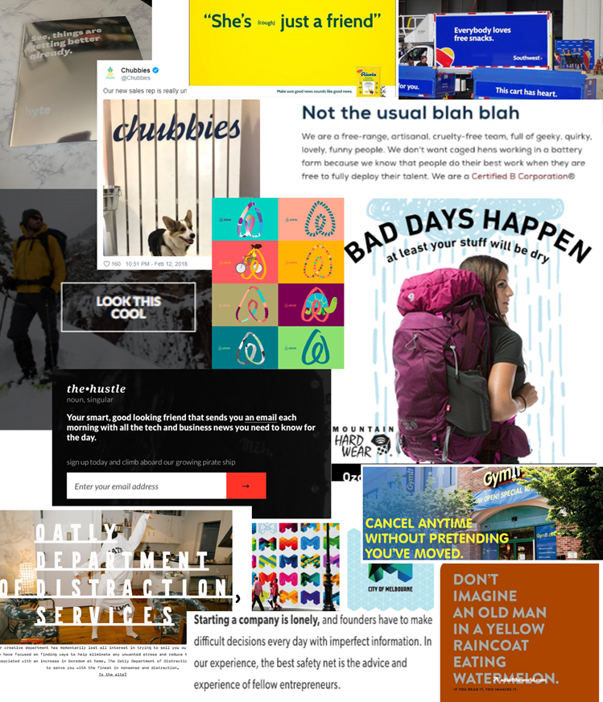
Playful
Notes:
Allison Felsen: Alright, so these are a couple of examples of mood boards that we put together. So this represents playful. This is sort of voice and style put together. So a couple of examples that'll sort of draw your eye. So you've got Southwest Airlines at the top, their snack truck. The side says, "Everybody loves snacks" on the sign. It's pretty... They have pretty playful messaging. That ad for the gym, sort of towards the bottom, I think. Yeah, towards the bottom, it says, "Cancel any time without pretending you've moved." That's kind of funny 'cause that's what people do. And then sort of one more example, which is not a voice example, but is a style example. Airbnb in the middle, they've changed their logo. It's still the same familiar shape, but they've switched it up to include patterns, colors, and graphics to represent a little bit more playful style.

Slide 50
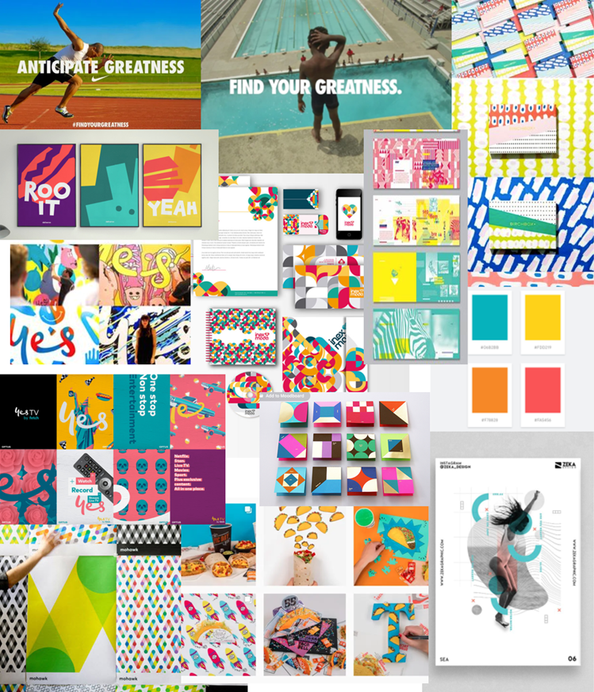
Energetic
Notes:
Allison Felsen: And then I have one more mood board example. So this one is energetic. Again, this both represents both voice and style. So this is more interpreted as like bright, fresh colors, conveying movement in graphics and patterns, and using action oriented photos. So, 'cause you would think energetic is a little bit harder maybe to represent things in, so this is just what spoke to us as visually as energetic. All right. And then we're going back to Nick.
Nicholas Sufrinko: Yeah, so those were real examples that we use when sort of reimagining the visual identity of Healthy Teen Network. Those mood boards, they've really helped us sort of like create a shared vision together of what, we knew that we wanted to be energetic, but we wanted to make sure that everybody on the team sort of had that shared vision of what it actually means to be energetic. With all that said, if you're sort of going along the branding process at this point, right now, you already have your personas like Winona, you have your archetype selected, the explorer, you have your voice style and value set, so whimsical, natural, wild, familiar. And ideally, you also sort of bring some of those attributes to life with some mood boards.

Slide 51
Let’s dig into… 5
Brand Names
Notes:
Nicholas Sufrinko: So the next step we're going to sort of go into is brand name.

Slide 52
Brand Name 2
Often, your very first opportunity to introduce a
product, service, or messaging campaign to your
audience.
Notes:
Nicholas Sufrinko: So the brand name is often your very first opportunity to introduce your product, service or messaging campaign to your audience, right? I mean, it's your name.

Slide 53
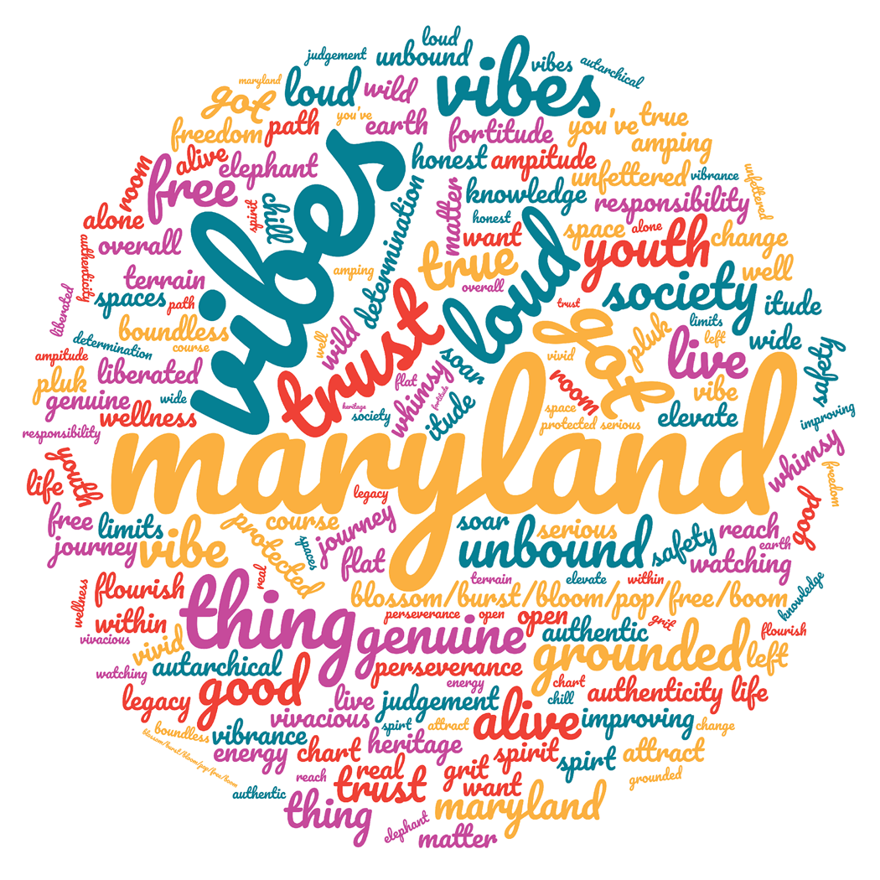
True You Maryland
Notes:
Nicholas Sufrinko: So I'm going to go back to the True You Maryland example. For True You Maryland, the project originally called MOAHP. We generated a ton of brand name ideas, and you could see just a fraction of them here in our word cloud. We generated Live Out Loud, Good Vibe Society. There was something with an elephant, I remember one of the young people, there was Elephant In The Room, and you could see just in this word cloud that there were so many names. Too many to read.

Slide 54
What’s in a name?
#1
Starts with a brainstorm.
#2
Tells your story.
#3
Is memorable.
#4
Lends itself to visuals.
#5
Is tested.
#6
Is protectable.
#7
Includes guidance.
Notes:
Nicholas Sufrinko: But what makes a good brand name? How did we get here? Well, I could tell you just a few of the things we were looking for when brainstorming and selecting a brand name. First, good brand name starts with the brainstorm, and all the brainstorming rules apply here. So if you're familiar with some rules for brainstorming thing, quantity over quality, right? You just want a lot of ideas quickly. You want to encourage wild ideas, sort of outside the box thinking. And if you don't know these sorts of rules for brainstorming, you could find 'em on the internet. There's a ton of different frameworks for rules for brainstorming, especially if you search human-centered design rules for brainstorming. You'll find some really great guidelines. But that's what a brand name starts with. Second, a good brand name tells your story. So, while it can't sort of include everything that we talked about, it should sort of nod toward our persona, Winona, it should sort of nod toward our archetype that was selected, explorer. So how can a brand name sort of evoke exploration, right? You could take that in a number of different directions. Third, a good brand name should be memorable. So one way to help with memory is alliteration, right? Using the same sounds. Or another way is using rhyming sounds, right? They can help your brand name be memorable. And because so many in our field use acronyms like MOAHP, maybe avoid those to stand out from the crowd. That said, I know DARE was a really memorable brand name. Another good tip is that, good brand names lead to visuals. So is there a color in your brand name? Does it generate a super obvious logo? So for a super obvious logo, think of Target, right? Its name is its logo. It's a target, right? Or for the color example, my new favorite mattress is a purple mattress, right? That's the name of the mattress. Obviously, they use a lot of purple in their branding. That helps people recognize the connection between the visual identity and the brand name. And while this is number five on my list, I think it's the most important, a good brand name is tested. You need to test your brand name ideas with your end users. Likely for us, it's the youth we're designing for, maybe it's other stakeholders in the community too, but the brand name meets to resonate with our youth, with the stakeholders, because you never know what associations they might see in your brand that you might not be thinking of. Holding a brand camp like we did for True You Maryland can help you test with end users. Another consideration is, is it protectable? Who owns the intellectual property for a brand name? So one thing you could do is check to see if the domain is available on the web. Like, for example, when Allison and I were working on Wingman, a keyboard that helps young adults talk about the hard stuff, talk about consent, boundaries, desires, we knew that wingman.com was not available. It was not in our budget to purchase. But for us, wingmankeyboard.org was. And for our tiny, tiny budget, that was good enough. That's what we needed. So testing it out to see what's sort of available and protectable. And then finally, your brand name should include guidance with it. So for True You Maryland, for example, we say that True You is acceptable as shorthand but never TYM and never True You MD because it could be confused to medical doctor. Think through these kinds of things and state upfront what your guidelines are for your entire team. So I know that's a lot to think about when it comes to brand naming, and we have a whole office hour set aside just for brand naming, and would love for you all to join, because we couldn't possibly do it justice here. But we want to go for it.

Slide 55
In the chat… 7
Suggest some brand names.
Notes:
Nicholas Sufrinko: So let's think about our persona, let's think about our archetype, which is the explorer, let's think about being whimsical and natural and familiar and wild. Think about all these things at once. What should we name our fictional park? It needs a name. Any ideas? You could leave them in the chat. So what are we naming our park? Or renaming our park. I feel the gears are turning. Tranquility. Free to Explore. Freeland Park, Refreshing.
Allison Felsen: Bigfoot's Backyard.
Nicholas Sufrinko: Bigfoot's Backyard. Bigfoot Fort, BFF. I like the wordplay.
Allison Felsen: Wonder Park.
Nicholas Sufrinko: Alison, what are you feeling? What's our park name? I think I like Angela's suggestion, BFF.
Allison Felsen: I like that too.
Nicholas Sufrinko: I feel like Winona would go to BFF. Yeah, so we'll go with BFF.
Allison Felsen: Deal.
Nicholas Sufrinko: Thanks, Angela.

Slide 56
5 steps to spark change
#1
Craft personas.
#2
Select archetypes.
#3
Set voice, styles, & values
#4
Create mood boards
#5
Choose a name.
Notes:
Nicholas Sufrinko: So, yeah, that's it. So this is how you can brand a TPP product, whether it's an app, a product like an app or whether it's a service like sort of an after hours clinic, special clinic, or whether it's a campaign like a behavior change campaign on social media. So first, you get into the head of your audience or end users by building personas, or better yet, you have your end users build the personas for you like we did, the youth and the Brand Camp created Daniel, for example. Then you select an archetype that helps you tap into the unconscious of humanity, or at the very least, sort of characters that we all might recognize from culture, literature and media. And then with that, you begin to set your voice, values and style. A brand star can help with that. Brand guidelines, the dos and don'ts, can help even more and set some guide rails for your brand. Then you make it real with mood boards, curating examples of voice, style and values. Finally, you choose a name that embodies all that. So for the left-brained people in the room, I want to know that, it's not only about those that are creating the logo or the tagline, all of these five steps, you can do this too. And you need to, because it's about building a shared vision for your brand.

Slide 57
Office Hours & TA
Office Hours: Wednesdays in August at 3PM ET!
August 3, 2022
Do-It-Yourself Brand Camp
Recruitment, selection, and set up
August 10, 2022
A Strong Foundation
Personas and archetypes
August 17, 2022
Build, Build, Build
Voice, values, styles, brand guidelines, and mood boards
August 24, 2022
Bring It Home
Brand name ideation and creative briefs
Technical Assistance: Please reach out to your grantee liaison.
Notes:
Nicholas Sufrinko: So with that said, I just want to tell you a little bit about the office hours. We're here to help no matter where you are in the branding process. And so that's why we created some office hours for the TPP grantees in the room to help talk about your specific innovations, branding your specific innovations, and what needs you may have. Starting... In the beginning of August, it's basically every Wednesday throughout August. August 3rd is the first one. And we're going to talk about, in the first one, we're really going to center the conversation about how to set up a brand camp like we did for True You Maryland. Again, we held it over a private Facebook group, but we could talk about like how to recruit youth for that, we did internet advertising for that, we could talk about how to select youth for that, we could talk about how to just set it up logistically, what questions to be asking along the five days of a brand camp that you might want to do. And then our second TA office, or second office hours, rather, is going to dive into personas and archetypes. So we're really going to try to help you build out some personas and select one of those 12 archetypes in that second office hours. Then in the third office hours, we'll move on to the next stages. And it's about sort of choosing a voice, choosing some values, choosing some style. After we sort of choose those attributes, we'll talk about sort of like bringing those attributes to life. So creating those brand guidelines, those dos and don'ts for your particular intervention. And we'll also talk about sort of like how you could begin to create mood boards. We could even do that live during the session for the office hours, if you join. And then finally we're going to dedicate one whole office hours to brand name ideation in case any of you want to start thinking about different names. I understand a lot of you probably already have your brand name set, but maybe some of you want to revisit that, and we could use that session to really brainstorm brand names particular for your intervention. And in addition to all these office hours, we're also offering some more intensive technical assistance, and you could reach out to your grantee liaison to hear more about that.

Slide 58
Q&A
What questions do
you have for us?
Notes:
Nicholas Sufrinko: So with all that said, would love to hear any questions that you might have now.
Aisha Moore: Thank you so much, Allison and Nick. If you found this useful, please just type them a nice message in the chat. The evaluation is great, but feedback right away, immediate gratification is even better so we know that you really tuned into it. And so if you do have a question, either, please, type it in the chat or use the raise hand feature, which is under reactions. And I just want to bring one note of clarification. This webinar was open to the general public, but if you would like to attend office hours, you need to be an OPA funded Tier 1 or Tier 2 or Innovation Network grantee. Okay, Adrian, please unmute yourself and ask your question.
Adrian: Yes. I'm just wondering as far as like, when you decide on a persona, if you're an organization that works with sort of, you know, so we're working people with disabilities and there's like teachers and administrators and then also youth with disabilities and a lot of parents and caregivers, how do you kind of pick one to like create your persona for?
Nicholas Sufrinko: That's a great question. Yeah, so for our sort of Bigfoot challenge today, we just created one persona, but when we branded True You Maryland, we created so many personas, and we were trying to keep them all, we shared two of them here. We tried to keep, but there were more. And we tried to keep them all in mind when we then selected the archetype. Allison, feel free to add to this. I would also suggest that you sort of, I don't know, give some hierarchy to the personas that you create. So if your end user is ultimately youth with disabilities, maybe you really center them above administrators or teachers or whoever the other personas are. And I think having that in mind, that sort of hierarchy in mind of all your personas, will really help you then select an archetype and select some voice, values and styles, attributes.
Allison Felsen: Yeah, and that's why personas, that's why you're sort of, it's sort of an amalgamation of a bunch of different people. So it's not just like one single person. But Nick is right. If your ultimate end user, that's who you want to be thinking about, but you could definitely create as many as you want. Just be prepared when you go to do the archetype exercise. You might end up with multiple archetypes.
Nicholas Sufrinko: You may have to vote, right.
Allison Felsen: Yeah. But that's fine too. Like, sometimes it's easier to have more options than to like pair it down rather than come, you end up with one that maybe you're not so happy with, and then you kind of have to start the process over. So for example, we did this with our staff for our website redesign and we ended up with four archetypes? Three?
Nicholas Sufrinko: Three.
Allison Felsen: Four? Three?
Nicholas Sufrinko: And really, two is the sweet spot, three, it starts to get a little washed out but...
Allison Felsen: Yeah.
Nicholas Sufrinko: We have a staff with very strong opinions.
Allison Felsen: Yeah.
Nicholas Sufrinko: And somebody asks, "How do you brand a service with several different audiences?" I think that goes to the same thing that we're talking about with the personas. I think, you know, assuming that your audiences have sort of different levels of engagement, like, maybe you sort of center one audience. If, for example, you're talking to youth but also need to be relevant for, I don't know, politicians or school board members or whoever.
Allison Felsen: I think I saw Estelle said, "Can we share what we've developed and get feedback?" I believe that's what the TA time is for.
Aisha Moore: Yeah, I would suggest... So what I would suggest is coming to the office hours first to see, 'cause it depends on how many people show up. So there might be time for... You just might be able to get some help there. And then if you need additional help, then make a TA request to your grantee liaison. If for some reason, that time for the office hours don't work for you, then just go ahead and make a request of your grantee liaison.
Nicholas Sufrinko: And feel free to, like, we structure them around different topics, but feel free to come to any office hours that work for you. We could talk about where you are in the process and really dive in no matter the topic of the office hours. It looks like Estelle has their hand up.
Estelle: Just a follow up question. Thank you so much, this was really great. I really feel the need to like dive down deeper and spend more time with this. But I'm just also curious, because we are a program within the New York City Department of Health, we don't have a lot of leeway in terms of photos or things of that nature, so I'm wondering if that's something that you guys have encountered as well.
Allison Felsen: Do you mean you have to get approval?
Estella: Yeah, like... I mean, like some of the stuff, for instance, which is sort of related, or like comments that our grant manager, not grant manager, a project officer had mentioned about like, us not having a social media presence and that's because the health department has the social media presence. So they really decide what gets posted and the look and that kind of thing. And we might have a little bit of input, but ultimately it's their decision. And so I would love to be able to pursue sort of a brand book for our program, but it would ultimately have to go through our communications department and their approvals and that kind of thing. So I'm wondering if like you've had experience with other organizations in sort of like a similar situation.
Nicholas Sufrinko: Yeah.
Allison Felsen: Oh, go ahead, Nick.
Nicholas Sufrinko: So I was sort of thinking of one example. So Healthy Teen Network has a conference every year, and we want to brand the conference every year as something unique. That's something we've always done at Healthy Teen Network. We have a theme, so like this year, it's Dare to Dream of a New Era, but at the same time, we don't want the conference brand, whatever it is, to clash with Healthy Teen Networks brand. So there has to be some play between the two of them. So I imagine for like NYC Department of Health, like, it would be very similar that you would sort of make sure the brands don't clash and sort of making it... One way of thinking of it is making it a sub-brand of NYC DOH rather than something completely different. But I think you could get like pretty specific, 'cause I imagine like NYC DOH has a lot of different campaigns that look quite different from each other. And so it's sort of like narrowing down and I think you could still work within the parameters of whatever approval structure you have and still create brand books.
Estelle: Yeah, that's true. That's a good reminder. Thank you. I'm going to join definitely the open office hours.
Nicholas Sufrinko: Thanks.
Aisha Moore: I want to add... Yeah, I was going to add something else to that. So when it's time for you to redo your brand, invite them to the process. Invite them to whatever you're doing, so that way they can see it and they can sort of get it before you bring things to them because I think they'll be more readily open to it 'cause they have been a part of the process. And then they'll also will be able to tell you where some of the boundaries are of what they were hearing and be able to strategize with you.
Estelle: Yeah, that sounds... Thank you.
Allison Felsen: That's what I was going to say. I would definitely... whoever the comms person is that, is sort of in charge of that, I would definitely see what... I'm sure they have something that's already laid out 'cause I mean, like Nick said, they run so many different campaigns. True You Maryland, actually some of the health departments, they did not allow the Youth Advisory Boards to have any social media presence or like have their own website. Like, nothing. They didn't... And they had to go through a lot of red tape and approval processes. So they were still using the True You branding as they could, they just had, it took them a while to get approved through the health department. So it never hurts to ask, to get as much information as possible before you start.
Estelle: Thank you so much.

Slide 59
Speakers Closing
Nicholas Sufrinko
he, him
nick@healthyteennetwork.org
Allison Tomai Felsen
she, her
allison@healthyteennetwork.org
Notes:
Nicholas Sufrinko: Hey, thank you all so much. It's been fun. I enjoyed meeting Winona. Aisha, do we have any other reminders before we close?

Slide 60
THANK YOU!
Please fill out the evaluation form after the webinar!
CONTACT US
rhntc@jsi.com
This webinar was supported by the Office of Population Affairs (Grants FPTPA006030, TPSAH000006) and the Office on Women’s Health (Grant ASTWH2000-90-01-00). The views expressed do not necessarily reflect the official policies of the Department of Health and Human Services; nor does mention of trade names, commercial practices, or organizations imply endorsement by the U.S. Government.
Notes:
Aisha Moore: I also want to let you know that in addition to the office hours and technical assistance, we are coming up with a dissemination template and a workshop that's related to that. So stay tuned for that. And please fill out the evaluation that will be chatted in too, that'll be put in the chat, and make sure that you check back at rhntc.org in about a week for all of the materials from this workshop. And if you registered in advance, then you will also receive an email with these materials. So thank you so much, and we look forward to seeing you on our next webinar.
Nicholas Sufrinko: Thank you all.
Allison Felsen: Thank you everybody.
Audience Member: Thank you.

