Slide 1

Making the case to sustain your program:
A template for TPP grantees
USING THE TEMPLATE
First, review Sustaining Your Programs: Strategic Partnership Mindsets to understand the underlying philosophy. Your mindset is key.
Tailor the deck for each contact. Don’t try to sell more than one big idea at a time. Keep it singular. Think of the deck as a menu of options; change it based on who you’re engaging.
Consider the “Rule of 3.” Things grouped in threes are more appealing, satisfying, and memorable. More than five items is overwhelming. Avoid using two or four items.
Use plain language and remove all acronyms.
Practice with colleagues, peers, and friends. Mistakes are inevitable. Build your skills and confidence before that
high-stakes meeting.
Research your contact in advance to identify shared priorities, passion, and goals.
Meet in a neutral space. Never meet a potential funder in their office. Meeting in a neutral space fosters collaborative partnership as peers.
This deck is not meant to replace a one-on-one conversation, and it should never be sent in advance. Learn more on how to run opening, shaping, and closing meetings.
This template is designed to help you build relationships with potential
funders and co-create ways to sustain and evolve your programs. It builds on the “OnePitch” format developed by Geoffrey MacDougall and Aspiration to help you develop
and distill a case for support.
Nonprofits use a case for support to cultivate long-term relationships and advance a common cause. The purpose of a case for support is to engage potential donors (or partners) emotionally and intellectually, inspiring them to collaborate with you to advance a common cause. They also can be internally, for example, as a reference document for developing outreach or advocacy materials, engaging board members, and onboarding and training staff.
Your case for support will be different from a private sector startup or company “pitch” for investment. Private sector interactions are fundamentally transactional, and success is easy to measure: If you give me one million dollars, I will generate twenty million in return.
In contrast, nonprofit interactions are relational, and measurement is fraught.
We come together as communities and networks for collective impact,
working in dynamic and complex systems with longer timelines. Each of us
contributes to change.
Notes:
Use the following resources to help you develop your case.
Sustaining Your Programs: Strategic Partnership Mindsets (see resource section at end of document)
Developing Strategic Messaging to Attract TPP Program Partners Job Aid
This template was prepared by Stacey Moody and Christine Prefontaine, based on Aspiration’s How to Raise Money: Strategic Leadership for Change program. It was edited by Jaya Mathur.
The content in this document is distributed under a Creative Commons Attribution-NonCommercial 4.0 International license.
If you build on this work, please cite/credit Geoffrey MacDougall and Aspiration.
(In this case, using any of this content and the associated resources to secure funding for mission-driven work does not constitute a commercial application.)
OPA grantees, please note the following disclaimer:
Costs associated with fundraising are unallowable according to the U.S. Health & Human Services Grants Policy and cannot be covered by an Office of Population Affairs grant. Please consult with your Project Officer and Grants Management Specialist to ensure costs are allowable and appropriate for your grant project.
The development of this template was supported by the Office of Population Affairs (Grant TPSAH000006).
The views expressed do not necessarily reflect the official policies of the Department of Health and Human Services;
nor does mention of trade names, commercial practices, or organizations imply endorsement by the U.S. Government.

Slide 2
Your Organization/Program
Your Name / Contact Information / Date
YourWebsite.org
Notes:
Customize this deck with your branding. Use the most appropriate branding for the entity you’re making the case for, whether that is your organization, program, or network.

Slide 3
This is who we are.
HISTORY
REACH
REPUTATION
EVIDENCE
KEY MESSAGE
KEY MESSAGE
KEY MESSAGE
KEY MESSAGE
Proof point or characteristic
Proof point or characteristic
Proof point or characteristic
Proof point or characteristic
Proof point or characteristic
Proof point or characteristic
Proof point or characteristic
Proof point or characteristic
Notes:
Please customize!
Proof point is irrefutable evidence of what you are trying to demonstrate.
The purpose of using the formatting in this template is to help you make your case for support. And to help you distill your key messages.
Introduce your organization/program/network.
Share values.
Establish connection and credibility.

Slide 4
Example: This is who we are.
HISTORY
REACH
REPUTATION
EVIDENCE
Network formed in 2018 following a local report about the high pregnancy rate of justice-involved youth in our county
Connected to all youth-serving justice organizations in our county
Network of mission-aligned local organizations
Our shared priority/goal for this year
7 organizations meet monthly to advance efforts to address and hold each other accountable to meet our agreed upon goals
Increase resources to support justice-involved youth to make healthy decisions about their sexual and reproductive health
Regular participation in the quarterly county juvenile justice accountability meetings
Received first grant in 2019 from the Office of Population Affairs (OPA)
The past two years, a representative from each local juvenile justice facility attended our annual youth health conference
Use a collective impact framework
Established network leadership structure and strategic plan in 2019
Notes:
Please customize!
Proof point is irrefutable evidence of what you are trying to demonstrate.
The purpose of using the formatting in this template is to help you make your case for support. And to help you distill your key messages.
Introduce your organization/program/network.
Share values.
Establish connection and credibility.

Slide 5
This is what we do.
MISSION
APPROACH
EXPERTISE
IMPACT
KEY MESSAGE
KEY MESSAGE
KEY MESSAGE
KEY MESSAGE
KEY MESSAGE
KEY MESSAGE
KEY MESSAGE
KEY MESSAGE
KEY MESSAGE
KEY MESSAGE
KEY MESSAGE
KEY MESSAGE
Notes:
Customize the number and labels of the boxes, as well as the content within them, to reflect your organization/program/network.
Mission: Who you serve, big thing you do, stretch goal
Have at the ready data that illustrates the needs of your community (e.g., needs assessment results, environmental scan, results of ethnographic inquiry and human-centered design)
Approach: Values and big approaches
Expertise: Your superpowers!
Impact: Big achievements (we mobilize, we’re a watchdog, X listens to us)
Have data ready that backs up your claims, as well as narrative examples that humanize any numbers

Slide 6
Example: This is what we do.
MISSION
APPROACH
EXPERTISE
IMPACT
Decrease teen pregnancy rate of justice-involved youth in our county
Solutions must be centered in youth experience and informed by youth voice
We understand and use the strengths, knowledge and connections of each network member
We mobilize to ensure that there is representation of network organizations and youth at each juvenile justice accountability task force meeting in the county
Ensure each juvenile justice facility in our county has implemented at least one evidence-based TPP program by 2025
We welcome and celebrate creative and innovative strategies
Our context team of youth are embedded at the center of every activity we perform
Last year, two juvenile justice facilities implemented evidence-based programming to educate residents on sexual and reproductive health
Notes:
Customize the number and labels of the boxes, as well as the content within them, to reflect your organization/program/network.
Mission: Who you serve, big thing you do, stretch goal
Have at the ready data that illustrates the needs of your community (e.g., needs assessment results, environmental scan, results of ethnographic inquiry and human-centered design)
Approach: Values and big approaches
Expertise: Your superpowers!
Impact: Big achievements (we mobilize, we’re a watchdog, X listens to us)
Have data ready that backs up your claims, as well as narrative examples that humanize any numbers

Slide 7
And we’re good at it.
A timeline spanning from 2017 to 2023, in one-year increments. Data: 2017, ACHEIVEMENT/OUTCOME; 2018, ACHEIVEMENT/ OUTCOME; 2019, ACHEIVEMENT/OUTCOME; 2020, ACHEIVEMENT/OUTCOME; 2021, ACHEIVEMENT/OUTCOME; 2022, ACHEIVEMENT/OUTCOME; 2023, ACHEIVEMENT/OUTCOME. An arrow points to 2018 with text: Key contributions to “the work”.
Notes:
Replace this with a timeline of your key achievements or outcomes—focus on those that relate to your contributions to “the work” = the thing you want to achieve together.
Don’t include process milestones—otherwise you start telling the story of your organization/program/network. Emphasize the result, not the date.
Achievements or outcomes may be key:
Goals or targets achieved (e.g., number of young people reached)
Milestones in your organization/program/network (e.g., new curriculum or promising intervention implemented)
Moments or inflection points (e.g., adaptation to virtual programming due to COVID)

Slide 8
Example: And we’re good at it.
A timeline spanning from 2017 to 2023, in one-year increments. Data: 2017, County regulation passed making it more difficult for youth-serving organizations to implement sexual and reproductive health programs; 2018, Statewide report finds highest rate of teen pregnancy in our county, with a growing rate among justice-involved youth; 2019, Our network receives a $1 million grant to identify innovative strategies to address teen pregnancy; 2020, Our network sponsors the first-ever local youth health conference; 2021, Our youth team pilots our new TikTok-based drama series on sexual and reproductive health with 50 youth; 2022, Drama series script revised and network hires professional media group to film and produce improved drama series; 2023, Network received foundation grant to evaluate outcomes of drama series. An arrow points to 2018 with text: Key contributions to “the work”.
Notes:
Replace this with a timeline of your key achievements or outcomes—focus on those that relate to your contributions to “the work” = the thing you want to achieve together.
Don’t include process milestones—otherwise you start telling the story of your organization/program/network. Emphasize the result, not the date.
Achievements or outcomes may be key:
Goals or targets achieved (e.g., number of young people reached)
Milestones in your organization/program/network (e.g., new curriculum or promising intervention implemented)
Moments or inflection points (e.g., adaptation to virtual programming due to COVID)

Slide 9
We face a challenge. And an opportunity.
A flowchart. Unassailable truth flows to Good-bad tension, which flows to Emerging opportunity that gives us both hope. In the center of the diagram are two paths disconnected from the surrounding chart. Good is in place, existing good thing that we need to protect, flows back and forth Bad as ascendent, Emerging threat that together we need to stop. Or, Bad is present, existing bad situation that we have to change, flows back and forth to Good needs to ascend, Emerging good thing that we need to advance.
Notes:
Overall flow:
“We’ve got a thing we both care about.
And we’re in a moment where it can be good, or it can be bad.
But thankfully, something is happening right now.
This emerging opportunity allows something to happen today that wasn’t possible yesterday.”
UNASSAILABLE TRUTH. A moral or ethical assertion requiring no further justification.
The core of the challenge is the unassailable truth: A moral or ethical assertion requiring no further justification (a person can’t ask “why does this matter?”).
To identify a shared unassailable truth, start by asking yourself questions like this:
Why is this your life’s work?
How did I come to this?
What is the foundational, core value that underlies what I do?
What is my big theme? (examples: family, democracy, justice)
Then, find the overlap with your potential funder/partner.
Frame as a “should” statement, e.g., “Children shouldn’t die in their sleep.”
GOOD / BAD TENSION. What dynamic is at play around that truth? What exists and needs protecting? Or, what’s not happening and needs to be advanced?
There’s a good-bad tension around the unassailable truth.
Think of it as a fork in the road, with two possible directions facing this thing that we both care about.
In one direction we win, and the road will lead to good things.
In the other direction we lose, and the road will lead to negative outcomes.
This sets the stage for a transformative conversation.
This slide may have minimal text. You can use an image to visually depict the dilemma, if helpful.
Simplistic examples:
Democracy — Good is in place and bad is ascendant. “We need to protect democracy against the rise of authoritarianism.”
Climate — Bad is present and good needs to become ascendant. “Our ecosystems are dying and we need to save ourselves and each other.”
EMERGING OPPORTUNITY. What’s happening right now that wasn’t happening yesterday? How does that create potential and possibility to advance/defend good?
The emerging opportunity should spark interest.
This is where you share your observations and analysis of the moment—and demonstrate how you’re different.
It should give hope and establish currency.
In conversation, ask questions that will get the other person meditating on this challenge using their own framing and language.
How might this opportunity create potential and possibility to advance or defend good?
How have you seen this challenge play out in the communities you support?
Examples of new things that create potential and opportunity:
Mindset
Technology
Science
Leadership
Cultural zeitgeist
Energy and momentum
…Or, the fact that you’re talking to this person for the first time!

Slide 10
Example: We face a challenge. And an opportunity.
A flowchart. All youth should have access to accurate information to support healthy decision making about their sexual and reproductive health flows to Good-bad tension, which flows to All juvenile justice facilities in our community are ready to implement sexual and reproductive health programming once the resources are available. In the center of the diagram is a single path disconnected from the surrounding chart. Good is in place, Juvenile justice facilities in our county are willing to implement new programming, flows back and forth to Bad as ascendent, Our county does not have the resources to implement programming across all locations.
Notes:
Overall flow:
“We’ve got a thing we both care about.
And we’re in a moment where it can be good, or it can be bad.
But thankfully, something is happening right now.
This emerging opportunity allows something to happen today that wasn’t possible yesterday.”
UNASSAILABLE TRUTH. A moral or ethical assertion requiring no further justification.
The core of the challenge is the unassailable truth: A moral or ethical assertion requiring no further justification (a person can’t ask “why does this matter?”).
To identify a shared unassailable truth, start by asking yourself questions like this:
Why is this your life’s work?
How did I come to this?
What is the foundational, core value that underlies what I do?
What is my big theme? (examples: family, democracy, justice)
Then, find the overlap with your potential funder/partner.
Frame as a “should” statement, e.g., “Children shouldn’t die in their sleep.”
GOOD / BAD TENSION. What dynamic is at play around that truth? What exists and needs protecting? Or, what’s not happening and needs to be advanced?
There’s a good-bad tension around the unassailable truth.
Think of it as a fork in the road, with two possible directions facing this thing that we both care about.
In one direction we win, and the road will lead to good things.
In the other direction we lose, and the road will lead to negative outcomes.
This sets the stage for a transformative conversation.
This slide may have minimal text. You can use an image to visually depict the dilemma, if helpful.
Simplistic examples:
Democracy — Good is in place and bad is ascendant. “We need to protect democracy against the rise of authoritarianism.”
Climate — Bad is present and good needs to become ascendant. “Our ecosystems are dying and we need to save ourselves and each other.”
EMERGING OPPORTUNITY. What’s happening right now that wasn’t happening yesterday? How does that create potential and possibility to advance/defend good?
The emerging opportunity should spark interest.
This is where you share your observations and analysis of the moment—and demonstrate how you’re different.
It should give hope and establish currency.
In conversation, ask questions that will get the other person meditating on this challenge using their own framing and language.
How might this opportunity create potential and possibility to advance or defend good?
How have you seen this challenge play out in the communities you support?
Examples of new things that create potential and opportunity:
Mindset
Technology
Science
Leadership
Cultural zeitgeist
Energy and momentum
…Or, the fact that you’re talking to this person for the first time!

Slide 11
How we might seize this opportunity.
A singular, bold idea. Don’t get into the details. Keep it emergent to leave space for co-creation.
Notes:
INTERVENTION / THEORY OF CHANGE. How do we seize that opportunity? What’s the core of the idea?
This is where you demonstrate your analysis—what you’re thinking will make a difference—and suggest what you might do together.
Focus on one big, bold idea that will realize this moment.
Don’t get into details; you want to keep the conversation emergent and leave space for co-creation.
The idea is to elicit a response like, “Hmm, interesting. How would that work?” And then you get to say, “Well, I’m thinking it would probably involve [thing you’re proposing to do together].”

Slide 12
Example: How we might seize this opportunity.
Create a local initiative to implement and evaluate new and innovative sexual and reproductive health programming for justice-involved youth.
Notes:
INTERVENTION / THEORY OF CHANGE. How do we seize that opportunity? What’s the core of the idea?
This is where you demonstrate your analysis—what you’re thinking will make a difference—and suggest what you might do together.
Focus on one big, bold idea that will realize this moment.
Don’t get into details; you want to keep the conversation emergent and leave space for co-creation.
The idea is to elicit a response like, “Hmm, interesting. How would that work?” And then you get to say, “Well, I’m thinking it would probably involve [thing you’re proposing to do together].”

Slide 13
What we might do together…
With our shared commitment, resources, and expertise, we can partner to:
__________
__________
__________
Notes:
THE 123. How does this big idea play out in practice? What approach does that suggest?
This is what the funding is for.
The strategy you propose to implement based on your big idea.
The 123 becomes the refrain and the anchor for what comes next—it starts to define the actual activities that are going to happen.
A good 123 feels complete, sounds informed, and makes sense. Others believe it will work.

Slide 14
Example: What we might do together…
With our shared commitment, resources, and expertise, we can partner to:
Design a multi-year initiative to spread sexual and reproductive health programming at all juvenile justice facilities
Evaluate the network’s innovative programs for effectiveness
Expand our network’s youth context team in number and scope so they become a formal youth voice for the county’s juvenile justice accountability task force
Notes:
THE 123. How does this big idea play out in practice? What approach does that suggest?
This is what the funding is for.
The strategy you propose to implement based on your big idea.
The 123 becomes the refrain and the anchor for what comes next—it starts to define the actual activities that are going to happen.
A good 123 feels complete, sounds informed, and makes sense. Others believe it will work.

Slide 15
… to achieve shared outcomes, we’ll co-create.
Good outcome we can create together by seizing the emerging opportunity
Bad situation
Good outcome we can create together by seizing the emerging opportunity
Bad situation
Good outcome we can create together by seizing the emerging opportunity
Bad situation
Notes:
Shared outcomes = the high-level impact of taking on the 123. Customize to reflect the situations you’re addressing and the outcomes you’re working to achieve.

Slide 16
Example… to achieve shared outcomes, we’ll co-create.
Juvenile justice facilities don’t implement sexual and reproductive health programs
All juvenile justice facilities select and implement an evidence-based program or pilot an innovative network strategy
Ineffective programming that facility staff feel is a “waste of time”
Programming with demonstrated outcomes and guidance to maintain program fidelity
Non-engaging programming that youth don’t participate in and/or complete
Engaging and effective programming centered in youth voice and experience
Notes:
Shared outcomes = the high-level impact of taking on the 123. Customize to reflect the situations you’re addressing and the outcomes you’re working to achieve.

Slide 17
Which benefits us all.
GROUP
GROUP
GROUP
Power to…
More…
Fewer…
Access to…
Greater…
Deeper…
Improved…
Better…
Included in…
Notes:
Specify the groups (people) who will benefit from the shared outcomes you achieve.
In each box, include a brief statement of how that group might benefit from these new outcomes or the new state of affairs.

Slide 18
Example: Which benefits us all.
YOUTH
COMMUNITY-BASEGROUPS
OUR COUNTY
Power to youth to guide and inform programming
More strategies for healthy decision making
Fewer teen pregnancies
Deeper understanding of youth needs by county leadership
Access to accurate medical information
Greater knowledge of effective programming options
Included in policies and procedures in all facilities to sustain programming
Improved communication between youth and county leadership
Better data to demonstrate program outcomes
Notes:
Specify the groups (people) who will benefit from the shared outcomes you achieve.
In each box, include a brief statement of how that group might benefit from these new outcomes or the new state of affairs.

Slide 19
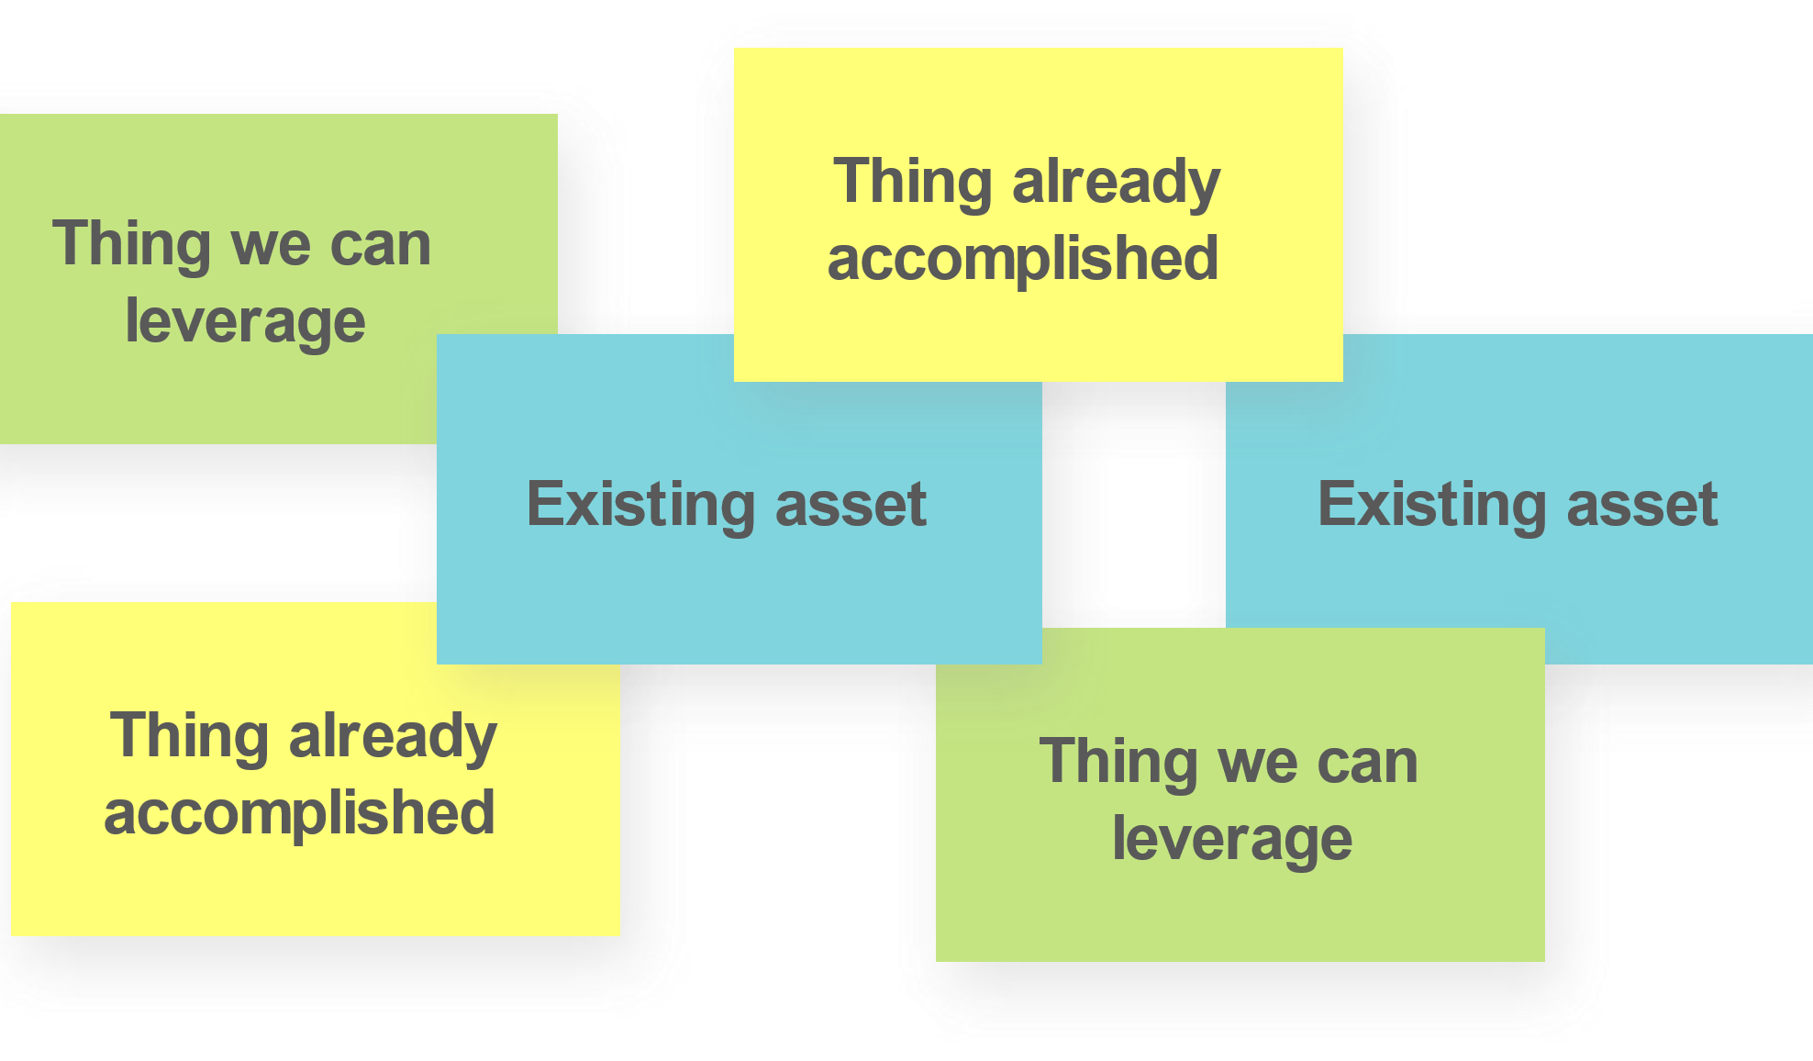
We’re already part of the way there.
Notes:
We’re almost there!
Show what you already have—together!—that you can use to get to your goal.
Review what you bring to the table.
Add what your potential donor/partner brings, too.
Think: assets, accomplishments, sources of power and influence.

Slide 20
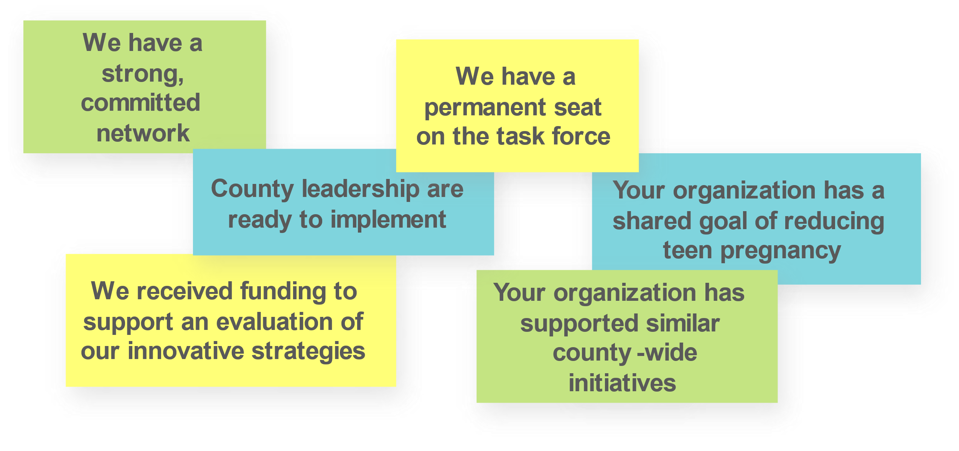
Example: We’re already part of the way there.
Notes:
We’re almost there!
Show what you already have—together!—that you can use to get to your goal.
Review what you bring to the table.
Add what your potential donor/partner brings, too.
Think: assets, accomplishments, sources of power and influence.

Slide 21
This is what we’ll need to make it happen.
Identity & lived experience of youth:
Race, gender, class
Institutional & professional
position and connections
Reputation, profile, influence
Moral authority, ethical high ground
Geographic location
Expertise, experience, education
History: family, legacy
Political position
Community organizing
& collective action
Ability to make decisions
and execute
Audience, reach
Momentum, energy
Persuasion, charisma
Trust
Money
Infrastructure, tools, technology
Data
Notes:
Select from this list. And add more! See the “Find your Power” exercise in the Reflection Guide.
You can put the content into columns to show what each party will bring, or keep all contributions together.

Slide 22
Example: This is what we’ll need to make it happen.
Identity & lived experience of youth:
Race, gender, class
Institutional & professional
position and connections
Reputation, profile, influence with county
Expertise, experience, education in rigorous evaluation
Ability to make decisions
and execute to spread this effort on a grander scale
Trust among county leadership, especially when it changes
Money
Notes:
Select from this list. And add more! See the “Find your Power” exercise in the Reflection Guide.
You can put the content into columns to show what each party will bring, or keep all contributions together.

Slide 23
This is where we might start.
Action step/project
Action step/project
Action step/project
Notes:
This should come from your strategic plan.
Aim to give the person you’re speaking with:
A sense of immediate movement and progress
A tangible starting point for what has been presented
A larger idea / potential / project
= What you’ll do with your combined resources
Be ready with your idea but keep it emergent. Use language that invites co-creation.
Never convey that this is set in stone.

Slide 24
Example: This is where we might start.
Establish a planning group to map out an implementation and evaluation plan
Determine if additional organizations or funders share our goal and invite them to engage in the discussion
Support our youth context team to brainstorm and propose how to grow and spread their youth voice model
Notes:
This should come from your strategic plan.
Aim to give the person you’re speaking with:
A sense of immediate movement and progress
A tangible starting point for what has been presented
A larger idea / potential / project
= What you’ll do with your combined resources
Be ready with your idea but keep it emergent. Use language that invites co-creation.
Never convey that this is set in stone.

