Slide 1
Supporting and Retaining Staff
May 19, 2023

Slide 2
Facilitator
Julie Rennecker, PhD, Chief Catalyst, Syzygy Teams

Slide 3
Agenda
Staff
Self
Community

Slide 4
Learning Objectives
By the end of this session, participants will be able to:
Describe two staff support actions they will implement
Perform one self-affirming activity to increase
personal resilience
Name one new community contact they can
contact for support

Slide 5
Burnout is Real and Widespread
76%
84%
81%
U.S. workers reporting at least one symptom of a mental health condition
Source: Mind Share Partners’ 2021 Mental Health at Work Report
Respondents reporting workplace conditions contributed to at least one mental health challenge
Source: Mind Share Partners’ 2021 Mental Health at Work Report
Workers reporting they will be looking for workplaces that support mental health
Source: APA 2022 Work and
Well-being Survey

Slide 6
Staff
“Work is an important social determinant
of worker health.”
The U.S Surgeon General’s Framework for Workplace Mental Health & Well-Being

Slide 7
Quote
“Employees likely to stay reported being equipped with what was needed to successfully do the job, manage stress, and navigate work-life challenges…
It is critical for organizations to find a balance
between work and well-being.”
Matt Fenton, Neel Gandhi, and Taylor Lauricella, McKinsey, 2022

Slide 8
Toolkit
Strategies for Creating a Supportive Work Environment for Sexual and Reproductive Health Staff Toolkit

Slide 9
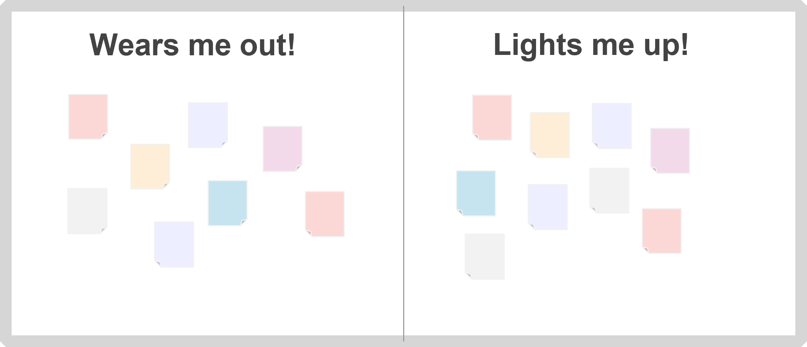
Tool: Energy Board
Fires me up!
Wears me out!
Use a whiteboard & sticky notes
Post daily for a week or until you have a collection of stickies
Host a task swap

Slide 10
Energy Board Task Swap
Does this task HAVE to be done?
Would someone else LIKE to do
the task?
Would someone else be willing to
take turns doing the task?
Is there a way the task could be done differently to be less draining?
Wears me out!

Slide 11
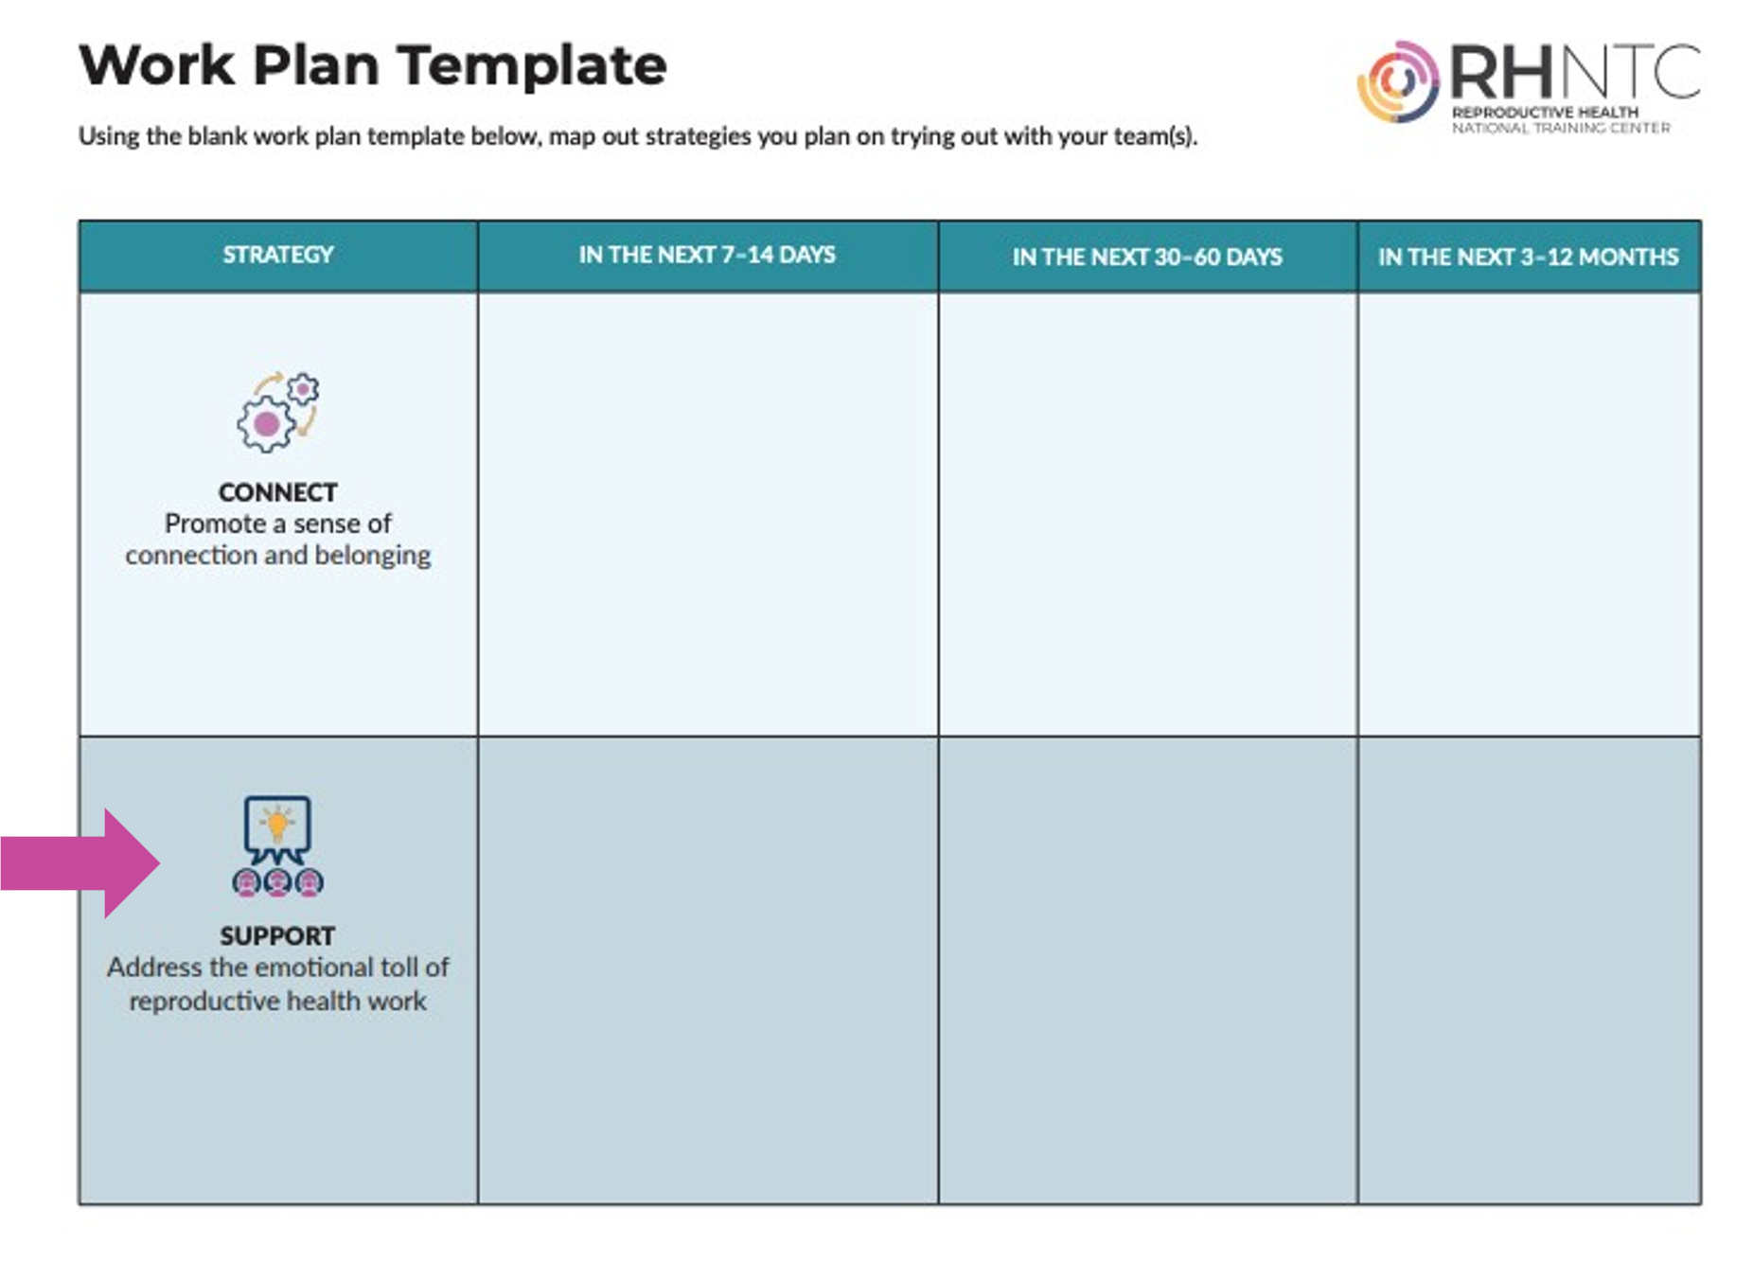
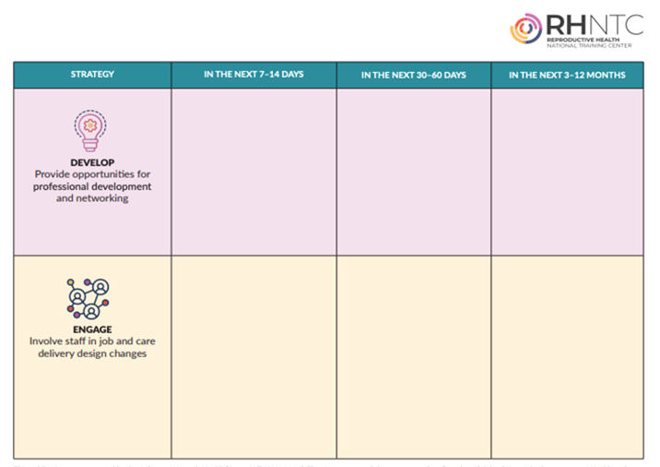
Work Plan for Building a Supportive Workplace Environment 1
Source: Work Plan for Building a Supportive Workplace Environment

Slide 12
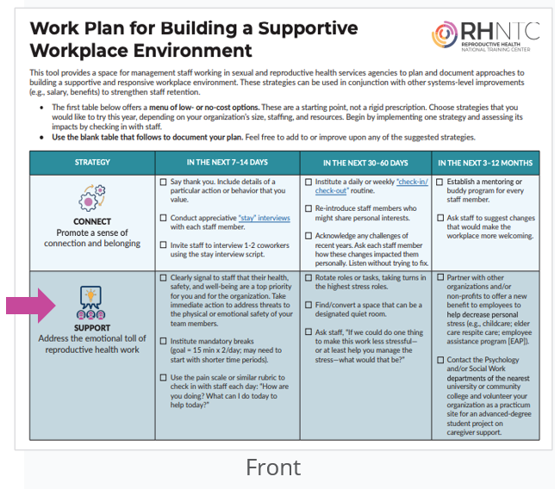
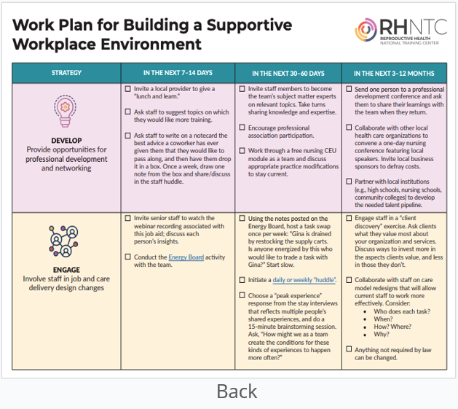
Work Plan for Building a Supportive Workplace Environment 2
Source: Work Plan for Building a Supportive Workplace Environment

Slide 13
Work Plan for Building a Supportive Workplace Environment Exercise
EXERCISE
Skim the suggested tactics in the filled-in copy.
Identify any tactics you think might work at your organization.
Discuss the tactics you identified with others at your table.
Share any additional tactics you’ve used at your organizations.
On the blank template, write at least one “support” action you can
commit to for each time period.

Slide 14
What Staff Need Most from Their Leaders in Uncertain Times 1
Information – about their job and the organization
Support – psychological and instrumental
Communication – clear, fast, accurate
RESPECT
Sources:
Kristine Power s and Jessica B.B. Diaz, MIT Sloan Management Review, Winter 2023
Donald Sull and Charles Sull, MIT Sloan Management Review, Fall 2021

Slide 15
What Staff Need Most from Their Leaders in Uncertain Times 2
Information – about their job and the organization
Support – psychological and instrumental
Communication – clear, fast, accurate
RESPECT
Does your action plan address these four needs?
Sources:
Kristine Powers and Jessica B.B. Diaz, MIT Sloan Management Review, Winter 2023
Donald Sull and Charles Sull, MIT Sloan Management Review, Fall 2021

Slide 16
Self
“Caring for myself is not self-indulgence, it is self-preservation…”
Audre Lorde

Slide 17
Exercise
On your own, think about your work:
What’s one thing that is going well?
What was/is your contribution to what’s going well?
2. With a partner you don’t know, share answers.

Slide 18
Daily Homework - “Three things” exercise
What are three things that are going well?
What was/is my contribution to what’s going well?

Slide 19
A Word on Modeling Self-Care
“People may doubt what you say, but
they will believe what you do.”
Lewis Cass

Slide 20
Community
“Alone, we can do so little;
together, we can do so much.”
Helen Keller

Slide 21
Building Your Network of Support
Find one person you don’t know
who works in a similar role.
Exchange contact information.
Schedule a call in ~2 weeks.

Slide 22
THANK YOU!
rhntc.org
CONTACT US
rhntc@jsi.com
This webinar was supported by the Office of Population Affairs (Grants FPTPA006030, TPSAH000006). The views expressed do not necessarily reflect the official policies of the Department of Health and Human Services; nor does mention of trade names, commercial practices, or organizations imply endorsement by the U.S. Government.

Slide 23
Additional Resources
The National Institute for Occupational Safety and Health (NIOSH). Worker Well-Being Questionnaire (WellBQ) – Resources for Action. CDC.
Knight, Rebecca. (2019, March 20). How to Help Your Team With Burnout When You’re Burned Out Yourself. Harvard Business Review.
Fenton, M. et al. (2022, January 31). When the grass is truly greener: How companies are retaining frontline talent. McKinsey Organization Blog.
Mortensen, M. and Edmondson, A. (2023, January-February). Rethink Your Employee Value Proposition. Harvard Business Review.

