Slide 1
Strategies and Resources for Equity & Quality While Increasing Access to All Contraceptive Care, Including LARC & EC
May 18, 2023

Slide 2
Facilitators
Jennifer Kawatu, RN, MPH, TTA Provider, RHNTC
Angie Fellers LeMire, MSN, TTA Provider, RHNTC

Slide 3

Introduction

Slide 4
Learning Objectives
By the end of this session, participants will be able to:
Describe the challenges related to increasing access to the full range of contraceptive methods while also applying principles of reproductive justice and client-centered care
Identify best and promising practices for increasing access
to contraception while ensuring equity and quality
Describe a variety of resources available to assist in improving clinic access to contraception, emergency contraception (EC), and other family planning services

Slide 5
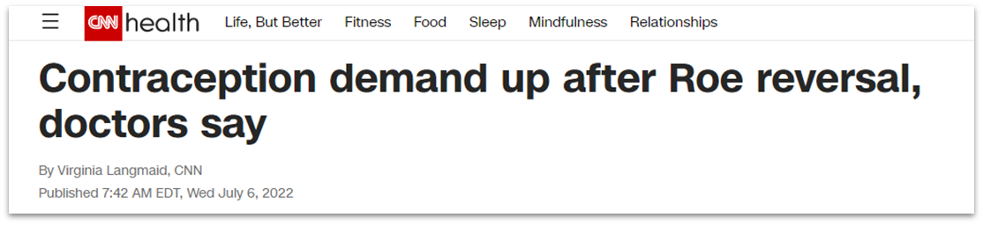
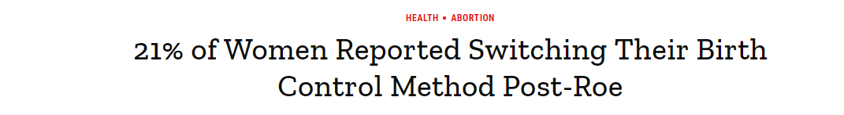
Increasing Access

Slide 6
Person-centered approach
Do you think you might like to have (more) children at some point?
  When do you think that might be?
  How important is it to you to prevent pregnancy (until then)?
Would you like to talk about ways to be prepared for a healthy pregnancy?
Would you like to talk about your birth control options?
Do you have a sense of what is important to you about your birth control method?
Client-Centered Reproductive Goals and Counseling Flow Chart
Contraceptive Counseling and Education eLearning
Person-Centered Contraceptive Counseling Measure

Slide 7
Reduce Barriers in Access
Accessible
Efficient
Private and confidential
Affordable
Safe and welcoming
Culturally and linguistically appropriate
Gender inclusive
Client-centered
Reducing Barriers in Access to Care Virtual Tour

Slide 8
Best Practices for Contraceptive Access
Stock a broad range of contraceptive methods
Assess reproductive goals and (when appropriate) provide patient-centered counseling and services
Offer same-visit provision of all contraceptive methods
Utilize diverse payment options to reduce cost as a barrier
Source: Increasing Access to Contraception Toolkit and Change Package

Slide 9
Key Resources for Contraceptive Access
Reducing Barriers in Access to Care Virtual Tour
Increasing Access to Contraception Toolkit
Contraceptive Access Change Package
Same-Visit Contraception: A Toolkit for Family Planning Providers
Promoting Family Planning Services Social Media Toolkit
  Also in Spanish

Slide 10
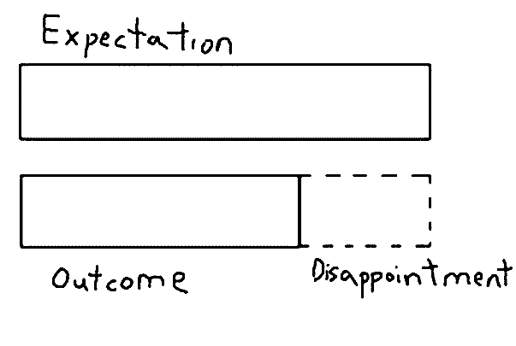
Clinic Efficiency
Effectiveness = extent to which patient expectations are met
Efficiency = resources needed
to provide effective care

Slide 11
Best Practices for Clinic Efficiency
Update and simplify scheduling systems
Improve clinic flow, e.g., reduce stops and wait times, improve communication
Reduce waste, e.g., duplication, unnecessary documentation
Use a team-based approach with everyone working top of license

Slide 12
Key Resources for Clinic Efficiency
Using Data to Increase Clinic Efficiency: A Quality Improvement Guide
Reducing Patient Wait Time Video
Patient Experience Improvement Toolkit

Slide 13
Best Practices for Emergency Contraception (EC) Access
Staff education and training
Advanced prescriptions
Advanced supply
Provide access in non-traditional settings
Collaboration with local pharmacy and pharmacists
Alternative EC purchasing options to reduce cost

Slide 14
Key Resources for EC Access
Emergency Contraceptive (EC) Methods Table
Emergency Contraception (EC) Social Media Toolkit
Emergency Contraception Facts for Family Planning Staff
Emergency Contraception Fast Facts Job Aid
Protocol Template: Emergency Contraception (NCTCFP)
Understanding the Mechanism of Action for Emergency Contraceptive Pills (NCTCFP)
Plan C: Copper IUD as Emergency Contraception (CAI)

Slide 15
Addressing Misinformation
Exaggerated side effect claims
Promoting less effective methods
EC vs. the abortion pill
Pharmacies and pharmacists

Slide 16
Breakout Groups
What other misinformation tactics or campaigns have you heard about from subrecipients?
How are you, as a grantee agency, addressing misinformation within your communities and among staff (e.g., staff training)?
In states where there are Board of Pharmacy statewide protocols for dispensing contraceptive methods, including EC—do you have suggestions on how to engage with
local pharmacies?
What are other potential strategies and solutions to
addressing misinformation?

Slide 17
Q&A
What other questions do you have?

Slide 18
THANK YOU!
rhntc.org
CONTACT US
rhntc@jsi.com
This webinar was supported by the Office of Population Affairs (Grants FPTPA006030, TPSAH000006). The views expressed do not necessarily reflect the official policies of the Department of Health and Human Services; nor does mention of trade names, commercial practices, or organizations imply endorsement by the U.S. Government.

